Slide 1
Learning rate

Slide 2
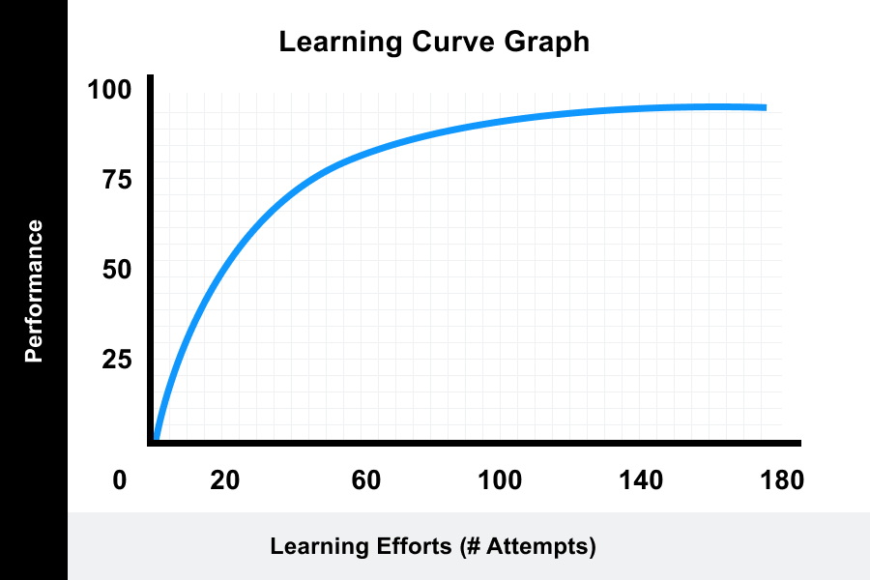
Learning curve
A learning curve is a correlation between a learner's performance on a task and the number of attempts or time required to complete the task; this can be represented as a direct proportion on a graph.
Learning rate is how much the gain is per time unit
https://www.valamis.com/hub/learning-curve#what-is-learning%20curve

Slide 3
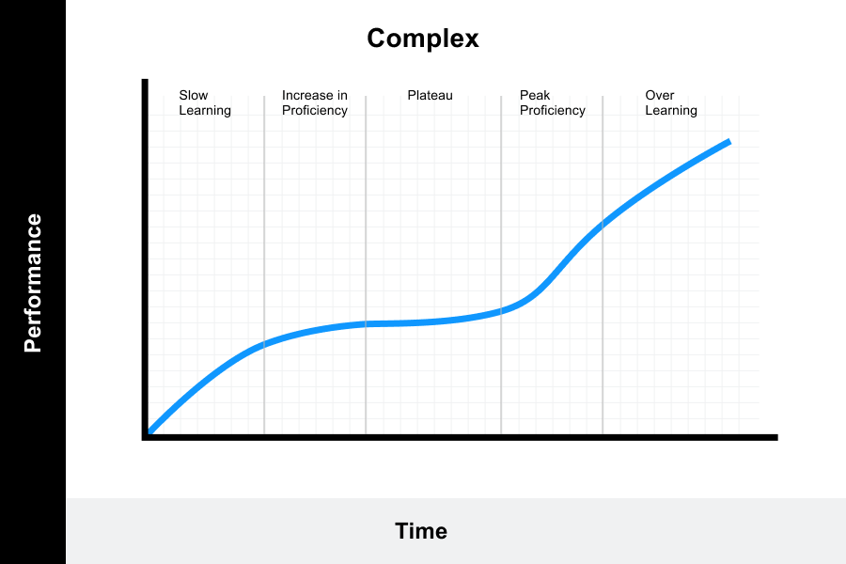
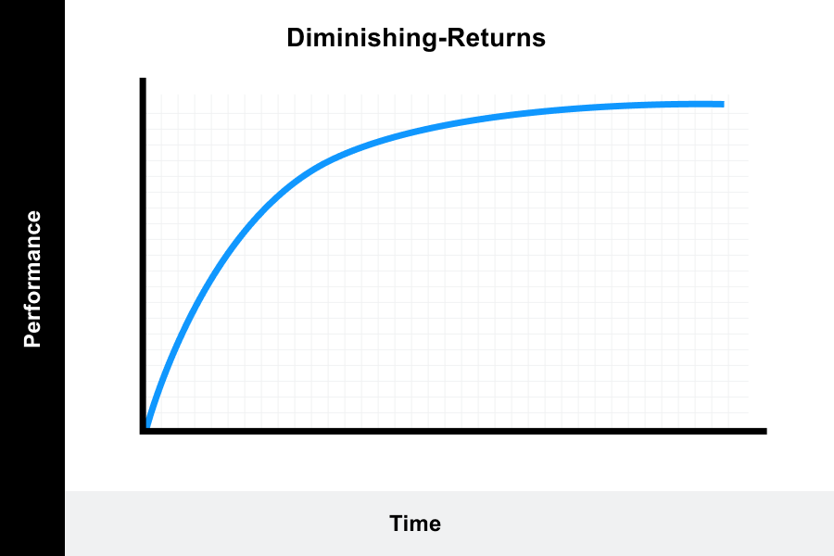
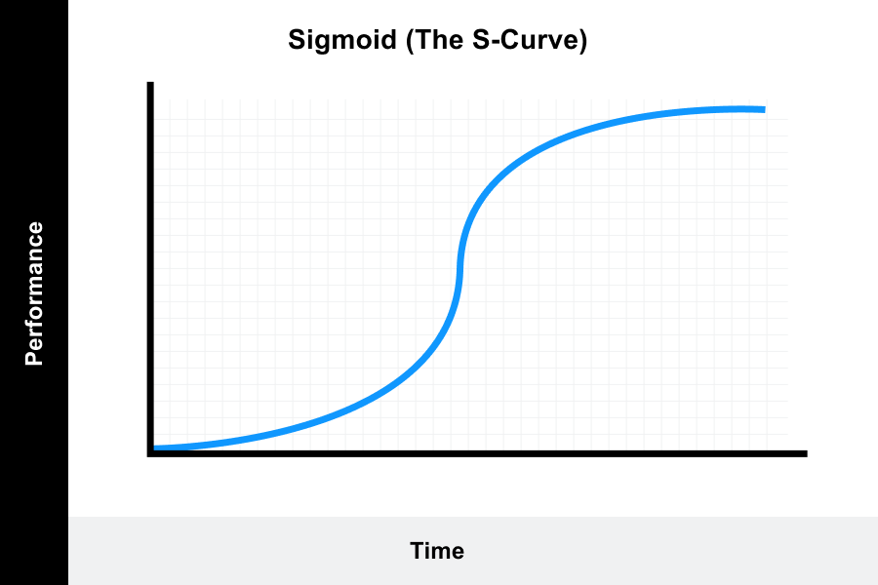
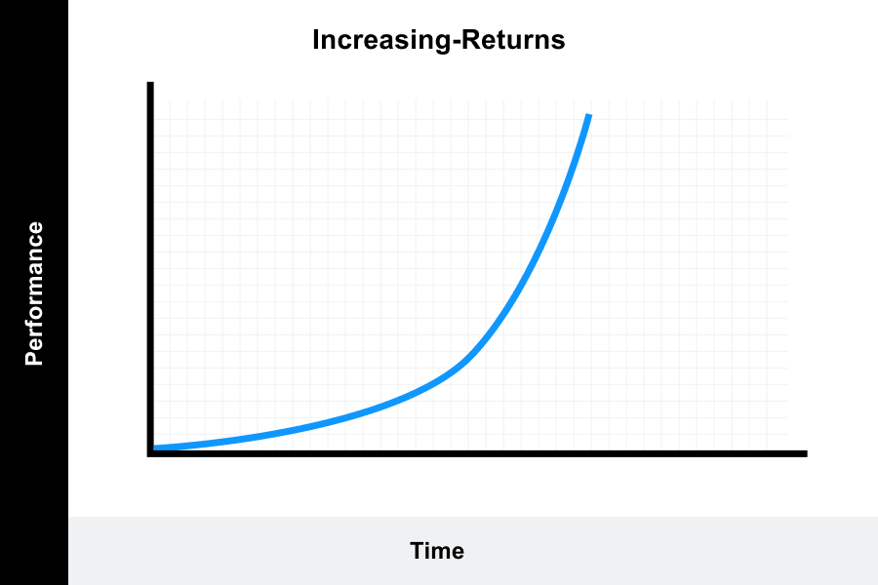
Learning curve is task specific and learner specific
https://www.valamis.com/hub/learning-curve#what-is-learning%20curve

Slide 4
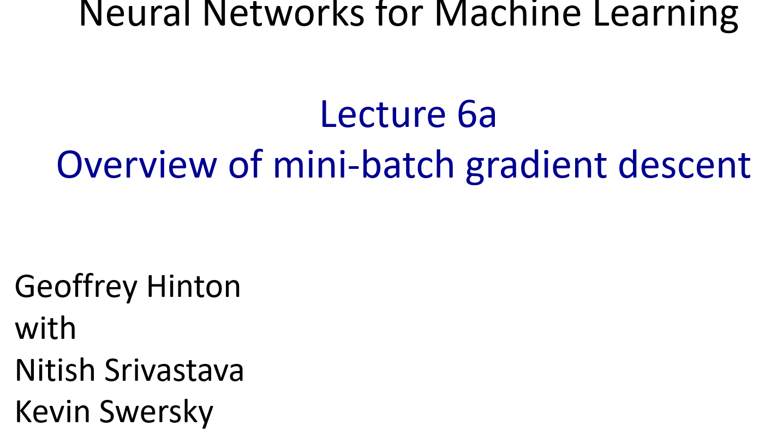
Reminder: The error surface for a linear neuron
The error surface lies in a space with a horizontal axis for each weight and one vertical axis for the error.
For a linear neuron with a squared error, it is a quadratic bowl.
Vertical cross-sections are parabolas.
Horizontal cross-sections are ellipses.
For multi-layer, non-linear nets the error surface is much more complicated.
But locally, a piece of a quadratic bowl is usually a very good approximation.
E
w1
w2

Slide 5
Convergence speed of full batch learning when the error surface is a quadratic bowl
Going downhill reduces the error, but the direction of steepest descent does not point at the minimum unless the ellipse is a circle.
The gradient is big in the direction in which we only want to travel a small distance.
The gradient is small in the direction in which we want to travel a large distance.
Even for non-linear multi-layer nets, the error surface is locally quadratic, so the same speed issues apply.

Slide 6
How the learning goes wrong
If the learning rate is big, the weights slosh to and fro across the ravine.
If the learning rate is too big, this oscillation diverges.
What we would like to achieve:
Move quickly in directions with small but consistent gradients.
Move slowly in directions with big but inconsistent gradients.
E
w

Slide 7
Be careful about turning down the learning rate
Turning down the learning rate reduces the random fluctuations in the error due to the different gradients on different mini-batches.
So we get a quick win.
But then we get slower learning.
Don’t turn down the learning rate too soon!
reduce learning rate
error
epoch

Slide 8
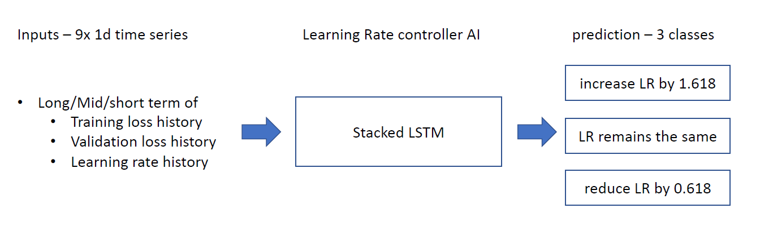
Can we automatically adjust learning rate in a supervised way?

Slide 9
Automated learning rate scheduler
Use weighted accuracy to select the best scheduler
Predict\Actual | decrease | stay | increase
decrease | High reward | Low penalty | High penalty
stay | Low penalty | Low reward | Low penalty
increase | High penalty | Low penalty | High reward

Slide 10
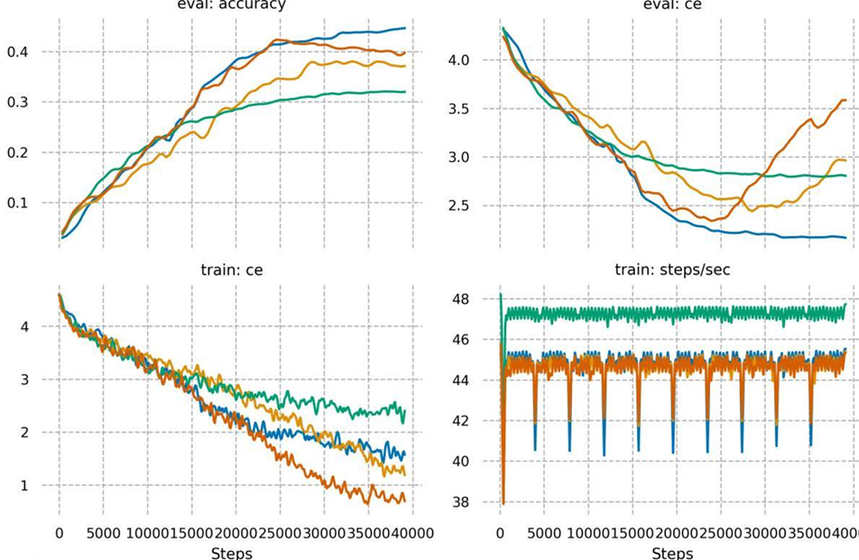
Apply VGG16 on cifar100
Weighted acc; more data
MCC; more data
MCC; less data
Baseline
https://towardsdatascience.com/the-best-classification-metric-youve-never-heard-of-the-matthews-correlation-coefficient-3bf50a2f3e9a

Slide 11
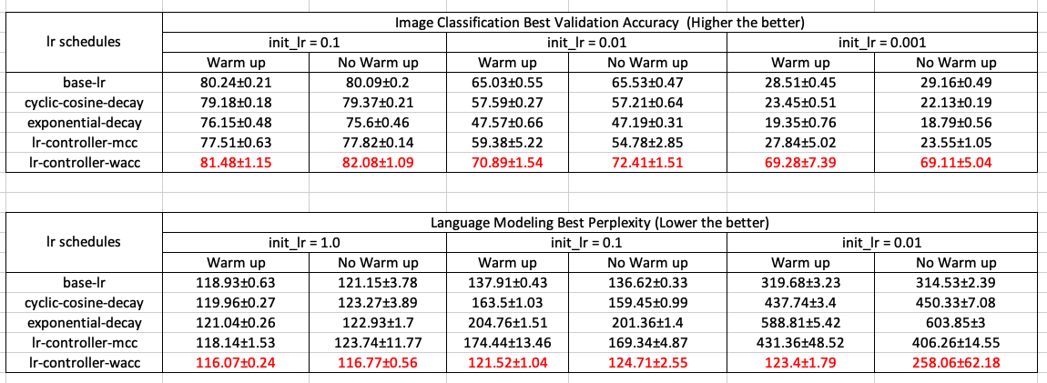
Comparisons with baseline and other learning rate scheduler using independent dataset, optimizer and networks
Our automated learning controller lr-controller-wacc outperforms all other cohort methods

