Slide 1
International Astronautical Congress-2019 COEP Satellite Initiative

Slide 2
Solar Panel Deployment Mechanism for a Solar Sailing Nanosatellite
Mr Vaibhav B. Wanere
Mr Roven Pinto
Mr Rohit Patil
Mr Juber Shaikh
Ms Chaitra Shet
Mr Akshay R. Deodhar
Ms Tanaya Bapat
Ms Mansi Kabade
Mr Pravin Londhe

Slide 3
Introduction
Current Mission Objectives:
1. To demonstrate the concept of orbit maneuvering using solar sails.
2. Characterization of charged particle environment with position.
Necessity of Solar Panels Deployment Mechanism:
1. Solar sails prevent the sunlight reaching the satellite faces behind it.
2. Maximum three faces can be facing the sun.
3. This limits the number of solar cells facing the sun thus limiting the power generation.
4. Volume constraints in the launch vehicle demands for foldable panels.
Tape Spring
Notes:
How is the sail

Slide 4
Research Questions and literature review
Currently available mechanisms:
1. Provide only deployment with no locking.
2. Provide deployment with active locking (more power consumption).
The mechanism presented uses passive means for deployment as well as locking.
The mechanism uses power only for the initiation of the deployment.
Notes:
Is for trigerring the nylon nichrome mechanism

Slide 5
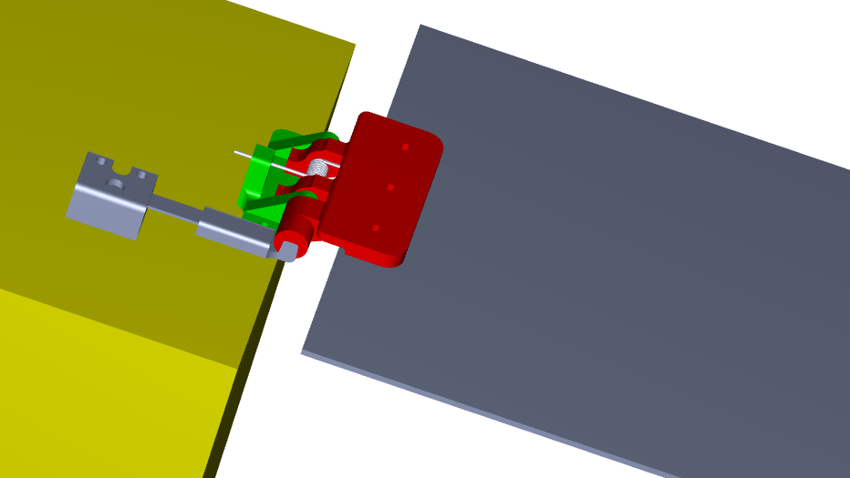
Present Mechanism
Torsion Spring
Body Leaf
Panel Leaf
Flat Spring
Flat Spring Holder
Follower
Fig.1 Creo of the Mechanism
Notes:
Nut bolt used to attach one leaf to the panel and one leaf to the body
The two leafs are assembled together with the help of a pin, forming a turning pair
The two leaves are loaded with a 180 degree torsion spring, with with it’s axis coinciding with the pin’ axis
A follower is used for providieng locking, and is attached to the satelllite body through a flat spring with the help of a flat spring holder

Slide 6
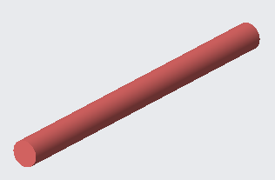
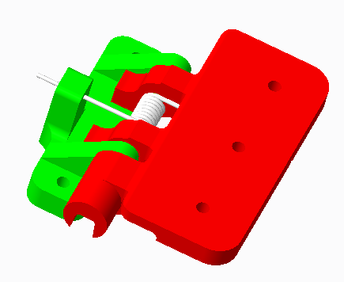
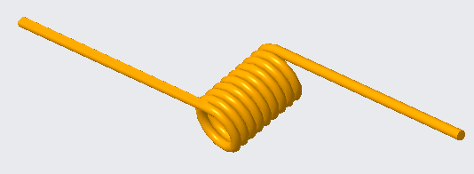
Pin
Parts of the current SPD
mechanism
Hinge Assembly:
Body Leaf
Panel Leaf
Fig.5. Pin
Torsion Spring
Fig.4. Body Leaf and Panel Leaf
Fig.6. Torsion Spring

Slide 7
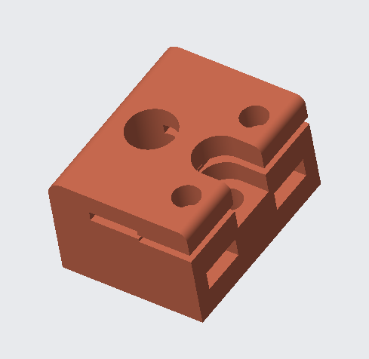
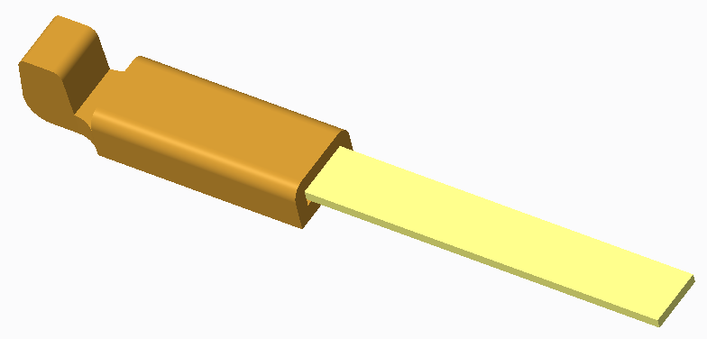
Parts of the current SPD mechanism
Flat spring holder
Flat Spring
Follower
Fig.7. Flat Spring and Follower Assembly
Fig.8. Flat Spring Holder

Slide 8
Torsion spring loaded Hinge Mechanism
Release mechanism : Nylon Nichrome mechanism
Actuation mechanism : Torsion Spring
Locking mechanism : Cam and Follower

Slide 9
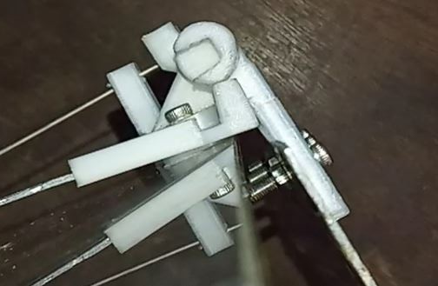
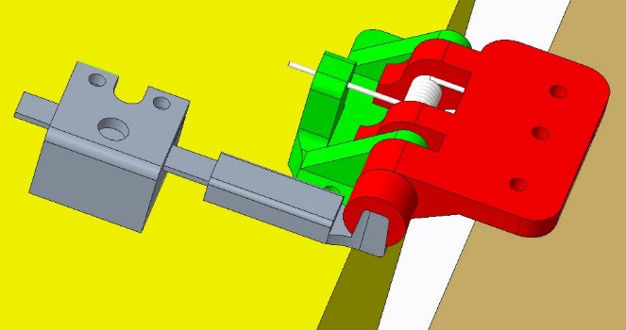
Cam
Follower
Cam Follower Locking
Fig.2. Mechanism in undeployed position
Fig.3. Mechanism in deployed and locked state
Notes:
Stress in the flat spring causes the follower to move upwards, as the panel is rotated by the torision spring to it’s deployed state.
It fits into a slot present in the the cam (rotating part)

Slide 10
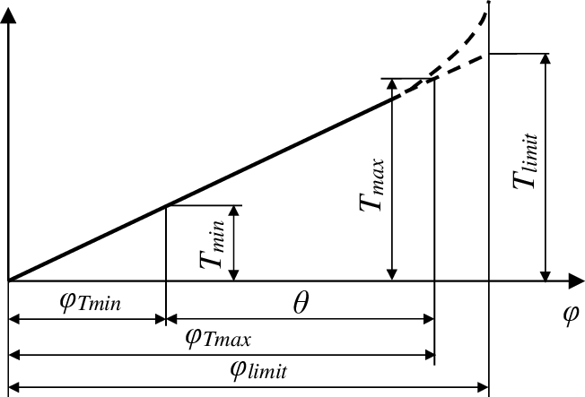
Fig.9. Torque vs. Deflection
Torsion spring specifications:
Torque needed for smooth deployment= 135 N-mm
Torque
Angular Deflection
Notes:
Based on tesing it was decided that time required for smooth deployment was decided to be one second. Yhr torqur ptobrfrf by the torsion spring is is a linear function of it’s deflection. The maximum amput of torque considering 1 as the time reid is 135 N-mm. According ly the stiffness of the torsion spring

Slide 11
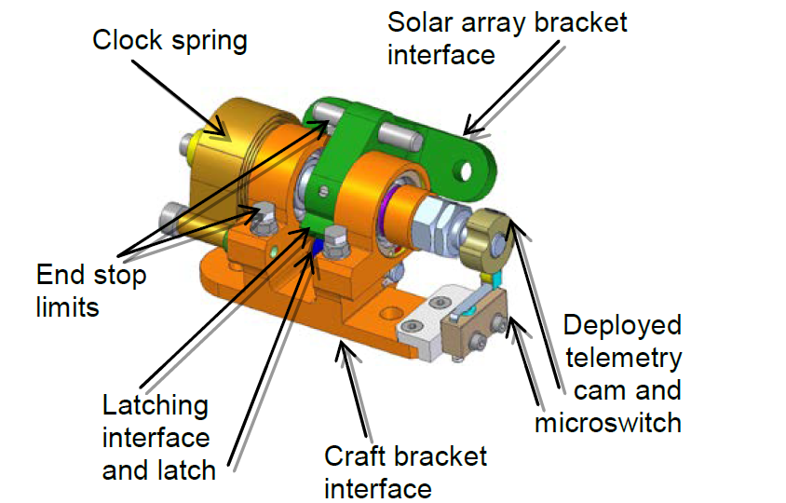
Idea of Cam-follower locking
Fig.10. Cam-Follower Locking
Notes:
So the idea of mechanical cam follower locking was based on an application where it was used for trigerring a microswitch

Slide 12
Cam-Follower Locking:
Fig.11. Follower displacement vs. Cam Rotation
Notes:
Once the panel rotates by 80 degrees, the the slot opens up for the follower to move into. Because of the slanting nature of the slot, the follower moves into the slot over a 10 degree planar rotation.,

Slide 13
Component details of SPD mechanism
The parts of the mechanism have been made from ABS plastic using 3D printing.
The maximum allowable deflection of the follower owing to height constraints of the satellite is around 8 mm to 9 mm. Flat spring is made of CFRP.
Design of the torsion spring was carried out considering the space constraints.
The material chosen for the torsion spring is stainless steel having tensile strength 1700 MPa.
Notes:
Althought more deflecgion of the flat spring will provide better locking, there are constraints on the height of the satellite due to which the maxximum deflection has been decided to be 9mm
Calculations were carried out to determine the stresses arising in the spring, and accordingly it was decide that stainless ssteel is to be used. It’s tensile stringth is suitable for

Slide 14
Conclusions
The value of torque required for smooth deployment has been found to be 135 𝑁𝑚𝑚 and has been verified experimentally.
The stiffness of the torsion spring required for this purpose is thus 1.5 𝑁𝑚𝑚/𝑑𝑒𝑔𝑟𝑒𝑒.
The maximum value of the locking force the system can provide is 40 𝑁 𝑡𝑜 50 𝑁 and has been limited due to the space constraints on the upper face of the satellite.
As the flat spring is made of composite (CFRP) and is under a constant deflection which might lead to the stress relaxation ; but the extent to which stress relaxation will take place has to explored before considering this as the limitation of the mechanism
Notes:
The maximum value of the locking force.
Flat spring is made of a

Slide 15
References
[1] Arturo Solı´s-Santome´1,2, Guillermo Urriolagoitia-Sosa2, Beatriz Romero-A´ ngeles2, Christopher Rene Torres-San Miguel2, Jorge J Herna´ndez-Go´mez1, Isaac Medina-Sa´nchez1, Carlos Couder Castan˜eda1, Jesu´s Ira´n Grageda-Arellano1 and Guillermo Urriolagoitia-Caldero´n2, Conceptual design and finite element method validation of a new type of self-locking hinge for deployable CubeSat solar panels, Advances in Mechanical Engineering-January 2019, Vol. 11(1) 1–13

Slide 16
THANK YOU!

