Slide 1
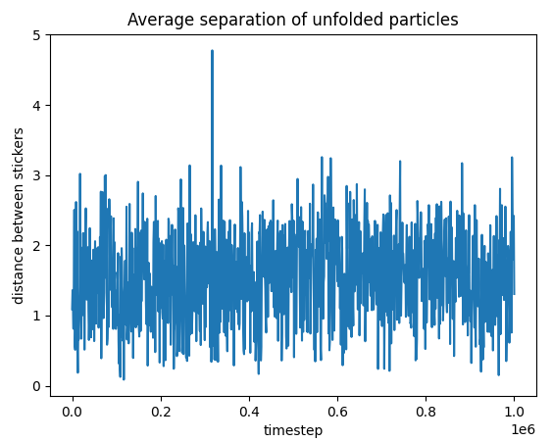
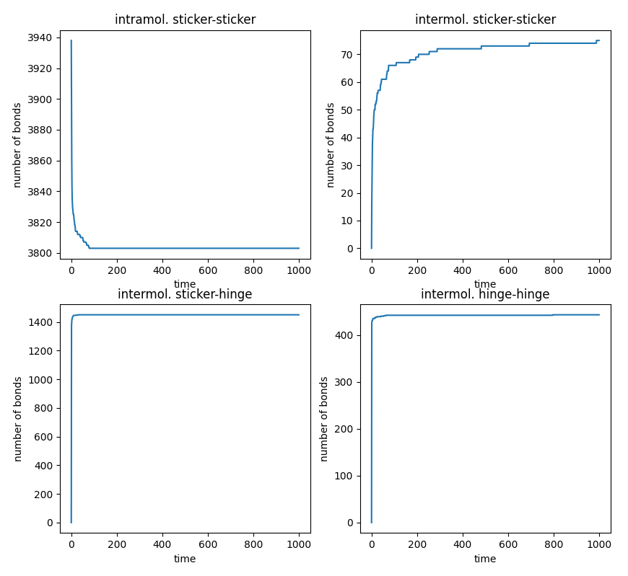
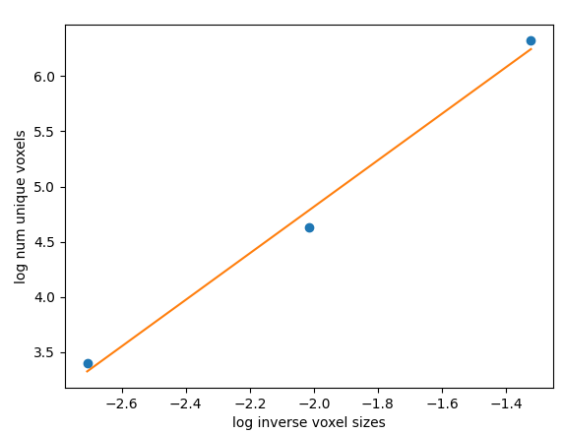
3938 molecules
BoxLength = 30
V_f = 0.07
Nsteps = 1E6
90 hours sim time
Percolation spans in 0 dimensions
D_f = 2.106025238557494

