Slide 1
Heirloom: digital legacy, preservation & access system
Minor Project – CAP3170
BCA Project – Department of Computer Applications, Manipal University Jaipur

Slide 2
Team Members
Kunal choudhary
priyansh
Vigya Upadhyay

Slide 3
Index
1
Introduction and Motivation
8
Data Flow Diagrams
2
Objectives
9
Chatbot Implementation
3
Existing System and Limitations
10
Output Screens
4
Proposed System: Key Modules
11
Testing
5
Technologies and Requirements
12
Conclusion and Future Scope
6
Use Case Diagrams
13
References
7
Database Design

Slide 4
Project Presentation
Heirloom: digital legacy, preservation & access system

Slide 5
Introduction and Motivation
Heirloom is a web-based academic hub that brings an AI chatbot, a course-wise resource library and a performance dashboard into one platform for students and faculty.
1
Fragmented resources
Notes, results and announcements sit on separate portals.
2
Delayed doubt resolution
Students wait for office hours to get basic answers.
3
core modules
2
user roles
1
unified hub
3
No personalized insight
Raw marks and attendance give no early warning.
4
Repetitive faculty workload
The same queries and reports are handled by hand.
Chatbot, resources and dashboard; students and admins; one login.

Slide 6
Objectives
1
Instant Academic Help
2
Centralized Resources
3
Track Performance
Answer student queries through a chatbot backed by a curated knowledge base.
One organized repository of notes and assignments for every course.
Visualize marks and attendance so students see where to improve.
4
Faculty Oversight
5
Early Support
6
Secure and Scalable
Let admins manage courses, resources and the chatbot's knowledge.
Flag students whose attendance or marks need attention.
Hashed passwords, role-based access and room to add courses.

Slide 7
Existing System and Limitations
Existing systems
Limitations
Google Classroom: assignments and class communication, no AI doubt help
Moodle: course and grade management, heavy to configure
Khan Academy, Coursera: self-paced courses, not institution-specific
ChatGPT: general answers, unaware of the syllabus
University ERP portals: static marks and attendance, no chat
Fragmented tools: separate portals for notes, results and doubts
Limited personalization: everyone sees the same static information
No institution-aware answers: general assistants do not know the course content
No early warning: attendance and marks shown as raw numbers
Heavy faculty workload: repetitive queries and manual reports

Slide 8
Proposed System: Key Modules
1
AI Chatbot
2
Resource Library
Matches a student's question against a curated knowledge base using TF-IDF and cosine similarity, and logs every exchange.
Course-wise notes, assignments and reference material that students browse and download, and admins upload.
3
Performance Dashboard
4
Admin Management
Shows marks, attendance and the average mark per student, and flags courses below 75 percent attendance.
Admins manage students, courses, resources, knowledge-base entries and performance records through Django admin.

Slide 9
Technologies and Requirements
Python 3
Core language
Django
Backend, ORM, authentication
Requirement | Specification
Developer software | Python 3.10+, Django, scikit-learn, VS Code, browser
Developer hardware | PC or server, 8 GB RAM or more, 5 GB disk or more
Client software | Modern browser, internet connection
Client hardware | PC or mobile phone
scikit-learn
TF-IDF chatbot matching
Bootstrap
Responsive interface
HTML and CSS
Structure and styling
JavaScript
Chat widget and charts
SQLite
Development database
VS Code
Development environment

Slide 10
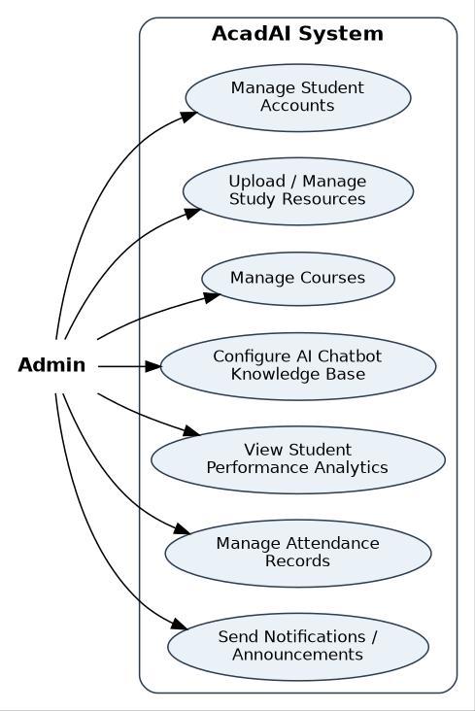
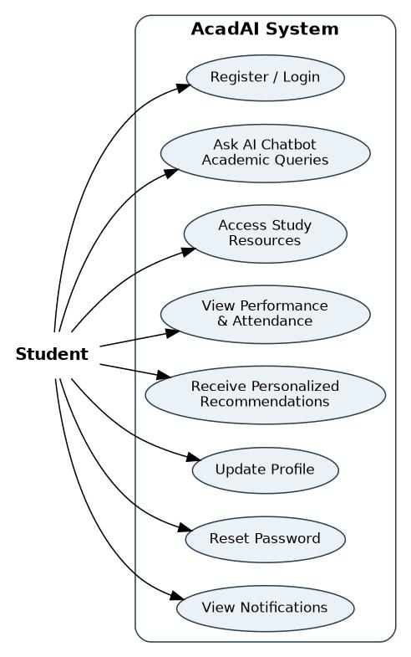
Use Case Diagrams
Admin
Student
Admin
Manages accounts, courses, resources, the chatbot knowledge base, attendance and announcements, and views class-wide analytics.
Student
Registers, asks the chatbot, accesses resources, tracks marks and attendance, gets recommendations and notifications.

Slide 11
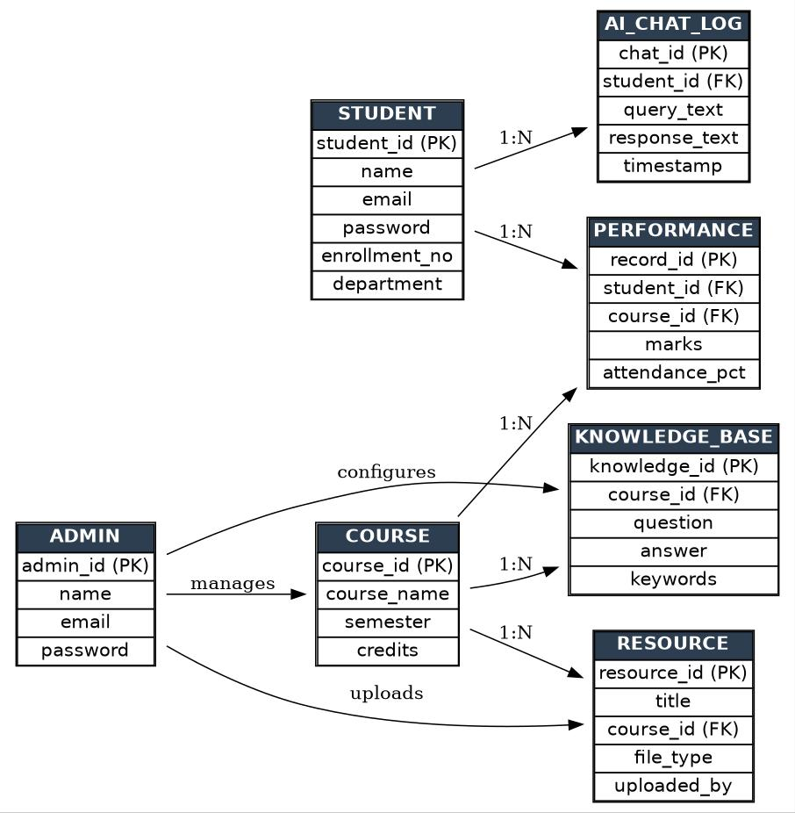
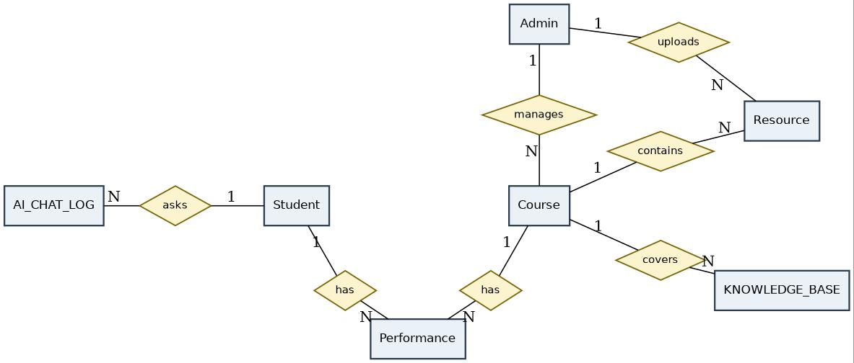
Database Design
Six tables: Student, Course, Resource, Knowledge Base, AI Chat Log and Performance.
One-to-many links tie chat history, marks and resources to the right student or course.
Passwords are stored hashed, never as plain text.

Slide 12
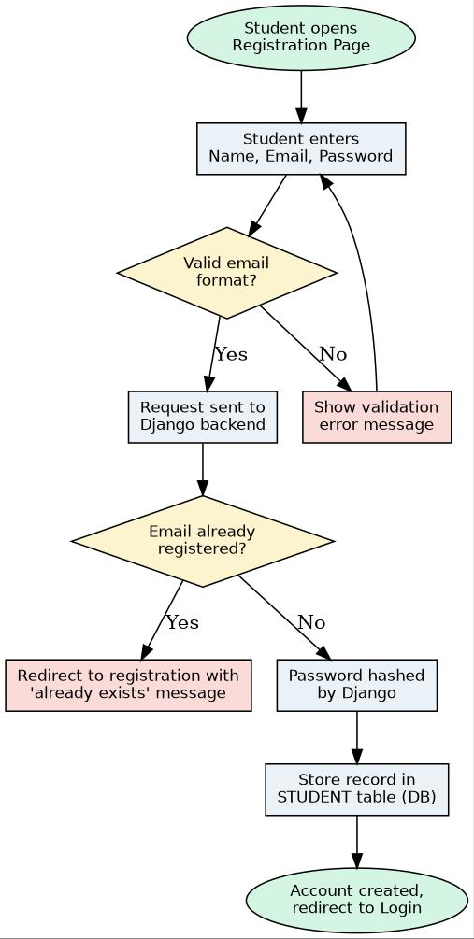
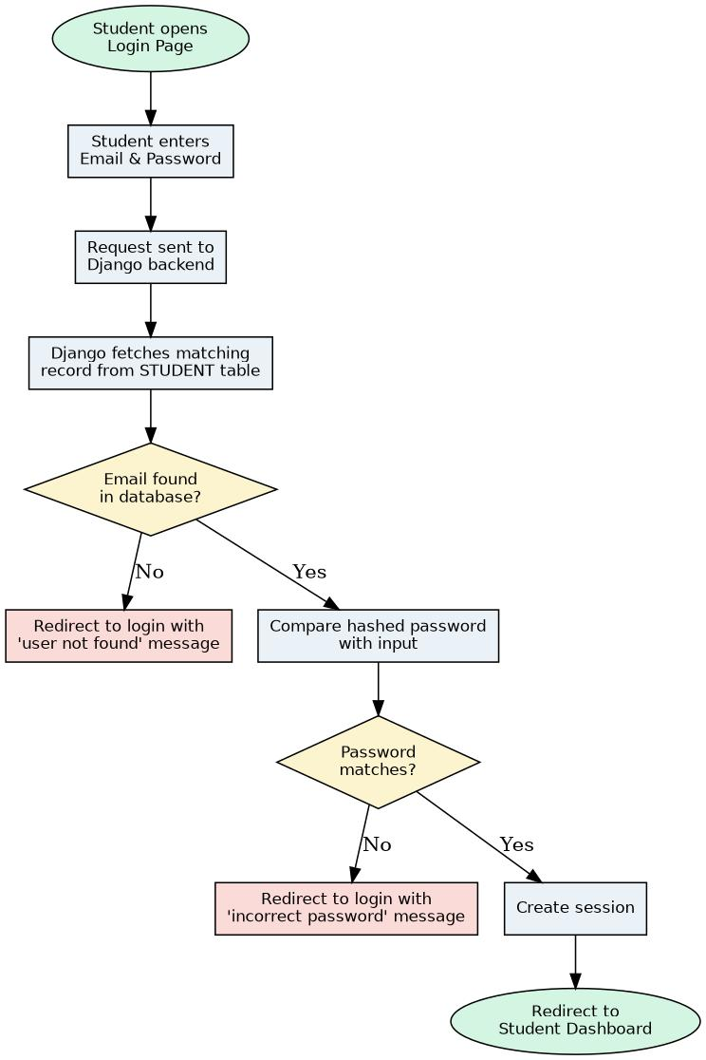
Data Flow Diagrams
Registration
Login
Registration
Validate the email format, check that it is not already registered, hash the password, then store the student record.
Login
Look up the email, compare the hashed password, create a session and open the dashboard. Wrong details return the student to login with a message.

Slide 13
Chatbot Implementation
1 Ask
Student types a question
2 Vectorize
TF-IDF vectors for query and entries
3 Compare
Cosine similarity finds the best entry
4 Decide
Score 0.25 or more returns the answer, else a fallback
5 Log
Query and reply saved in the chat log
Why TF-IDF?
Simple and transparent, no external API
Answers come from the department's own knowledge base
Faculty improve it by editing entries in the admin panel
Core matching logic (views.py)
scores = cosine_similarity(
matrix[-1], matrix[:-1]).flatten()
best = scores.argmax()
if scores[best] >= THRESHOLD: # 0.25
reply = entries[best].answer

Slide 14
Output Screens
Home Page
Paste screenshot here
AI Chatbot Interface
Paste screenshot here
Resource Library
Paste screenshot here
Performance Dashboard
Paste screenshot here

Slide 15
Testing: Key Test Cases
No. | Scenario | Expected result
1 | Login with unregistered email | Redirected to login with an error message
2 | Register with existing email | “Email already registered” message shown
3 | Register with new email | Account created, redirected to login
4 | Chatbot: question in knowledge base | Matching answer shown, exchange logged
5 | Chatbot: unrelated question | Fallback message to contact faculty
6 | Open resource library for a course | Resources listed, selected file downloads
7 | Open performance dashboard | Marks, attendance and average shown, low attendance flagged
8 | Click logout | Session ends, logout page shown

Slide 16
Conclusion and Future Scope
Conclusion
Future Scope
Heirloom joins a chatbot, resource library and dashboard in one platform.
Django, Bootstrap and TF-IDF keep it responsive, secure and easy to maintain.
Faculty keep answers accurate by curating the knowledge base.
The dashboard turns marks and attendance into early warnings.
Language model: answers grounded in uploaded course material
Predictive analytics: forecast students at risk
Personalized plans: study schedules for weak areas
Mobile app: push notifications on the go
Voice and multilingual: hands-free, regional languages
ERP / LMS integration: no manual entry of marks

Slide 17
References
https://docs.djangoproject.com/en/4.2/
https://www.w3schools.com/html/
https://www.w3schools.com/css/default.asp
https://getbootstrap.com/
https://www.sqlite.org/index.html
https://scikit-learn.org/stable/
https://developer.mozilla.org/en-US/docs/Web/JavaScript

