Slide 1
Problem Statement
To find the effectiveness of the marketing campaign of the SUV

Slide 2
R- Programming
> summary(dataset)
Age Estimated Salary Purchased
Min. :18.00 Min. : 15000 Min. :0.0000
1st Qu.:29.75 1st Qu.: 43000 1st Qu.:0.0000
Median :37.00 Median : 70000 Median :0.0000
Mean :37.66 Mean : 69742 Mean :0.3575
3rd Qu.:46.00 3rd Qu.: 88000 3rd Qu.:1.0000
Max. :60.00 Max. :150000 Max. :1.0000

Slide 3
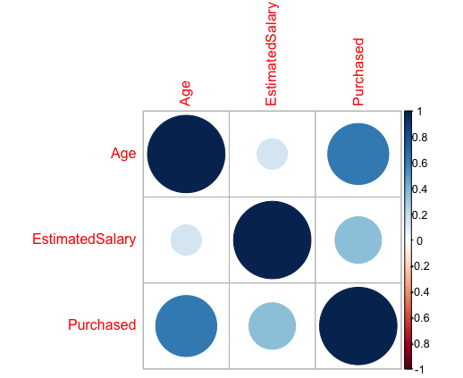
Correlation Plot

Slide 4
Logistic Regression
CONFUSION MATRIX
FALSE TRUE
0
1
57 | 7
10 | 26

Slide 5
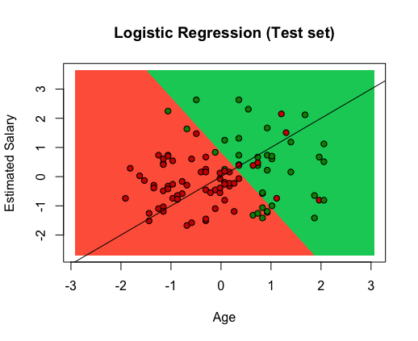
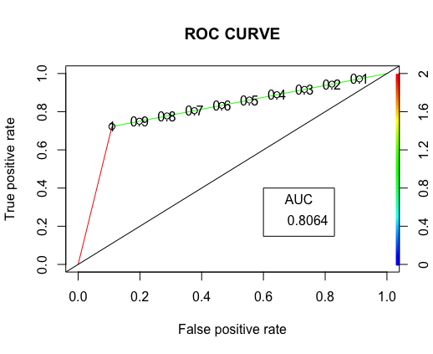
Logistic Regression

Slide 6
Logistic Regression

Slide 7
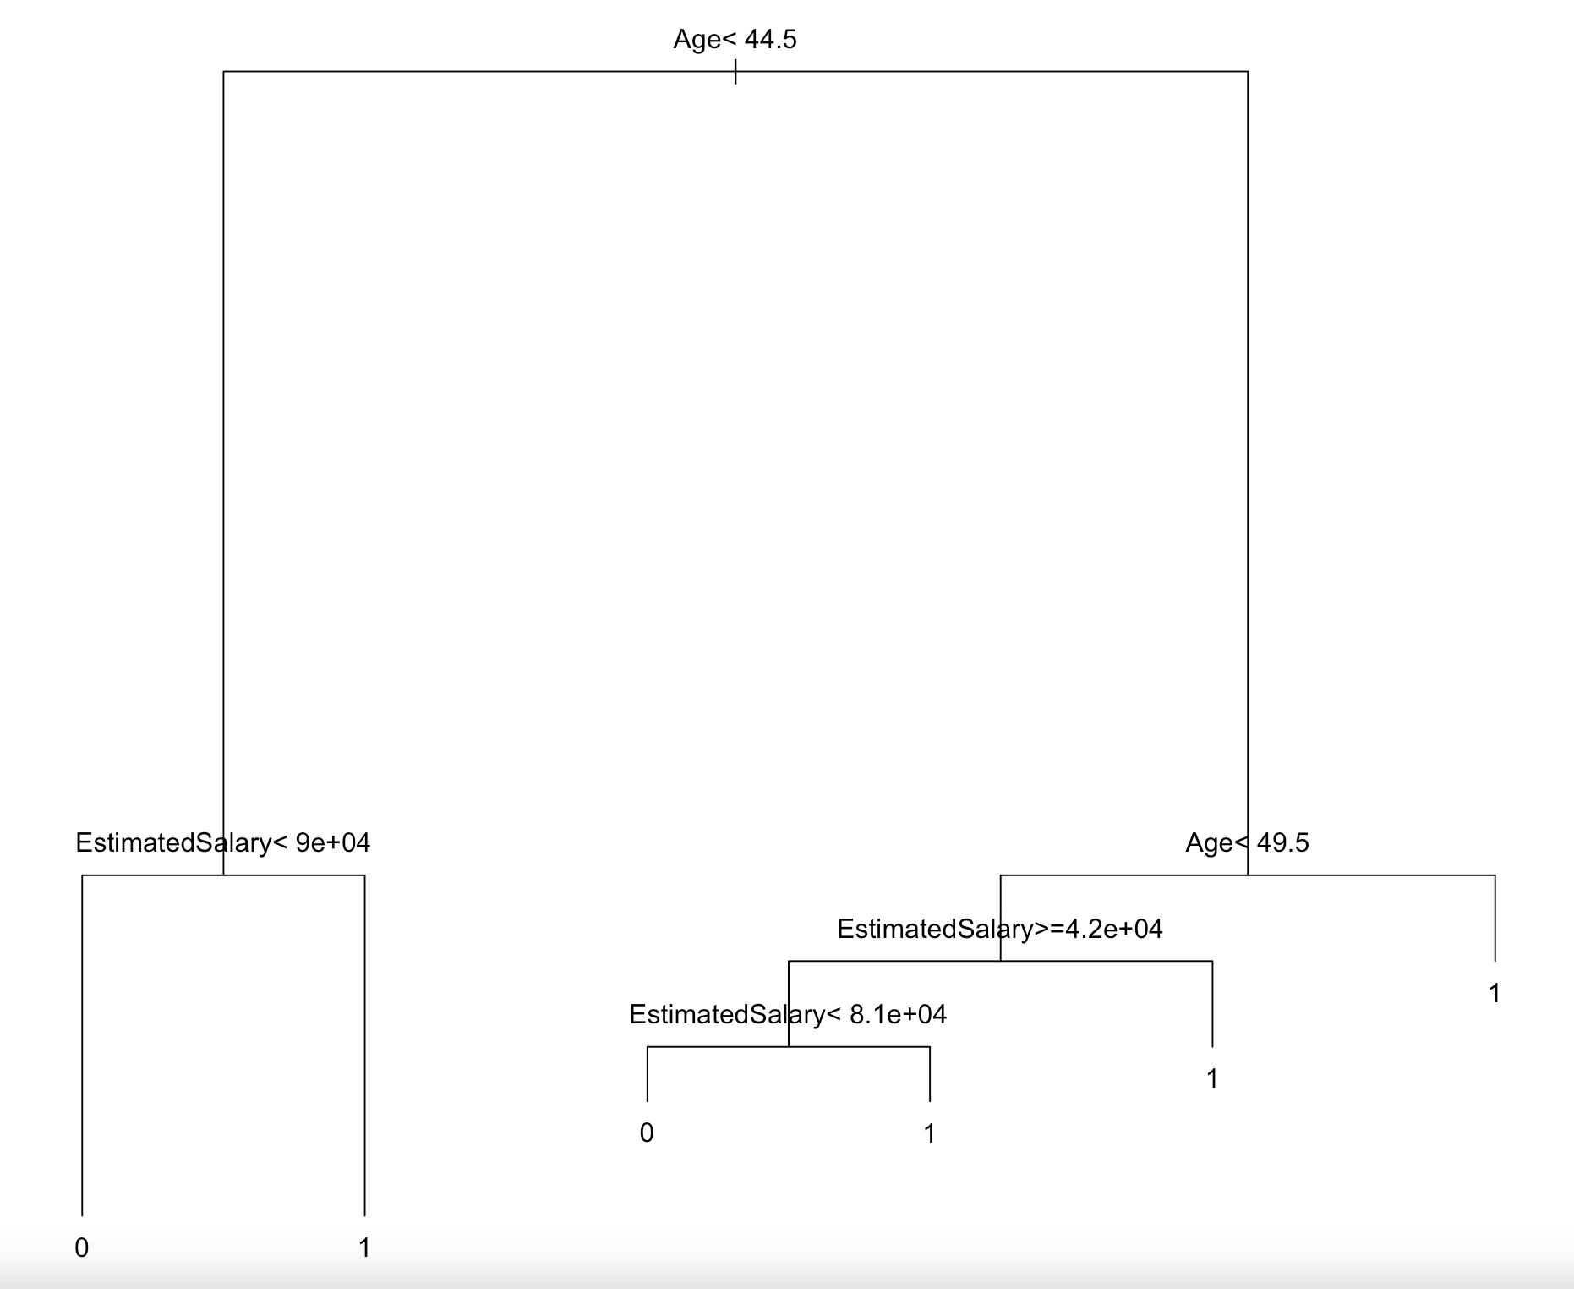
Logistic Regression

Slide 8
Decision Tree

Slide 9
Naive Bayes
Confusion Matrix
0 1
0
1
57 | 7
7 | 29

Slide 10
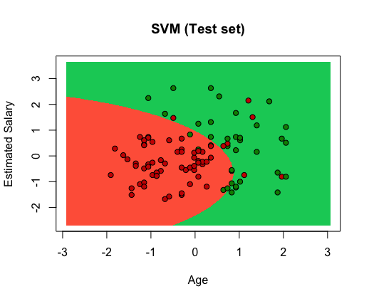
Naive Bayes-SVM

