Slide 1
挑点那些事er
Standard operating procedure for somatic variant refinement of sequencing data with paired tumor and normal samples
张诗影
19-01-18

Slide 2
一些常见的突变模式
检测中的哪些环节会导致什么样的突变模式呢？

Slide 3
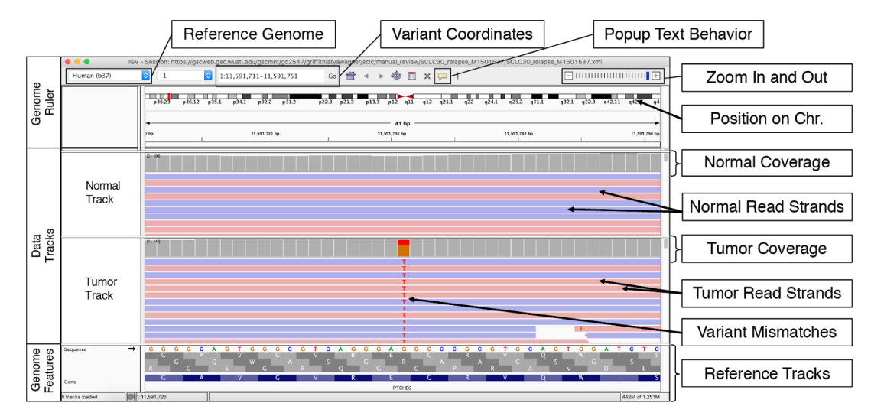

Slide 4
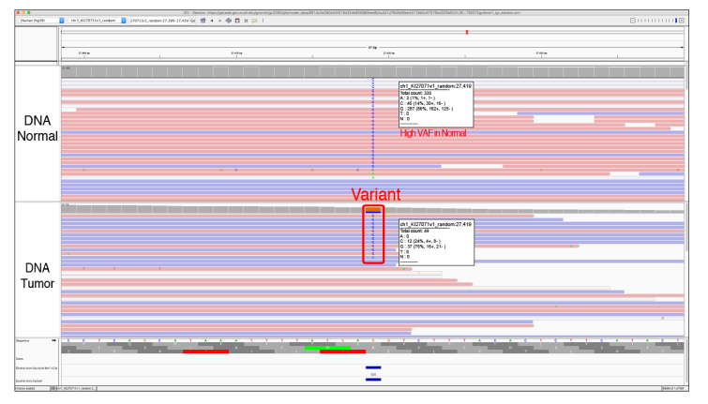
Tumor类型及来源
血液肿瘤 或 高转移性肿瘤
Tumor in Normal (TN)
Notes:
Helpful Hints: 1) TN does not occur in all hematopoietic tumors but is likely when tumor cells are circulating in the bloodstream (e.g., acute myeloid leukemias with high blast counts). 2) Tumors that are metastatic may have tumor cells circulating in the bloodstream and thus can also have TN contamination. 3) Problems with sample barcoding (indexing) or cross contamination of samples can also lead to apparent support for a somatic variant in the normal. 4) Evaluating other normal samples from your cohort, or evaluating multiple variants within the same sample/experiment, can help set a relative acceptable TN threshold. This will help to differentiate sequencing and pipeline artifacts from tumor contamination of normal tracks. 5) Variants created by sequencing or alignment artifacts will also often occur in both the tumor and the normal tracks and can be labeled with TN.

Slide 5
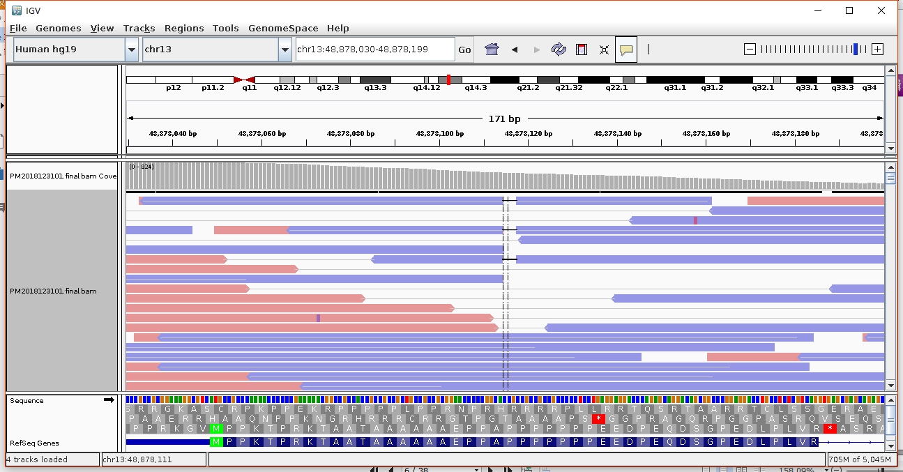
Tumor类型及来源
降解的核酸 (FFPE) 或 小的DNA片段(cf-DNA)
Short Inserts (SI) and Short Inserts Only (SIO)
Notes:
Helpful Hints: 1) To visualize short insert variants you must view the tracks as pairs. Regions where the paired reads overlap will be dark purple and contain a horizontal grey line. At the ends, where there is no overlap, reads will remain blue or pink. Reads can be viewed as pairs using IGV commands: right click each data track > “View as pairs” 2) When viewing reads as pairs, short inserts can be observed; however, it will also overlay reads to reduce the total information available to the reviewer. 3) Short inserts are generally observed at lower variant frequencies and present in two or three read pairs (i.e., four to six reads in total).

Slide 6
Tumor类型及来源
降解的核酸 (FFPE) 或 小的DNA片段(cf-DNA)
Short Inserts (SI) and Short Inserts Only (SIO)
Notes:
Helpful Hints: 1) To visualize short insert variants you must view the tracks as pairs. Regions where the paired reads overlap will be dark purple and contain a horizontal grey line. At the ends, where there is no overlap, reads will remain blue or pink. Reads can be viewed as pairs using IGV commands: right click each data track > “View as pairs” 2) When viewing reads as pairs, short inserts can be observed; however, it will also overlay reads to reduce the total information available to the reviewer. 3) Short inserts are generally observed at lower variant frequencies and present in two or three read pairs (i.e., four to six reads in total).

Slide 7
Tumor类型及来源
降解的核酸 (FFPE) 或 小的DNA片段(cf-DNA)
Short Inserts (SI) and Short Inserts Only (SIO)
Notes:
Helpful Hints: 1) To visualize short insert variants you must view the tracks as pairs. Regions where the paired reads overlap will be dark purple and contain a horizontal grey line. At the ends, where there is no overlap, reads will remain blue or pink. Reads can be viewed as pairs using IGV commands: right click each data track > “View as pairs” 2) When viewing reads as pairs, short inserts can be observed; however, it will also overlay reads to reduce the total information available to the reviewer. 3) Short inserts are generally observed at lower variant frequencies and present in two or three read pairs (i.e., four to six reads in total).

Slide 8
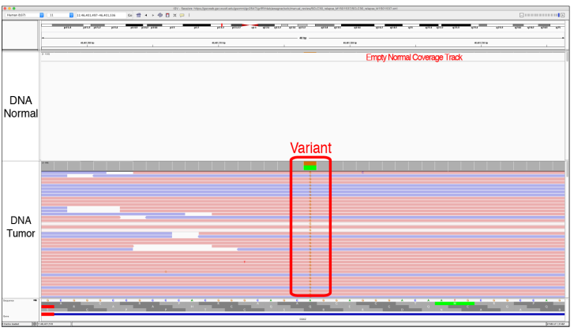
基因组打断、建库、富集
DNA 质量和数量、捕获试剂的效率等很多因素会影响样本覆盖的均一性
No Count Normal (NCN)
Notes:
Helpful Hints: 1) If a variant has low coverage in the normal track, it can be treated like a tumor only sample. This might require populating the Genome Features section with a SNPs Track (e.g., dbSNP, 1000 genomes, ExAC, gnomAD, etc.) to ensure that the variant is not a polymorphism (see Step 3 in ​Figure 3A​ for setting up manual review). 2) Thresholds can be used to pre-filter variants with no coverage in tumor or normal to eliminate the need to evaluate these variants during manual review.

Slide 9
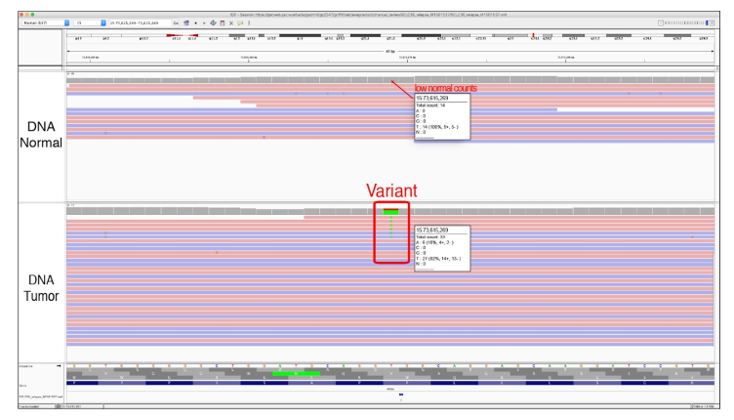
基因组打断、建库、富集
DNA 质量和数量、捕获试剂的效率等很多因素会影响样本覆盖的均一性
Low Count Normal (LCN)
Notes:
Helpful Hints: 1) If a variant has low coverage in the normal track, it can be treated like a tumor only sample. This might require populating the Genome Features section with a SNPs Track (e.g., dbSNP, 1000 genomes, ExAC, gnomAD, etc.) to ensure that the variant is not a polymorphism (see Step 3 in ​Figure 3A​ for setting up manual review). 2) Thresholds can be used to pre-filter variants with low coverage in tumor or normal to eliminate the need to evaluate these variants during manual review

Slide 10
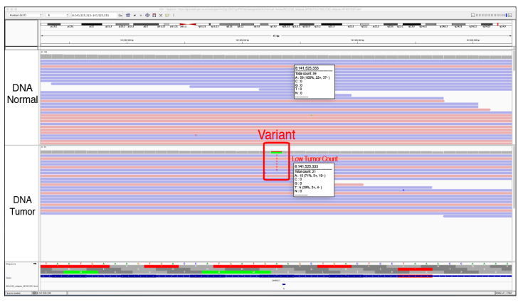
基因组打断、建库、富集
DNA 质量和数量、捕获试剂的效率等很多因素会影响样本覆盖的均一性
Low Count Tumor (LCT)
Notes:
Helpful Hints: 1) Calling a variant with low coverage has important downstream implications. When the tumor track has low coverage, variant allele frequency (VAF) estimates can be heavily influence by sequencing noise and sampling bias. This may result in: a false negative with an underestimated VAF, a false positive due to over-estimation of the VAF, and/or a true positive call with inaccurate VAF. 2) The LCT tag acts as a bare minimum for tumor coverage but only in concert with a 5% VAF minimum with at least 4-5 reads of support (taking into account short inserts). Therefore, the LCT tag can denote that a variant was considered ambiguous or somatic in a rare sequencing context. 3) Thresholds can be used to pre-filter variants with low coverage in tumor or normal to eliminate the need to evaluate these variants during manual review.

Slide 11
基因组打断、建库、富集
DNA 质量和数量、捕获试剂的效率等很多因素会影响样本覆盖的均一性
No Count Normal (NCN)
Notes:
Helpful Hints: 1) If a variant has low coverage in the normal track, it can be treated like a tumor only sample. This might require populating the Genome Features section with a SNPs Track (e.g., dbSNP, 1000 genomes, ExAC, gnomAD, etc.) to ensure that the variant is not a polymorphism (see Step 3 in ​Figure 3A​ for setting up manual review). 2) Thresholds can be used to pre-filter variants with no coverage in tumor or normal to eliminate the need to evaluate these variants during manual review.

Slide 12
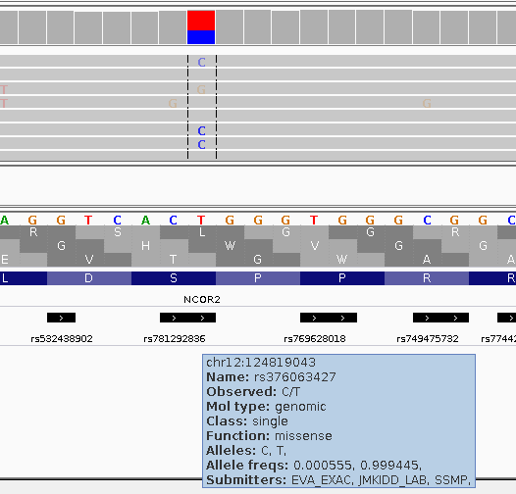
基因组打断、建库、富集
DNA 质量和数量、捕获试剂的效率等很多因素会影响样本覆盖的均一性
If a variant exists at a very low (e.g. <0.5%) or zero population frequency within these databases, it increases the likelihood that the variant is somatic.
No Count Normal (NCN)
Notes:
Helpful Hints: 1) If a variant has low coverage in the normal track, it can be treated like a tumor only sample. This might require populating the Genome Features section with a SNPs Track (e.g., dbSNP, 1000 genomes, ExAC, gnomAD, etc.) to ensure that the variant is not a polymorphism (see Step 3 in ​Figure 3A​ for setting up manual review). 2) Thresholds can be used to pre-filter variants with no coverage in tumor or normal to eliminate the need to evaluate these variants during manual review.

Slide 13
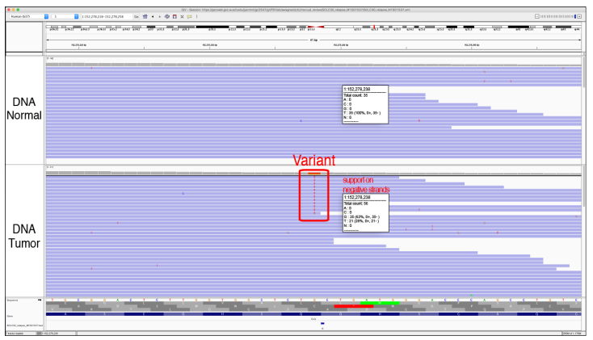
PCR 扩增
聚合酶在一个方向上有偏好性会导致链偏好性
Directional (D)
Notes:
Helpful Hints: 1) This tag can best be assessed when the reads are not viewed as pairs. When viewing data tracks as pairs, the reads in both directions are overlaid and could possibly make the variant appear to be exclusively supported by read strands in a particular direction. 2) To observe this artifact, it is necessary to color the alignments by read strand: Right click on data track > “Color alignments by” > “read strand”

Slide 14
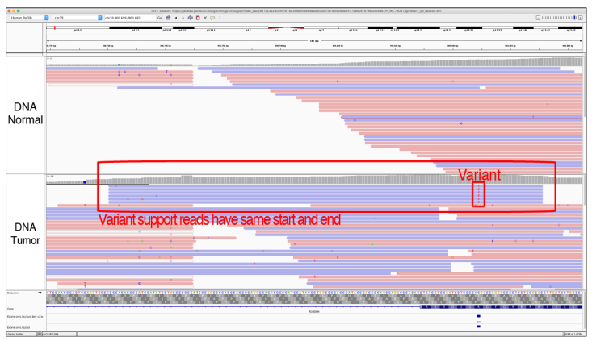
PCR 扩增
一段序列具备扩增优势且数据没有去dup会导致支持该突变的reads是一样的
Same Start/End (SSE)
Notes:
Helpful Hints: 1) Identifying SSE artifacts requires first sorting the reads by base and subsequently zooming out to view a larger genomic region. This allows for visualization of the ends of the reads.

Slide 15
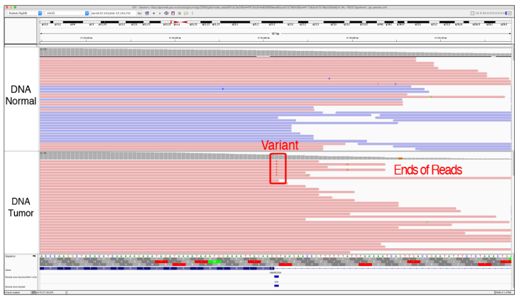
测序
测序试剂的效率、图像采集、目标序列簇周围的其他簇的影响、软件的局限性等会导致核苷酸的误读
End of reads (E)
dephasing
Notes:
Helpful Hints: 1) Identifying End of reads artifacts requires first sorting the reads by base and subsequently zooming out to view a larger genomic region. This allows for visualization of the ends of the reads. 2) Additional mismatches downstream the called variant can increase confidence that the variant in question is a sequencing artifact. 3) This artifact is more easily evaluated by coloring the alignments by read strand: Right click on data track > “Color alignments by” > “read strand”

Slide 16
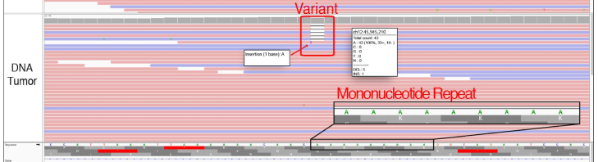
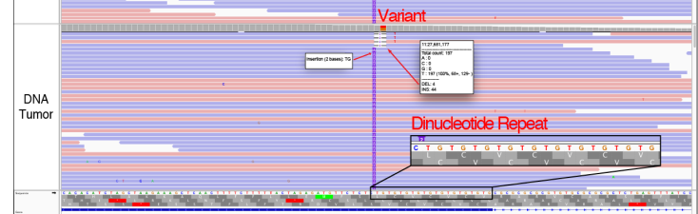
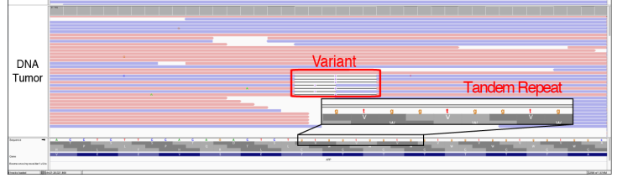
比对
辅助判断:
重复序列的长度
突变丰度
对照样本的检出情况
同批其他样本在该点的突变丰度
Mononucleotide repeat (MN)
Dinucleotide repeat (DN)
Tandem Repeat (TR)
Notes:
Helpful Hints: 1) Typically, these variants are small deletions or insertions, and they are usually visualized in both the tumor and normal tracks. 2) Although the variant being evaluated here is a one base-pair deletion, other reads at the same locus typically have insertions and deletions of varying lengths.
Helpful Hints: 1) Typically, these variants are small deletions or insertions and they are usually visualized in the both tumor and normal tracks. 2) Although the variant being evaluated is a two base-pair deletion, other reads at the same locus typically have insertions and deletions in multiples of two.
Helpful Hints: 1) Typically, these variants are small deletions or small insertions and they are usually visualized in both the tumor tracks and the normal tracks. 2) In this example, the variant being evaluated is a three base-pair deletion, whereas other reads at the same locus have insertions and deletions in multiples of three, which reduces confidence in the called variant. This pattern can help distinguish a TR artifact from a true somatic variant.

Slide 17
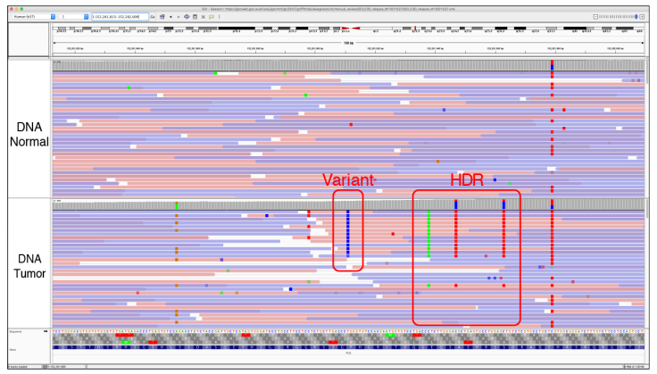
比对
High Discrepancy Region (HDR)
Notes:
Helpful Hints:
1) The presence of more than three identical mismatches within a 100-200 base-pair region is highly
indicative of an HDR.
2) It is important to be sure that the variant being evaluated is not surrounded by a cluster of single
nucleotide polymorphisms (SNPs). Sometimes, true variants can occur in close proximity to multiple
SNPs and might be confused with an area of HDR. This is particularly true for individuals with
haplotypes that are not well-represented by the reference sequence

Slide 18
比对
High Discrepancy Region (HDR)
Notes:
Helpful Hints:
1) The presence of more than three identical mismatches within a 100-200 base-pair region is highly
indicative of an HDR.
2) It is important to be sure that the variant being evaluated is not surrounded by a cluster of single
nucleotide polymorphisms (SNPs). Sometimes, true variants can occur in close proximity to multiple
SNPs and might be confused with an area of HDR. This is particularly true for individuals with
haplotypes that are not well-represented by the reference sequence

Slide 19
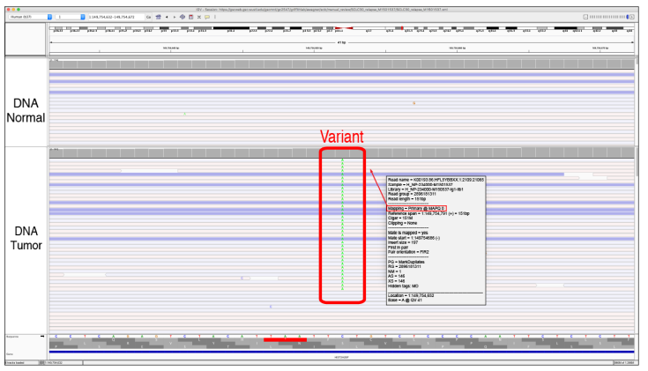
比对
Low Mapping (LM) quality
Notes:
Helpful Hints: 1) Mapping quality scores can be ascertained by clicking on the read. 2) In regions where numerous reads have a mapping quality of 0, the reads are often mapped to multiple locations across the genome. This results in low mapping quality reads in both the normal and tumor tracks. Alternate mapping locations can be ascertained by clicking on the read. 3) By default, all reads are shown in IGV, even if the mapping quality is 0. This threshold can be adjusted to eliminate low quality reads from IGV during manual review: “View” > “Preferences” > “Alignments” > “Mapping quality threshold” > insert threshold

Slide 20
比对
Low Mapping (LM) quality
Notes:
Helpful Hints: 1) Mapping quality scores can be ascertained by clicking on the read. 2) In regions where numerous reads have a mapping quality of 0, the reads are often mapped to multiple locations across the genome. This results in low mapping quality reads in both the normal and tumor tracks. Alternate mapping locations can be ascertained by clicking on the read. 3) By default, all reads are shown in IGV, even if the mapping quality is 0. This threshold can be adjusted to eliminate low quality reads from IGV during manual review: “View” > “Preferences” > “Alignments” > “Mapping quality threshold” > insert threshold

Slide 21
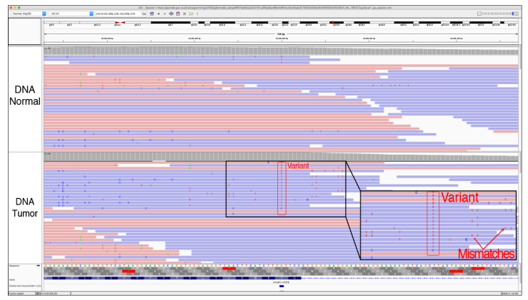
比对
Multiple Mismatches (MM)
Notes:
Helpful Hints: 1) If the mismatches are of high quality, this likely indicates that the read was properly sequenced. In this case, the mismatches occur due to misalignment. If the mismatches are of low quality, this likely indicates that the read was improperly sequenced. Both of these examples reduce confidence in the variant. 2) High densities of mismatches in the tumor track increase the probability that identical base substitution errors align across reads causing the VAF to surpass filtering thresholds. The higher the read depth, the less likely this situation is to arise, as low percentage VAF variants increase in plausibility with increased read depth.

Slide 22
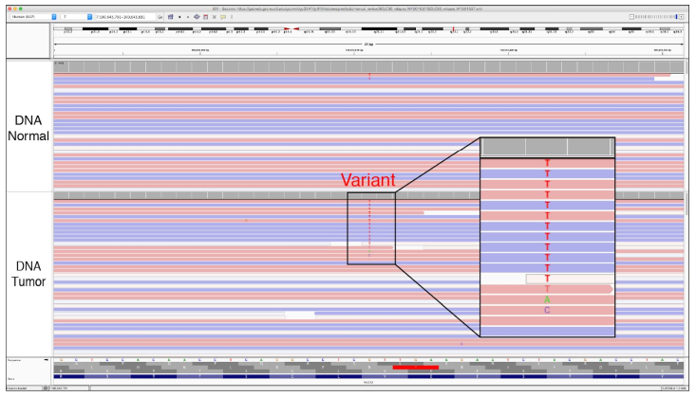
比对
Multiple Variants (MV)
Notes:
Helpful Hints: 1) Clicking on the coverage track will reveal a popup window with relative abundance of each base at the selected locus. 2) Do not rely on coverage track coloring as there might be multiple variants that have a variant allele frequency (VAF) too small to be represented in the coverage bar. The VAF threshold for coloring the coverage bar can be changed in the IGV preferences panel: “View” > “Preferences” > “Alignments” > “Coverage allele-fraction threshold” > insert threshold 3) For very deep data, multiple variants due to random error will start to accumulate. The relative abundance of each base should be considered in cases with deep coverage. 4) While rare, true multi-allelic somatic variants are possible in tumors.

Slide 23
比对
Multiple Variants (MV)
Notes:
Helpful Hints: 1) Clicking on the coverage track will reveal a popup window with relative abundance of each base at the selected locus. 2) Do not rely on coverage track coloring as there might be multiple variants that have a variant allele frequency (VAF) too small to be represented in the coverage bar. The VAF threshold for coloring the coverage bar can be changed in the IGV preferences panel: “View” > “Preferences” > “Alignments” > “Coverage allele-fraction threshold” > insert threshold 3) For very deep data, multiple variants due to random error will start to accumulate. The relative abundance of each base should be considered in cases with deep coverage. 4) While rare, true multi-allelic somatic variants are possible in tumors.

Slide 24
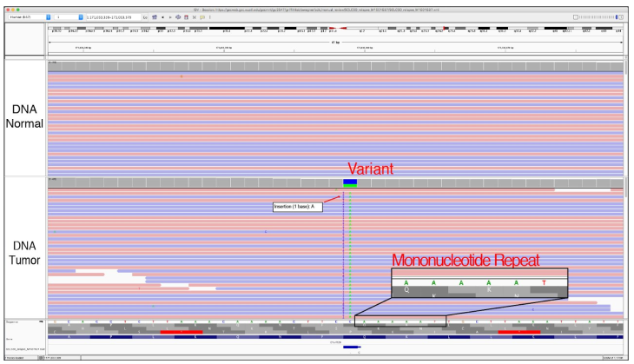
Alignment
Adjacent Indel (AI)
Notes:
Helpful Hints: 1) Clicking on the coverage track will reveal a popup window with relative abundance of each base at the selected locus. 2) Do not rely on coverage track coloring as there might be multiple variants that have a variant allele frequency (VAF) too small to be represented in the coverage bar. The VAF threshold for coloring the coverage bar can be changed in the IGV preferences panel: “View” > “Preferences” > “Alignments” > “Coverage allele-fraction threshold” > insert threshold 3) For very deep data, multiple variants due to random error will start to accumulate. The relative abundance of each base should be considered in cases with deep coverage. 4) While rare, true multi-allelic somatic variants are possible in tumors.

Slide 25
tip

Slide 26
tip

Slide 27
Thanks

