Slide 1








Verified Compilation and Optimization of Floating-Point Programs in CakeML
Heiko Becker, Robert Rabe, Eva Darulova, Magnus O. Myreen, Zachary Tatlock, Ramana Kumar, Yong Kiam Tan, Anthony Fox

Slide 2




Floating-Point Arithmetic in Unverified & Verified Compilers
before our work
IEEE-754 arithmetic
fast-math-style optimizations
correctness & accuracy proofs
no floating-point support
LLVM
in this talk
IEEE-754 arithmetic
fast-math optimizations
no correctness guarantees
IEEE-754 arithmetic
no performance optimizations
full correctness proof
Notes:
flip order for CompCert -> unverified to make sure that correctness is clear

Slide 3


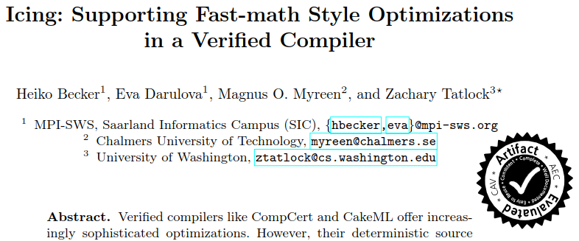
Fast-Math-Style Optimizations in Compilers
CAV’19
LLVM
$$x ∗\left(x ∗\left(x ∗x\right)\right)→\left(x ∗x\right)∗(x ∗x)$$
preserve IEEE-754 floating-point arithmetic
changes bit-level result
requires bit-level accuracy
Notes:
Say somewhere that fast-math is a flag for the compiler
say: there are some semantics preserving optimizations, but the fast-math ones wreck havoc
do not say: Icing has solved the problem, say something like “Provides a fully verified semantics that can handle fp optimizations”

Slide 4
proof-of-concept optimizer
verified floating-point optimizations
fine-grained control
Icing: Supporting Fast-math Style Optimizations in a Verified Compiler [CAV’19]
missing
no accuracy guarantees
non-deterministic semantics
technical challenge
Notes:
say: you want accuracy guarantees to ensure that the program is still correct → Here is why

Slide 5
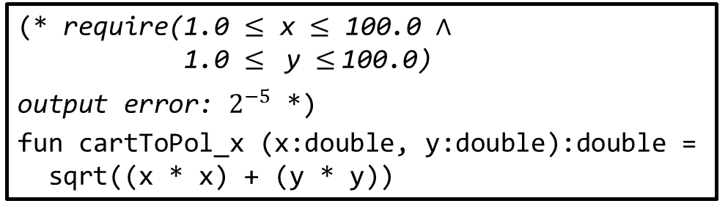
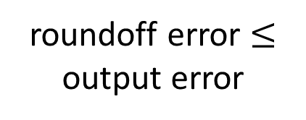
Why Accuracy Matters
(* require(1.0 $≤$ x $≤$ 100.0 $∧$ 1.0 $≤$ y $≤$100.0)
output error: $2^{−5}$ *)
fun cartToPol_x (x:double, y:double):double =
sqrt((x * x) + (y * y))
roundoff error $≤$ output error
IEEE-754
program designed for unavoidable input and output errors
machine code
machine code
machine code
error refinement any optimized implementation below output error is fine
Notes:
highlight require and output error as non-code elements!
Use

Slide 6
Contributions
RealCake:
extends CakeML with relaxed non-deterministic floating-point semantics
optimizes with a fast-math optimizer
soundly proves roundoff errors of floating-point kernels with automated tools
proves error refinement
Notes:
unhighlight last bullet point after speaking of first 3 points

Slide 7

The RealCake Compiler Zoomed In
relaxed
floating-point semantics
oracle-based
to encode non-determinism
source program
with output error
fast-math optimizer
optimized program
accuracy analysis
real-valued semantics
accuracy bound
error refinement
proof
machine code
Notes:
try reordering to have machine code arrow better
say: oracle makes things work

Slide 8

Floating-Point Programs in CakeML
(* output error: $2^{−5}$,
precondition P: 0.0 ≤ x1 ≤ 5.0 ∧ −20.0 ≤ x2 ≤ 5.0 *)
fun jetEngine(x1:double, x2:double):double =
opt: (let val t = (((3.0 * x1) * x1) + (2.0 * x2)) - x1
val t2 = (((3.0 * x1) * x1) - (2.0 * x2)) - x1
val d = (x1 * x1) + 1.0
val s = t / d
val s2 = t2 / d
in
x1 + (((((((((2.0 * x1) * s) * (s - 3.0)) +
((x1 * x1) * ((4.0 * s) - 6.0))) * d) +
(((3.0 * x1) * x1) * s)) +
((x1 * x1) * x1)) + x1) + (3.0 * s2))
end)
input constraints
tolerable noise
double operations
optimization annotation
Notes:
fix indentation of code
say that function is a non-linear controller from FPBench
we need constraints because otherwise error is unbounded

Slide 9
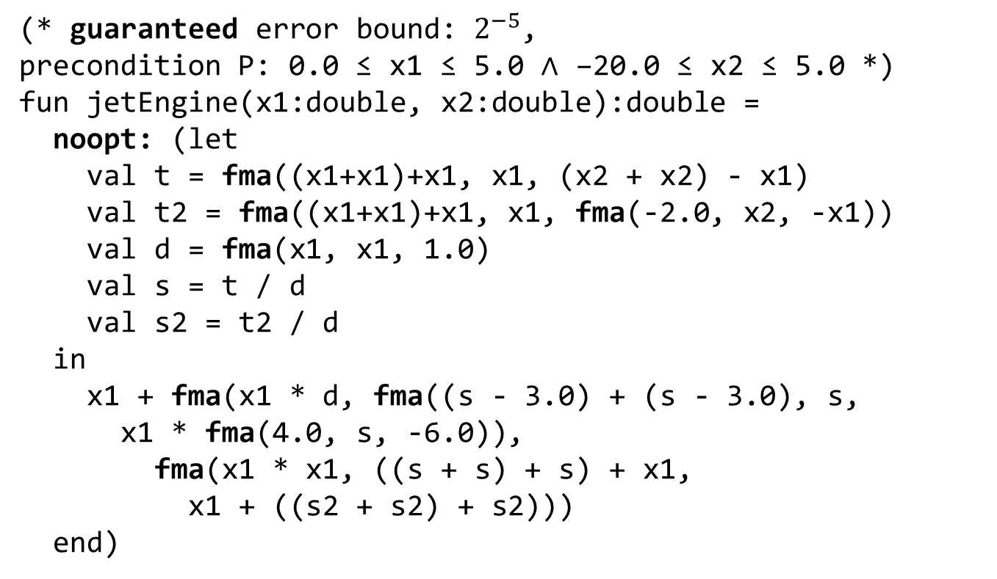
Optimized Floating-Point Programs
machine code from IEEE-754 preserving compilation in CakeML
(* guaranteed error bound: $2^{−5}$,
precondition P: 0.0 ≤ x1 ≤ 5.0 ∧ −20.0 ≤ x2 ≤ 5.0 *)
fun jetEngine(x1:double, x2:double):double =
noopt: (let
val t = fma((x1+x1)+x1, x1, (x2 + x2) - x1)
val t2 = fma((x1+x1)+x1, x1, fma(-2.0, x2, -x1))
val d = fma(x1, x1, 1.0)
val s = t / d
val s2 = t2 / d
in
x1 + fma(x1 * d, fma((s - 3.0) + (s - 3.0), s,
x1 * fma(4.0, s, -6.0)),
fma(x1 * x1, ((s + s) + s) + x1,
x1 + ((s2 + s2) + s2)))
end)
verified by accuracy analysis
faster, locally more accurate
disallow further optimization
Notes:
Highlight all FMA’s

Slide 10
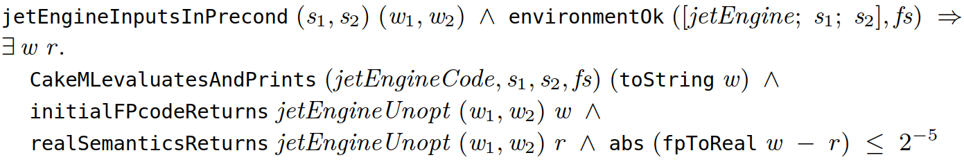
The Final Specification Theorem
inputs in specified constraints
program returns double word w
the program is run with the correct inputs
RealCake is the first verified compiler that proves end-to-end accuracy bounds for compiled fast-math optimized programs
w also result of nondeterministic semantics
real-number semantics returns r
output error sound

Slide 11
The RealCake Compiler Zoomed In
relaxed
floating-point semantics
oracle-based
to encode non-determinism
source program
with output error
fast-math optimizer
optimized program
accuracy analysis
real-valued semantics
accuracy bound
error refinement
proof
machine code

Slide 12
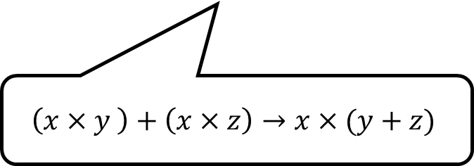
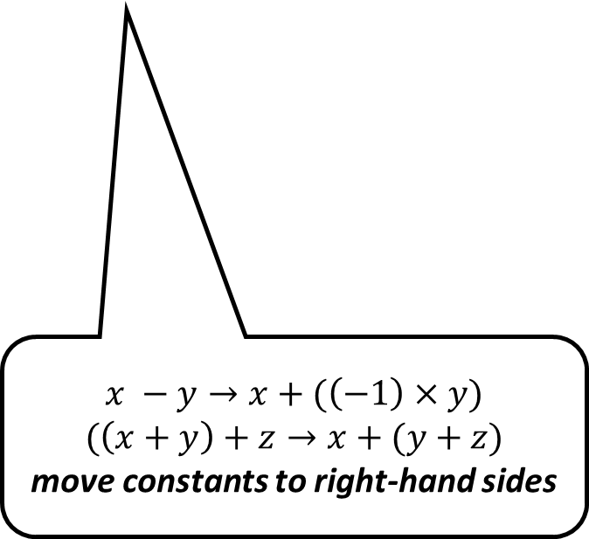
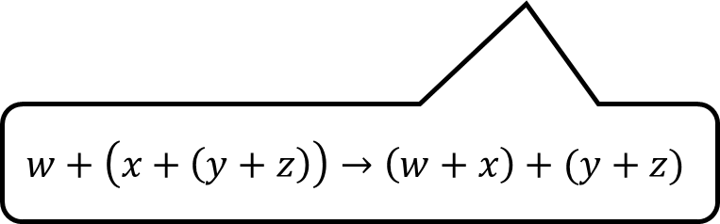
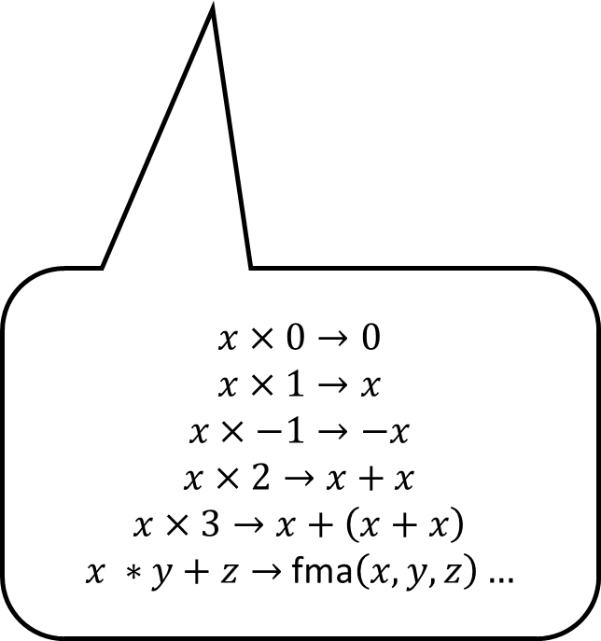
RealCake’s Four-Phase-Optimizer
canonical form
undistribute
peephole optimizer
balance trees
each phase proven correct for relaxed floating-point semantics
$$\left(x×y \right)+\left(x×z\right)→x×(y+z)$$
$$w+\left(x+\left(y+z\right)\right)→\left(w+x\right)+(y+z)$$
$$x×0→0$$
$$x×1→x$$
$$x×−1→−x$$
$$x×2→x+x$$
$$x×3→x+\left(x+x\right)$$
$x ∗y+z→$ fma$\left(x,y,z\right)…$
$$x −y→x+(\left(−1\right)×y)$$
$$(\left(x+y\right)+z→x+(y+z)$$
move constants to right-hand sides

Slide 13
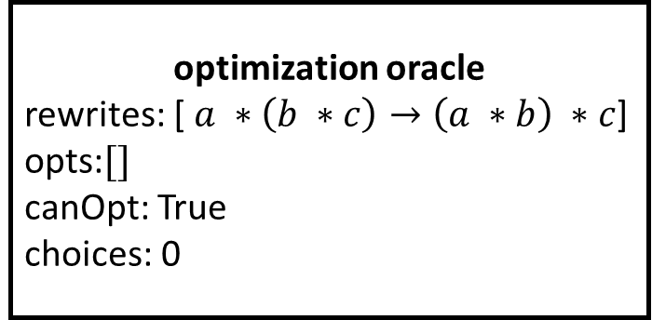
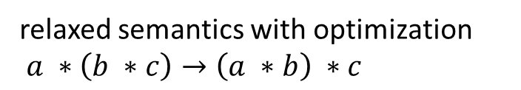
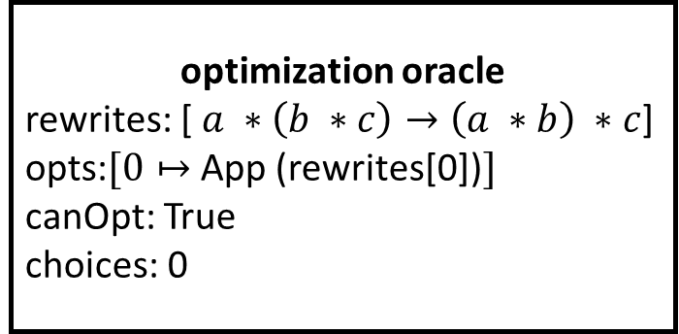
RealCake’s Relaxed Floating-Point Semantics
a *_{double} (b *_{double} c)
IEE754 arithmetic
relaxed semantics with optimization
$a ∗\left(b ∗c\right)→\left(a ∗b\right) ∗c$
optimization correctness:
Is there an oracle such that
the relaxed floating-point semantics returns this value?
round (a *_{double} (round (b *_{double} c))
round ((round (a *_{double} b)) *_{double} c)
optimization oracle
rewrites: [ $a ∗\left(b ∗c\right)→\left(a ∗b\right) ∗c$]
opts:$[]$
canOpt: True
choices: 0
optimization oracle
rewrites: [ $a ∗\left(b ∗c\right)→\left(a ∗b\right) ∗c$]
opts:$[0↦$ App (rewrites[0])$]$
canOpt: True
choices: 0

Slide 14
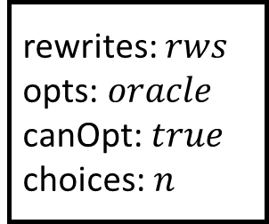

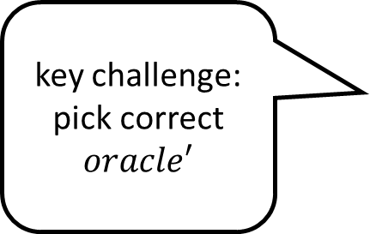
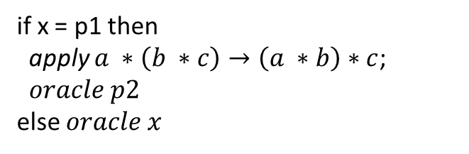
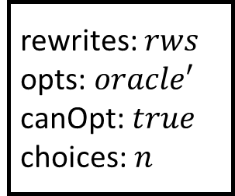
How To Verify an Optimization Pass
initial state
intermediate state
rewrites: $rws$
opts: $oracle$
canOpt:$true$
choices: $n$
key challenge: pick correct $oracle′$
rewrites: $rws$
opts: $oracle′$
canOpt:$true$
choices: $n$
if x = p1 then
apply $a ∗\left(b ∗c\right)→\left(a ∗b\right)∗c$; $oracle p2$
else $oracle x$
relaxed semantics
p1 = let … in …
p2 = let … in …
syntactic optimization
verification of optimization pass
split into separate verification proofs for every single optimization
$$a ∗(b ∗c)→\left(a ∗b\right) ∗c$$

Slide 15
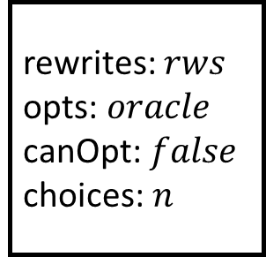
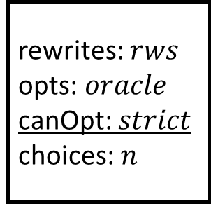
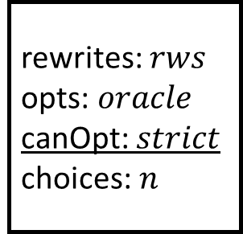
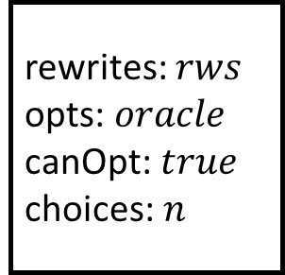
Integrating Relaxed Floating-Point Semantics with CakeML
rewrites: $rws$
opts: $oracle$
canOpt:$false$
choices: $n$
rewrites: $rws$
opts: $oracle$
canOpt:$true$
choices: $n$
opt: (let x = … in …)
let x = … in …
…
optimizations must be disallowed once code enters the compiler!
rewrites: $rws$
opts: $oracle$
canOpt: $strict$
choices: $n$
rewrites: $rws$
opts: $oracle$
canOpt: $strict$ choices: $n$
opt: (let x = … in …)
let x = … in …
…

Slide 16
The RealCake Compiler Zoomed In
relaxed
floating-point semantics
oracle-based
to encode non-determinism
source program
with output error
fast-math optimizer
optimized program
accuracy analysis
real-valued semantics
accuracy bound
error refinement
proof
machine code

Slide 17

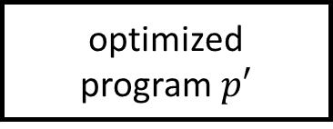
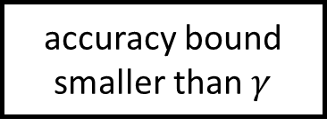
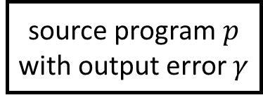
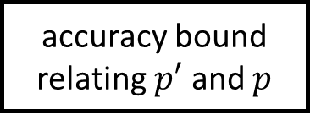
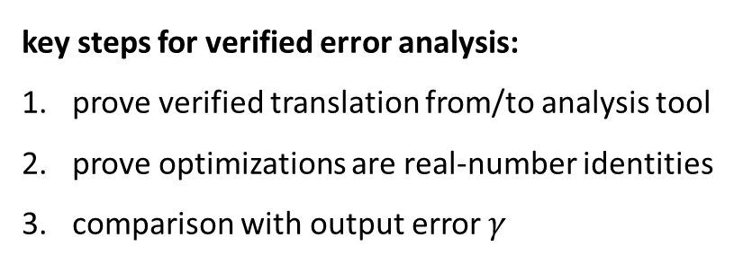
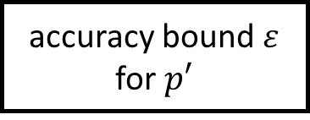
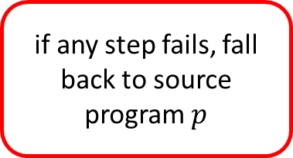
Integrating an External Roundoff Error Analysis
fast-math optimizer
key steps for verified error analysis:
prove verified translation from/to analysis tool
prove optimizations are real-number identities
comparison with output error $γ$
source program$p$
with output error $γ$
optimized program$p′$
accuracy analysis
if any step fails, fall back to source program $p$
accuracy bound $ε$
for $p′$
optimizations are
real-numbered identities
check $ε≤γ$
accuracy bound
smaller than $γ$
accuracy bound
relating $p′$ and $p$

Slide 18
Experimental Results – Roundoff Errors
Name | Original | fast-math | Improvement
cartToPol | 2.815e-09 | 2.463e-09 | 13%
delta | 1.970e-13 | 2.940e-12 | -198%
doppler2 | 6.534e-13 | 1.639e-12 | 50%
pid | 7.621e-15 | 7.727e-15 | -1%
sine_newton | 7.495e-15 | 6.27e-15 | 16%
sqroot | 1.115e-15 | 1.059e-15 | 5%
turbine1 | 1.588e-13 | 1.541e-13 | 3%
trade accuracy for performance
Notes:
Show columns 1-1 instead

Slide 19
Experimental Results – Performance
Name | Original | Csts | fast-math
cartToPol | 2.05 | 1% | 9%
delta | 13.49 | 1% | 16%
doppler2 | 36.00 | 91% | 6%
pid | 104.11 | 96% | 0%
sine_newton | 126.34 | 92% | 0%
sqroot | 87.06 | 95% | 5%
turbine1 | 121.02 | 96% | 0%
Notes:
Show only percentage improvements here to make it easier to understand
Show csts only after discussing fast-math, say only with cprop you get…

Slide 20

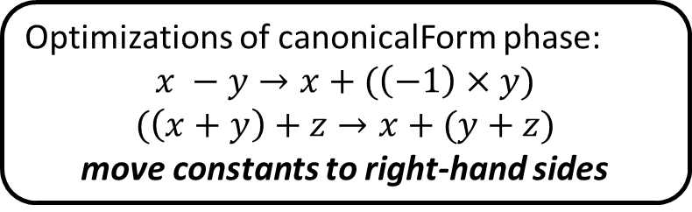

Avoiding Slow-Downs With a Heuristic
Optimizations of canonicalForm phase:
$$x −y→x+(\left(−1\right)×y)$$
$$(\left(x+y\right)+z→x+(y+z)$$
move constants to right-hand sides
some optimizations will increase program size
canonicalForm
heuristic rejects programs whose $size$ increases after optimization
2.0 – x
((-1) * x) + 2.0
can introduce fma
x – 2.0
x + ((-1) * 2.0)
cannot introduce fma
$size($x – 2.0 $)≤$ $size($x + ((-1 )* 2.0)$)$

Slide 21
Conclusion
RealCake:
proves error refinement for CakeML programs
extends CakeML with oracle-based floating-point semantics
optimizes with fast-math-style optimizations
is integrated into official CakeML codebase: https://code.cakeml.org
in the paper: - verified constant lifting optimization
- details of integration into CakeML toolchain
- implementation of real-numbered and IEEE-754 semantics
Notes:
show 4th bullet point only after discussing the first 3, add GitHub logo/ url
show in-the-paper box later

