Slide 2
OOP in JavaScript
AGENDA
2
Class
Object
Properties
Methods
Constructors
Inheritance

Slide 3
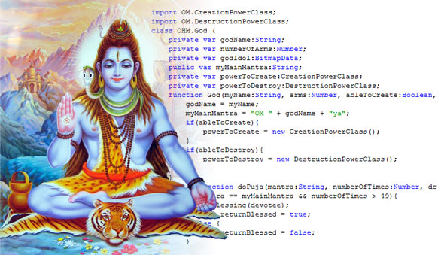
Object Oriented
Programming in JavaScript

Slide 4
Typical OO Terminology
Class: Defines the characteristics of the Object.
Object: An Instance of a Class.
Property: An Object characteristic, such as color.
Method: An Object capability, such as walk.
Constructor: A method called at the moment of instantiation.
Inheritance: A Class inheriting characteristics from another Class.

Slide 5
Classical Model
function Dog(name) { // constructor function
this.name = name; // `this` keyword refers to a particular dog instance.
}
var dog1 = new Dog("Fido"); //new instance of Dog.
var dog2 = new Dog("Spot"); //another new instance of Dog.
dog1.name; //=> "Fido"
dog2.name; //=> "Spot"

Slide 6
Instances are based off of a prototype object
function Dog(name) {
this.name = name;
}
var dog1 = new Dog("Fido"); //inherits from Dog’s prototype
var dog2 = new Dog("Spot"); // also inherits from Dog’s prototype
dog1.name; //=> "Fido"
Dog.prototype.bark = function() { alert(this.name+' says woof!'); }
dog1.bark; //=> "Fido says woof!"
dog2.bark; //=> "Spot says woof!"

Slide 7
Constructor method hooks into moment of instantiation
function Dog(name) {
this.constructor.population++; //constructor refers back to the Dog function.
this.name = name;
}
Dog.population = 0; // static property
var dog1 = new Dog("Fido");
Dog.population; //=> 1
var dog2 = new Dog("Spot");
Dog.population; //=> 2

Slide 8
Private Properties and Methods
function Dog() {
var legs = 4; // private property
function operation() { legs -= 1; return legs+' legs left.'; } // private function
this.visitDoctor = function() { operation(); } // privileged method
}
dog1 = new Dog();
dog1.legs = 3; // Error, undefined property legs for dog1
dog1.visitDoctor(); //=> 3 legs left.

Slide 9
Public, Private, Privileged, Prototype, Constructor, and Static
function Dog(name) {
this.constructor.population++; // constructor method
var alive = true; // private property
function die() { alive = false; } // private functions
this.name = name; // public property
this.pupName = function() { this.name += " pup"; } // privileged method
}
Dog.population = 0; // static property
Dog.prototype.bark = function() { alert(this.name+' says woof!'); } // public method
Dog.prototype.legs = 4; // prototype property

Slide 10
Prototypal Model
var Dog = {
name: 'unknown'
}
var dog1 = Object.create(Dog);
dog1.name; //=> "unknown"
dog1.name = "Fido";
Dog.bark = function() { return this.get_name+' says woof!'; }
dog1.bark; //=> "Fido says woof!"

