Slide 1
COMP1860 Computer Systems and Architecture
S1.W6.L1: Computer Architecture and Instruction Sets
Leandro Soares Indrusiak

Slide 2
Learning outcomes
Explain basic building blocks of a computer, e.g., ALU, registers, CPU, memory.
Explain how instructions are represented at the machine level and in the context of a symbolic assembler.

Slide 3
Text Books
Noam Nisan and Shimon Schocken, The Elements of Computing Systems: Building a Modern Computer from First Principles
  MIT Press, 2nd Edition, 2021
William Stallings, Computer Organisation and Architecture: Designing for Performance,
  Pearson Education, 11th edition, 2021

Slide 4
Drop-in Lab sessions in Week 6 to Week 11
Mondays 14:00 - 16:00, Bragg Computing UG teaching lab (2.05)
Wednesdays 12:00 - 14:00, EC Stoner Cluster (6.61)
Fridays 11:00 - 13:00, Worsley LIDA Cluster (11.06)
You are welcome to any of these sessions if there is space

Slide 5
Overview
Part I – How a computer runs a program: components, registers, buses
The fetch–execute cycle, and tracing a program on a simple machine (MARIE)
Von Neumann vs Harvard architectures, and our Hack computer
Part II – Instruction set architectures (ISAs): what an ISA defines
Stack, accumulator and register architectures; number of addresses
Addressing modes; RISC vs CISC; where Hack fits

Slide 6
S1.W6.L1: PART I How a computer runs a program

Slide 7
传统单处理器计算机的层次结构图
Hierarchical Structure（Computer Level）
Recap: Structure
Hierarchical Structure（CPU Level）
Figure 1.1 provides a hierarchical view
of the internal structure of a traditional single-processor computer
Hierarchical Structure（CU Level）
Source: Stallings. Computer Organisation & Architecture. p.27

Slide 8
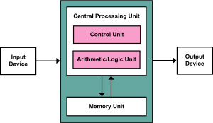
Recap: von Neumann Architecture（图要背）
The von Neumann machine is based on four linked components（基于4种相互连接的组件）:
  Main memory which can store programs alongside data.
  An Arithmetic and Logic Unit (ALU) capable of operating on binary data.
  A control unit which interprets instructions in memory and executes them.
  Input and output equipment operated by the control unit.

Slide 9
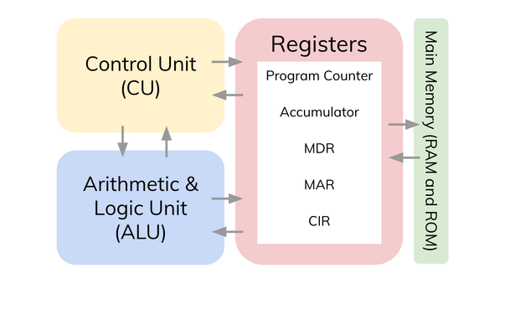
Recap: Registers （图要背）
Memory address register (MAR)
  Specifies the address in memory of the word to be written from or read into the MDR
Memory data register (MDR)
  Contains a word to be stored in memory or sent to the I/O unit
  Or is used to receive a word from memory or from the I/O unit
Current Instruction register (CIR)
  Contains the opcode instruction being executed
Program counter (PC)
  Contains the address of the next instruction to be fetched from memory
Accumulator (AC)
  Employed to temporarily hold operands and results of ALU operations
Notes:
General Purpose Registers Typically between 8 to 32 (128 in Intel Itanium)
Large enough to hold full address/word
But we can use two data registers for one word/address

Slide 10
General Purpose Registers（通用目的寄存器）
Data:
  Like accumulators
Addressing:
  Hold addresses of memory locations
How many?
  Typically between 8 to 32 (128 in Intel Itanium)
How big?
Large enough to hold full address/word
But we can use two data registers for one word/address

Slide 11
Program Status Word Register（PSW）
PSW stores a set of bits
Typically including condition codes like
  Zero flag: set when the result of an arithmetic/logical operation is zero
    E.g., to test whether a = b, compute a − b and check whether the zero flag is set
  Carry
    Enables numbers larger than a single word to be added/subtracted by carrying a binary digit
  Overflow
  Interrupt enable/disable
  Interrupt flags
Bit 7
Bit 6
Bit 5
Bit 4
Bit 3
Bit 2
Bit 1
Bit 0
Carry bit | Overflow | Zero | Int. enable | Int. flag | … | … | …
An 8-bit PSW

Slide 12
System bus: address bus（单向：CPU->内存 ）
Memory
CPU
Control unit
control signals
program
(instructions)
registers
ALU
data
PC
IR
address bus
addresses (CPU → memory)
地址线用于指定数据总线上数据的来源或去向，地址线通常也用于I/O端口的寻址。
CPU将所需要的地址放在地址线上。
地址线的高位用于选择总线上指定的模块, 低位用于选择模块内具体的存储器单元或1/0端口。
例如,在一个8位地址总线上,小于等于01111111的地址可以用来访问有128个字的存储器模块 (模块0),
而大于等于10000000的地址可用来访问接在I/O模块上的设备(模块1)。

Slide 13
System bus: data bus （双向：CPU↔内存 ）
Instructions are just words in memory:
they travel on the data bus, like any other data
Memory
CPU
Control unit
control signals
program
(instructions)
registers
ALU
data
PC
IR
address bus
addresses (CPU → memory)
data bus
instructions and data
数据线提供系统模块间传送数据的路径,这些线组合在一起称为数据总线。典型的数据总线包含32、64、128或更多的分离导线, 这些线的数目称为数据总线的宽度。数据总线宽度是决定系统总体性能的关键因素。例如,如果数据总线为32位宽,而每条指令64位长,那么处理器在每个指令周期必须 访问存储器模块两次。

Slide 14
System bus: control bus（双向：CPU↔内存 ）
The control bus carries signals, not instructions:
memory read/write, clock, reset, interrupts
Memory
CPU
Control unit
control signals
program
(instructions)
registers
ALU
data
PC
IR
address bus
addresses (CPU → memory)
双向：CPU↔内存
data bus
instructions and data
control bus
read/write, clock, …
控制线用来控制对数据线和地址线的存取和使用。由于数据线和地址线被所有模块共享, 因此必须用一种方法
来控制它们的使用。
控制信号在系统模块之间发送命令和时序信号。时序信号指定了数据和地址信号的有效性, 命令信号指定了
要执行的操作。典型的控制信号:
memory read/write、I/O read/write、Bus Request/Grant、Interrupt Request/Ack、Clock、Reset….

Slide 15
三种Bus相互协作的例子：将指定内存地址中的数放入累加器
阶段1：CPU发起访存请求（控制总线先启动）
CPU的控制单元（CU）首先通过控制总线向内存发送一组控制信号：
核心命令信号：发出 Memory Read 命令信号；
时序同步信号：发送Addree Eanble信号和全局时钟信号，保证CPU和内存的操作节奏一致；
如果内存当前正在处理其他请求，会通过控制总线向CPU返回「BUSY信号」，CPU会自动等待，直到内存空闲。
阶段2：地址总线指定目标单元
CPU确认内存空闲后，会把目标内存地址放到CPU内部的MAR中，MAR会通过地址总线把地址信号发送到内存 的地址引脚。
内存的地址译码器(Decoder)会根据地址总线上的信号，将地址里的数据读到内存的内部数据缓冲器中，但此时不会直接把数据放到外部数据总线上，等待下一步确认。
阶段3：控制总线确认数据就绪
内存把数据准备好后，会通过控制总线向CPU发送「Data READY信号」，相当于告诉CPU「你要的数据我已经拿到了，可以收了」。
阶段4：数据总线传输实际数据
CPU检测到READY信号有效后，会通过控制总线发送「数据接收使能信号」，此时内存才会把缓冲好的数据放到数据总线上。 CPU内部的MDR会在时钟信号的边沿，锁存数据总线上的数值，完成「内存→CPU」的数据传输，至此三总线的外围交互已经全部完成。
阶段5：CPU内部传输到累加器（三总线不再参与）

Slide 16
Programming
Configure the hardware to carry out a specific task
  Control signals are supplied along with the data to execute the operations（控制信号与数据一起提供以执行操作）
Programs are made up of instructions（程序由指令组成）
  CPU executes one instruction every step (or clock cycle)
    Modern CPUs do more
  For each step, an arithmetic or logical operation is performed on some data.

Slide 17
Program instructions
Opcode | Binary rep,
Load | 000
Store | 001
Add | 010
Sub | 011
Jump | 100
A program instruction consists of
  opcode (operation code)
  zero or more operands
    immediately available data (embedded within the instruction)
    the address where the data can be found in main memory or registers
The most significant bits provide the opcode (最重要的位提供操作码)
The remaining bits give operands
OpCode
Operand (Address)
000 010101
load
Operand (memory address)

Slide 18
The control unit
It all comes down to the control unit
This is just a state machine(状态机)
Register 0
ALU
Register 1
Register 2
Register 3
Instruction Register (IR)
Control Unit
Program Counter (PC)

Slide 19
The control unit (cont.)
Fetch:
ask the main memory (RAM) for the instruction whose address is stored in program counter (PC)
Increase PC:
increase the address stored in PC by 1
Execute:
There are only a small number of possible instructions. Depending on which it is, do what is necessary to execute it.
Repeat
  Go back to step 1
Start
Fetch instruction
Execution instruction

Slide 20
Fetch (1): the PC addresses memory
The PC always holds the address of the next instruction
The control bus tells memory to read
Memory
CPU
Basic loop:
Fetch
an instruction
(by supplying
an address)
Execute
the instruction
(And… figure out the address of the next instruction)
Control unit
control signals
program
(instructions)
registers
ALU
data
PC
IR
address bus
address of next instruction
data bus
control bus
read

Slide 21
Fetch：将指定内存地址中的指令放入CPU
阶段1：CPU发起访存请求（控制总线先启动）
CPU的控制单元（CU）首先通过控制总线向内存发送一组控制信号：
核心命令信号：发出 Memory Read 命令信号；
时序同步信号：发送Addree Eanble信号和全局时钟信号，保证CPU和内存的操作节奏一致；
如果内存当前正在处理其他请求，会通过控制总线向CPU返回「BUSY信号」，CPU会自动等待，直到内存空闲。
阶段2：地址总线指定目标单元
CPU确认内存空闲后，会把目标内存地址放到CPU内部的MAR中，MAR会通过地址总线把地址信号发送到内存 的地址引脚。
内存的地址译码器(Decoder)会根据地址总线上的信号，将地址里的数据读到内存的内部数据缓冲器中，但此时不会直接把数据放到外部数据总线上，等待下一步确认。
阶段3：控制总线确认数据就绪
内存把数据准备好后，会通过控制总线向CPU发送「Data READY信号」，相当于告诉CPU「你要的数据我已经拿到了，可以收了」。
阶段4：数据总线传输实际数据
CPU检测到READY信号有效后，会通过控制总线发送「数据接收使能信号」，此时内存才会把缓冲好的数据放到数据总线上。 CPU内部的MDR会在时钟信号的边沿，锁存数据总线上的数值，完成「内存→CPU」的数据传输，至此三总线的外围交互已经全部完成。
阶段5：MDR内部传输传输到指令寄存器（IR)中解码执行（三总线不再参与）

Slide 22
Fetch (2): the instruction arrives in the IR
The instruction travels on the data bus, the same path as data
This shared path is the von Neumann bottleneck
Memory
CPU
Basic loop:
Fetch
an instruction
(by supplying
an address)
Execute
the instruction
(And… figure out the address of the next instruction)
Control unit
control signals
program
(instructions)
registers
ALU
data
PC
IR
address bus
data bus
the instruction
control bus

Slide 23
Execute the instruction
The control unit decodes the IR
The instruction bits specify which operation to execute, and which memory address it acts on
Control signals drive the ALU and registers
Memory
CPU
Basic loop:
Fetch
an instruction
(by supplying
an address)
Execute
the instruction
(And… figure out the address of the next instruction)
Control unit
control signals
program
(instructions)
registers
ALU
data
PC
IR
address bus
data bus
control bus

Slide 24
A Simple Instruction Set
Instruction Number | Instruction | Meaning
1 | Load X | Load content of address X in AC
2 | Store X | Store the contents of AC at address X
3 | Add X | Add the contents of address X to AC and store result in AC
4 | Subt X | Subtract the contents of address X from AC and store result in AC
5 | Input | Input a value form keyboard into AC
6 | Output | Output the value of AC to the display
7 | Halt | Terminate the program
8 | Skipcond | Skip the next instruction on condition
9 | Jump X | Load the value of X into the PC
OpCode 4-bits
Operand (Address) 12-bits
将16-bits拆成4-bits和12bits
4-bits放OpCode，12-bits放Operand
MARIE’s instruction set, from L. Null and J. Lobur 2014, The Essentials of Computer Organization and Architecture

Slide 25
Example: tracing a MARIEprogram
Memory address | Memory value
300 | 1940
301 | 3941
302 | 2941
… | …
940 | 0003
941 | 0002
Opcodes:
1 : Load AC from memory
2 : Store AC to memory
3 : Add to AC from memory
PC initially has a value of 300
Note: values are in hexadecimal – one hex digit of opcode followed by three hex digits of address (4 + 12 bits), exactly MARIE's format(指令集见上页).

Slide 26
Example (cont.)
Memory address | Memory value
300 | 1940
301 | 3941
302 | 2941
… | …
940 | 0003
941 | 0002
Fetch: place the contents of address 300 in the IR
          IR = 1940
Increment the contents of PC
          PC = 0301
Execute: interpret and carry out the instruction held in IR,
i.e. load the contents of memory(OpCode：1) address 940 into AC
          AC = 0003
Fetch: place the contents of address 301 in the IR
          IR = 3941
Increment the contents of PC
          PC = 0302
Execute: interpret and carry out the instruction held in IR, i.e. add the contents of memory address 941 into AC (OpCode：3)
          AC = 0005
Instruction Number | Instruction
1 | Load X
3 | Add X

Slide 27
Memory address | Memory value
300 | 1940
301 | 3941
302 | 2941
… | …
940 | 0003
941 | 0002
Fetch: place the contents of address 302 in the IR
IR = 2941
Increment the contents of PC
PC = 0303
Execute: interpret and carry out the instruction held in IR,
i.e., store the contents of A C in memory address(OpCode：2)
Mem[941] = 0005
Instruction Number | Instruction
2 | Store X

Slide 28
Your Turn: What would the following program do?
Memory address (Hex) | Memory value (Bin) | Memory value (Hex)
100 | 0001000100000100 | 1104
101 | 0011000100000101 | 3105
102 | 0010000100000110 | 2106
103 | 0111000000000000 | 7000
104 | 0000000000100011 | 0023
105 106 | 1111111111101001 0000000000000000 | FFE9 0000
Program Counter starts at 100
Values in memory are stored in two’s complement

Slide 29
Your Turn: What would the following program do?
Memory address (Hex) | Memory value (Bin) | Memory value (Hex)
100 | 0001000100000100 | 1104
101 | 0011000100000101 | 3105
102 | 0010000100000110 | 2106
103 | 0111000000000000 | 7000
104 | 0000000000100011 | 0023
105 106 | 1111111111101001 0000000000000000 | FFE9 0000
Step | PC | IR | AC
(initial values) | 100 | - | -
Fetch | 100 | 1104 | - | Fetch instruction from address 100
Execute | 101 | 1104 | 0023 | Load AC with contents of address 104 (35)
Fetch | 101 | 3105 | 0023 | Fetch instruction from address 101
Execute | 102 | 3105 | 000C | Add contents of 105 (-23) to AC
Fetch | 102 | 2106 | 000C | Fetch instruction from address 102
Execute | 103 | 2106 | 000C | Store contents of AC in address 106 (12)
Fetch | 103 | 7000 | 000C | Fetch instruction from address 103
Execute | 104 | 7000 | 000C | Halt
 | Instruction
1 | Load X
2 | Store X
3 | Add X
5 | Input
6 | Output
7 | Halt

Slide 30
Your Turn: What would the following program do?
Memory address (Hex) | Memory value (Bin) | Memory value (Hex)
100 | 0001000100000100 | 1104
101 | 0011000100000101 | 3105
102 | 0010000100000110 | 2106
103 | 0111000000000000 | 7000
104 | 0000000000100011 | 0023
105 106 | 1111111111101001 0000000000001100 | FFE9 000C
Adds 0x0023 and 0xFFE9 and stores result (0x000C) in address 106
In decimal: Adds 35 and -23 and stores result (12) in address 106
Program Counter starts at 100
Values in memory are stored in two’s complement

Slide 31

https://indrusiak.github.io/files/COMP1860/instruction-set-simulator.html

Slide 32
HACK Computer Architecture
计算机要素：P62
Memory
CPU
program
data register
data register
•
input
•
output
•
ALU
data
data register
address register
PC
Hack平台是一个16位的冯·诺依曼机,专门用于执行使用Hack机器语言编写的程 序。
Hack平台由一个CPU、两个单独的存储器模块(分别用作指令存 储器和数据存储器),
以及两个内存映射的I/O设备(屏幕和键盘)组成。
和冯诺曼体系不同的是，指令和数据是分开存放的。

Slide 33
HACK Computer Registers
Address register (A)
  Specifies the address in memory of the word to be written from or read into
  （指定要写入或读入的字在内存中的地址）
  OR can be used as a Data Register （或者当数据寄存器使用）
Data Register (D)
  Contains a word to be stored in memory or sent to the ALU
Program counter (PC)
  Contains the address of the next instruction to be fetched from (instruction) memory

Slide 34
Fetch – Execute Issues
单个内存输出应被解释为数据还是指令？
Memory
Should the single Memory output be interpreted as data, or as instruction?
program
instruction (→ control)
out
ALU
data
data
(for the instructions to operates on)
Possible solutions:
Two-cycle machine（双周期机）
One-cycle, two-memory machine（单周期双内存机）
address
instruc.
address
data
address
单一内存地址输入映射到2个地址中哪个？
Which of the two addresses to feed into the Memory’s single address input?
control bus
address bus

Slide 35
Two-Cycle Solution（双周期解决方案）
Memory
Mux: 信号选择器
Dmux：反向信号选择器
program
when fetching
16
instruction register
control bits
a
out
Mux
out
DMux
ALU
b
data
data
16
when executing
(for the instruc. to operates on)
sel
address
Mux
instruc.
address
data
address
(when fetching)
(when executing)
a
control bus
b
address bus
sel
Two-Cycle Solution：
Fetching cycle用于instruction address
Executing cycle用于data address

Slide 36
Two-Cycle Solution
Memory
program
when fetching
16
instruction register
control bits
Mux: 信号选择器
Dmux：反向信号选择器
a
out
DMux
ALU
Mux
out
data
data
b
when executing
(for the instruc. to operates on)
16
sel
Two-Cycle Solution
Fetch cycle: Loads an instruction into the instruction register
Execute cycle: Loads a data value from memory, and executes the instruction
address
fetch / execute bit
Mux
(when fetching)
instruc.
address
data
address
(when executing)
control bus
a
b
address bus
sel

Slide 37
Von Neumann Bottleneck（瓶颈）
Von Neumann architectures shares memory bus for data and program instructions
Single bus limits throughput (data transfer rate) between CPU and memory
CPU must wait for data to be moved to or from memory

Slide 38
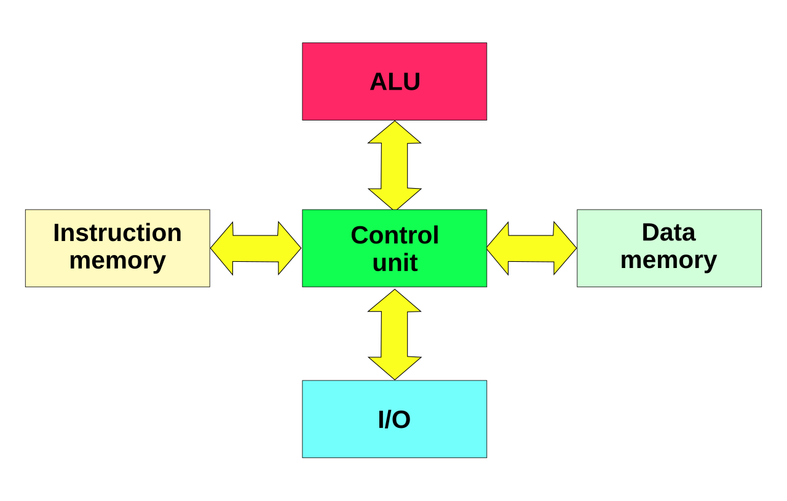
Harvard Architecture
Named for Harvard Mark 1 (1944)
Difference is two buses from memory to CPU
  Instructions
  Data
  Mark 1 could read in instructions and data from punch cards simultaneously（从穿孔卡片）
Advantages
  CPU receives instruction and data concurrently（同时）
Disadvantages
  Programs cannot be stored in same memory as data

Slide 39


HACK: Single cycle, two-memory machine
Instruction Memory
CPU
Data Memory
program
data
instruc-
tion
D register
write
Hello, world
A register
ALU
read
address
address
PC
Single cycle： 单周期
所有Hack指令，都严格在1个时钟周期内完成从取指、译码、ALU运算、结果写回的全部操作，不需要拆分到多个周期
Two memory：双内存/指令-数据分离存储（并非冯诺曼体系的单一内存架构: 数据和指令在同一内存中）
Instruction Memory, IM：只读ROM，存储整个程序的二进制指令，运行时仅支持读取、无法修改，程序启动时一次性烧录。
Data Memory, DM： RAM，存储程序的变量、堆栈数据，还做了内存映射I/O：Hack平台的屏幕、键盘等外设的寄存器都挂在DM的地址空间里，读写对应地址等同于操作外设。
HACK机器采用的是Harvard Architecture（哈佛架构）

Slide 40
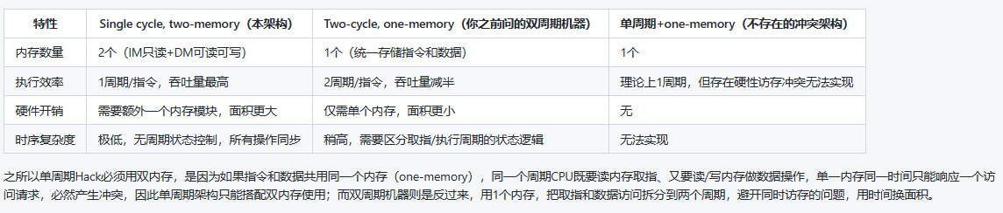
HACK: Single cycle, two-memory machine

Slide 41
Your turn: A simple program
c ← a +b
Instructions in program for HACK architecture:

Slide 42
Your turn: A simple program
c ← a +b
Instructions in program for HACK architecture:
  Load value in a into D register
  Load value in b into A register
  D ← D + A
  Store D in address c

Slide 43
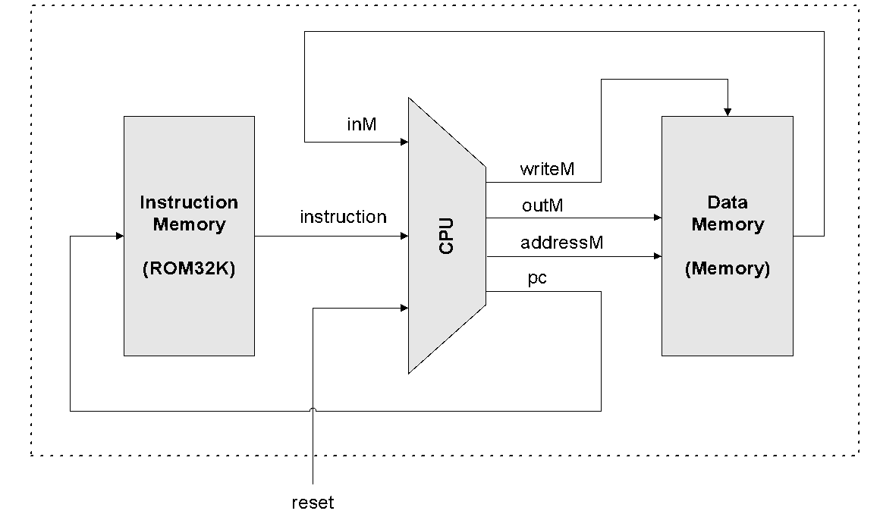
Proposed Computer Architecture（拟议的计算机体系结构）
当用户输入reset置1时,CPU 的输出pc发出0,使指令存储器(ROM32K)输出程序中的第一条指令。
CPU将执行该指令,这个执行过程可能包括读取或写入数据存储寄存器。
在该指令的执行过程中,CPU会 确定下一条要提取的指令,并通过其输出pc发出该地址。
CPU的输出pc送到指令存储 器的输入address,后者会输出下一条应该执行的指令
这个输出又会送到CPU的输入 instruction,从而完成本次取指-执行周期。
Hack平台由一个CPU、两个单独的存储器模块(分别用作指令存 储器和数据存器)组成。
Hack计算机执行存储在指令存储器中的程序。在Hack平台的物理实现中:
指令存储 器可以用只读存储器(ROM)芯片实现,ROM芯片可以预先加载好所需的程序。

Slide 44
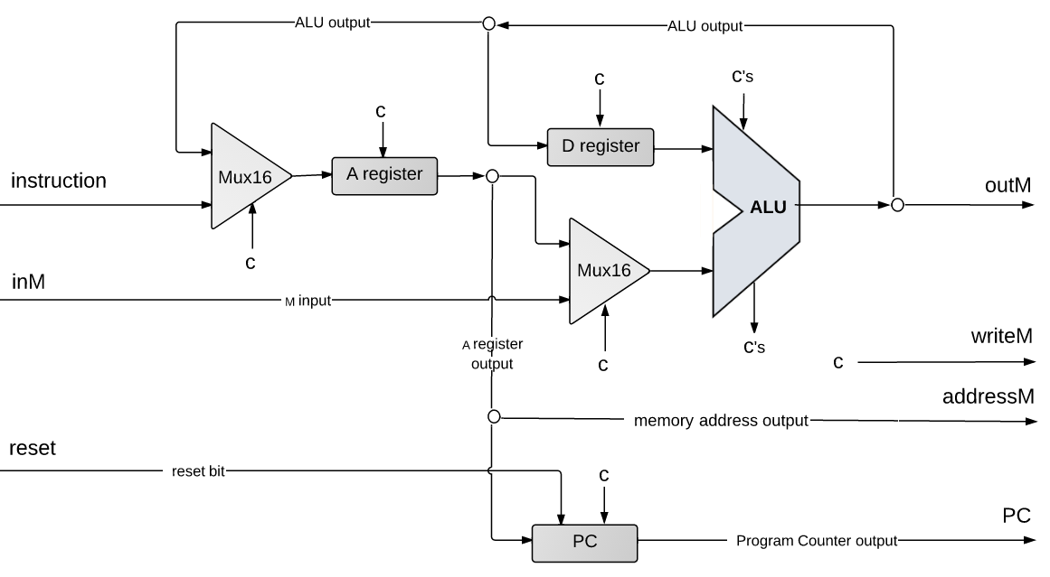
CPU implementation
计算机要素：P67
  Load value in a into D register
  Load value in b into A register
  D ← D + A
  Store D in address c
In the diagram, “c“ denotes “control bit”;
The control bits come from the instruction;
They tell the various chip-parts what to do.
pc
Notes:
It’s a very lean ALU, consisting of 2 registers, named D and A, a program counter, an ALU, and few more trivial gates.

Slide 45
S1.W6.L1: PART II Instruction set architectures
计算机组成与体系结构 P238

Slide 46
Instruction set architecture
“Instruction Set Architecture (ISA) is the structure of a computer that a machine language programmer (or a compiler) must understand to write a correct (timing independent) program for that machine.”
IBM, Introducing the IBM 360 (1964)

Slide 47
The ISA defines
Operations that the CPU can execute
Data transfer mechanism + how to access data
Control mechanism (branch, jump etc.)
"Contract” between programmer/compiler and hardware

Slide 48
Elements of an instruction
Operation code (Opcode)
  Do this
Source operand reference
  From this
Result operand reference
  Put the answer here
Next instruction reference（jmp addr这样的指令）
  When you have done that, do this…
4 bits
6 bits
6 bits
Opcode | Operand Reference | Operand Reference
16 bits

Slide 49
An early ISA: EDSAC (1949)
Opcode (5 bits)
Operand (10 bits)
reserved
Operand size (1/2 word operands)
Single accumulator architecture: e.g. AC <- AC + Mem[n]
单累加器架构：用1个累加器和1个内存数进行运算，结果放回累加器
Instruction examples:
  A n: add mem[n] into AC
  T n: transfer the content of AC to mem[n]
  E n: if AC>0, branch to mem[n], else proceed serially
  I n: read the next character from paper tape, and store it in mem[n]
  Z: halt the machine and ring the warning bell.
Slides adapted from James C. Hoe @ CMU

Slide 50
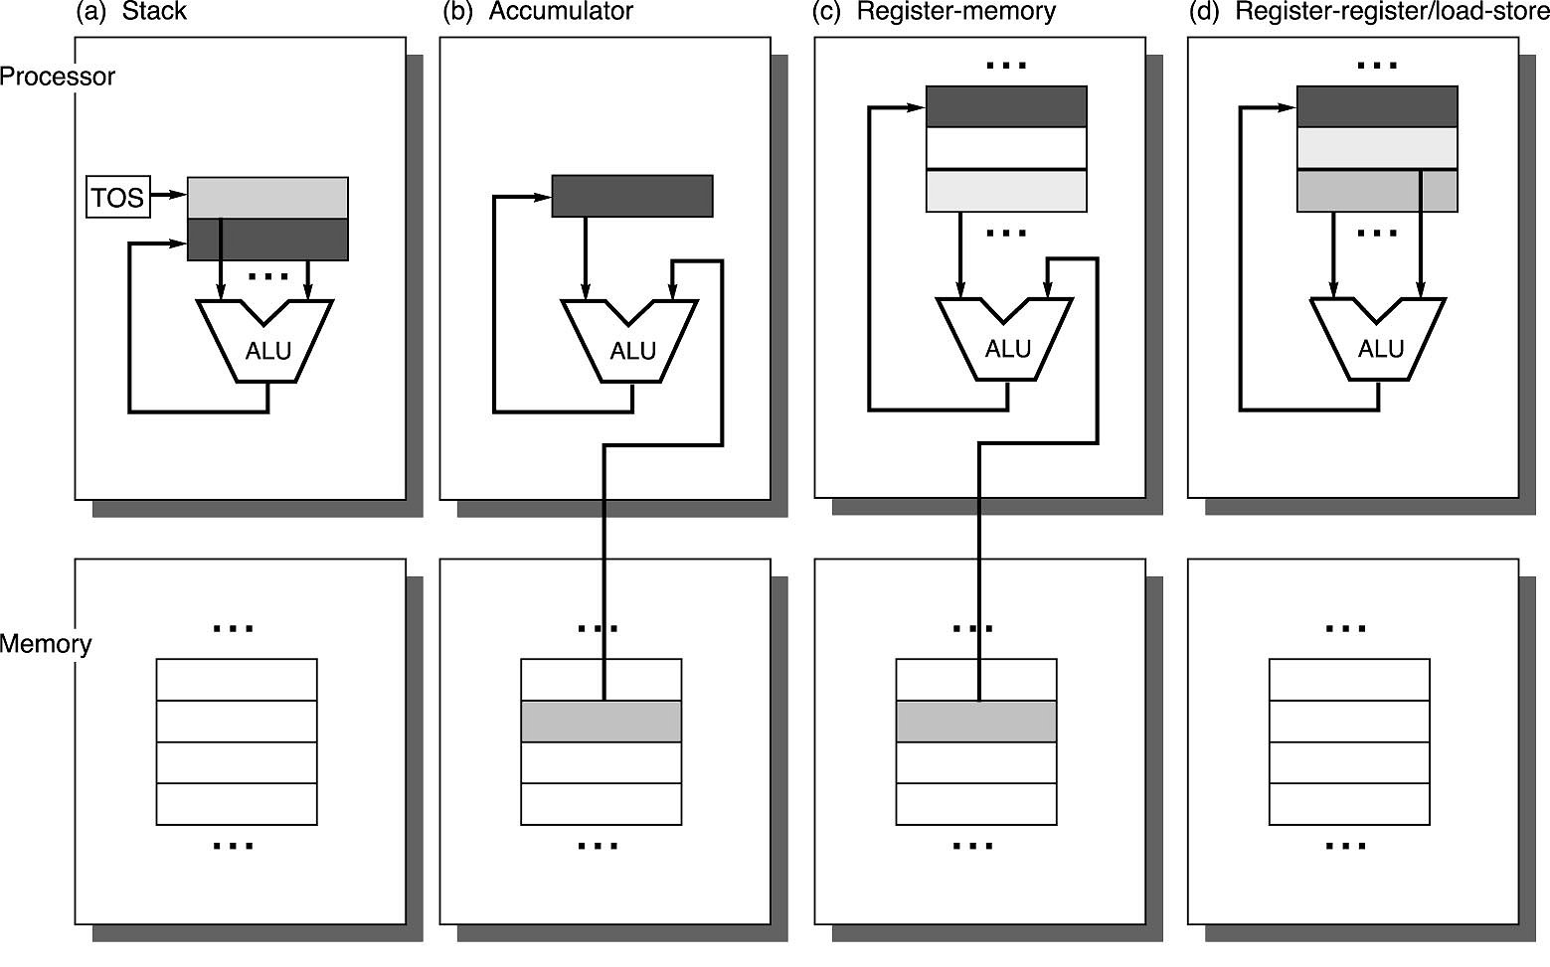
Classifying ISAs: how ALU operates on data（逻辑运算单元如何操作 数据）
a：Stack:
stack = acc + stack[top]
b: Accumulator:
acc = acc + mem[n]
c: Register - memory
r1 = r1 + mem[n]
d: Register – Register
r3 = r1 + r2

Slide 51
Stack architecture(堆栈架构)
Instruction set:
add, sub, mult, div, . . .
  push, pop
Example C = A+B
PUSH A
PUSH B
ADD
POP C
x86 floating point operations use stacks
Java virtual machine uses stacks
Time
Stack
A
B
A+B
A
Stack architecture中的ALU运算，没有acc和memory的事，operand（操作数）是用stack来实现的。
比如实现C = A+B：
将 A,B顺序 push堆栈（此时栈顶为B，其下为A。 Stack：后进先出）
在栈顶实现add ，将结果放回栈顶（此时栈顶为A+B的result）
从栈顶pop结果到c

Slide 52
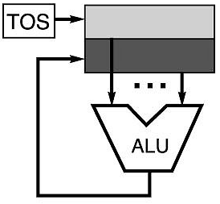
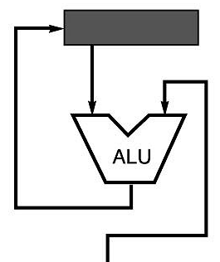
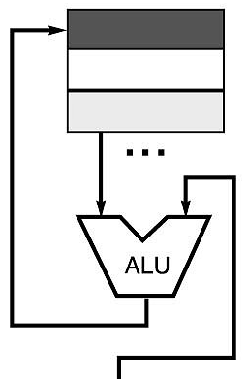
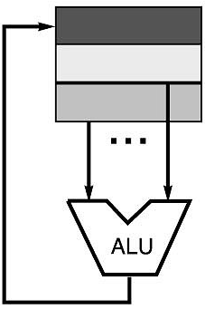
C = A+ B under different ISAs（不同指令集下的C+A+B）
Stack | Accumulator | Register (register-memory) | Register (load-store)
Push A Push B Add Pop C | Load A Add B Store C | Load R1, A Add R1, B Store C, R1 | Load R1,A Load R2, B Add R3, R1, R2 Store C, R3
memory
memory
acc = acc + mem[B]
R1 = R1 + mem[B]
R3 = R1 + R2

Slide 53
Stacks
Pros
  Compact code (紧凑代码，destination/source is always the top of the stack)
    Push and Pop operations have 1 explicit operand（1个显式操作数）
  Low hardware requirements
  Easy to write a simpler compiler for stack architectures
Cons
  Stack becomes the bottleneck
  Little ability for pipelining
  Difficult to write an optimising compiler for stack architectures

Slide 54
Modern processors use general purpose registers（通用寄存器）
GPR (General purpose registers) are faster than memory
  Register values are available immediately
  (gpr在cpu内部，取数不需要addr bus + data bus中转，速度快)
Registers are convenient for program variables（便于作为程序变量）
  Compiler assigns some variables just to registers
  （编译器仅将一些变量分配给寄存器）
  More compact code since small fields (3-8 bits) specify registers (compared to memory addresses)
  代码更紧凑，因为仅需用3~8比特的短字段即可指定寄存器（对比之下，指定内存地址需要更长的字段）

Slide 55
Disadvantages of registers
Need to save and restore during function calls
Fixed size (e.g., can’t store strings of an arbitrary length)
Compiler must manage
Limited number

Slide 56
Number of addresses
Program to execute Y = ^{A−B}
C+D×E
Instruction Comment SUB Y, A, B Y ←A – B MPY T, D, E T ←D ×E ADD T, T, C T ←T + C DIV Y, Y, T Y ←Y ÷ T
Instruction Comment
LOAD D AC ←D
MPY E AC ←AC ×E
ADD C AC ←AC + C
STOR Y Y ←AC
LOAD A AC ←A
SUB B AC ←AC – B
DIV Y AC ←AC ÷ Y
STOR Y Y ←AC
(a) Three-address instructions(指令数:4)
Instruction Comment
MOVE Y, A Y ←A
SUB Y, B MOVE T, D MPY T, E
ADD T, C
DIV Y, T
Y ←Y – B
T ←D
T ←T ×E
(c) One-address instructions (指令数:8)
T ←T + C Y ←Y ÷ T
(b) Two-address instructions (指令数:6)

Slide 57
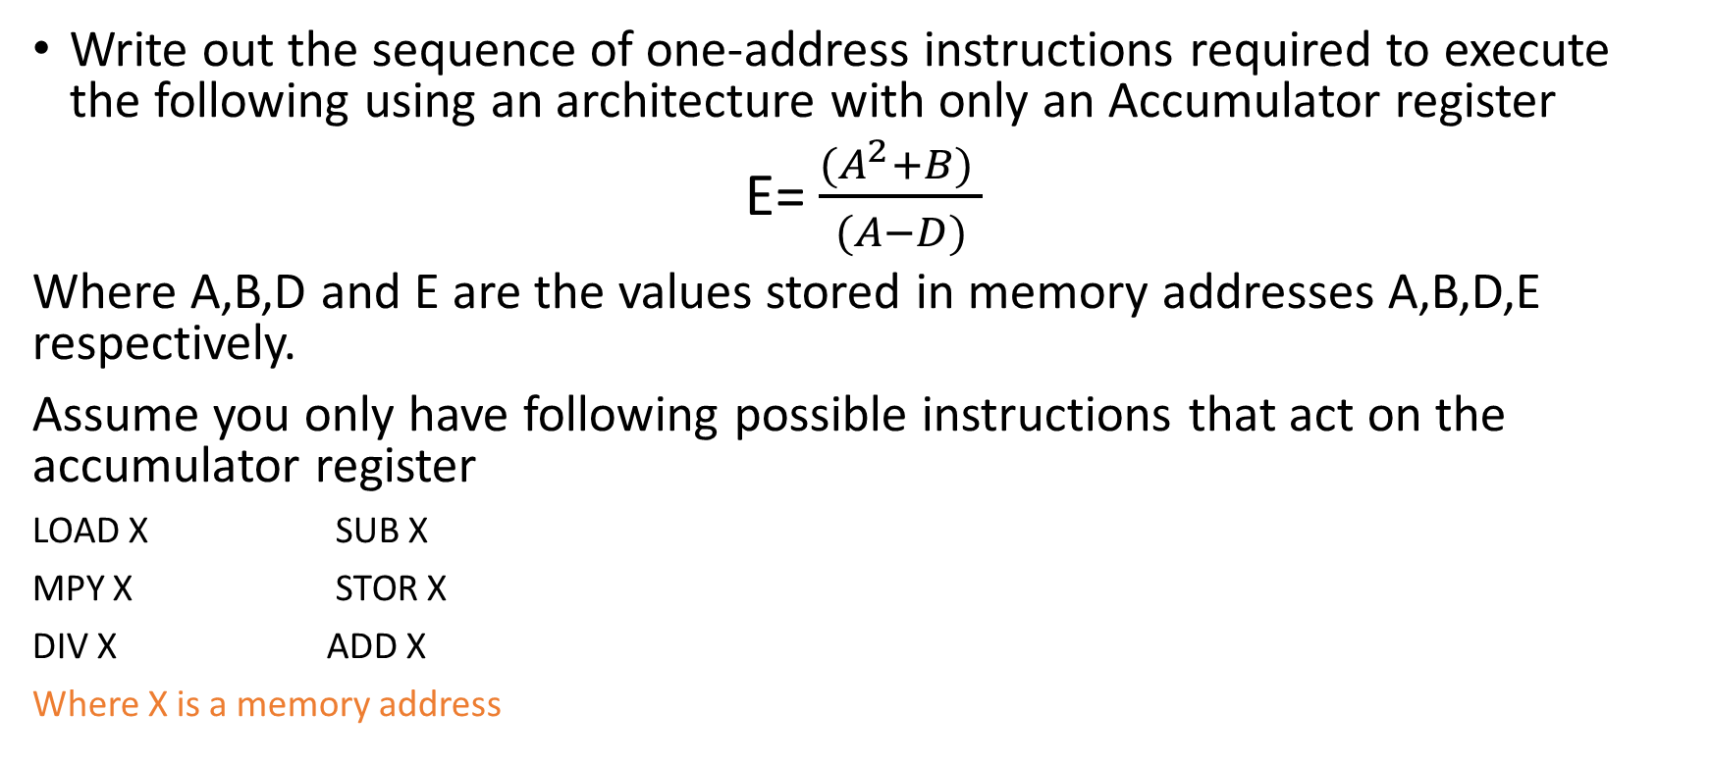
Your turn:
Write out the sequence of one-address instructions required to execute the following using an architecture with only an Accumulator register
E= $\frac{(A^{2}+B) }{(A−D)}$
Where A,B,D and E are the values stored in memory addresses A,B,D,E respectively.
Assume you only have following possible instructions that act on the accumulator register
LOAD X SUB X
MPY X STOR X
DIV X ADD X
Where X is a memory address

Slide 58
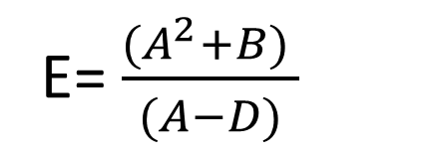
Your turn: solution
Compute the denominator first and park it in E, which is free until the end:
  LOAD A AC ← A
  SUB D AC ← A − D
  STOR E E ← A − D
  LOAD A AC ← A
  MPY A AC ← A²
  ADD B AC ← A² + B
  DIV E AC ← (A² + B) / (A − D)
  STOR E E ← AC
E= $\frac{(A^{2}+B) }{(A−D)}$

Slide 59
Your turn:
If the opcodes for these instructions are:
1 LOAD 2 STOR
3 ADD 4 SUB
5 DIV 6 MPY
7 HALT
The memory addresses of A,B,D and E are 100,101,105 and 106 in Hex respectively
and your instructions are 16-bits long and the opcodes are 4 bits
Write out the machine instructions to execute this task (in Hex)

Slide 60
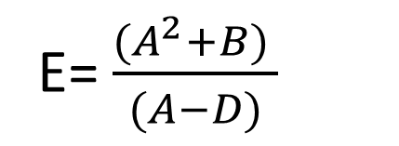
Your turn: solution
16-bit instruction = 4-bit opcode + 12-bit address, so each instruction is 4 hex digits
  1100 LOAD A
  4105 SUB D
  2106 STOR E
  1100 LOAD A
  6100 MPY A
  3101 ADD B
  5106 DIV E
  2106 STOR E
  7000 HALT
E= $\frac{(A^{2}+B) }{(A−D)}$
1 LOAD 2 STOR
3 ADD 4 SUB
5 DIV 6 MPY
7 HALT
A,B,D and E are 100,101,105 and 106 in Hex
instructions are 16-bits long and the opcodes are 4 bits

Slide 61
How many addresses?
More addresses per instruction
  More complex (powerful?) instructions
  More registers: inter-register operations are quicker
  Fewer instructions per program
  Longer instructions
Fewer addresses per instruction
  Less complex (powerful?) instructions
  Shorter instructions: faster fetch and decode
  More instructions per program
  Accumulator machines are the extreme(极端): one address

Slide 62
Sources of Operands
Number of operands
  OP in acc = acc op in e.g. EDSAC (use the AC as an implicit destination)
  OP inout, in2 out = in op in2 e.g. IBM 360
  OP out, in1, in2 out = in1 op in2 e.g. MIPS
Can ALU operands be in memory (register-memory)?
  No e.g. MIPS (only register-register)
  Yes e.g. x86 (can also be register-register)
How many different formats and addressing modes?
  A few e.g. MIPS (因为是reg-reg模式，不直接操作内存)
  A lot e.g. x86
Notes:
MIPS = Microprocessor without Interlocked Pipelined Stages

Slide 63
Memory addressing modes(内存寻址模式)
Direct(直接寻址, 数1001) Load R4, 1001
Register indirect (寄存器间接寻址, 地址R1) Load R4, (R1)
  Use the content stored at R1 as address
Memory indirect (内存间接寻址, 地址1001) Load R4, (1001)
  Use value at mem[1001] as address
Based (基址寻址, 地址20+R1) Load R4, 20(R1)
  Use 20+(R1) as address
Indexed(索引寻址, 地址R2[R3]) Load R4, (R2+R3)
Auto inc/decrement (自动增长寻址, 地址R1,R1++) Load R4, (R1)+
  use (R1) as address, and inc. or dec. R1
Notes:
Displaced: instruction operands include registers (base address register, destination register) and offset (fixed)
Indexed: instruction operands include registers (base address register, destination register, offset register (which contains the actual offset to be added to the address contained by the base register)
Auto increment/decrement: content of address register is updated automatically upon read/write (not used very often anymore, complicates pipelining and out-of-order execution)

Slide 64
Your turn
What value would be stored in R4 in each of the following cases?
Load R4, R2 Direct
Load R4, (R3) Register indirect
Load R4, 1(R3) Based
Load R4, (R2+R3) Indexed
Address | Value (hex)
R1 | 0001
R2 | 0002
R3 | 3010
1999 | 0012
2000 | 0013
2001 | 0015
2002 | 0014
3010 | 2001
3011 | 0034
3012 | 0100

Slide 65
Your turn: solution
Load R4, R2 register: R4 = 0002
Load R4, (R3) register indirect: R4 = M[3010] = 2001
Load R4, 1(R3) displaced: R4 = M[3010 + 1] = M[3011] = 0034
Load R4, (R2+R3) indexed: R4 = M[0002 + 3010] = M[3012] = 0100
Note: 2001 is the value at 3010 – the answer for (R3), not an address to follow again (that would be memory indirect)

Slide 66
What makes a good/bad ISA
Ease of Implementation (for Architect/Designer)
  Can it lead to simple hardware implementation
Ease of Programming (for Programmer/Compiler)
  Can the compiler use the ISA effectively?
Future Compatibility
  ISAs may last 30+ years
  Special Features, Address range, etc. need to be thought out

Slide 67
RISC: reduced instruction set computer
Simple operations
  2-input, 1-ouput
  few alternatives for accomplishing the same thing
Simple data movements
  ALU ops are register to register; only load/store instructions access memory – needs more registers
  Few addressing modes (typically register + displacement for loads/stores)
Simple instruction encoding
  All instructions encoded in the same number of bits
Examples:
  MIPS, ARM, RISC-V

Slide 68
X86: complex instruction set computer (CISC)
Variable length ISA (1-16 bytes)
ALU ops can be register-register and register-memory
Multiple memory accessing modes
Has been extended many times
  E.g., x86-64 (released in 2000)

Slide 69
Design trade-offs（设计约定）
Can decode CISC instructions into internal “micro-ISA” (in RISC)
  可以将CISC指令解码为内部“微ISA”
  This takes a couple of extra cycles and a few hundred thousand transistors
  这需要几个额外的周期和几十万个晶体管
  External ISA for compatibility, internal ISA can be tweaked each generation
  外部ISA用于兼容性，内部ISA可以在每一代中进行调整
Energy efficiency can be significantly different
能源效率可能存在显著差异

Slide 70
Where does Hack fit?（Hack计算机适合哪些）
Fixed-length instructions: every instruction is 16 bits
Harvard: separate instruction memory and data memory
Two registers: D (data) and A (address or data)
Register–memory: ALU operands are D and either A or the memory word M[A]
One addressing mode: the memory address is always the value in A (register indirect)
Two instruction formats: one loads a constant into A; the other computes, stores and/or jumps
Hack's assembly language is covered next semester; next lecture we build the ALU that executes the computations

Slide 71
Summary
Reviewed the components of a computer and the role of each register
Followed the fetch–execute cycle and traced programs on a simple accumulator machine (MARIE)
Compared von Neumann and Harvard architectures; introduced our Hack computer
Defined an ISA; compared stack, accumulator and register architectures
Number of addresses, addressing modes, RISC vs CISC
Next: building the adders and the ALU

