Slide 1
COMP1850 Programming
Week 6 Session 1
Class Collaboration & Inheritance

Slide 2
Recap
Last time, we
Considered how type hinting and type checking can be used to document classes better and make them more robust
Looked at how we can write setter methods that validate attempts to modify the value of a field (though we cannot enforce use)
Explored the use of dunder methods to customize the ways in which object behave in particular situations (e.g., printing, or use with operators such as +, in, [], etc)

Slide 3
Today’s Aims
Understand the distinction between equality of identity and equality of state, and see how we can test for the latter in classes
Explore further the idea of classes that collaborate to solve a problem
Investigate the concept of inheritance, and how we can build new classes from existing classes using this concept

Slide 4

Reminder: Point Class
class Point:
"""
A point in 2D space. """
def init (self, x, y): """
Creates a Point, given x & y coordinates. """
self.x = x
self.y = y
...
What happens when we try
to test Point objects for equality?

Slide 5
Task 1
week1.6/session1/task1/
cd to this directory in the terminal window
Run the Python interpreter by entering python
Enter these commands at the >>> prompt:
from point import Point
p = Point(1, 2)
q = Point(1, 2) p == q
Press Ctrl+D to exit the interpreter

Slide 6
What’s Going On?
The objects referenced by variables p and q are in the same state, but they have different identities
变量p和q引用的对象处于相同的状态，但它们具有不同的标识
The default behaviour of == for instances of user-defined classes is to test for equality of identity – i.e., whether the two variables are referencing the same object
对于用户定义类的实例，==默认行为是测试标识（ identity ）的相等性， 即两个变量是否引用同一个对象
Normally, what we want is for == to test for equality of state – i.e., whether the fields of the objects have the same values
通常，我们想要的是for==来测试状态的相等性，即对象的字段是否具有相同的值
We achieve this by overriding dunder method eq ()
我们通过重写dunder方法__eq__()来实现这一点 (dunder方法就是形如 __xx__()的方法，它只能被系统调用）

Slide 7

Overriding eq () （重写__eq__()方法）
class Point:
...
def eq (self, other): """
Tests whether this Point has the same coordinates as another.
"""
if not isinstance(other, Point): return False
return self.x == other.x and self.y == other.y
Note: we assume here that x and y coordinates have integer values

Slide 8

Task 2
week1.6/session1/task2/
cd to this directory in the terminal window
Run the Python interpreter by entering python
Enter these commands at the >>> prompt:
from point import Point
p = Point(1, 2)
q = Point(1, 2) p == q
4. Press Ctrl+D to exit the interpreter
This new version of Point
overrides eq ()
p == q should now be True

Slide 9
Class Relationships(类关系)
OO software is composed of multiple classes 面向对象软件由多个类组成
Those classes can relate to each other in different ways 这些类可以以不同的方式相互关联
One very strong type of relationship has one class acting as a parent to others, providing them with code they can use
一种非常强的关系类型是：一个类充当其他类的父类（parent class），为它们提供可以使用的代码
Another type of relationship has one class providing a component part that another can use 另一种类型的关系有一个类提供另一个可以使用的组成部分
Looser associations are also possible 松散的关联也是可能的
We will consider examples of all of these today...

Slide 10
Inheritance（继承：强关系，父子关系）
In OO languages, we can create new classes by extending the features and functionality of existing classes 在面向对象语言中，我们可以通过扩展现有类的特性和功能来创建新类
The class we are extending is known as the superclass and the new class is known as the subclass
我们扩展的类称为超类(父)，新类称为子类(子)
  The terms base class & derived class are sometimes used 有时会使用基类(父)和派生类(子)这两个术语
A subclass inherits the attributes and behaviour of its superclass, and adds its own attributes and behaviour 子类继承了其超类(父)的属性和行为，并添加了自己的属性和行为
A subclass can also replace behaviour inherited from the superclass
子类也可以替换从超类(父)继承的行为

Slide 11
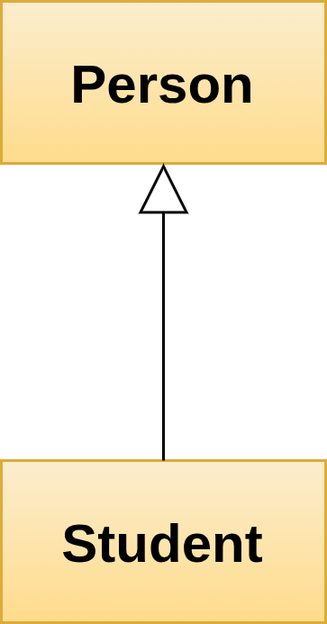
‘Is a Kind Of’ (是一种: 子 is a kind of 父)
SuperClass/ Base Class
When a subclass inherits from a superclass, this models the relationship ‘is a kind of’ between the corresponding real-world classes
当一个子类从超类继承时，这会模拟相应现实世界类之间的关系“是一种”
Example: a Student is a kind of Person; students have the same attributes and behaviour as people, but they add new things:
例如：学生是一种人；学生具有与人相同的属性和行为，但他们添加了新的东西
  New attributes such as university, degree programme, duration of degree, etc
  大学、学位等新属性
  New behaviour such as attend lecture, submit coursework, sit exam, etc
参加讲座、课程作业、笔试等新行为
SubClass/ Derived class

Slide 12
How Does This Work in Python?
When defining a subclass, its name should be followed by () containing the name of the superclass
class Child(Parent): 定义子类时，其名称后面应加上包含超类名称的括号
Subclass constructor should invoke the superclass constructor, to ensure that fields inherited from the superclass are created and initialized correctly:
子类constructor应调用超类constructor ，以确保从超类继承的字段被正确创建和初始化
super(). init (arg1, arg2)
super() allows us to reference the superclass without naming it
In this example, the superclass constructor expects to be supplied with two arguments

Slide 13

Example
class Die:
def init (self, sides): self.sides = sides self.value = 1
def roll(self):
self.value = random.randint(1, self.sides) return self.value
class D6(Die):
See week1.6/examples
for the full code
定义子类时，其名称后面应加上包含超类名称的括号
def init (self):
super(). init (6)
子类constructor应调用超类constructor

Slide 14
Task 3
week1.6/session1/task3/
Study the provided Point & Shape classes
Create a Circle class that inherits properly from Shape
Write a demo program for Circle
See README.md for full details of what is required

Slide 15
Composition & Association（组成与关联）
One class can act as a ‘building block’ for another without there being an inheritance relationship
一个类可以充当另一个类的“构建块”，而不存在继承关系
You’ve seen an example of this already: the Circle class uses the Point class to represent the centre coordinates of a circle, but it doesn't inherit from the Point class
您已经看到了一个例子：Circle类使用Point类来表示圆的中心坐标，但它并没有继承Point类
This is another form of software reuse, sometimes described as ‘reuse through composition’
这是另一种形式的软件重用（reuse），有时被描述为“通过组合(composition)重用”，即A中包含B
class Circle:
center = Point (0,0)
Note that we don’t always think of classes as components of other classes; sometimes the collaboration is looser than that
请注意，我们并不总是将类视为其他类的组成部分；有时合作(collaboration)比这更松散

Slide 16
Relationship： Inheritance VS Composition
Inheritance（继承：总类/细分类关系） Composition（组成：包含/被包含关系）
class Person: # Base Class
name: string
age: int
def __init__(self,Name,Age):
self.name = Name
self.age = Age
class Student(Person): # Derived class
university: string
def __init__(self,Uni,Name,Age):
super().__init__(Name,Age)
self.university = Uni
class Point: # Normal Class
x: float
y: float
def __init__(self,X,Y):
self.x = X
self.y = Y
class Circle: # Normal class
radius: float
centre: Point # 在内部Compose了另一个类Point
def __init__(self,R,Centre):
super().__init__(Centre.x,Centre.y)
self.radius = R
继承可看做总类和细分类的关系，比如：
父类/总类 子类/细分类
电脑 笔记本、台式机、平板
图形 矩形、圆、多边形、椭圆
食品 中式食品、西式食品
组成可看做包含关系，比如：
包含类 被包含类
商品 质保卡、说明书、包装
文具盒 笔、橡皮、尺
成绩单 语文成绩、数学成绩、英语成绩

Slide 17
An Extended Example
The scenario:
The United States Geological Survey operates an Earthquake Hazards Program in which it collates and publishes seismometer data to the web as various data feeds
美国地质调查局实施了一项地震灾害计划，它整理地震仪数据并将其作为各种数据来源馈送发布到网络上
Feeds are available in different formats, including CSV 数据来源有不同的格式，包括CSV
Feeds cover different time periods (past hour, day, week, month) 数据来源覆盖不同的时间周期
Feeds have different significance levels (e.g., ‘all’, ‘magnitude 4.5 or above’, ‘significant events only’) 数据来源具有不同的等级（例如，“全部”、“4.5级或以上”、“仅重大事件”）

Slide 18
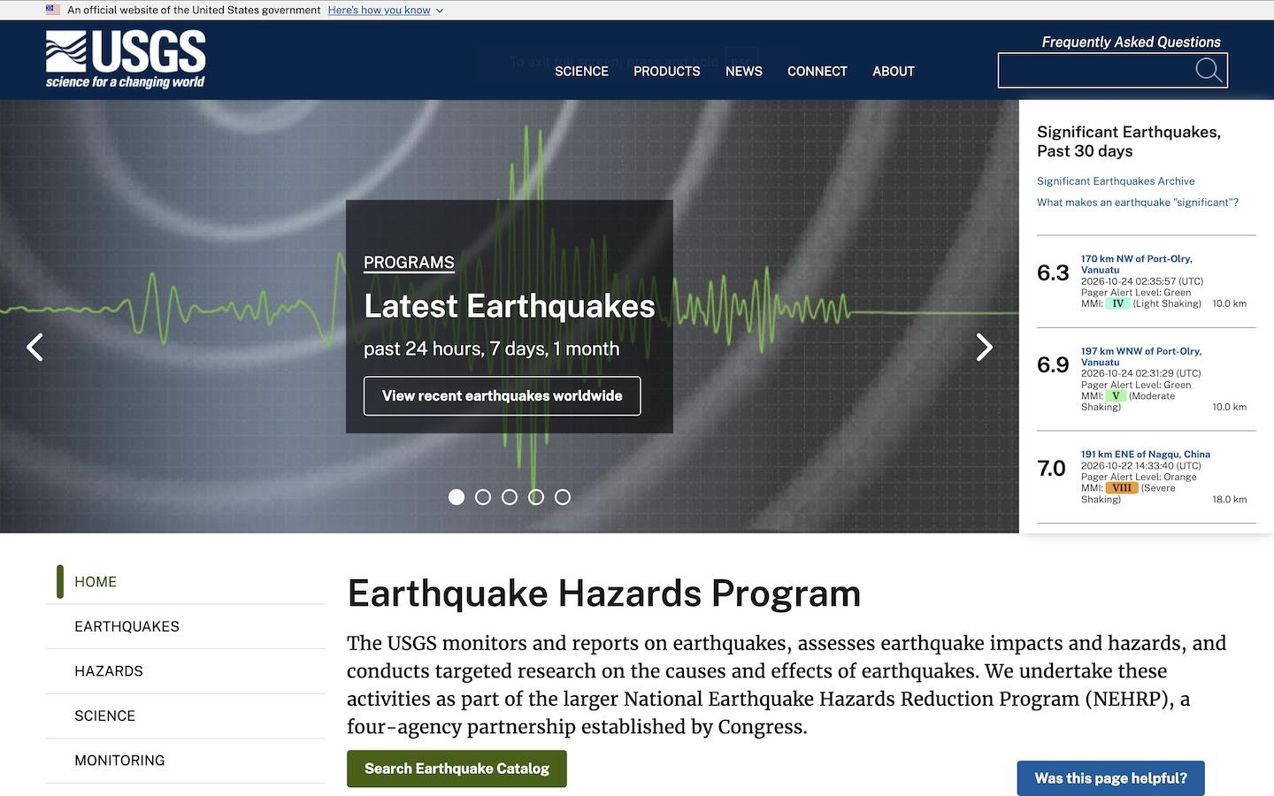

Slide 19
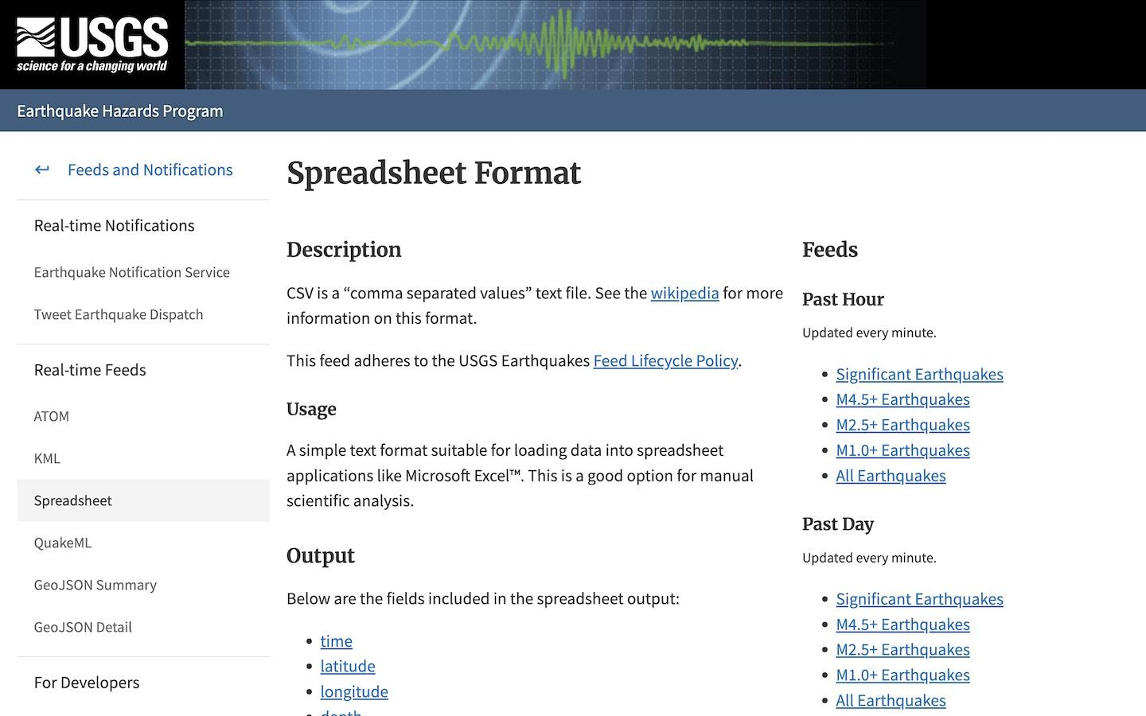

Slide 20
Our Goal
We want some software that can download data from a user-specified earthquake data feed and analyze it in different ways
我们希望软件可以从用户指定的地震数据源下载数据，并以不同的方式进行分析
We want to follow an object-oriented approach 我们希望遵循面向对象的方法
What classes do we need? What responsibilities will these classes have? How will they collaborate to achieve the goal?
我们需要什么class？这些class将承担哪些职责？他们将如何合作以实现目标？
We will need multiple classes here; the Single Responsibility Principle applies in OOP as well as procedural programming...
我们这里需要多个class；单一职责原则不仅适用于面向对象编程，也适用于过程式编程..

Slide 21
A Possible Approach（一个可能的方法）
Quake（地震类）
Responsibilities: represent relevant details of a single earthquake
职责：展示单次地震的相关细节
QuakeFeed（地震来源类）
Responsibilities: represent the chosen feed and provide access to its data
职责：代表所选数据来源，并提供对其数据的访问
QuakeDataset（地震数据集类）
Responsibilities: store downloaded data and facilitate analysis of it
职责：存储下载的数据并便于分析
Collaborations: uses a QuakeFeed object to represent a feed and access its data; uses Quake objects to represent the details of individual earthquakes
协作：使用QuakeFeed对象表示提要并访问其数据；使用Quake对象来表示单个地震的细节

Slide 22
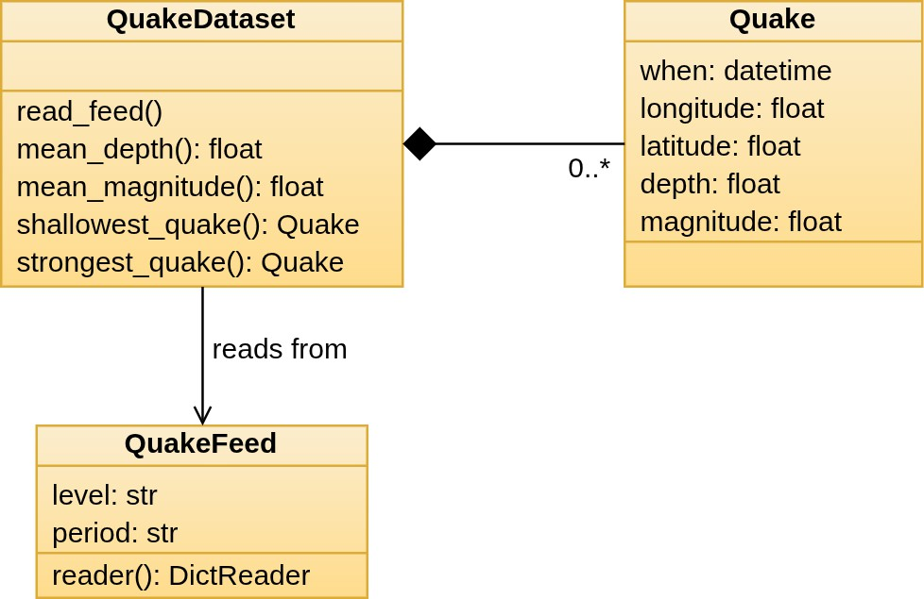
Graphical Representation
职责：存储下载的数据并便于分析
职责：展示单次地震的相关细节
地震数据集QuakeDataset从数据来源QuakeFeed中读取数据。
数据来源QuakeFeed返回自己拥有的地震数据
地震数据集QuakeDataset将QuakeFeed返回的地震数据，创建成Quake对象，放入list中保存
This is a UML class diagram
We will discuss these i more detail next year...
职责：代表所选数据来源，并提供对其数据的访问

Slide 23

Quake as a Data Class
When classes are needed primarily as a way of bundling related items of data together, Python, like many OO languages, provides more concise syntax for defining them:
当类主要是作为将相关数据项捆绑在一起的一种方式时，Python和许多面向对象语言一样，提供了更简洁的语法来定义它们
from dataclasses import dataclass
from datetime import datetime
@dataclass
@dataclass Decorator(装饰器)
class Quake:
when: datetime longitude: float latitude: float depth: float magnitude: float
Note use of @dataclass decorator, and how the fields are specified with names & types
A constructor is created for us!

Slide 24
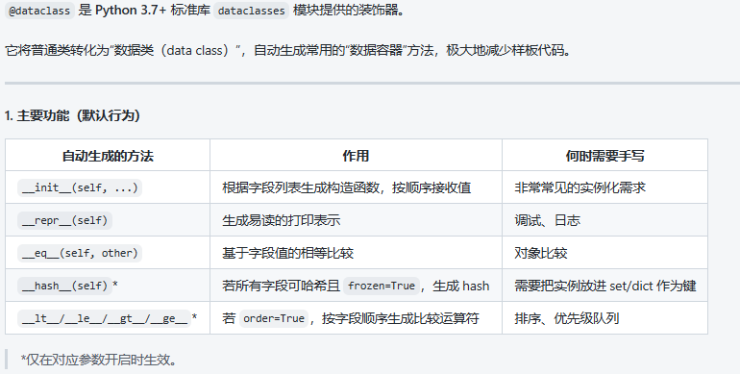
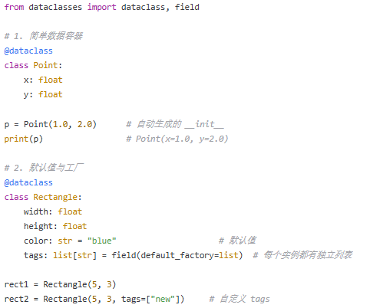
@dataclass 装饰
在class前面写上@dataclass，python将自动创建一些常用的
类方法，如上图。避免手工写方法的繁琐

Slide 25
QuakeFeed
Stop working on the tasks and pay attention!
We will walk you through the implementation of QuakeFeed
If you have any questions, please ask...

Slide 26
Task 4
week1.6/session1/task4/
Experiment with the Quake & QuakeFeed classes
See README.md for full details of what to do

Slide 27
QuakeDataset
Stop working on the tasks and pay attention!
We will discuss some of the features of QuakeDataset
If you have any questions, please ask...

Slide 28
Task 5
week1.6/session1/task5/
Complete the implementation of QuakeDataset
Write a program that uses the classes, in quakeinfo.py
See README.md and comments in the files for full instructions

Slide 29
Reflection
Could we design this differently? (Does QuakeDataset have too many reponsibilities? Could we have chosen different classes?)
我们有不同的设计吗？（QuakeDataset是否有太多的责任？我们可以选择不同的类吗？）
What would a solution look like if we adopted a procedural approach instead of an OO approach?
如果我们采用过程方法而不是面向对象方法，解决方案会是什么样子？
What would a solution look like without user-defined classes or functions? How easy to understand would it be? What would we lose by implementing it in this way?
如果没有用户定义的类或函数，解决方案会是什么样子？它有多容易理解？以这种方式实施它，我们会失去什么？

Slide 30
Summary
We have
Distinguished between equality of identity and equality of state, and seen how to test for the latter in user-defined classes
区分标识相等和状态相等，并了解如何在用户定义的类中测试后者
Discussed how we can create classes in Python that inherit from existing classes, adding new fields & methods or replacing methods
讨论了如何在Python中创建从现有类继承的类，添加新的字段和方法或替换方法
Worked through a practical example of how an OO approach involves creating classes that collaborate to solve a problem
通过一个实例，说明OO方法如何创建协作解决问题的类

Slide 31
Learning More
How to Think Like a Computer Scientist
Section 18.3: Sameness of Objects
Chapter 19: Inheritance

