Slide 1
COMP1850 Programming
Week 6 Session 2
Image Processing Case Study

Slide 2
Recap
Last time, we
Explored the difference between equality of identity and equality of state, and saw how we can test for the latter in our own classes by overriding eq ()
Saw how classes can extend others through inheritance
Considered the idea that classes collaborate to solve problems, illustrating this by developing object-oriented software for earthquake data analysis

Slide 3
Today’s Aims
To revisit an example from previous weeks: reading images from PGM files, processing the images, writing the results to files
To see how we might apply an object-oriented approach to this scenario, by creating an Image class
To consider some of the design decisions involved in this process
To cover the broader issue of how we write well-structured and well- documented code

Slide 4
Approach
We will spend ~30 mins discussing the issues and explaining some of the code; pay close attention here!
The remainder of the session is open-ended, with several options for things you can develop, building on the code we provide

Slide 5
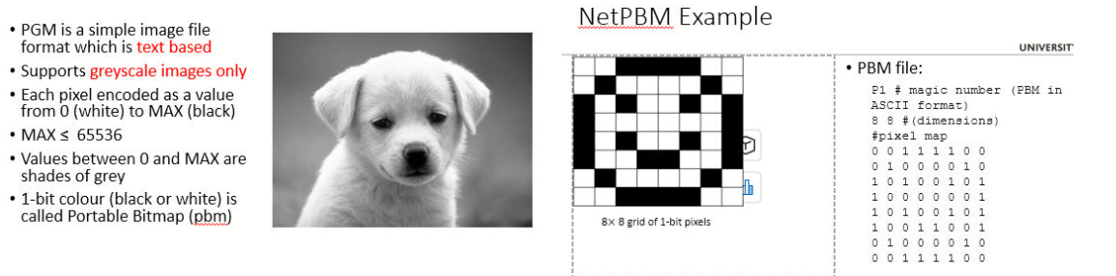
PBM File Format

Slide 6
Design Decision 1
Support creation of ‘blank slate’ images and creation of images that are loaded from PGM files:
支持创建“白板”图像和创建从PGM文件加载的图像：
class Image:
...
# method：create a blank slate image
def create_pixels(self, width, height, value=0, maximum=255):
...
# method: load PGM file
def read_pgm(self, filename):
...

Slide 7
Design Decision 2
How do we store pixel data?
Linear list? [0, 0, 0, 0, 0, 0,...] 1维数组？
List of lists? [[0, 0, 0,...], [0, 0, 0,...],...] 2维数组？
(With the ‘list of lists’ approach, the inner lists are individual rows of pixels, the outer list stores those rows in sequence)
使用“2维数组”方法，内部列表是单独的像素行，外部列表按从上到下的顺序存储这些行
Each approach has advantages and disadvantages...

Slide 8
Comparison of Options
Linear List （一维数组）
Easier to create
Pixels can be accessed by a single index – convenient for operations where pixel coordinates are irrelevant
像素可通过索引访问，便于像素坐标无关的操作
Code to access a pixel via its 2D coordinates is more complex
通过坐标(row,col)访问像素的代码更复杂,需转换为index
List of Lists（二维数组）
More complex to create
Always need nested for loops to iterate over all pixels
始终需要嵌套for循环来迭代所有像素
Code to access the pixel via 2D coordinates is simple
通过坐标(row,col)访问像素的代码很简单复杂,无需转换

Slide 9
API vs Implementation
Key point: the interface presented to class users can be the same, irrespective of how we choose to store pixel data
关键点：无论选择如何存储像素数据，呈现给类用户的interface（接口）都是相同的，这就是encapsulation(封装)
encapsulation(封装)隐藏了物理实现细节，暴露在外的是一个易于调用的interfae。内部实现改动不影响调用者
# pixel values stored as a list of lists
def get(self, row, col):
return self.pixels[row][col] # 二维数组实现返回pixel
# pixel values stored as a linear list
def get(self, row, col):
# 二维数实现返回pixel，需要将(row,col)转换为index
index = row * self.width + col return self.pixels[index]

Slide 10
create_pixels()
# create a blank slate image（创建空的白板图像）
def create_pixels(self, width, height, value=0, maximum=255):
...
if width < 1:
raise ImageError("width cannot be < 1")
if height < 1:
raise ImageError("height cannot be < 1")
#保存image的格式信息
self.width = width self.height = height self.max_value = maximum
#创建保存image data的1维数组
self.pixels =
[value] * (width * height)

Slide 11
Reminder: PGM Images
One of a family of image file formats, not widely used these days, but simple enough that we can work easily with it
PGM = ‘Portable Grey Map’ 可移植灰度图
Two versions: one where all of the file is text, which we focus
on; another where the header is text but the pixel data are stored in raw binary form
2版本：1个是所有内容都是文本，这是我们关注的；另1种是标题是文本，但像素数据以原始二进制形式存储
Related formats are PBM (Portable Bit Map) where pixels are 0 or 1, and PPM, where each pixel has a 3 colour components
相关格式是PBM（便携式位图），其中像素为0或1，以及PPM，其中每个像素有3个颜色分量

Slide 12
PGM Example
Magic number,
identifying file type
P2 #文件类型
# Comment line
5 5
16 #pixel的最大值+1，因为从0开始
Image width & height
Max pixel value
0 1 2 3 4
1 2 3 4 5
2 3 4 5 6
3 4 5 6 7
4 5 6 7 8
Pixel values # 图片数据

Slide 13

Design Decision 3
Follow a structured approach to reading PGM files
遵循结构化方法读取PGM文件
Subdivide task into reading of header, then reading of pixel data
将任务细分为读取标题，然后读取像素数据
Reading of header can be further subdivided into 标题的读取可以进一步细分为
  Parse and check magic number (must be P2)
  Parse image dimensions 分析图像高宽
  Parse max value
Can follow a similar approach when writing files...

Slide 14

read_pgm()
def read_pgm(self, filename):
...
with open(filename) as imgfile: self. parse_magic_number(imgfile) self. parse_dimensions(imgfile) self. parse_max_value(imgfile) self. parse_pixels(imgfile)
_
_
_
_
Note use of underscore as a prefix
This hides the methods from Python's help() function & IDEs
类方法前带_，会被VS Code隐藏不显示，是private method，之所以要隐藏是因为这些method是内部细节，不应该被外部调用
Examine the implementation in image.py for more details

Slide 15
Design Decision 4
Hard to write a constructor that caters neatly for these two very different ways of creating an image
很难编写一个构造函数来巧妙地满足这两种截然不同的图像创建方式
Users could simply invoke default constructor and then call either
create_pixels() or read_pgm() on that empty object:
用户可以简单地调用默认构造函数，然后对该空对象调用create_pixels（）或read_pgm（）
img = Image()
img.read_pgm("scene.pgm")
As a convenience, we can wrap these steps up as a class method
为了方便起见，我们可以将这些步骤打包为一个类方法（就是java的static method）

Slide 16
Class Methods
class Image:
...
#相当于java的static method
@classmethod
def create(cls, width, height, value=0, maximum=255):
image = Image()
image.create_pixels(width, height, value, maximum) return image
#调用calssmethod要用class，而不是class instance。
image = Image.create(100, 100)
Note use of class name here!

Slide 17
Over To You...
week1.6/session2/projects contains various subdirectories, each containing a possible project
README.md in each project subdirectory gives full details of what the project is about
Examine these, then pick one or two projects to work on for the remainder of this session
检查这些，然后选择一两个项目在本课程的剩余时间里继续工作
  Tip: lookup_tables, filtering and pixel_rep are probably the easiest ones to tackle
  提示：lookup_tables、filtering和pixel_rep可能是最容易处理的

Slide 18
End of Session
Remember:
git add to stage your changes
git commit –m followed by a commit message in quotes, to commit your changes to your Codespace or local repository
git push to send your commits back to github.com

