Slide 1
COMP1860 Computer Systems and Architecture
S1.W7.L1: Adders and the ALU
Leandro Soares Indrusiak

Slide 2
Last time
The fetch–execute cycle; tracing programs on a simple accumulator machine (MARIE)
Von Neumann vs Harvard; our Hack computer
Instruction set architectures: stack, accumulator, register; addressing modes; RISC vs CISC
Today: the arithmetic hardware that executes those instructions

Slide 3
Objectives
Build adders from logic gates: half adder, full adder, 16-bit ripple-carry adder
Explain why ripple-carry adders are slow, and how carry-lookahead speeds them up
Subtract in two's complement, and detect overflow
Understand the requirements of the ALU, and design a simple ALU for our Hack computer
Implement the chips required for the ALU in HDL

Slide 4
S1.W6.L2: PART I Arithmetic in gates

Slide 5
Binary addition (Recap)
x_{n} | y_{n} | Z_{n} carry to z_{n+1}
0 | 0 | 0 carry 0
0 | 1 | 1 carry 0
1 | 0 | 1 carry 0
1 | 1 | 0 carry 1

Slide 6
Binary addition example
x_{n} | y_{n} | Z_{n} carry to z_{n+1}
0 | 0 | 0 carry 0
0 | 1 | 1 carry 0
1 | 0 | 1 carry 0
1 | 1 | 0 carry 1
 | 2⁴ | 2³ | 2² | 2¹ | 2⁰
x | 0 | 0 | 1 | 1 | 1
y | 1 | 0 | 1 | 1 | 0
x+y
Carry

Slide 7
x + y 低位进位 x+y的和 x+y的进位
Adders in logic
x | y | carry in | sum | carry
0 | 0 | 0 | 0 | 0
0 | 1 | 0 | 1 | 0
1 | 0 | 0 | 1 | 0
1 | 1 | 0 | 0 | 1
0 | 0 | 1 | 1 | 0
0 | 1 | 1 | 0 | 1
1 | 0 | 1 | 0 | 1
1 | 1 | 1 | 1 | 1
Adding two bit’s together can be represented by a truth table
Adding two bit’s together can be computed by logic gates

Slide 8
Half-adder（半加器：不考虑低位进位）
Adding two bit’s together can be represented by a truth table
Adding two bit’s together can be computed by logic gates
Haslf-adder has 2 input：x and y
x | y | sum | carry
0 | 0 | 0 | 0
0 | 1 | 1 | 0
1 | 0 | 1 | 0
1 | 1 | 0 | 1

Slide 9
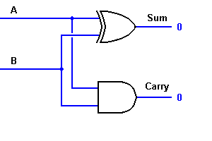
Half Adder Circuit
根据真值表 or gate and gate
a
x | y | sum | carry
0 | 0 | 0 | 0
0 | 1 | 1 | 0
1 | 0 | 1 | 0
1 | 1 | 0 | 1
sum
b
carry
HalfAdder (a= ,b= ,sum= , carry= );

Slide 10
x + y 低位进位 x+y的和 x+y的进位
Full-Adder （全加器：
考虑低位进位）
x | y | carry in | sum | carry
0 | 0 | 0 | 0 | 0
0 | 1 | 0 | 1 | 0
1 | 0 | 0 | 1 | 0
1 | 1 | 0 | 0 | 1
0 | 0 | 1 | 1 | 0
0 | 1 | 1 | 0 | 1
1 | 0 | 1 | 0 | 1
1 | 1 | 1 | 1 | 1
Adding 3 bits together can be seen as adding 2 bits together followed by adding the 3rd bit to the result
Adding 3 bits together can be achieved using two half-adders
Full-adder has 3 input：x and y and carry in
What about adding more than single bits?

Slide 11
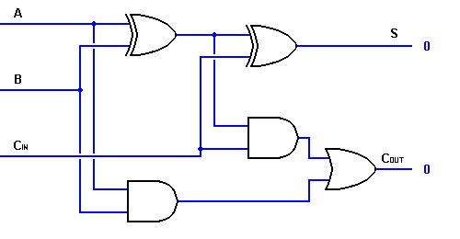
Full Adder(全加器由两个半加器组成)
FullAdder (a= ,b= ,c= ,sum= ,carry= );
第一个
半加器
第二个
半加器
a
x
sum
sumab
b
y
c
carry
carry in
carry ab
连接方法：
第一个半加器的a，b接 x ， y
第二个半加器的a，b接 第一个半加器的输出sum ab、低位进位carry in
第二个半加器的carry = or (第一个半加器的输出carry ab ,低位进位carry in）

Slide 12
16-bit Adder
By cascading full-adders into each other we can achieve a multi-bit adder
No carry in for the first bit
Carry out of the last bit is “lost”
This format of multi-bit add is called a ripple adder

Slide 13
Your turn: Can you build a 16-bit Adder
Add16 (a= ,b= ,out= );

Slide 14
Your turn:
Build a chip that increments a value by one.
Inc16 (in= ,out= );

Slide 15
How slow is a ripple-carry adder?
Every gate takes time to settle its output: one gate delay
In our full adder, the carry goes through 2 gates (AND, then OR) from carry-in to carry-out
Bit i cannot produce its final sum until the carry from bit i−1 has arrived
16-bit ripple-carry adder: the carry passes through 16 full adders
  about 2 × 16 = 32 gate delays before the last bit is correct
Delay grows linearly with the number of bits: a 64-bit ripple-carry adder is 4 times slower
Can we compute every carry without waiting for the previous one?

Slide 16
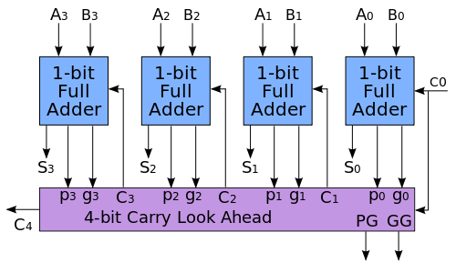
Carry-Look ahead adder
Some problems with ripple-adders can be overcome by carry-look ahead add
No more long propagation times
At the expense of simplicity

Slide 17
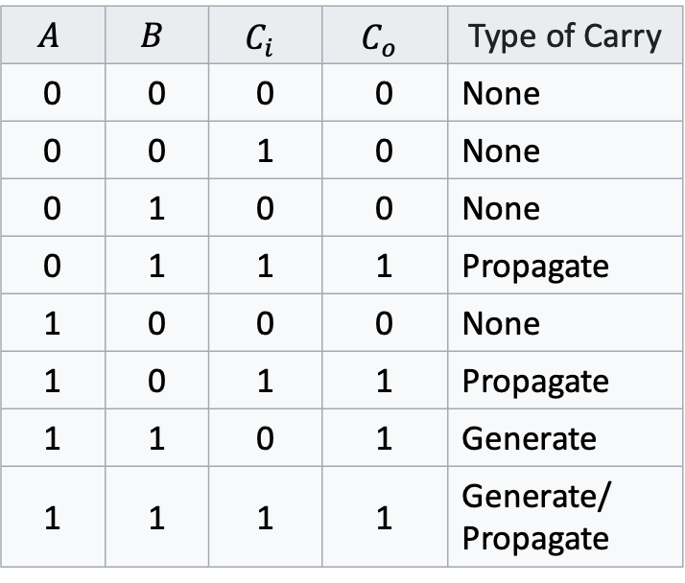
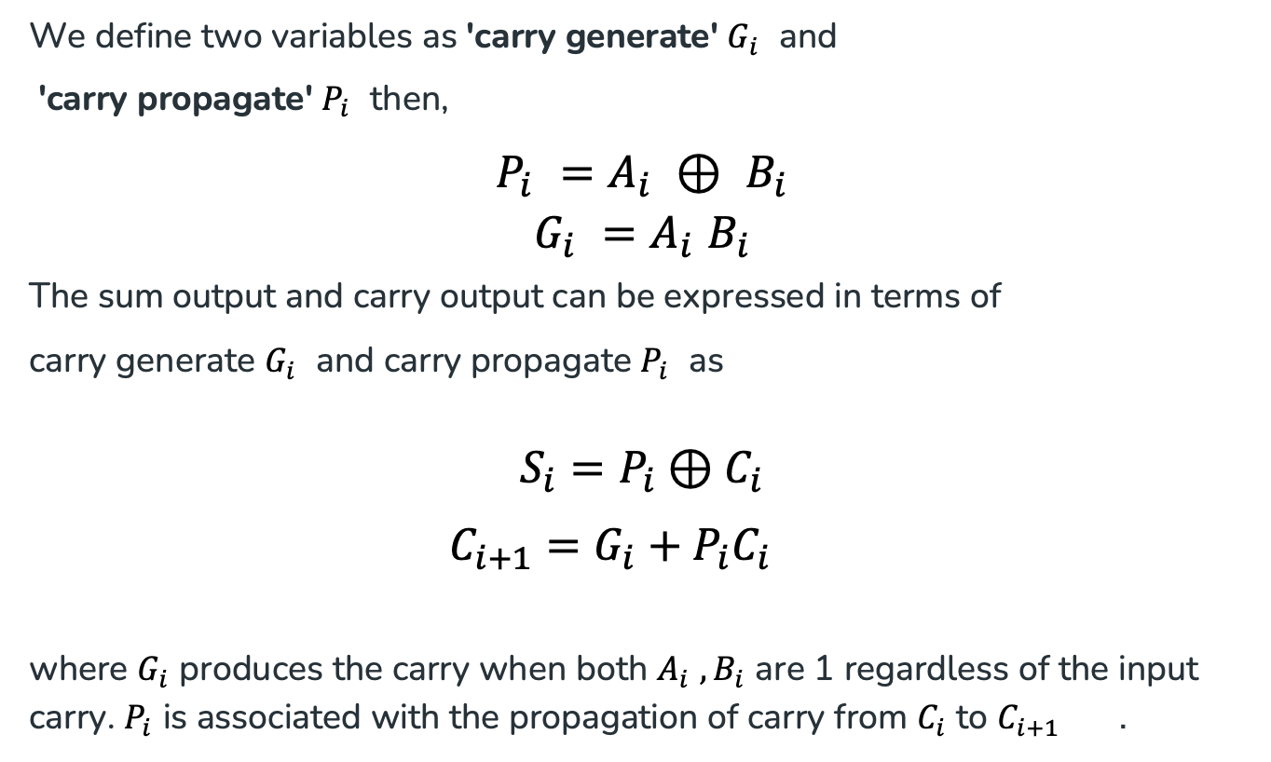
Carry-Look ahead adder
$$A$$ | $$B$$ | $$C_{i}$$ | $$C_{o}$$ | Type of Carry
0 | 0 | 0 | 0 | None
0 | 0 | 1 | 0 | None
0 | 1 | 0 | 0 | None
0 | 1 | 1 | 1 | Propagate
1 | 0 | 0 | 0 | None
1 | 0 | 1 | 1 | Propagate
1 | 1 | 0 | 1 | Generate
1 | 1 | 1 | 1 | Generate/ Propagate
We define two variables as 'carry generate' $G_{i}$and
'carry propagate' $P_{i}$then,
$$P_{i} =A_{i} ⊕ B_{i}$$
$$G_{i} =A_{i} B_{i}$$
The sum output and carry output can be expressed in terms of
carry generate $G_{i}$and carry propagate $P_{i}$as
$$S_{i}=P_{i}⊕C_{i}$$
$$C_{i+1}=G_{i}+P_{i}C_{i}$$
where $G_{i}$produces the carry when both $A_{i} , B_{i}$are 1 regardless of the input carry. $P_{i}$is associated with the propagation of carry from $C_{i}$to $C_{i+1}$.

Slide 18
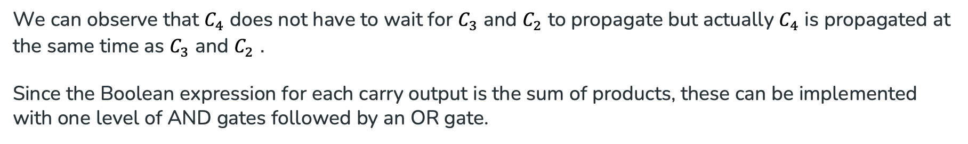
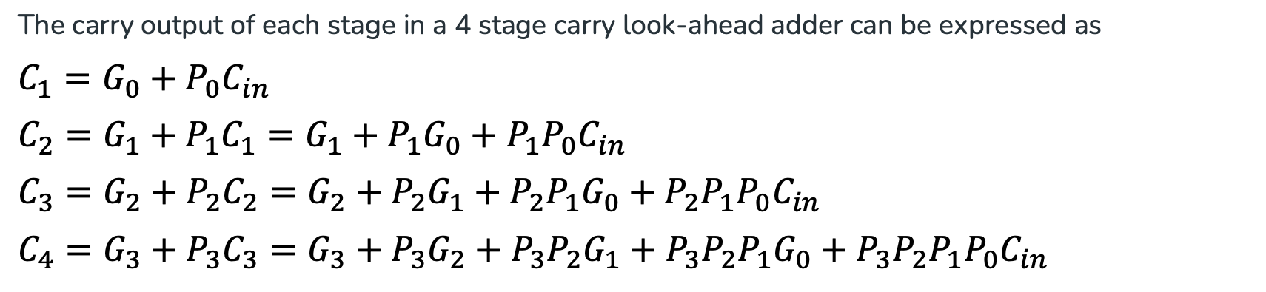
Carry-Look ahead adder
The carry output of each stage in a 4 stage carry look-ahead adder can be expressed as
$$C_{1}=G_{0}+P_{0}C_{in}$$
$$C_{2}=G_{1}+P_{1}C_{1}=G_{1}+P_{1}G_{0}+P_{1}P_{0}C_{in}$$
$$C_{3}=G_{2}+P_{2}C_{2}=G_{2}+P_{2}G_{1}+P_{2}P_{1}G_{0}+P_{2}P_{1}P_{0}C_{in}$$
$$C_{4}=G_{3}+P_{3}C_{3}=G_{3}+P_{3}G_{2}+P_{3}P_{2}G_{1}+P_{3}P_{2}P_{1}G_{0}+P_{3}P_{2}P_{1}P_{0}C_{in}$$
We can observe that $C_{4}$does not have to wait for $C_{3}$and $C_{2}$to propagate but actually $C_{4}$is propagated at the same time as $C_{3}$and $C_{2}$.
Since the Boolean expression for each carry output is the sum of products, these can be implemented with one level of AND gates followed by an OR gate.
https://www.geeksforgeeks.org/digital-logic/carry-look-ahead-adder/

Slide 19
Ripple-carry vs carry-lookahead
 | Ripple-carry | Carry-lookahead
Carry into bit i | waits for the carry out of bit i−1 | computed directly from the G, P and C_in signals
Delay (n bits) | grows with n: about 2n gate delays | constant: G, P (1) + carries as AND–OR (2) + sum XOR (1)
Hardware | n full adders | grows fast: C_n needs AND and OR gates with n+1 inputs
In practice | small, slow designs | 4-bit lookahead blocks, combined in a hierarchy
Both are valid implementations of Add16: same interface (a, b, out), different speed and size.

Slide 20
Signed binary number
2’s complement can represent 2^{n} integers
Maximum and minimum values are 2^{n-1} -1 and -2^{n-1} (respectively)
All positive numbers start with 0
All negative numbers start with 1

Slide 21
Binary subtraction example
x_{n} | y_{n} | Z_{n} carry to z_{n+1}
0 | 0 | 0 carry 0
0 | 1 | 1 carry 0
1 | 0 | 1 carry 0
1 | 1 | 0 carry 1
 | 2⁷ | 2⁶ | 2⁵ | 2⁴ | 2³ | 2² | 2¹ | 2⁰
x | 0 | 0 | 0 | 1 | 0 | 1 | 1 | 0
y | 0 | 0 | 0 | 0 | 0 | 1 | 1 | 1
!y
!y+1
x+(!y+1)
Carry

Slide 22
Overflow in two's complement
With 16 bits we can represent −32768 … +32767; a result outside that range wraps around
4-bit examples (range −8 … +7):
  0111 + 0001 = 1000 7 + 1 gives −8: overflow
  1001 + 1110 = (1)0111 −7 + (−2) gives +7: overflow
  1110 + 0011 = (1)0001 −2 + 3 gives +1: carry out, but no overflow
Rule: overflow happens when both operands have the same sign and the result has the other sign
  equivalently: carry into the top bit ≠ carry out of the top bit
A discarded carry is not an error; overflow is
The PSW from last lecture has an overflow flag; the Hack ALU does not – software must avoid it

Slide 23
Your turn: detect overflow
Build a 16-bit adder that also reports overflow:
  Add16V (a= ,b= ,out= ,ovf= );
ovf = 1 when a and b have the same sign, but out has a different sign
Hint: the sign is bit 15; you can use your Add16 chip plus a few gates

Slide 24
Your turn: solution
CHIP Add16V {
IN a[16], b[16];
OUT out[16], ovf;
PARTS:
Add16(a=a, b=b, out=out, out[15]=s);
Xor(a=a[15], b=b[15], out=diffsign); // operands differ in sign?
Not(in=diffsign, out=samesign);
Xor(a=a[15], b=s, out=flipped); // result sign differs from a?
And(a=samesign, b=flipped, out=ovf);
}

Slide 25
S1.W6.L2: PART II The Hack ALU

Slide 26
Arithmetic Logic Unit
The Arithmetic Logic Unit (ALU) is the centerpiece of any modern day computer
The ALU implements a set of logic commands
The ALU allows for the selection of which command should be output

Slide 27
Arithmetic Logic Unit
ALU’s implement a fixed set of functions
Each function can take at most two multi-bit arguments
The ALU outputs the result of the boolean function and a set of flags
Design issue: Which functions should the ALU perform?
A hardware / software tradeoff: Any function not implemented by the ALU
can be implemented later in system software
Hardware implementations: Faster, and more expensive
Software implementations: Slower, less expensive

Slide 28
Arithmetic Logic Unit
The instruction is a set of control bits which select which function the ALU should output
  And
  Adder
  Pre/post processing on inputs/outputs

Slide 29
Arithmetic Logic Unit
Our specific ALU accepts
Two 16-bit wide two’s complement values
A 6-bit wide instruction (control bits)
And outputs
A 16-bit wide output
A bit to indicate if the output is 0
A bit to indicate if the output is less than 0

Slide 30
Arithmetic Logic Unit
out
0
1
-1
a
b
!a
!b
-a
-b
a+1
b+1
a-1
b-1
a+b
a-b
b-a
a&b
a|b
With a 6-bit wide instruction gives the ALU a possible 2⁶ (=64) instructions
We are only interested in 18 of them

Slide 31
Control bits
The ALU has the choice between two basic functions logical And and Addition
All operations are multi-bit operations
All of the required components have been covered previously
Bit | Description
za | Zero input A
na | Negate input A
zb | Zero input B
nb | Negate input B
f | Select between & and +
no | Negate output

Slide 32
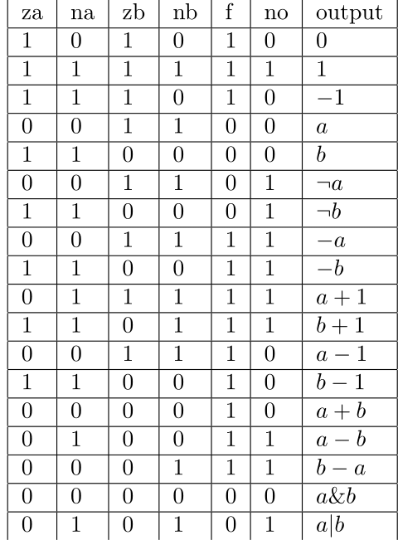
Control bits
Each of the 18 configurations of the control bits does something of interest
Let us consider the control bits set to 001110
  The ALU is instructed to compute a-1
  Input a is neither zero’ed nor negated
  Input b is zeroed and then negated (2’s complement -1₁₀ )
  f-bit set to Addition
  Output is not negated

Slide 33
 | za | na | zb | nb | f | no | output
 | if za then a=0 | if na then a=!a | if zb then b=0 | if nb then b=!b | if f then out=a+b else out=a&b | if no then output=!out | output(a,b)=
 | 0 | 0 | 1 | 1 | 1 | 0 | a-1
a
b
 | za | na | zb | nb | f | no | output
 | 0 | 0 | 1 | 1 | 1 | 1 | -a
a
b

Slide 34
 | za | na | zb | nb | f | no | output
 | if za then a=0 | if na then a=!a | if zb then b=0 | if nb then b=!b | if f then out=a+b else out=a&b | if no then output=!out | output(a,b)=
 | 0 | 0 | 1 | 1 | 1 | 0 | a-1
a | a | a | a | a | a-1 | a-1 | a-1
b | b | b | 0 | -1 (11111111)
 | za | na | zb | nb | f | no | output
 | 0 | 0 | 1 | 1 | 1 | 1 | -a
a
b

Slide 35
 | za | na | zb | nb | f | no | output
 | if za then a=0 | if na then a=!a | if zb then b=0 | if nb then b=!b | if f then out=a+b else out=a&b | if no then output=!out | output(a,b)=
 | 0 | 0 | 1 | 1 | 1 | 0 | a-1
a | a | a | a | a | a-1 | a-1 | a-1
b | b | b | 0 | -1 (11111111)
 | za | na | zb | nb | f | no | output
 | 0 | 0 | 1 | 1 | 1 | 1 | -a
a | a | a | a | a | a-1 | !(a-1) | -a
b | b | b | 0 | -1

Slide 36
Your turn: compute !a
 | za | na | zb | nb | f | no | output
 | if za then a=0 | if na then a=!a | if zb then b=0 | if nb then b=!b | if f then out=a+b else out=a&b | if no then output=!out | output(a,b)=
a=1100
b=1011

Slide 37
Your turn: compute !a
 | za | na | zb | nb | f | no | output
 | if za then a=0 | if na then a=!a | if zb then b=0 | if nb then b=!b | if f then out=a+b else out=a&b | if no then output=!out | output(a,b)=
 | 0 | 0 | 1 | 1 | 0 | 1 | !a
a=1100 | 1100 | 1100 | 1100 | 1100 | 1100 | 0011 | !a
b=1011 | 1011 | 1011 | 0000 | 1111

Slide 38
Your turn: compute b-a
 | za | na | zb | nb | f | no | output
 | if za then a=0 | if na then a=!a | if zb then b=0 | if nb then b=!b | if f then out=a+b else out=a&b | if no then output=!out | output(a,b)=
a=0010(2)
b=0111(7)

Slide 39
Your turn: compute b-a
 | za | na | zb | nb | f | no | output
 | if za then a=0 | if na then a=!a | if zb then b=0 | if nb then b=!b | if f then out=a+b else out=a&b | if no then output=!out | output(a,b)=
 | 0 | 0 | 0 | 1 | 1 | 1 | b-a
a=0010(2) | 0010 | 0010 | 0010 | 0010 | 1010 | 0101 | 5
b=0111(7) | 0111 | 0111 | 0111 | 1000

Slide 40
Why does it work?
In two's complement, negation is: invert all bits, then add 1
  −x = !x + 1
Rearranging:
  !x = −x − 1
Check with 4 bits: x = 0101 (5)
  !x = 1010 which is −6 = −5 − 1, as expected
So each negate bit (na, nb, no) is arithmetic negation minus one
Also: all ones = !0 = −1

Slide 41
Deriving the rows from the identity
a−1 (001110): b = !0 = −1; out = a + (−1) = a − 1
−a (001111): out = !(a − 1) = −(a − 1) − 1 = −a
a+1 (011111): a → !a = −a − 1; b → −1; sum = −a − 2
  out = !(−a − 2) = −(−a − 2) − 1 = a + 1
a−b (010011): a → !a = −a − 1; sum = −a − 1 + b
  out = !(−a − 1 + b) = −(−a − 1 + b) − 1 = a − b
Each row is just za/na, zb/nb, f, no applied in order

Slide 42
Your turn: derive these rows
b−a (000111)
b+1 (110111)
a|b (010101) hint: De Morgan's law

Slide 43
Your turn: solution
b−a: b → !b = −b − 1; sum = a − b − 1
  out = !(a − b − 1) = −(a − b − 1) − 1 = b − a
b+1: a → !0 = −1; b → !b = −b − 1; sum = −b − 2
  out = !(−b − 2) = b + 2 − 1 = b + 1
a|b: a → !a; b → !b; f = & gives !a & !b
  out = !(!a & !b) = a | b (De Morgan)

Slide 44
The Output Flags
if (out == 0) then zr = 1, else zr = 0
if (out < 0) then ng = 1, else ng = 0
The zr and ng output bits will come into play when we’ll build the complete CPU architecture, later in the course.

Slide 45
ALU
The ALU we implement is quite basic
No multiplication/division
No floating point numbers
No exponentiation (required for some encryptions)
Modern ALU’s support many more operations

Slide 46
Implementation
Notice that the ALU is composed of
A logic circuit that can negate or zero an input (times 2)
Logic circuits for Addition and And.
A logic circuit to select between them
A logic circuit to negate the output
A logic circuit to handle flags

Slide 47
The Hack ALU operation
pre-setting the a input |  | pre-setting the b input |  | selecting between computing + or & | post-setting the output | Resulting ALU output
za | na | zb | nb | f | no | out
if za then a=0 | if na then a=!a | if zb then b=0 | if nb then b=!b | if f then out=a+b else out=a&b | if no then out=!out | out(a,b)=
1 | 0 | 1 | 0 | 1 | 0 | 0
1 | 1 | 1 | 1 | 1 | 1 | 1
1 | 1 | 1 | 0 | 1 | 0 | -1
0 | 0 | 1 | 1 | 0 | 0 | a
1 | 1 | 0 | 0 | 0 | 0 | b
0 | 0 | 1 | 1 | 0 | 1 | !a
1 | 1 | 0 | 0 | 0 | 1 | !b
0 | 0 | 1 | 1 | 1 | 1 | -a
1 | 1 | 0 | 0 | 1 | 1 | -b
0 | 1 | 1 | 1 | 1 | 1 | a+1
1 | 1 | 0 | 1 | 1 | 1 | b+1
0 | 0 | 1 | 1 | 1 | 0 | a-1
1 | 1 | 0 | 0 | 1 | 0 | b-1
0 | 0 | 0 | 0 | 1 | 0 | a+b
0 | 1 | 0 | 0 | 1 | 1 | a-b
0 | 0 | 0 | 1 | 1 | 1 | b-a
0 | 0 | 0 | 0 | 0 | 0 | a&b
0 | 1 | 0 | 1 | 0 | 1 | a|b

Slide 48
Your turn to build the ALU
ALU (a= ,b= ,za= ,na= ,zb= ,nb= ,f= ,no= ,out= ,zr= ,ng= );
First sketch out the circuit using blocks to represent the parts of the chip and then have a go at implementing it.

Slide 49


za
na
0
Mux16
Not16
Mux16
b
b
Add16
a
f
no
a
a
Mux16
Not16
Mux16
b
b
out
And16
a
a
0
Mux16
Not16
Mux16
b
b
out[15]
ng
b
a
a
Or8Way
out[0..7]
zb
nb
Or8Way
Zr
out[8..15]

Slide 50
Driving the ALU from an instruction
Bits | Meaning in a Hack computation instruction
15–13 | 1 1 1: marks this as a computation instruction
12 | selects the ALU's second input b: the A register or the memory word M[A]
11–6 | the six ALU control bits: za na zb nb f no
5–3 | where to store the result: A, D and/or M[A]
2–0 | jump condition, decided using the ALU's zr and ng flags
The ALU's first input a is always the D register
Decoding is mostly wiring: bits 11–6 go straight to the ALU
The assembly language for these instructions comes next semester

Slide 51
Summary
Built the half adder, full adder and 16-bit ripple-carry adder in HDL
Saw why the ripple carry is slow and how carry-lookahead removes the chain
Subtraction and overflow in two's complement
Designed the Hack ALU: six control bits, why they work, and the zr/ng flags
Saw how a computation instruction drives the ALU control bits

