Slide 1



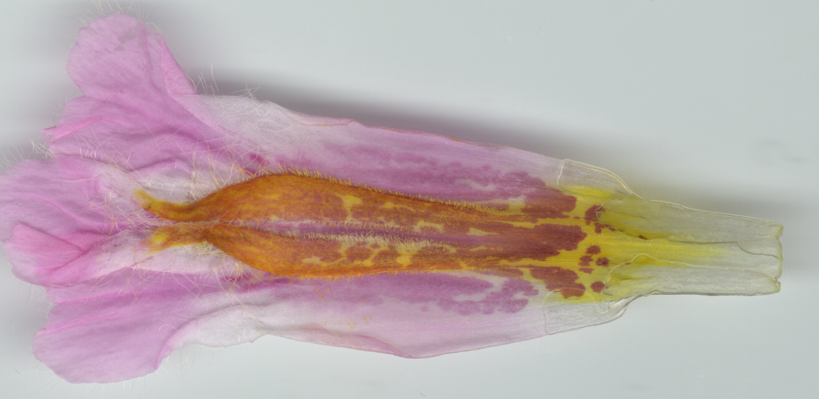


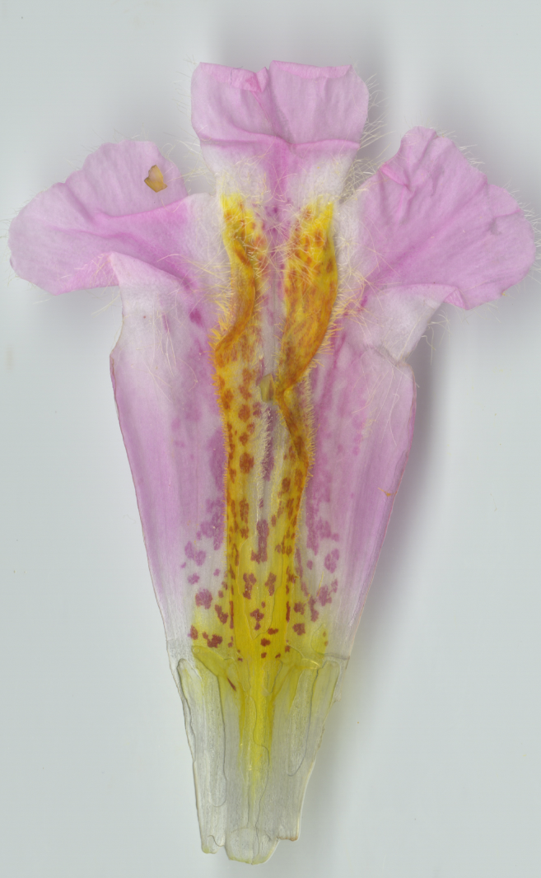


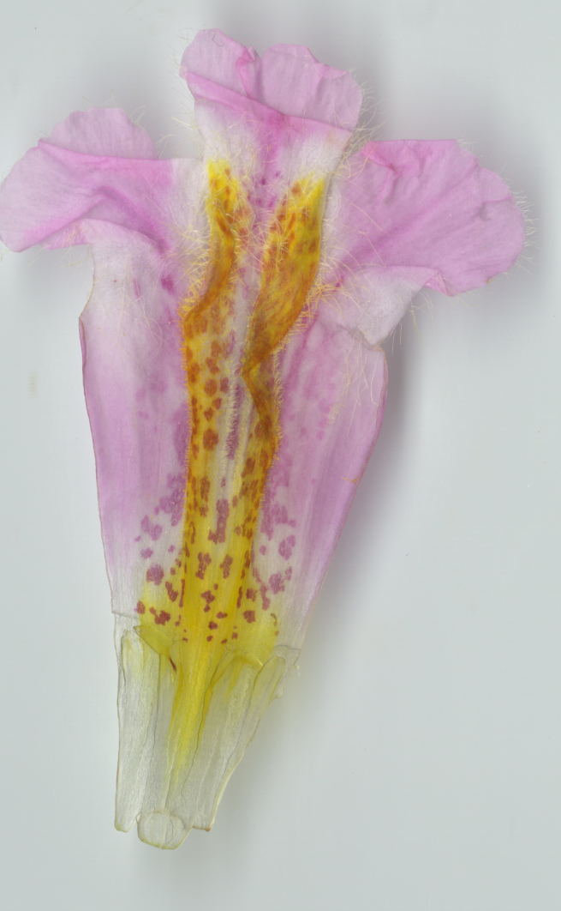
Using XGBoost:
Unprocessed Image
Processed Binary Image
VCell Simulation based on XGBoost Predicted Params (Threshold at VCell value 3)
RTO_RNAi_1
RTO_RNAi_2a
RTO_RNAi_2b

Slide 2


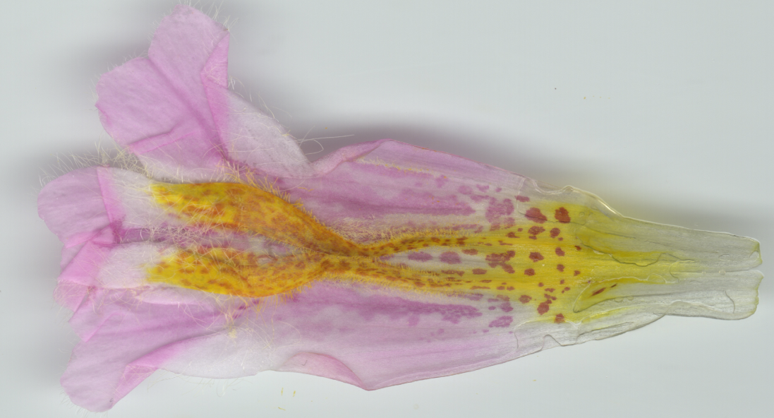


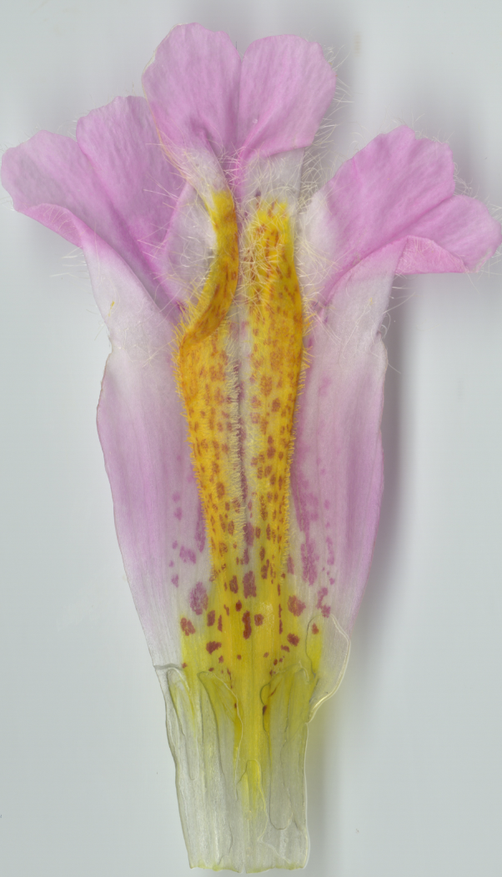


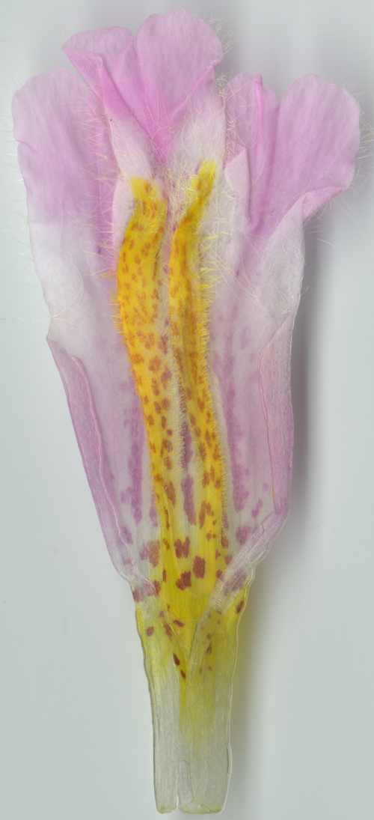
Using XGBoost:
Unprocessed Image
Processed Binary Image
VCell Simulation based on XGBoost Predicted Params (Threshold at VCell value 3)
RTO_RNAi_2c
RTO_RNAi_3
RTO_RNAi_4a

Slide 3

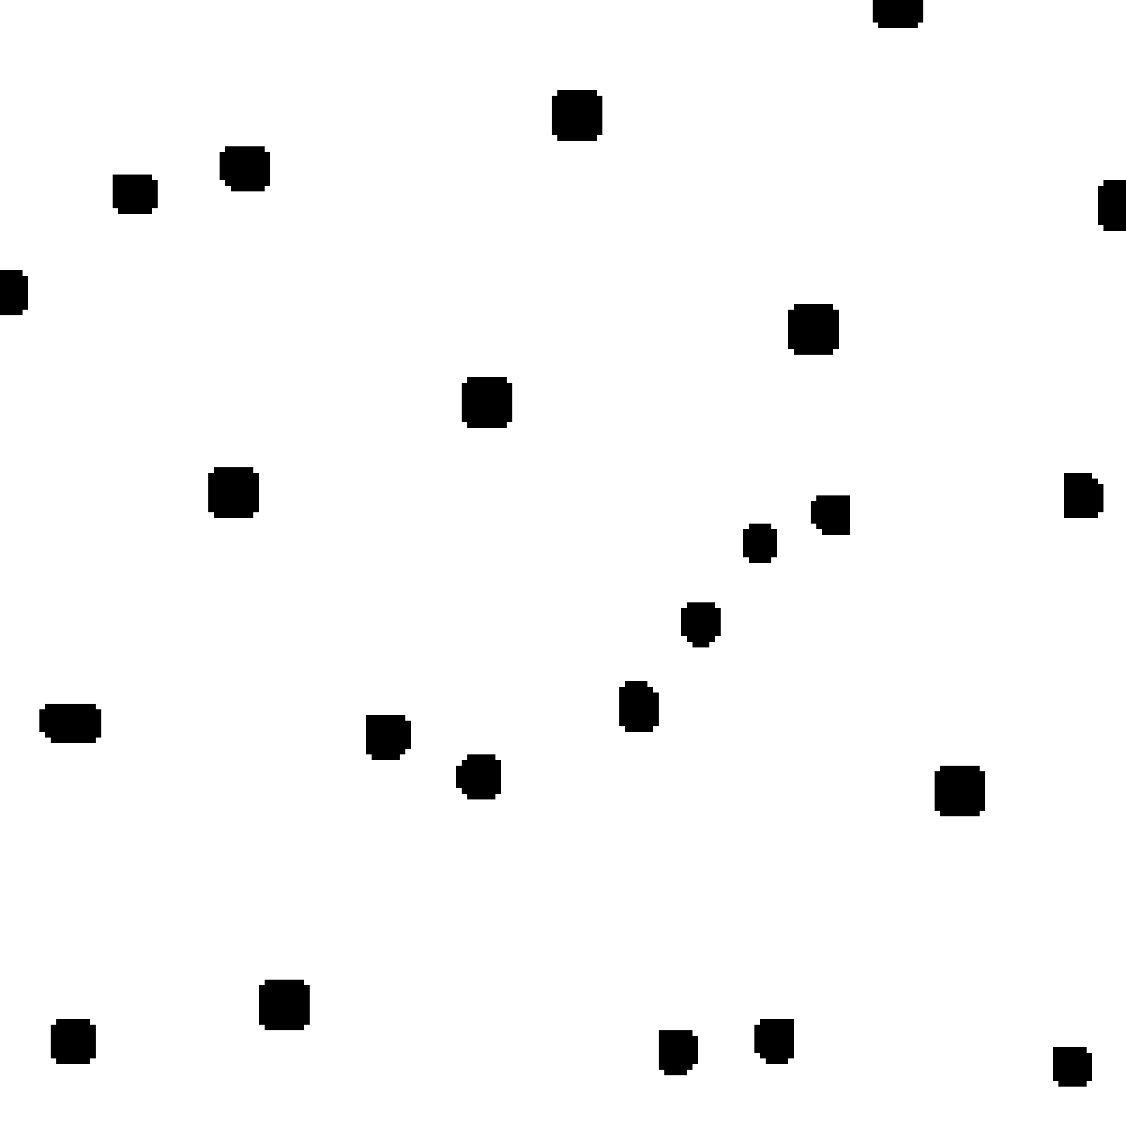
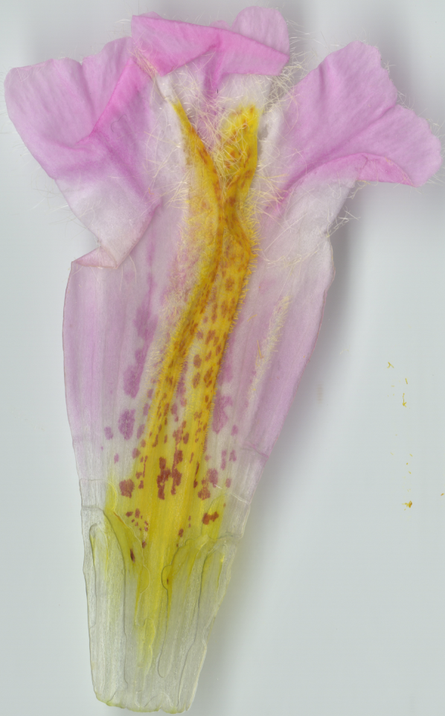


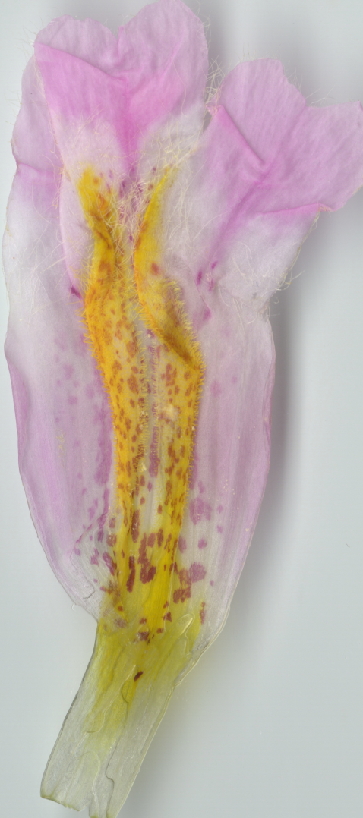


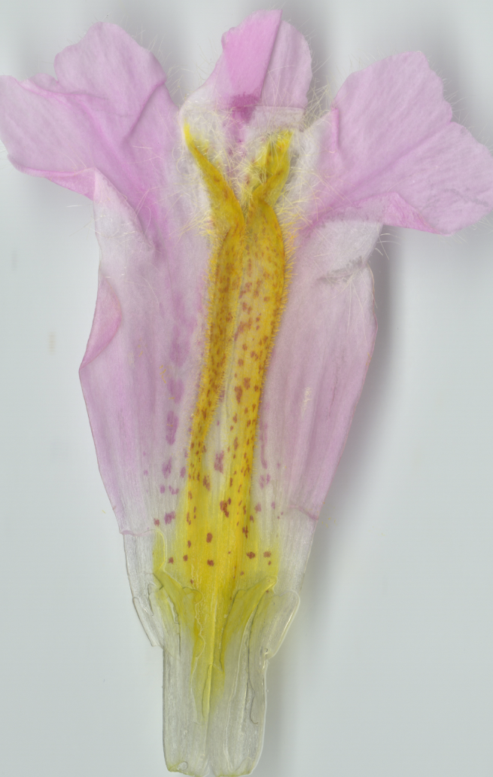
Using XGBoost:
Unprocessed Image
Processed Binary Image
VCell Simulation based on XGBoost Predicted Params (Threshold at VCell value 3)
RTO_RNAi_4b
RTO_RNAi_4c
RTO_RNAi_6

Slide 4
RTO_RNAi_1
RTO_RNAi_2c

