Slide 1
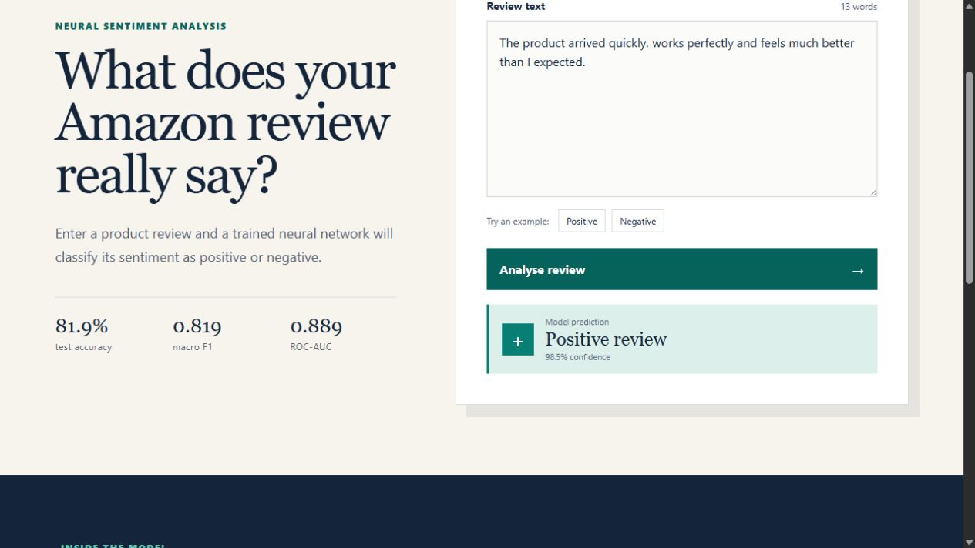
ISY503 · ASSESSMENT 3
ReviewLens
Neural sentiment analysis for Amazon product reviews
WORKING BROWSER DEMO
From raw review text to a clear positive or negative prediction.
Same trained weights.
No external prediction API.
Group presentation
Notes:
Good morning. Our project is called ReviewLens. It is a sentiment analysis tool for English Amazon product reviews. The user enters a review, and our neural network classifies it as either a positive review or a negative review. In this presentation, we will briefly explain the problem, the data, the model, the results and the working website.
[Sources]
- https://vcg-code.github.io/ISY503-Assessment-3-ReviewLens/ (project interface)
[/Sources]

Slide 2
A simple question becomes a complete NLP pipeline
Can a short product review be classified reliably as positive or negative?
1
Input
An English Amazon product review
ReviewLens connects data preparation, neural-network training, evaluation and browser inference in one working tool.
2
Model
Clean, encode and run the trained neural network
3
Output
“Positive review” or “Negative review”
The prediction runs locally in the browser.
02
Notes:
The project follows a complete NLP pipeline. First, we receive an English Amazon review as text. Then we clean and encode the text, pass it through the trained neural network, and return one clear result. The website uses the same trained model files as our evaluation. The prediction runs inside the browser, so the review is not sent to an external server.
[Sources]
- https://github.com/vcg-code/ISY503-Assessment-3-ReviewLens
[/Sources]

Slide 3
Cleaning reduced leakage before the model learned
8,000
7,698
labelled reviews · 4 domains
reviews retained
Load
Clean
Deduplicate
Filter
Split
Positive and negative files
Case, HTML, URLs and punctuation
148 exact copies removed
154 length outliers removed
Train · validation · test
5,388
1,153
1,157
training
validation
testing
03
Notes:
For training, we used the official Johns Hopkins Multi-Domain Sentiment Dataset. It contains eight thousand labelled Amazon reviews from four domains: books, DVDs, electronics and kitchen products. I removed one hundred and forty-eight exact duplicates to reduce data leakage. I also removed one hundred and fifty-four very short or very long reviews as length outliers. This left seven thousand six hundred and ninety-eight reviews. Finally, I used a reproducible stratified split: five thousand three hundred and eighty-eight reviews for training, one thousand one hundred and fifty-three for validation, and one thousand one hundred and fifty-seven for testing.
[Sources]
- https://www.cs.jhu.edu/~mdredze/datasets/sentiment/index2.html
- https://aclanthology.org/P07-1056/
- https://github.com/vcg-code/ISY503-Assessment-3-ReviewLens/blob/main/ml/artifacts/training_report.json
[/Sources]

Slide 4
The network learns from compact word-vector summaries
Token IDs
Embedding
Average pooling
Dense + ReLU
Dropout
Sigmoid
clean words + bigrams
48 dimensions
one review vector
64 hidden units
35% during training
positive probability
The decision threshold converts the final probability into the required label.
Small model · fast browser inference · editable trained weights
04
Notes:
The model is a small neural network built in PyTorch. First, each token becomes an ID. The embedding layer converts each ID into a forty-eight-dimensional word vector. Average pooling combines all valid word vectors into one summary of the review. A dense layer with sixty-four units and ReLU learns nonlinear sentiment patterns. Dropout randomly hides thirty-five per cent of the hidden activations during training, which helps reduce overfitting. Finally, the sigmoid output produces a probability between zero and one. The decision threshold converts this probability into Positive review or Negative review.
[Sources]
- https://github.com/vcg-code/ISY503-Assessment-3-ReviewLens
- https://proceedings.neurips.cc/paper/2019/hash/bdbca288fee7f92f2bfa9f7012727740-Abstract.html
[/Sources]

Slide 5
Training choices favour stability and repeatability
The best model was selected by validation performance—not by the final epoch.
✓
Binary cross-entropy
loss function
✓
AdamW
optimiser
The vocabulary was fitted on training data only, preventing test information from entering the model early.
✓
128 reviews
batch size
✓
Early stopping
best validation checkpoint
✓
Gradient clipping
Seed 503 makes the split and training reproducible
stable updates
05
Notes:
For training, I used binary cross-entropy as the loss function and AdamW as the optimiser. The batch size was one hundred and twenty-eight. Early stopping selected the best validation result instead of simply keeping the last epoch. Gradient clipping helped keep the updates stable. I also used seed five-zero-three so the data split and training process can be reproduced. Importantly, the vocabulary was fitted only on the training data, which reduces information leakage from the validation and test sets.
[Sources]
- https://github.com/vcg-code/ISY503-Assessment-3-ReviewLens/blob/main/ml/train_model.py
- https://github.com/vcg-code/ISY503-Assessment-3-ReviewLens/blob/main/ml/artifacts/training_report.json
[/Sources]

Slide 6
The held-out test set shows balanced performance
Confusion matrix
Predicted label
Negative
Positive
Actual negative
484
89
Actual positive
120
464
84.5% negative recall
79.5% positive recall
06
Notes:
I evaluated the final model on the held-out test set, which was not used for training. The accuracy was eighty-one point nine per cent, the macro F1 score was zero point eight-one-nine, and the ROC-AUC was zero point eight-eight-nine. The recall was seventy-nine point five per cent for positive reviews and eighty-four point five per cent for negative reviews. The confusion matrix shows four hundred and eighty-four correct negative predictions and four hundred and sixty-four correct positive predictions. The similar recall values indicate that performance is reasonably balanced between the two classes.
[Sources]
- https://github.com/vcg-code/ISY503-Assessment-3-ReviewLens/blob/main/ml/artifacts/training_report.json
[/Sources]

Slide 7
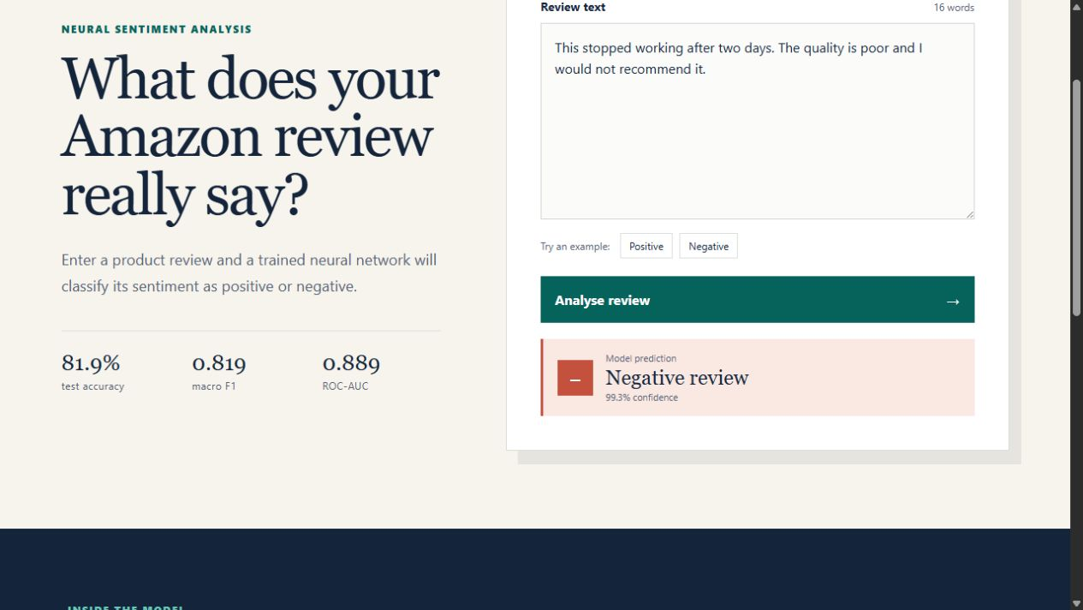
The website makes the trained model usable
1
Enter
Type a review or choose an example
2
Analyse
Run the exported weights in the browser
3
Interpret
Read the exact label and confidence
vcg-code.github.io/ISY503-Assessment-3-ReviewLens/
07
Notes:
Now I will demonstrate the final tool. I enter an English product review or choose one of the prepared examples. When I click Analyse review, the browser cleans and tokenises the text, loads the exported neural-network weights, and performs the forward pass locally. The output uses the exact required wording: Positive review or Negative review. The percentage is the model confidence, but it is not certainty. I will show one clearly positive example and one clearly negative example. If the internet connection fails, I will use the screenshots in this slide as a backup. Positive demo: The product arrived quickly, works perfectly and feels much better than I expected. Negative demo: This stopped working after two days. The quality is poor and I would not recommend it.
[Sources]
- https://vcg-code.github.io/ISY503-Assessment-3-ReviewLens/ (project interface)
[/Sources]

Slide 8
RESPONSIBLE NLP
Useful evidence—
not a final verdict.
R
English Amazon reviews only
Sarcasm and mixed sentiment remain difficult
Human judgement stays essential
Notes:
ReviewLens demonstrates a complete and working NLP system, from data preparation and neural-network training to evaluation and browser inference. However, a prediction is not a fact. The data contains older English Amazon reviews, and the model can struggle with sarcasm, unusual spelling, mixed sentiment and cultural context. For this reason, confidence should support human judgement rather than replace it. Our conclusion is that the model provides useful evidence, but not a final verdict.
[Sources]
- https://www.cs.jhu.edu/~mdredze/datasets/sentiment/index2.html
- https://github.com/vcg-code/ISY503-Assessment-3-ReviewLens#ethics-and-limitations
[/Sources]

