Slide 1
Automated
code review
And fixes you can trust
A research assessment for personal and organization repositories
21 October 2026
01
Notes:
Complete target-design research, not a pilot or implemented product. The report separates public code, documented behavior, vendor-reported results and proposals. Source and transcript evidence is linked throughout the report.

Slide 2
The recommended design
Take the strongest ideas
Context engine
Qodo + Greptile
Find and validate
Uber + Claude
Repair and verify
Google + Meta
Build missing blocks and own the evidence
02
Notes:
Select private and public design ideas first; source-code availability does not filter the target. Implementation choices follow. The controller owns state, evidence and publishing. These are design recommendations from source inspection, not measured product rankings. Sources: https://www.qodo.ai/resources/high-signal-ai-code-review-a-multi-agent-blueprint/ https://www.greptile.com/blog/how-to-build-a-code-review-agent https://www.uber.com/us/en/blog/ureview/ https://code.claude.com/docs/en/code-review https://deepmind.google/blog/introducing-codemender-an-ai-agent-for-code-security/

Slide 3
Three different jobs
Find a real bug
Make a focused fix
Check the repair
Each step needs its own evidence
03
Notes:
Reviewing code, implementing feedback and independently checking a patch are separate workflows. A replacement snippet or an addressed comment is not proof of an executable, safe fix. Proposed conceptual diagram.

Slide 4
What is available
Type | Examples | Main role
Published designs | Uber · Google · Meta | Architectural ideas
Hosted reviewers | Bugbot · Greptile · CodeRabbit | Services and design ideas
Open implementations | PR-Agent · Kodus | Inspectable review code
Repair and control | OpenHands · gh-aw · DBOS | Execution and recovery
Missing source code does not exclude a useful idea
04
Notes:
Representative categories, not a ranking. Open-source engines: PR-Agent, Kodus (AGPL plus commercial EE), Shippie. Hosted engines are not established as open source. Reviewdog does deterministic diagnostic transport, not semantic review. Sources: https://github.com/The-PR-Agent/pr-agent https://github.com/kodustech/kodus-ai https://github.com/OpenHands/software-agent-sdk https://github.com/github/gh-aw https://cursor.com/docs/bugbot https://www.greptile.com/docs/introduction

Slide 5
One quality design, different deployments
Personal
Organization
Local or hosted context
Existing client route can stay
Approve the tested patch
Governed context service
Approved models and workers
Owner-defined checks
Cost and hosting are implementation choices
05
Notes:
Local launcher source was inspected and pins claude-sonnet-5-5; live auth/quota/generation were not requalified. Official Claude Action docs support subscription OAuth on Pro/Max/Team/Enterprise, but recommend API or workload identity for shared organization secrets. Managed Code Review is billed separately from included usage. Sources: https://code.claude.com/docs/en/github-actions https://code.claude.com/docs/en/code-review-costs Local launcher: /Users/denniscvsg/.hermes/scripts/claude_code_work/runner.py

Slide 6
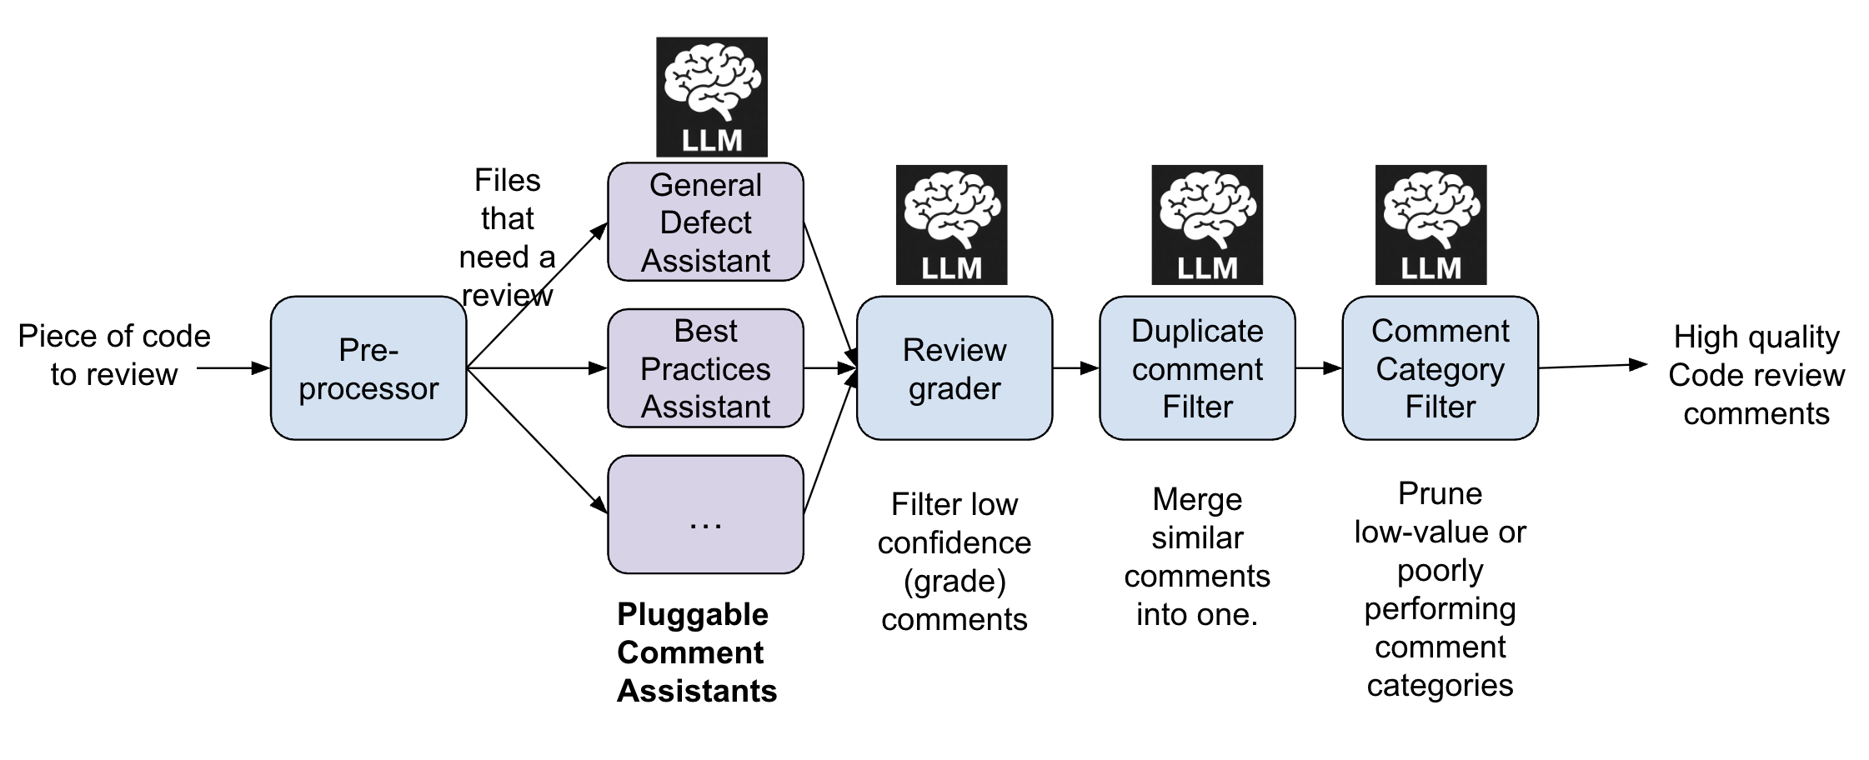
Uber filters before it speaks
Borrow the filters and feedback loop
06
Notes:
Original Uber Figure 2, reproduced with attribution. It shows specialized comment assistants, review grading, duplicate filtering and category filtering. Source: https://www.uber.com/us/en/blog/ureview/ Image: https://tb-static.uber.com/prod/udam-assets/b4413453-80e2-5d89-8aca-bec46d4c4841.png . This is Uber's documented internal architecture, not public uReview source. Self-reported usefulness is not independently measured precision.

Slide 7
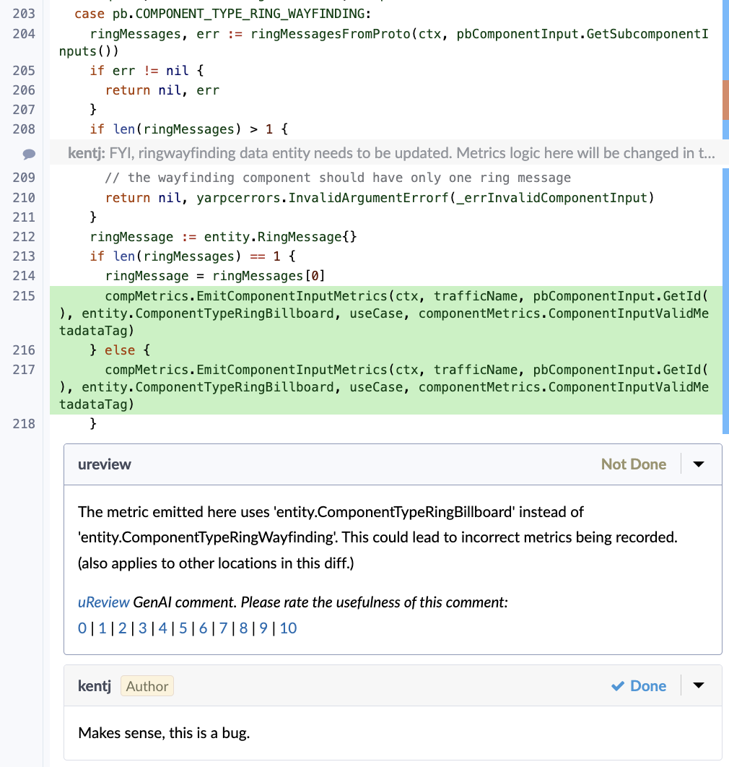
A useful comment is only the beginning
The wrong metric type
is recorded
Is the finding correct?
Does the repair work?
What was not tested?
Example from Uber Engineering
07
Notes:
Original Uber Figure 1, an incorrect metric bug caught by uReview. It is a documented example rather than an experiment performed in this research. Source: https://www.uber.com/us/en/blog/ureview/ Image: https://tb-static.uber.com/prod/udam-assets/a898698b-6e21-5e5e-ad71-b2d55fa5013c.png . Our recommendation adds reproduction and independent patch checks; the image does not prove those were executed here.

Slide 8
The complete review and fix path
Exact PR
and intent
Context
and risk plan
Find and
challenge
Runtime
investigation
Outcome
and feedback
Restricted
publisher
Approve
exact patch
Repair and
verify
The agent cannot grant itself permission to push
08
Notes:
Proposed architecture. Deterministic controller owns immutable revision identity, one active generation per PR, finding ledger, bounded tasks, independent checks, exact-candidate approval and remote-effect reconciliation. Workers do not receive publication credentials. This design has not been built or executed by this research.

Slide 9
Approval belongs to one exact patch
Tested patch
+ recorded checks
+ your approval
New code or a changed PR invalidates the old approval
09
Notes:
Proposed publication contract. Approval binds old head, tested base, candidate identity, evidence and policy. The publisher rechecks the remote head immediately before the approved effect, and reconciles uncertain results before retrying. Source for analogous commit-bound internal practice: https://claude.dev/blog/solving-code-review-at-anthropic/

Slide 10
Four shortcuts that break trust
Inventing intended behavior from code alone
Changing code before validating the finding
Using agent agreement as a substitute for evidence
Letting one green check hide missing verification
10
Notes:
These are compatibility judgments, not claims that the products have no use. OpenQodex does not pin exact model or reject all API credentials in the inspected driver; managed Claude review uses separate billing and no build execution; stock Copilot /pr fix commits and pushes. Sources: https://github.com/openqodex/openqodex https://code.claude.com/docs/en/code-review-costs https://code.claude.com/docs/en/code-review https://docs.github.com/en/copilot/how-tos/copilot-cli/use-copilot-cli/manage-pull-requests

Slide 11
Company lessons worth copying
Company | Useful lesson
Uber | Filter weak and repetitive findings
Google | Test security repairs in context
Meta | Use narrow domain checks and owner feedback
Anthropic | Stop endless review and fix loops
SpaceX | Internal review details remain undocumented
11
Notes:
Sources and evidence limits: Uber filtering https://www.uber.com/us/en/blog/ureview/; Google CodeMender security research https://deepmind.google/blog/introducing-codemender-an-ai-agent-for-code-security/ (current production availability is separately restricted); Meta AI Regression Solver https://engineering.fb.com/2026/04/16/developer-tools/capacity-efficiency-at-meta-how-unified-ai-agents-optimize-performance-at-hyperscale/; Anthropic internal convergence and incident replay https://claude.dev/blog/solving-code-review-at-anthropic/; SpaceX acquisition statement https://cursor.com/blog/joining-spacex does not document internal flight-code review.

Slide 12
What trustworthy means
Correct findings
Missed important bugs
Safe fixes
Your time
Measure each separately on representative changes
12
Notes:
Required evaluation dimensions: useful precision, severe known-bug recall, clean-change false alarms, independent repair success/regressions, human effort and authorization reliability. Vendor scores, addressed-comment rates and SWE-bench issue-resolution scores measure different things. Source: https://arxiv.org/abs/2610.13668; https://github.com/review-bench/ReviewBench . No comparative runtime score is claimed in this report.

Slide 13
The target worth building
Take the best ideas
Build the missing pieces
Choose code, services and custom blocks
to serve the complete quality design
13
Notes:
Research conclusion: compose established components and retain one authoritative controller for policy, evidence and publication. Both personal and organizational end states are covered in the report. There is no claim of perfect review or a completed implementation; environment-specific qualification remains necessary. Slides 14–20 are an optional beginner walkthrough; the preceding 13 slides are the executive brief.

Slide 14
A pull request in plain language
Base B1
Current project
Head H1
Proposed change
Pull request
Compare and discuss
The diff is what changed between the two versions
14
Notes:
A repository holds project history. A branch points to a commit. A commit identifies a saved tree and its history. A pull request proposes merging changes from a head branch into a base branch; its diff is the change under review. The bot must record immutable identities rather than infer them from branch names. Current event semantics: https://docs.github.com/en/actions/reference/workflows-and-actions/events-that-trigger-workflows . Explain aloud: a PR number identifies a discussion; a commit identifies code.

Slide 15
A tiny change with a real consequence
Rule: delivery is free at $50 or more
Before
Changed to
subtotal >= 50
subtotal > 50
At exactly $50, the new code charges a fee
15
Notes:
Invented teaching example, not production code or an executed test. Intended rule: delivery is free for subtotal >=50. Head changes >= to > and wrongly charges at exactly50. Because intended behavior is supplied explicitly, the finding is falsifiable. Without that requirement the bot should ask or retrieve evidence instead of inventing policy. Follow the same B1/H1/C1 example in the field guide.

Slide 16
Check the claim before making a fix
Version | At $50 | Meaning
Base B1 | $0 fee | Expected behavior
Head H1 | $5 fee | Shows the claimed defect
Candidate C1 | $0 fee | Target behavior restored
Then check $49.99, $50.01 and the existing tests
Expected results for an unexecuted example
16
Notes:
Expected results for the invented example, not observed test outcomes. The trusted requirement is free delivery at >=50. Test baseline B1, faulty head H1 and candidate C1 separately. Candidate check must also cover neighboring inputs, existing tests and relevant environments. Explain aloud: the reproducer identifies the defect; regression tests look for damage elsewhere.

Slide 17
Three real GitHub controls
Setting | What it protects
Require status checks to pass | Chosen checks must report an eligible result
Dismiss stale approvals | New code can require human review again
Require conversation resolution | Open review discussions must be addressed
Merge rules do not approve an unpublished patch
17
Notes:
Current labels and availability are documented, not settings installed on your repositories. Rulesets can require status checks, dismiss stale approvals or require approval of the most recent reviewable push, and require conversation resolution. Plan/repository visibility affects availability. These merge controls are not an exact-patch approval-before-push implementation. Source: https://docs.github.com/en/repositories/configuring-branches-and-merges-in-your-repository/managing-rulesets/available-rules-for-rulesets . Explain aloud: GitHub can enforce merge rules while a bot still has too much authority to push.

Slide 18
One bot needs different PR strategies
PR type | Useful strategy
Documentation | Check truth, links and executable instructions
Dependencies | Check compatibility, lockfile and install risk
Native or GPU code | Use real toolchain and device checks
Security or workflow changes | Use specialist evidence and human ownership
18
Notes:
Proposed routing strategies, not universal hardcoded rules. Docs can change executable instructions; dependency updates can change install hooks; native numerical code needs actual compiler/device validation. Escalate risk by content, not by author or filename alone.

Slide 19
New commits make old results stale
Review H1
Test candidate C1
Author pushes H2
Stop and reconcile before any write
19
Notes:
Hypothetical race: analyze H1, generate/test C1, author pushes H2 before publication. The candidate must not be blindly rebased and pushed under old approval. Reconcile and verify new work; re-approve as required. GitHub concurrency cancellation alone is not a publisher compare-and-set. Source: https://docs.github.com/en/actions/how-tos/write-workflows/choose-when-workflows-run/control-workflow-concurrency . Two PRs may also share a head ref, requiring repo/ref fencing.

Slide 20
The questions you should be able to answer
Which code did we review?
What evidence supports the finding and repair?
Which risks did the checks leave open?
Who can publish this exact patch?
20
Notes:
Use this as a teach-back. Follow the field guide for examples and the research report for full edge cases, live-checked settings, YAML and source inspections. Answers must identify exact code, the falsifiable defect, evidence and its limits, and the responsible publication authority. No tool or source reviewed here eliminates every bug.

