Slide 1
E-Commerce Sales Analysis
Data Analytics Internship Project Unified Mentor Internship Program
Chandana Mala Veeranki

Slide 2
Project Objective
To analyze E-Commerce sales data and identify business trends.
To understand sales performance across product categories, regions, and time.
To visualize key metrics using dashboards and charts for better decision making.

Slide 3
Dataset Information
The dataset contains E-Commerce furniture sales data for different products.
It includes information such as Product Title, Category, Price, Units Sold, Revenue, and Discount.
Additional fields like Price Band and Discount Band help analyze pricing strategies and sales trends.

Slide 4
Tools Used
Microsoft Excel
Data Cleaning and Data Preparation
Pivot Tables and Pivot Charts
Data Visualization using Excel Dashboards

Slide 5
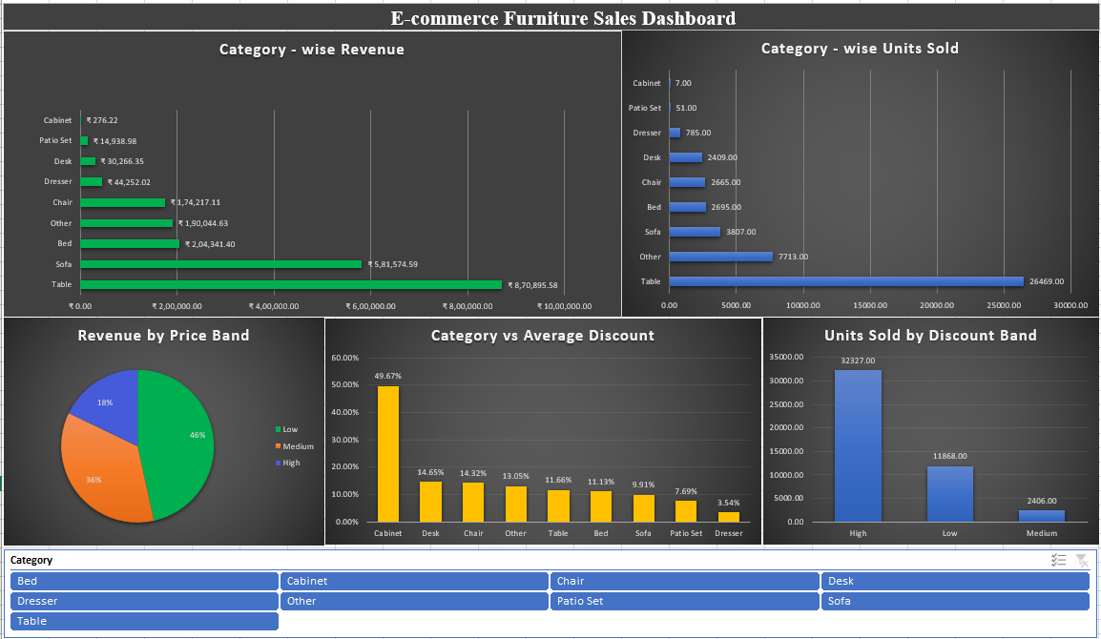
Dashboard & Visualizations

Slide 6
Conclusion
The analysis helped identify top-performing product categories and sales trends.
Discount strategies significantly influenced the number of units sold.
Data visualization through dashboards made it easier to interpret sales performance.
This project demonstrates the use of Excel for data analysis and business insights.

