Slide 1
IBM HR Employee Attrition Analysis
Data Analytics Internship Project
Unified Mentor Internship Program
Chandana Mala Veeranki

Slide 2
Project Objective
To analyze employee attrition patterns within the organization.
To understand factors influencing employee turnover such as job role, department, salary, and job satisfaction.
To visualize workforce trends and attrition insights using interactive dashboards.

Slide 3
Dataset Information
The dataset contains employee information related to workforce demographics and job roles.
It includes details such as Age, Department, Job Role, Monthly Income, Job Satisfaction, and Attrition status.
The dataset is used to analyze employee turnover and identify patterns affecting workforce retention.

Slide 4
Tools Used
Microsoft Excel for initial data exploration and cleaning
SQL for querying and analyzing employee data
Power BI for data visualization and dashboard creation
Data analysis to identify employee attrition patterns

Slide 5
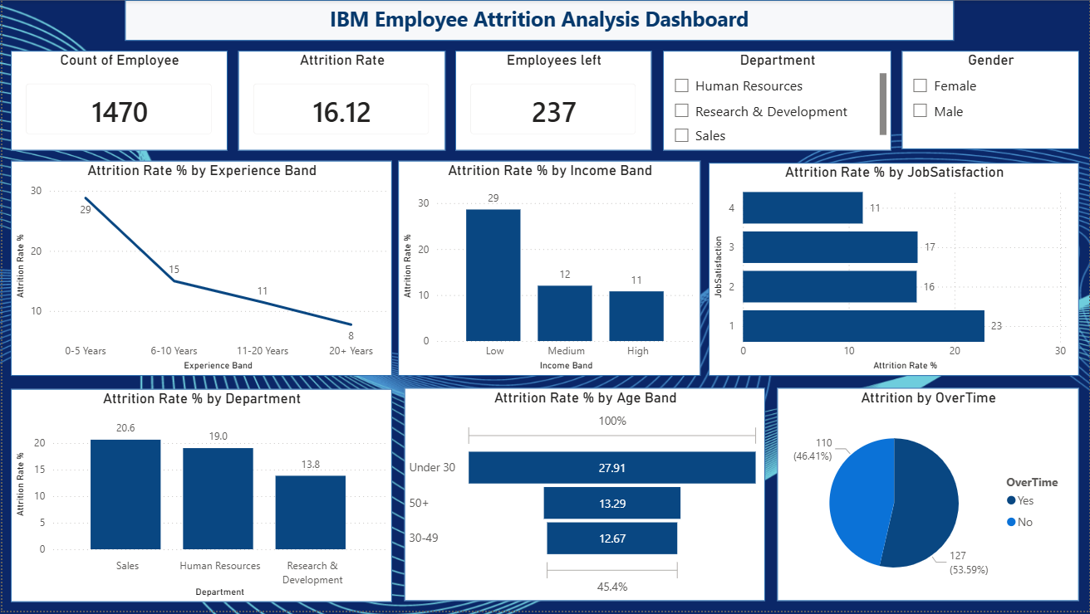
Employee Attrition Dashboard

Slide 6
Key Insights
The overall employee attrition rate is approximately 16%.
Employees with lower income levels show higher attrition rates.
Attrition is highest among employees with 0–5 years of experience.
The Sales department records the highest employee attrition.
Overtime appears to be a significant factor contributing to employee turnover.

