Slide 1
Super Mart Sales Analysis
Data Analytics Internship Project
Unified Mentor Internship Program
Chandana Mala Veeranki

Slide 2
Project Objective
To analyze sales performance of Super Mart across different categories and regions.
To identify key trends in revenue, profit, and product sales.
To visualize sales insights using an interactive Power BI dashboard.

Slide 3
Dataset Information
The dataset contains Super Mart sales transaction data.
It includes information such as Order Date, Product Category, Sales, Profit, Quantity, and Region.
The dataset is used to analyze sales performance and identify business trends.

Slide 4
Tools Used
Microsoft Excel for data preparation and exploration
Power BI for data modeling, measures, and dashboard creation
Data visualization using charts and KPIs
Business insight generation from sales data

Slide 5
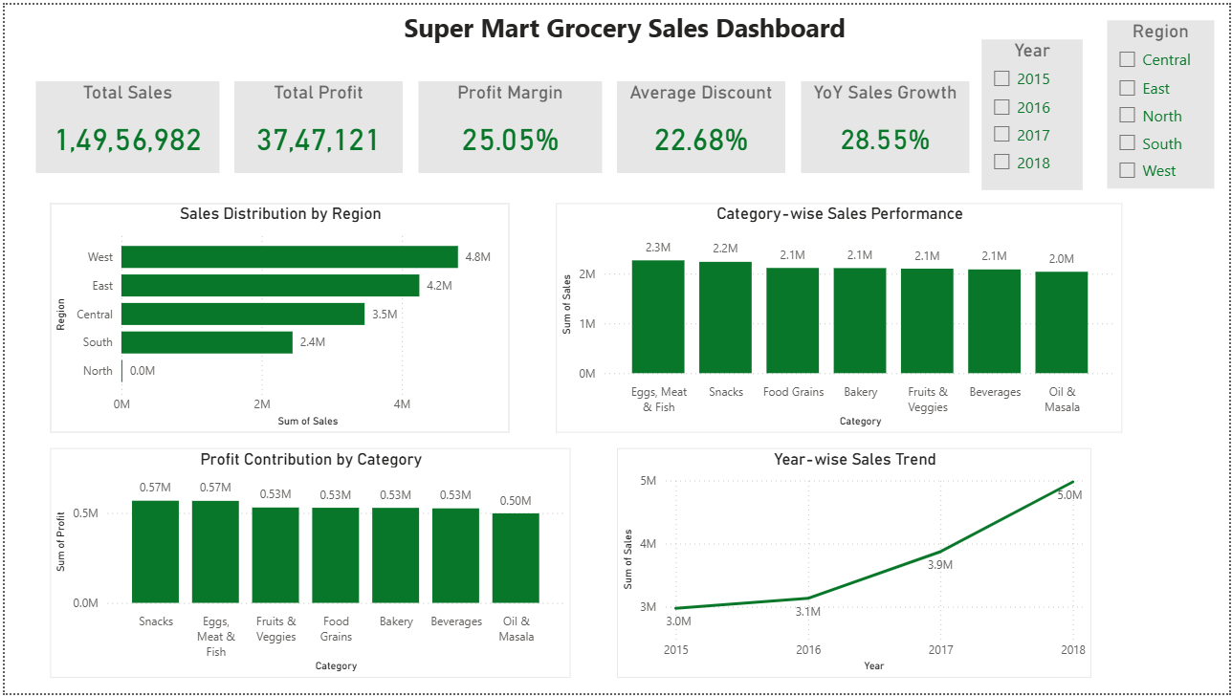
Sales Performance Dashboard

Slide 6
Key Insights
The West region recorded the highest sales among all regions.
Categories such as Eggs, Meat & Fish and Snacks generated the highest sales.
Snacks and Eggs, Meat & Fish contributed the most to overall profit.
Sales have shown steady growth from 2015 to 2018.
Discounts and pricing strategies significantly influence profit margins.

