Slide 1
Agentic AI

Slide 2
🌐 What is Agentic AI?
Agentic AI refers to AI systems that behave as autonomous agents — systems that can:
Perceive (observe inputs),
Reason (make decisions),
Plan (sequence actions),
Act (interact with tools/APIs/external systems),
Adapt (react to new information dynamically).
Think of it as upgrading from LLM-as-a-function to LLM-as-an-agent.

Slide 3
🤖 How is Agentic AI Different from Regular ML/LLMs?
Aspect | Traditional ML / LLM | Agentic AI
Task | One-shot response | Multi-step goal pursuit
Memory | Stateless | Maintains memory/state
Tools | Passive usage | Actively uses tools / APIs
Control Flow | Prompt in → Response out | Plans, loops, branches
Use Case | Q&A, classification, regression | Workflow automation, task orchestration, decision-making

Slide 4
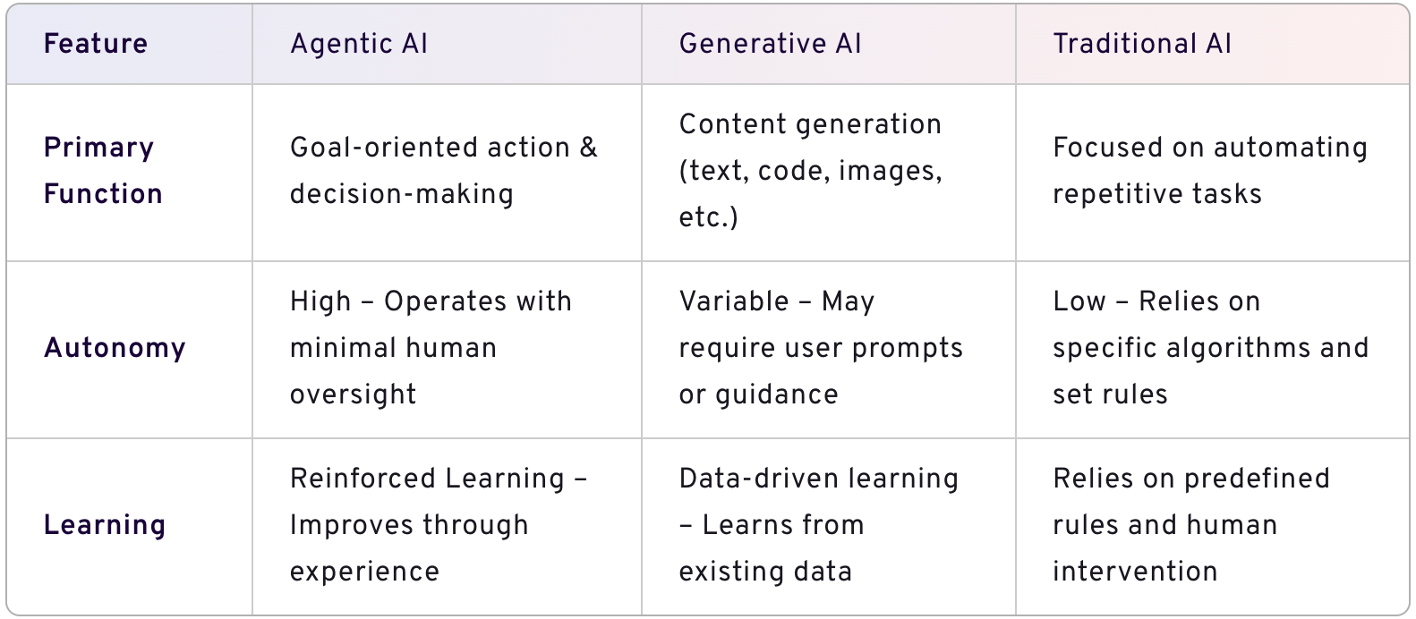

Slide 5
When to use what?
Given a dataset, how do we decide whether to apply Traditional AI, Generative AI, or Agentic AI?

Slide 6
Traditional AI
You have : Structured data (tables, time series, images).
A clear, narrow task like:
Classification (spam/not spam),
Regression (predict sales),
Clustering (group customers),
Forecasting (time series),
Computer vision (object detection),
Rule-based decision-making (fraud scoring).
🔧 Tech used: XGBoost, Random Forest, SVM, ARIMA, LSTM, CNN, etc.
Key trait: It learns from past data and makes predictions — but no language, no open-ended understanding, no real-world planning.

Slide 7
GenAI
You have : Unstructured data like text, code, images, audio.
You need:
Summarization, Q&A, translation.
Writing content (emails, blogs).
Code generation, data extraction from documents.
Chatbots, NLP/NLU applications.
Working with embeddings for document similarity or search.
Key trait: GenAI like LLMs (ChatGPT, Gemini, Claude, LLaMA) generates human-like responses from patterns in data, but requires prompts and doesn't plan or remember goals.

Slide 8
Agentic AI
You have : A goal rather than just a question.
Need to automate multi-step tasks that involve planning, reasoning, and decision-making.
Want to integrate tools, memory, and APIs.
Examples:
“Research top 5 startup funding trends and create a report with graphs.”
“Monitor stock prices and alert me if my portfolio falls by 10%.”
“Extract data from 100 PDFs, enrich with an API, and load to database.”
Key trait: Agents can:
Take goals, not just instructions.
Decide next steps.
Use tools (search, APIs).
Store and use memory.
Interact with the environment over time.
🛠️ Tech used: LangChain, LangGraph, Autogen, CrewAI, OpenAI Functions, Ollama + tools, vector DBs, workflows.

Slide 9
Research top 5 startup funding trends and create a report with graphs.
Steps
Web/Data Research
Trend Analysis
Graph Generation
Report Writing
Final Compilation and Output

Slide 10
Agents We can create
Agent Name | Role
Research Agent | Searches the web (e.g., via SerpAPI, Bing API, or News APIs) to find relevant articles, reports, or data sources.
Data Extraction Agent | Parses scraped data or documents to extract relevant statistics (e.g., investment amounts, sectors, years).
Trend Analysis Agent | Performs analytics: e.g., counts trends, ranks sectors, computes YOY growth.
Graph Builder Agent | Creates graphs using matplotlib or Plotly based on analyzed data.
Report Writer Agent | Summarizes findings in natural language, formats text, and embeds graphs.
Orchestrator Agent | Controls flow: assigns tasks to sub-agents, checks progress, combines outputs.
Critic Agent | Reviews draft report, suggests improvements or rephrasing.

Slide 11
High Level Architecture
Goal
Find top-5 funding
Orchestrator
Research Agent
Extraction Agent
Trend Analysis Agent
Graph Builder Agent
Report Writer Agent
Report Agent

Slide 12
⚙️ How Does Agentic AI Work?
A typical agentic system includes:
LLM (e.g., GPT/Ollama) – central reasoning brain.
Embeddings – for semantic understanding of documents (vector search).
Memory – stores past interactions, facts, state.
Tools/Functions/APIs – agents can call APIs, run code, or access documents.
Orchestration (e.g., LangChain, LangGraph) – manages control flow like loops, retries, conditionals.
🎯 Goal is defined, and the agent decides how to achieve it step by step.

Slide 13
🧠 What Problems Does Agentic AI Solve?
Problem | How Agentic AI Helps
Simple LLMs forget context | Agents use memory to persist knowledge
Single prompts can’t handle complex tasks | Agents plan and decompose tasks
LLMs can’t use external systems | Agents invoke tools, APIs, databases
Manual integration is hard | Agentic frameworks like LangChain simplify tool orchestration

Slide 14
🚧 Challenges Without Agentic AI
Without agentic design, LLM systems face:
Shallow interactions – every query is stateless.
Manual chaining – developers hard-code every step.
No adaptability – can't react to dynamic inputs or unexpected API results.
Limited utility – can’t automate real workflows or make decisions.

Slide 15
🚀 Starter Tools in the Series
Tool | Purpose
LangChain | Framework for building applications using language models.
LangGraph | Build multi-step, stateful agent workflows with branching and loops.
LangSmith | Debugging, monitoring, evaluation, and observability platform.
Ollama | Run LLMs like LLaMA, Mistral locally
Vector DB (e.g., FAISS) | Store/search embeddings
Embeddings | Semantic representation of text chunks

Slide 16
🧠 Stateless vs. Stateful in LLM/Agentic AI
Concept | Stateless | Stateful
Definition | Each interaction is treated independently | System remembers past interactions and context
Memory | No memory of previous queries or actions | Keeps track of conversation, tasks, or data
Example | Asking "What’s the weather?" twice gives the same response each time | Asking "What about tomorrow?" after "What's the weather today?" gives a connected response
Typical Use | Standard LLM API call (e.g., chat.openai.com) | Agentic systems, chatbots with memory, goal-based agents
Analogy | Like a vending machine — it doesn’t remember what you bought earlier | Like a personal assistant — remembers your past preferences and tasks
Limitation | Cannot handle multi-step reasoning or follow-up questions | Can build on prior steps, results, and decisions

Slide 17
🧩 Why Does It Matter for Agentic AI?
Agentic systems often:
Work toward a goal over multiple steps
Need to remember what has already been done
Require context to choose next actions or tools
So they must be stateful — tracking:
Task progress
Intermediate results
Past tool/API calls
User preferences and history
Frameworks like LangChain with memory modules or LangGraph with persistent state make this possible.

Slide 18
🔧 Example:
Stateless (Standard LLM):
llm.predict("Translate 'Hello' to French")
# ➝ 'Bonjour’
llm.predict("Now translate it to German")
# ➝ Doesn't know what 'it' is
Stateful (Agentic AI):
agent.handle("Translate 'Hello' to French")
# Stores: 'Hello' → 'Bonjour'
agent.handle("Now translate it to German")
# Remembers context: 'Hello' → 'Hallo'

Slide 19
🔧 Example:
Stateless (Standard LLM):
llm.predict("Translate 'Hello' to French")
# ➝ 'Bonjour’
llm.predict("Now translate it to German")
# ➝ Doesn't know what 'it' is
Stateful (Agentic AI):
agent.handle("Translate 'Hello' to French")
# Stores: 'Hello' → 'Bonjour'
agent.handle("Now translate it to German")
# Remembers context: 'Hello' → 'Hallo'

Slide 20
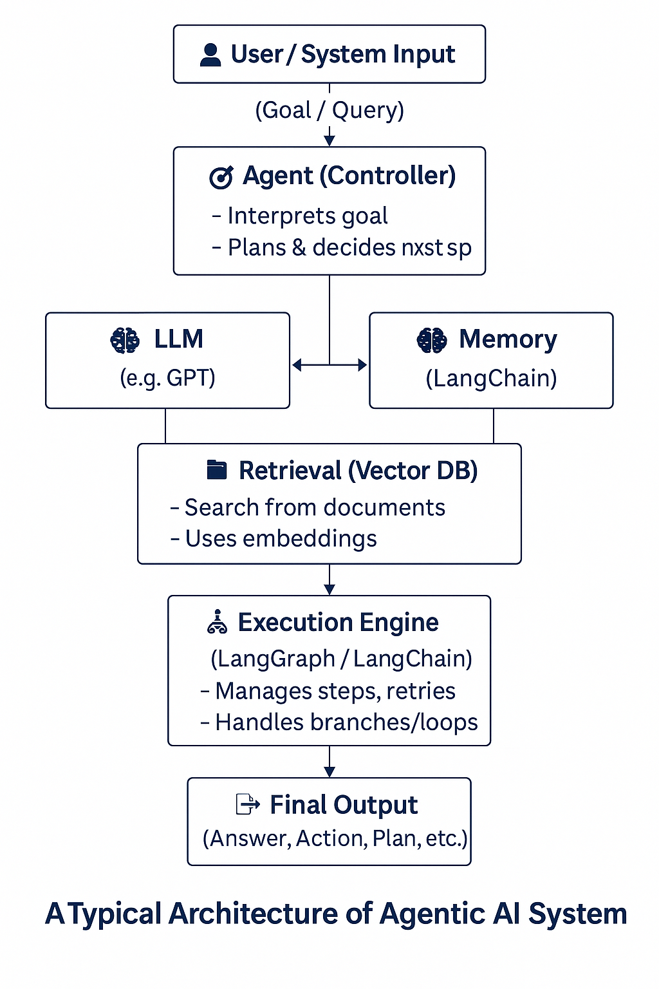
High Level Architecture

Slide 21
🔧 Key Features of GenAI
Content creation: Where gen AI excels is in content generation. The AI models can create coherent context like essays and answers to complex problems. AI applications, like OpenAI’s ChatGPT can generate answers, write lists, and give advice when prompted by user input. Using gen AI solutions to produce code can streamline software development and make it easier for developers of varying skill levels to write code.
Data analysis: Generative AI can analyse vast amounts of data and use that analysis to discover patterns and trends. The gen AI models can streamline complex workflows, especially when it comes to the supply chain and drive a better customer experience.
Adaptability: Gen AI can adapt its outputs based on the input it receives from the user. If the user is providing specific feedback to the model the outcome shifts to align more to what the user is seeking and in turn refine the output.
Personalization: Gen AI technology can make personalized recommendations and experiences based on the inputs from the user. The retail industry has, for example, taken to highly personalized experiences for their customers thanks to gen AI technology that is helping them understand every detail of their customer preferences.

Slide 22
🔧 Key Features of Agentic AI
Decision-making: Because of the pre-defined plans and objectives these AI systems can assess situations and determine the path forward without or with minimal human input.
Problem-solving: Agentic AI uses a four-step approach for solving issues; perceive, reason, act, and learn. These four steps start by having AI agents gather and process data. The LLM then acts as an orchestrator that analyses perceived data to understand the situation. And is then integrated with external tools that are continuously improving and learning through feedback.
Autonomy: Autonomous behaviour defines agentic AI. It’s unique ability to learn and operate on its own make it a promising technology for organizations seeking to streamline workflows and have machines perform complex tasks with minimal human intervention.
Interactivity: Due to its proactive nature, agentic AI can interact with the outside environment and gather data to adjust in real-time. One example is self-driving vehicles, which must constantly analyze its surroundings and make safe, accurate driving decisions.
Planning: Agentic AI models can handle complex scenarios and execute multi-step strategies to achieve specific goals.

Slide 23
Pydantic?
A data validation and settings management library.
Built on Python type hints (uses dataclasses + typing).
Fast, extensible, and integrates well with APIs, especially FastAPI.
Key Features
Type validation at runtime using Python 3.7+ type hints.
Automatic data parsing (e.g., strings to numbers/dates).
Error reporting with clear, structured messages.
Built-in support for JSON serialization/deserialization.
Supports default values, field constraints, nested models.

Slide 24
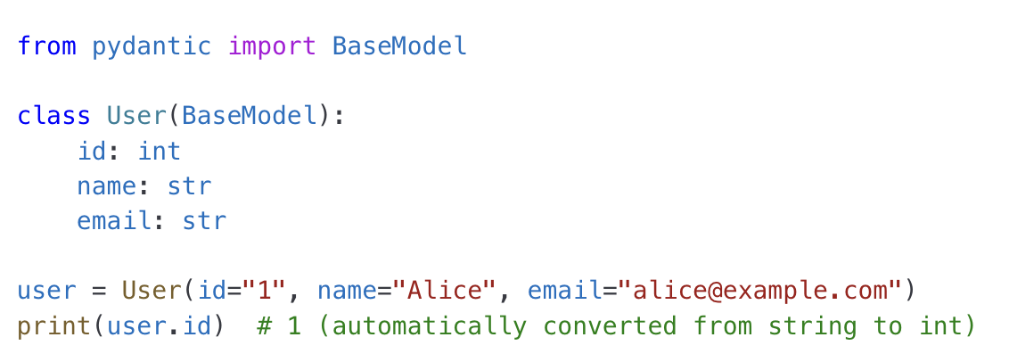
Example

Slide 25
Why Use Pydantic?
Improves data integrity in APIs and applications.
Replaces manual validation logic with declarative schemas.
Simplifies config handling via BaseSettings.
Widely used in modern frameworks like FastAPI, LangChain, etc.

Slide 26
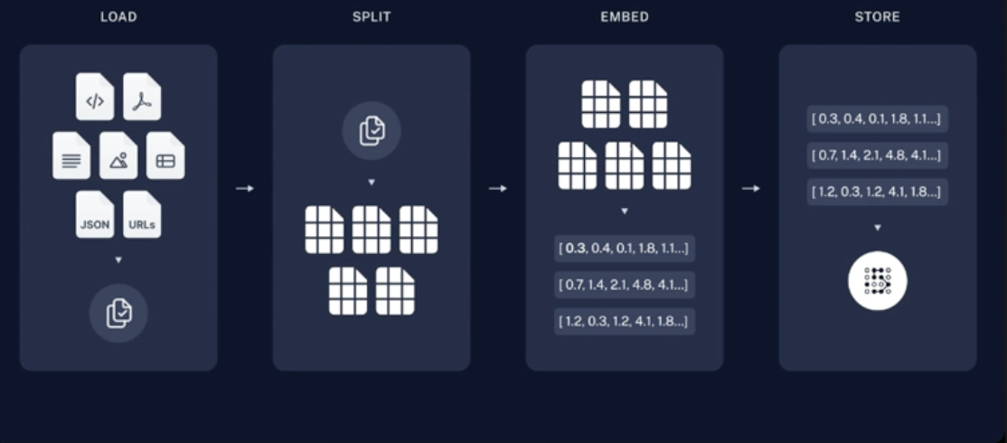
Important Components of Langchain
Data Source
Data Transformation
Embedding
VectorStore DB
FAISS
CHROMA DB
ASTRA DB

Slide 27
Important Components of Langchain
Data Source
Data Transformation
Embedding
VectorStore DB

Slide 28
Important Components of Langchain
Data Source
Data Transformation
Embedding
VectorStore DB

Slide 29
Important Components of Langchain
Data Source
Data Transformation
Embedding
VectorStore DB

Slide 30
Embedding
OpenAI
Ollama
HuggingFace

Slide 31
Embedding
Feature | OpenAI | Hugging Face | Ollama
Quality | ⭐⭐⭐⭐⭐ | ⭐⭐⭐⭐ (varies) | ⭐⭐⭐
Offline Support | ❌ | ✅ | ✅
Open Source | ❌ | ✅ | ✅
Ease of Use | ✅ (simple API) | Medium | ✅
Customization | ❌ | ✅ | ❌
Cost | Paid (token) | Free (local) / Paid | Free (local)
Best For | RAG, Prod Cloud | Offline RAG, Open Dev | Local agents

Slide 32
Which one to choose?
Use OpenAI if:
You want the highest quality embeddings, and cost + cloud is not a concern.
You're building an enterprise-grade chatbot or RAG pipeline.
Use Hugging Face if:
You need flexibility (local, custom models) or are working in regulated environments.
You're doing research or experimentation.
Use Ollama if:
You want a fast, local, no-internet-required setup for prototypes, demos, or privacy-focused tools.
You're already using Ollama for your LLMs.

Slide 33
Important Components of Langchain
Data Source
Data Transformation
Embedding
VectorStore DB
FAISS
CHROMA DB
ASTRA DB

Slide 34
Appendix

Slide 35
https://vimeo.com/1052265114

Slide 36
Aspect | Traditional ML / LLM | Agentic AI
Task | One-shot response: You give an input (like a prompt or data), it gives an output in a single step. Example: "Summarize this article" → summary generated. | Multi-step goal pursuit: It doesn't stop at one reply. It breaks down goals into steps, makes decisions, and continues until the goal is achieved. Example: "Analyze market trends and recommend top 3 stocks."
Memory | Stateless: No memory of previous tasks or interactions. It reacts only to the current input. | Maintains memory/state: Remembers past actions, context, and decisions during or across sessions. Useful for long tasks and personalized experiences.
Tools | Passive usage: May use tools via prompt chaining or plugins, but doesn’t actively decide when/how to use them. | Actively uses tools/APIs: Chooses which tools to use, when, and how—like searching the web, calling APIs, or using a calculator mid-task.
Control Flow | Prompt in → Response out: It reacts and replies. No loops, decisions, or branching logic. | Plans, loops, branches: It builds a plan, adapts as it works, can retry, branch out, or delegate tasks to other agents.
Use Case | Q&A, classification, regression: Predictive tasks, summarization, translation, document parsing. | Workflow automation, orchestration: End-to-end task execution, such as automating research, filling reports, or coordinating agents.

