Slide 1

Teradata Migration
Vikas Chandra

Slide 2


Problem Statement
What are the challenges with the current Legacy Teradata environment?
Why cloud migration is necessary?
Identify tech stack required for cloud migration.
Prepare a detailed Teradata migration plan.
Sridhar Chunduri
Manoj Yadav
Nidhi Pratapneni
Ravi Natrajan
Nirupama Guruprasad
Dhiman Shah
Archana Jaganathan
Ashu Jain
Kamesh LN
Barath Sampath

Slide 3


Current Spending : $ 326,970,000
Future Spending: $ 485,934
Org | TBs (Allocated) | TBs (Used) | $AMC/GB | Yearly Cost
EIW | 1892 | 567 | 54 | 102168000
C2T | 631 | 361 |  | 34074000
BMG | 2036 | 1180 |  | 109944000
Wholesale | 1496 | 669 |  | 80784000
Total | 6055 | 2777 |  | $ 326,970,000
Cluster Size | # Clusters | Price | Total
XL | 4 | 12777 | 51108
L | 4 | 6519 | 26076
Compute | 12 node * 8 | 3390 | 325440
Storage (actual*$30) |  |  | 83310
Total |  |  | $ 485,934

Slide 4
Challenges
Schema
Teradata to target
1:1 mapping
IAM
Access control on
various objects
Queries and Workloads
SQL Query migration to support target and repointing existing reports/analytics to new database
Capacity Planning
Disk storage, memory,
YoY growth
Testing & Validation
Data/Report validation between Teradata and Target
Initial migration
Bulk movement of historical data
Ingestion pipeline
Setup data Ingestion pipeline from different sources

Slide 5











Tools Evaluated
Factors considered

Slide 6
Price
Performance
Ease of Use
Scalability
Security
Total Saving in 5 years = $ 326484066
Snowflake Performance is mostly better than Redshift
Both Snowflake & Redshift are easy to use
Snowflake is slightly easier than Redshift
Both Snowflake & Redshift have advance scalability features
Snowflake falls behind in this race
Both Snowflake & Redshift have Robust Security Features
Protects confidentiality and integrity of data
Compliant with industry-specific regulations such as HIPAA and PCI DSS

Slide 7

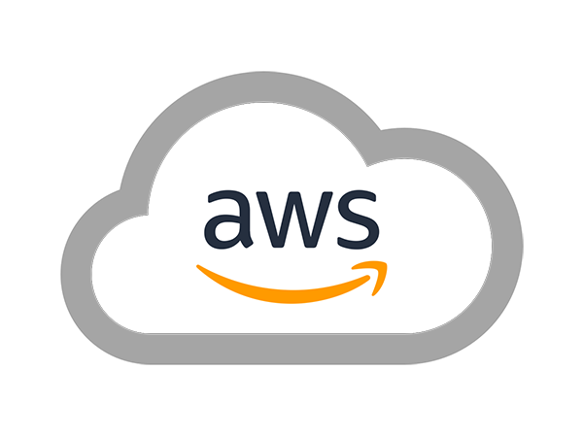
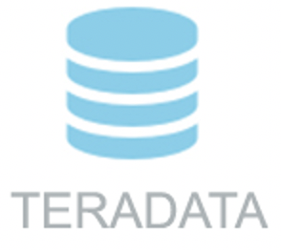
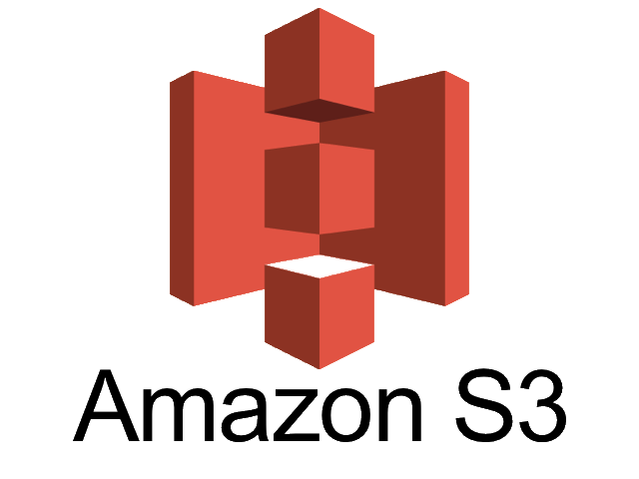





Migration Plan
On-premise Datacenter
5
Metadata
1
2
Shipping
3
4
6
9
10
8
Internet
7

Slide 8
Pipeline & Cutover
Analyze current Teradata Usage
Integration Plan
Setup Cloud Databases
Migrate DDLs
One time Load
Setup ongoing Pipeline
Update Applications
Validations on Prod Parallel
Decommission Teradata
Which databases & tables are to be migrated?
Which users, roles, and applications have access to these databases?
How is data getting loaded into these tables?
Which scripts and applications are responsible for the data load?
How is data in these tables getting used?
Which scripts and applications are pulling data from these tables?
Don’t go for a Big bang migration, go for a phased approach
Vertical slice migration - – i.e. end-to-end ingestion, migration, and consumption
Use automation & tools
Create databases and warehouses on Snowflake
Create users and accounts on Snowflake.
Export DDL
Convert to Snowflake schema using automation/tool
Use Snowball for onetime faster data migration
Use Airflow for scheduling
Till cutover, copy in both Teradata and Snowflake
Use Prod Parallel till cutover
Configure prod parallel apps to start consuming from Snowflake
Phase 1: Teradata – Primary, Snowflake – Secondary
Phase 2: Snowflake – Primary, Teradata – Secondary

