Slide 1

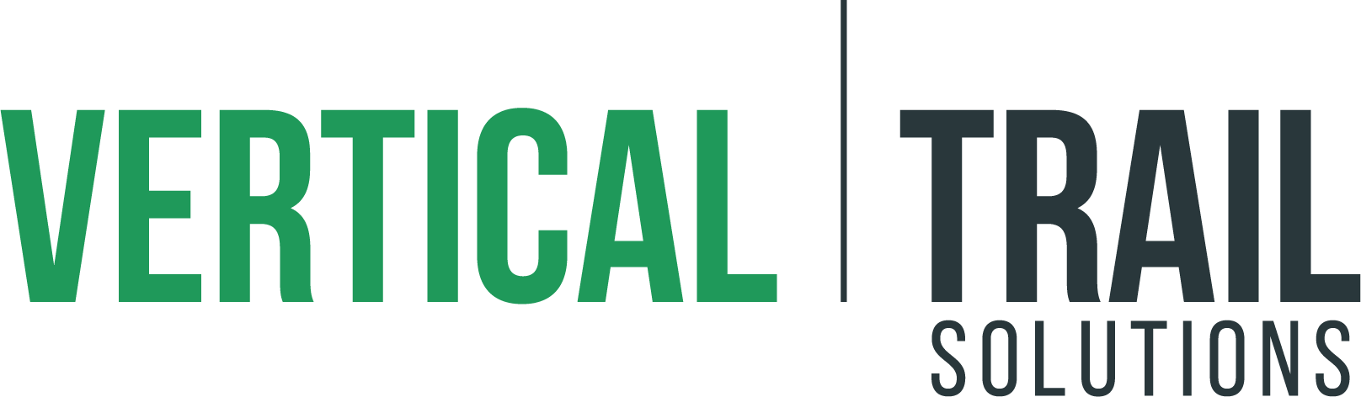
Enhancing Local Serverless Development Using AWS SAM and Docker
Prepared for AWS Community Day | Midwest
Val Chapman, Cloud Engineer
Vertical Trail LLC
June 2020

Slide 2
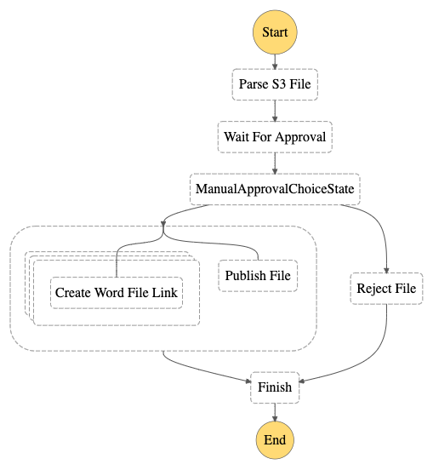

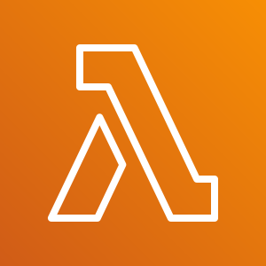


Step Function
Resources
Workflow
AWS Step Functions Workflow
AWS Lambda
Manual Approval
Amazon DynamoDB

Slide 3





Step Function Trigger
AWS Cloud
Amazon Simple Storage Service
AWS CloudTrail
Amazon CloudWatch
AWS Step Functions

Slide 4
AWS Services and Local Solutions
AWS Service | Local Implementation
Lambda | Serverless Application Model CLI
DynamoDB | Official AWS DynamoDB Docker Container
S3 | Minio Docker Container
Step Functions | Official AWS Step Functions Docker Container
DynamoDB UI | DynamoDB NoSQL Workbench

Slide 5
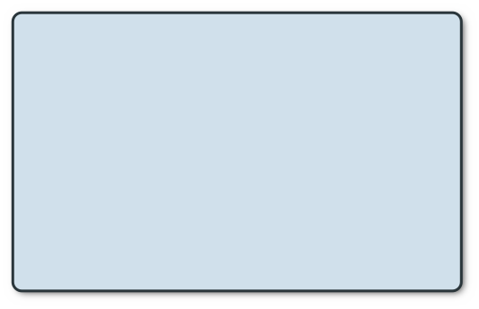
Advantages of Local Development
Faster Feedback Loop
Integration into Build Environment
No Execution Cost
No Internet

Slide 6
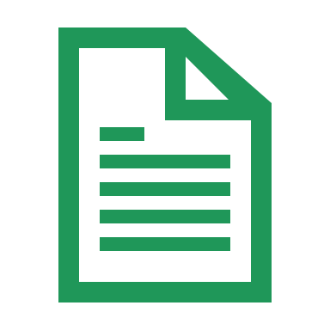


What we can test
Step Function State Transitions and Data Flow
Lambda Execution
DynamoDB and S3 API Calls

Slide 7



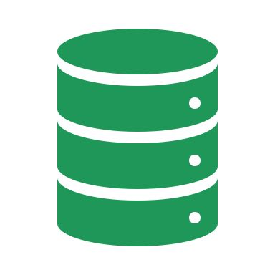
What we cannot test
Networking
IAM Permissions
DynamoDB Provisioned Throughout
Other AWS Service Integrations (e.g., CloudWatch, CloudTrail)

Slide 8
DEMO

Slide 9
QUESTIONS?

Slide 10
References
Code: https://github.com/vchapmanse/local_serverless_with_docker_AWS_SAM
DynamoDB Docker: https://hub.docker.com/r/amazon/dynamodb-local
Step Functions Docker: https://hub.docker.com/r/amazon/aws-stepfunctions-local
AWS SAM CLI: https://docs.aws.amazon.com/serverless-application-model/latest/developerguide/serverless-sam-cli-install.html
DynamoDB NoSQL Workbench: https://docs.aws.amazon.com/amazondynamodb/latest/developerguide/workbench.html
Minio: https://hub.docker.com/r/minio/minio/
LocalStack: https://hub.docker.com/r/localstack/localstack/

