Slide 1
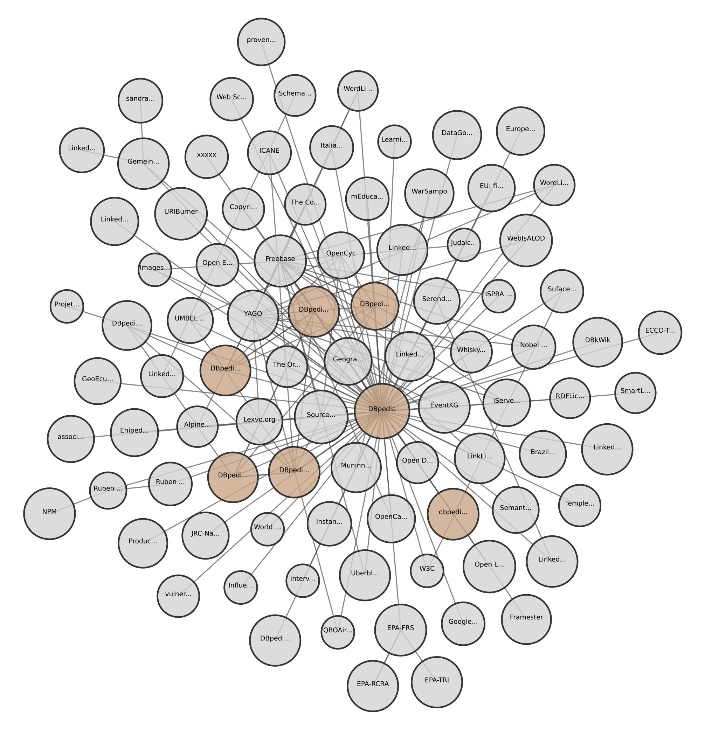


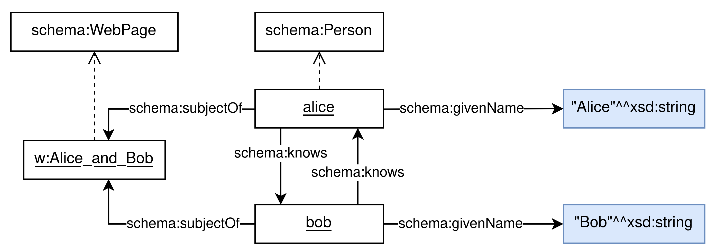
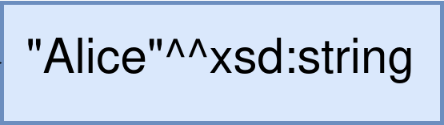
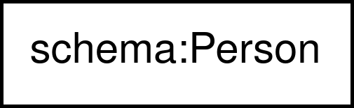

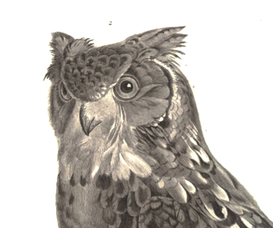
OWL
Web Ontology Language
Data (ABox)
The Linked Open Data (LOD) cloud is a collection of more than 1,5k interlinked RDF graphs.
Knowledge is expressed on the Web in the Resource Description Framework (RDF), a graph data model.
RDF Model
Node | URI | Universally named resource
 | Blank node | Anonymous resource
 | Literal | String, number, date, etc.
Triple | 3-tuple of the form (subject, predicate, object)
Graph | Set of RDF triples
Credits: https://www.lod-cloud.net/ (CC BY)
A. Hogan et al., Knowledge Graphs, Morgan & Claypool, 2021.
chapters 3 and 4 about OWL
representation in the Chowlk visual notation
Schema (TBox)
Semantics
Horn logic / Datalog
Web ontologies are made of a vocabulary and logical axioms over that vocabulary. The underlying formalism of OWL is a Description Logics (DL) called SROIQ.
OWL has model-theoretic semantics: terms defined in the vocabulary map to a domain of interpretation, whose structure is constrained by ontological axioms.
Δ^{I}
Knowledge is often expressed in a rule langage such as Datalog. Such langages are all based on the properties of Horn clauses.
(schema:Person)^{I}
Vocabulary
Class | Set of resources
Object property | Relation between two resources
Datatype property | Relation between a resource and a literal
Named individual | Same as URI node
Interpretation Function (·^{I})
owl:Thing | Δ^{I}
owl:Nothing | ∅
(not C)^{I} | Δ^{I} ∖ C^{I}
(C and D)^{I} | C^{I} ∩ D^{I}
(C or D)^{I} | C^{I} ∪ D^{I}
(p some C)^{I} | { r₁∣∃.r₂ (r₁, r₂)∈p^{I} and r₂∈C^{I} }
(p only C)^{I} | { r₁∣∀.r₂, (r₁, r₂)∉p^{I} or r₂∈C^{I} }
(p value i)^{I} | { r₁∣∃.i^{I} (r₁, i^{I})∈p^{I} }
(p Self)^{I} | { r∣(r, r)∈p^{I} }
({i, j, k, ...})^{I} | {i^{I}, j^{I}, k^{I}, ...}
(inverse p)^{I} | { (r₁, r₂)∣(r₂, r₁)∈p^{I} }
(p o q)^{I} | { (r₁, r₃)∣(r₁, r₂)∈p^{I} and (r₂, r₃)∈p^{I} }
(schema:WebPage)^{I}
The intersection of Horn logic and SROIQ is called DL rules. Rules beyond this fragment are however commonly used in Web ontologies via the Semantic Web Rule Language (SWRL). SWRL rules must be DL-safe.
Class Expressions | Prop. Expressions
C, D owl:Thing, owl:Nothing not C, C and D, C or D p some C, p only C p (min | max | exactly) n C p value i p Self {i, j, k, ...} | p, q inverse p p o q
Axioms
C SubClassOf: D p Domain: C p Range: D p SubPropertyOf: q
I ⊨ α can read either as ‘I models axiom α’ or as ‘I satisfies axiom α’
Rule-based inference
Satisfiability
I ⊨ (C SubClassOf: D) | C^{I}⊆D^{I}
I ⊨ (p Domain: C) | r₁∈C^{I} for all (r₁, r₂)∈p^{I}
I ⊨ (p Range: D) | r₂∈D^{I} for all (r₁, r₂)∈p^{I}
I ⊨ (p SubPropertyOf: q) | p^{I}⊆q^{I}
Reasoning with rules is generally fast. Reasoning procedures are referred to as consequence-based reasoning and consist in applying a small set of rewriting rules until a fixed point is reached.
1M+ classes and properties can be found in the Linked Open Vocabulary (LOV) cloud and in OntoPortal repositories.
defs. given in the OWL Manchester syntax
full def. in Rudolph (p. 20)
full def. in Rudolph (p. 22)
F. Baader, D. Calvanese, D. L. McGuinness, D. Nardi, P. F. Patel-Schneider (Eds.), The Description Logic Handbook : Theory, Implementation and Applications, 2nd edition, Cambridge University Press, 2010.
Sebastian Rudolph, Foundations of Description Logics, 2011.
Modal logics
Tableaux algorithm
Reasoners
Several well-known OWL reasoners are being commercially used.
with chapter 1 as quick overview
The most common reasoning procedure for OWL consists in constructing a model of a knowledge graph (with axioms) until a trivial contradiction is found or the model satisfies all axioms.
Subsets of SROIQ, identified as OWL profiles, have desired properties w.r.t. reasoning complexity.
OWL can be seen as a notational variant of various modal logics. The domain of interpretation then corresponds to a set of possible worlds and binary relations express transitions across possible worlds (e.g. over time).
Profile | Reasoner
DL (SROIQ) | Pellet
 | HermiT
 | FaCT++
RL (Rule language) | RDFox
EL (Existential language) | ELK
 | CEL
QL (Query language) | ontop
Other procedures based on automata have also been devised.
more reasoners on the OWL@Manchester website
All DL fragments, with reasoning properties, are listed on Evgeny Zolin’s website.

