Slide 1
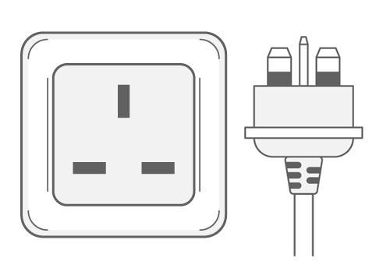
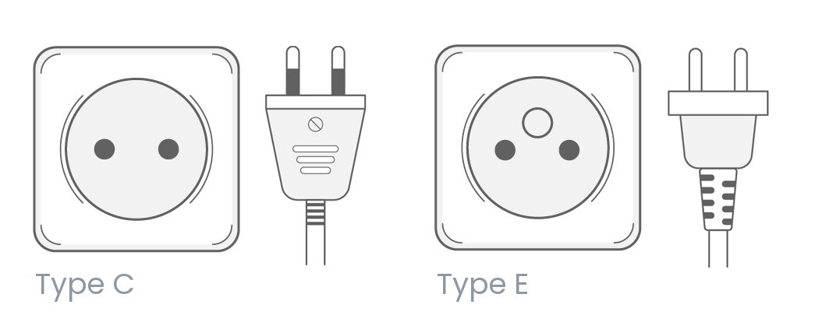
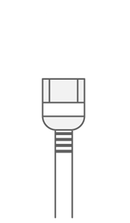

Slide 2
Independent behaviors should be isolated from each other

Slide 3
DO NOT OPEN

Slide 4
DO NOT OPEN
Extensions may be realized via dedicated interfaces
Inspection is still important, though

Slide 6
Components with the same interface have the
same behavior
Components with different behaviors should have different interfaces

Slide 7
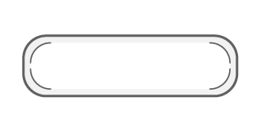

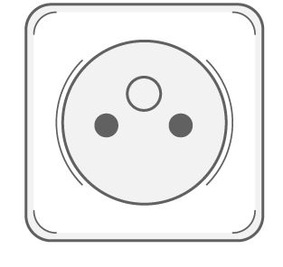

Slide 8
Independent interfaces should be provided separately

Slide 9
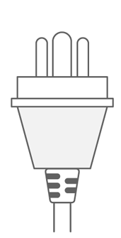

Slide 10
Is this feature really needed?
If two interfaces are available, a component should choose the most generic one

