Slide 1
Image Generation Using Generative Adversarial Nets (GAN)

Slide 2
Introduction
AIM – Generating images from a random vector of noise using Graphical Adversarial Network
Implemented Generative Adversarial Networks using PyTorch Framework
Database used – CIFAR10
Goal achieved by reducing the error between the images generated by Generator and sample data used to train Discriminator

Slide 3
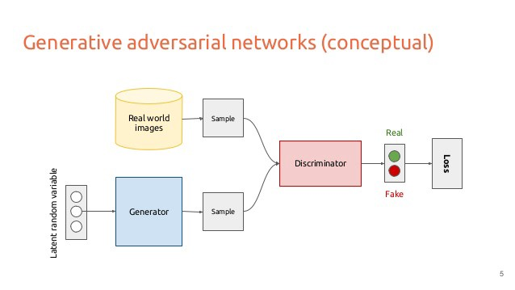
GAN Architecture

Slide 4
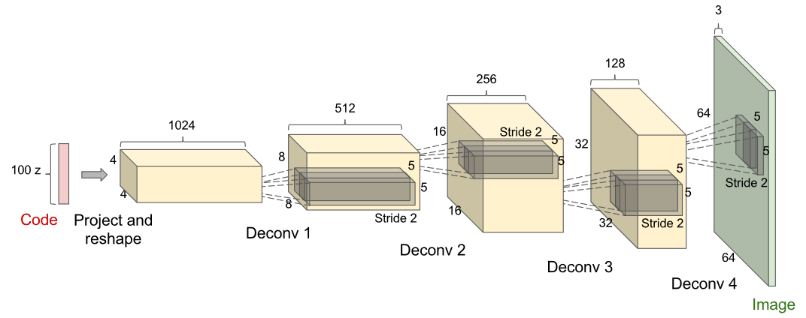
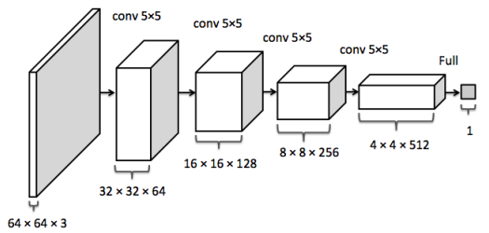
Architecture of Generator and Discriminator

Slide 5
RESULTS
Generator
Discriminator

Slide 6
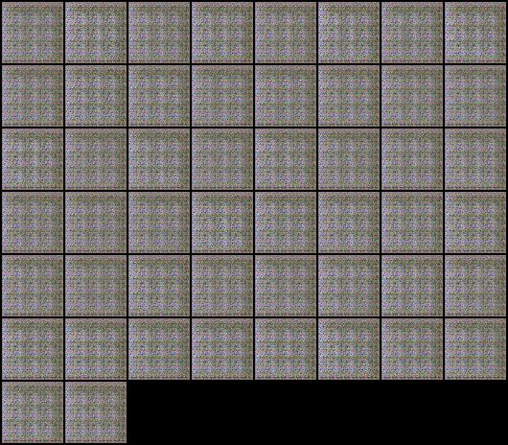
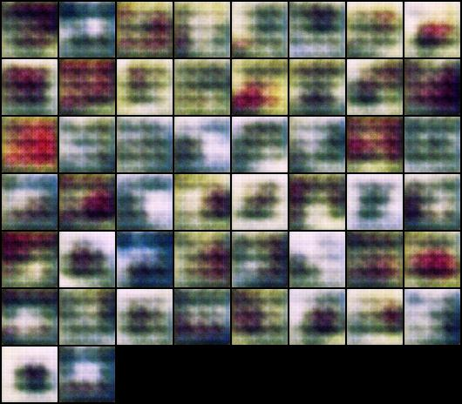
Images Generated During Initial Epochs

Slide 7
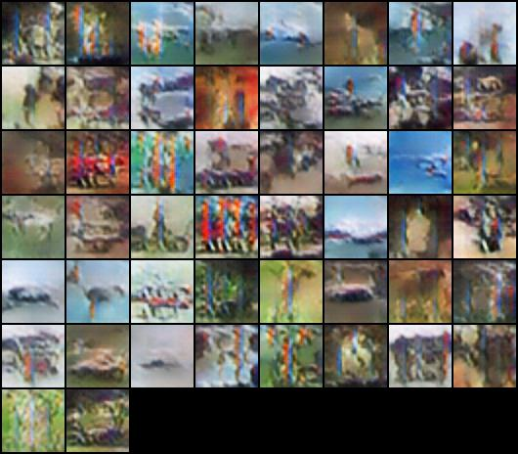
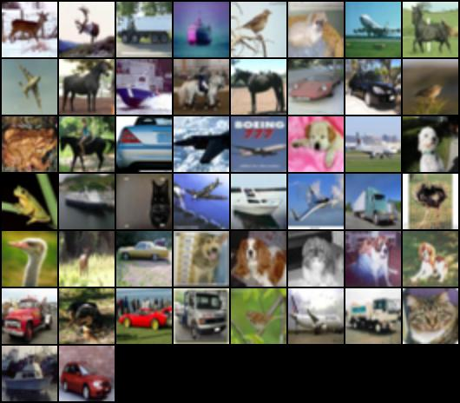
Final Image Comparison
GAN with Epoch 49
Sample Image

Slide 8
Conclusion and Future Work
We observe that as we increase the Epochs the loss difference between the images generated using the Generative model and the trained data that was generated using the Discriminator reduces
Generated Fake images using random vector
For the future work we can work on improving GAN algorithm so that we will be able to generate image of single class instead of all.

