Slide 1

Customer Review Sentiment Analysis using BERT
AI/ML Specialization Capstone Project
By: Vaibhav Krishnakant Chavan,
Course: PGDSAIML-Batch1
Objective: Automate the classification of customer feedback to enable faster response times and improve customer experience.

Slide 2

IMDb Dataset and Preprocessing
Dataset Characteristics
Data Split Strategy
The project utilizes the IMDb Large Movie Review Dataset, a standard benchmark for sentiment analysis.
Subset
Count
Percentage
Training Set
20,000
40%
Total Reviews: 50,000
Validation Set
5,000
10%
Balance: Perfectly balanced (50% positive, 50% negative)
Test Set
25,000
50%
Length: Mean text length of 1,325 characters (approx. 234 words)
Total
50,000
100%
Data Preprocessing Pipeline
To ensure model quality, the raw text underwent rigorous cleaning:
Removal of HTML tags (found in 14,667 reviews)
Removal of URLs and special characters
Conversion to lowercase to standardize vocabulary

Slide 3

Baseline Model: TF-IDF + Logistic Regression
Methodology
TEST ACCURACY
F1-SCORE
To establish a performance benchmark, a traditional machine learning pipeline was implemented:
89.32%
89.38%
Vectorization: TF-IDF extracts up to 50,000 features using unigrams and bigrams.
TRAINING TIME
2.5s
Classification: A Logistic Regression model learns the relationship between word frequencies and sentiment labels.
Highly efficient CPU execution
Advantages & Limitations
Pros: Extremely resource-efficient, highly interpretable, and requires no specialized GPU hardware.
Cons: Acts as a "bag-of-words" model, ignoring word order, grammar, and complex context (e.g., sarcasm).

Slide 4
Advanced Model: Fine-Tuned DistilBERT
Transformer Architecture
TEST ACCURACY
F1-SCORE
To overcome the limitations of the baseline model, a transformer-based approach was implemented using DistilBERT.
91.22%
91.25%
Deep Contextual Understanding: Reads sentences bidirectionally, understanding word context based on surroundings.
TRAINING TIME
INFERENCE
~7.9m
2.17ms
Efficiency: Retains 97% of BERT's language understanding capabilities while being faster.
Requires GPU (T4)
Per sample latency
Training Configuration
Base Model: distilbert-base-uncased
Epochs: 3
Batch Size: 16
Learning Rate: 2e-5
Max Sequence Length: 256 tokens

Slide 5

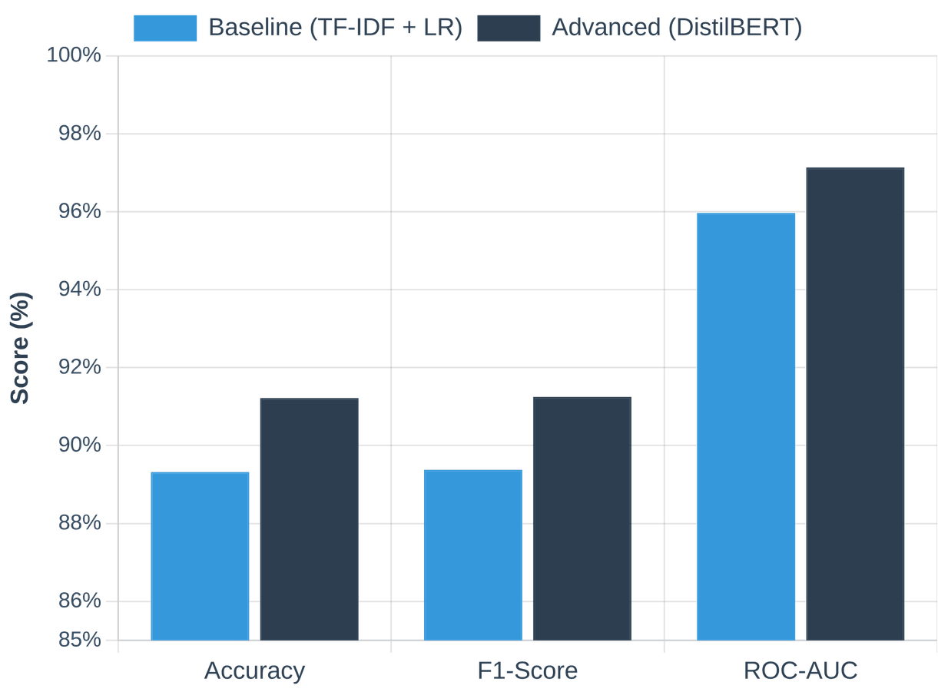
Performance Comparison and Trade-offs
Predictive Performance
Resource Requirements
Metric
Baseline (TF-IDF)
DistilBERT
Hardware
Standard CPU
T4 GPU
Training Time
2.5 seconds
~7.9 minutes
Inference Latency
0.003 ms/sample
2.17 ms/sample
Business Application Suitability
Baseline Model: Ideal for highly cost-constrained environments processing massive volumes of reviews where nuanced understanding (like sarcasm) is less critical.
DistilBERT Model: Best suited for premium customer experience monitoring. The +1.90% accuracy gain and deep contextual understanding justify the higher infrastructure costs when missing a critical complaint is unacceptable.

Slide 6
Error Analysis and Limitations
Overall Error Rate
Known Failure Cases
8.78% Misclassification Rate (2,196 errors out of 25,000 test samples)
CHALLENGE: SARCASM
"Oh great, another superhero movie. Just what we needed. The special effects were amazing though, I will give them that."
Key Challenges
Sarcasm & Irony: The model frequently misinterprets positive words used in a negative or sarcastic context.
Predicted: Positive (89.6% Confidence)
Mixed Sentiment: Reviews that list both pros and cons can overwhelm the primary sentiment, confusing the classifier.
CHALLENGE: NEUTRAL / MIXED SIGNALS
"The movie was not bad, not good, just... there. Like wallpaper."
Input Truncation: The DistilBERT model is limited to a maximum sequence length of 256 tokens. Extremely long reviews lose critical context if the true sentiment is revealed at the end.
Predicted: Negative (99.6% Confidence)

Slide 7
Deployment Strategy
1. Streamlit Web Application
2. FastAPI REST Endpoint
An interactive, user-friendly web interface designed for business stakeholders and customer experience teams.
A robust, high-performance API designed for software engineers and data scientists.
Instant Analysis: Users can paste reviews and instantly view sentiment predictions.
Programmatic Access: Allows automated batch prediction and system-to-system communication.
Confidence Scores: Displays model certainty to aid human-in-the-loop decision making.
Seamless Integration: Easily connects with existing backend systems, ticketing workflows, and data pipelines.
Accessibility: Requires no coding knowledge to operate and evaluate customer feedback.
Scalability: Built on ASGI standards for high throughput and concurrent request handling.
Operational Efficiency: Both deployment artifacts load the serialized DistilBERT model directly into memory upon startup. This ensures low-latency inference and immediate business value without requiring any model retraining.

Slide 8
Conclusion and Future Work
Project Conclusion
Future Enhancements
The capstone project delivered an end-to-end automated sentiment analysis system.
To improve robustness and business value, consider:
Chunking: Overlapping text chunks for reviews >256 tokens.
Aspect-Based: Identify sentiment toward specific features (e.g., acting vs plot).
Superior Performance: Fine-tuned DistilBERT reached 91.22% accuracy vs TF-IDF baseline.
Contextual Understanding: Transformer captured linguistic nuances missed by traditional models.
Multi-Class: Add a Neutral category for nuanced feedback.
Domain Adaptation: Fine-tune on industry datasets for better accuracy.
Deployment Ready: Integrated into Streamlit and FastAPI applications.

