Slide 1
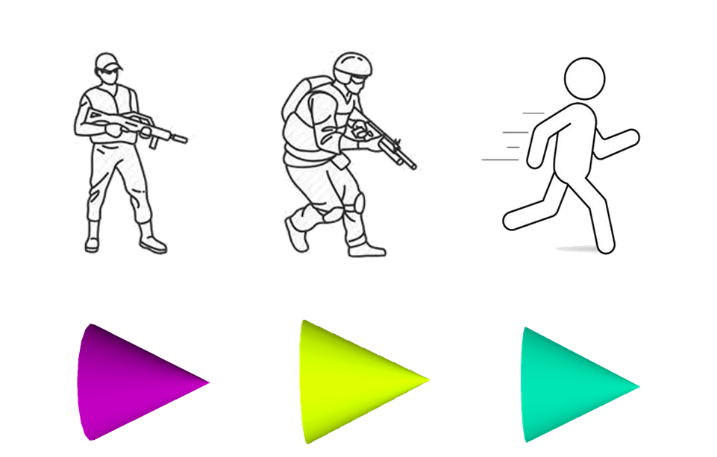
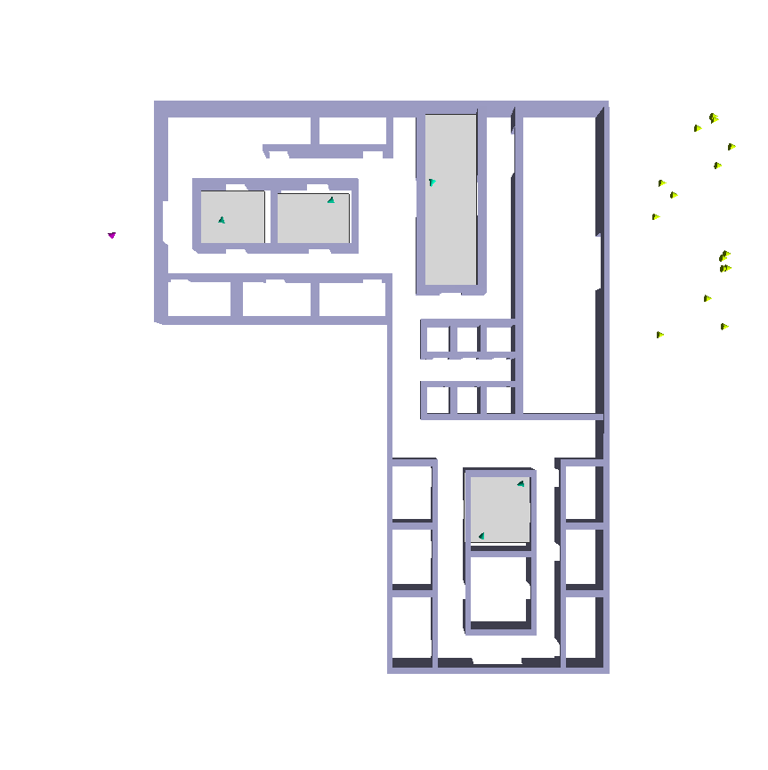
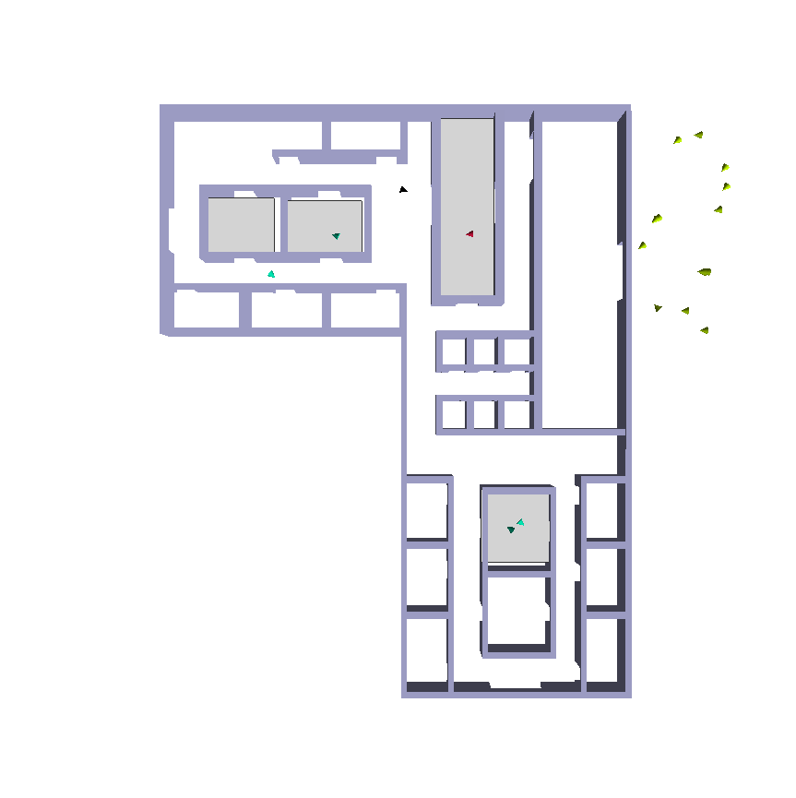
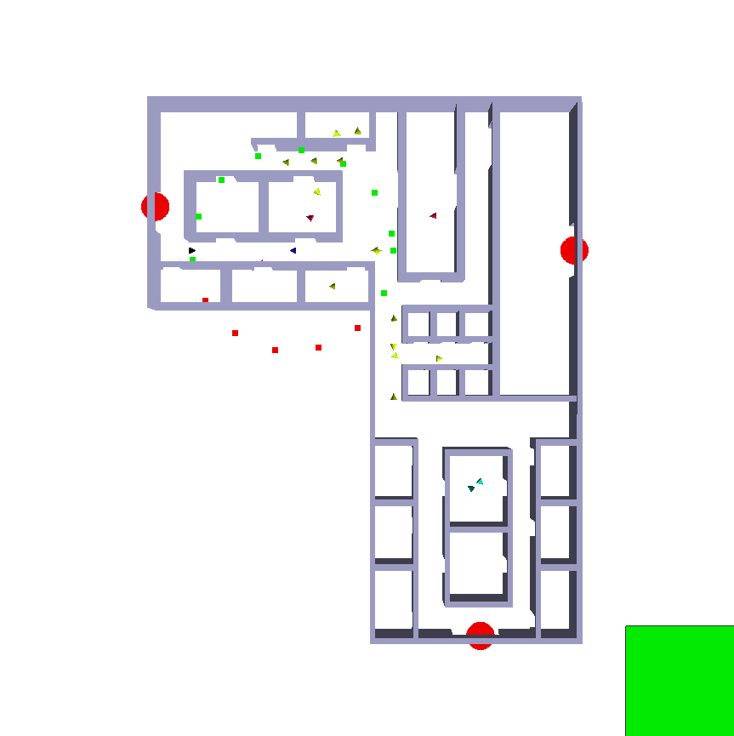

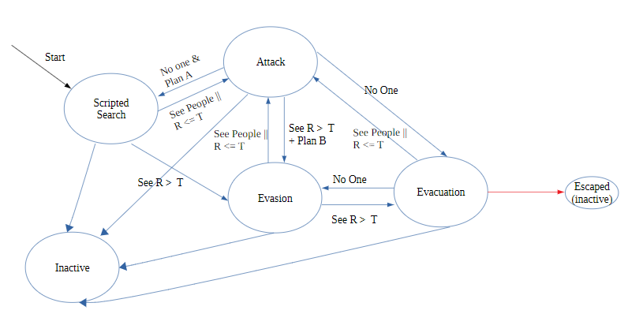
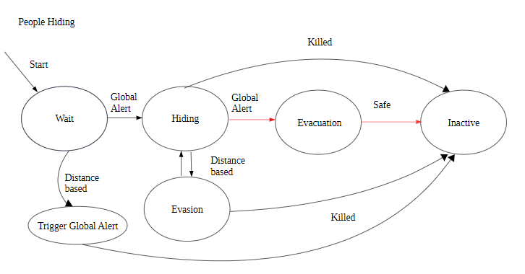


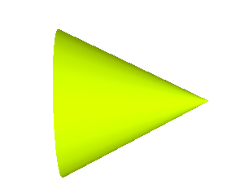
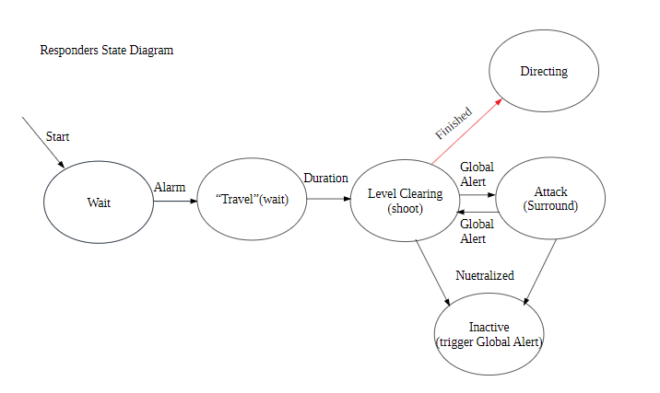
Plan A: Stopping an Active Shooter Simulation of an Active Threat Scenario
Paige Li and Victor Chen | Mentored by Dr. Jory Denny
Problem & Motivation
Agent Overview
Motivation
Provide a preparational tool for law enforcement and campuses to help prepare for active threat crises
Develop an accurate and realistic model of active threat situations by combining a multi-agent system with a physically-based simulator
Problem
How can we model active threat scenarios accurately?
How can we realistically simulate human behaviors and reactions in these situations?
Behaviors
Determines what goal the agent needs to reach
Motion Planner
Determines subgoals needed to avoid obstacles
Local Controller
Determines a force to accelerate the agent
Motion Model
Alters the agent’s position and velocity
Threat Responder People
Multi-Behavior
Active Threat Scenario
We chose to represent our three complex behaviors (Threat, Responder, Person) as state transition diagrams.
Each state in this diagram is a smaller and simpler behavior
Transitions between states represent events in the scenario.
Threat: People:
Responder:
Initial State
Threat and responders start outside the building.
People loiter around inside the structure.
Attack State
Surround State
Threat
Neutralized Person
Surround Positions
Threat attacks people in view range. This sends
an alert to other people in the building to hide and
to the responders to enter the building.
After a responder is neutralized,
other responders will create a surrounding
formation around that agent’s position.
Future Work
References
Experimentally analyze our approach
Improve efficiency and complexity of current behaviors
Simulating these behaviors in multi-level buildings
Improving graphical display
Rodriguez S., Denny J., Zourntos T., Amato N.M. (2010) Toward Simulating Realistic Pursuit-Evasion Using a Roadmap-Based Approach. In: Boulic R., Chrysanthou Y., Komura T. (eds) Motion in Games. MIG 2010. Lecture Notes in Computer Science, vol 6459. Springer, Berlin, Heidelberg
Burchan Bayazit, O & Lien, Jyh-ming & Amato, Nancy. (2003). Better Group Behaviors Using Rule-Based Roadmaps. Springer Tracts in Advanced Robotics. 7.
Notes:
Switch motivation and problem and edit simulation parts

