Slide 1
Visual Construction
A Hololens Project

Slide 2
Members:
Sadek Almuganahi(unity)
Jonathan Trembley(fbx modelling)
Robert Slick(db and fbx modelling)
Vincent Cheng(file transfer, Winforms fe)
Bryon DeYoung(hololens)
Bin Li(web)

Slide 3

LPCiminelli
Largest General Contracting Company in Buffalo Area
Already uses VR to bid jobs
Asked for a solution to a problem:
How to change the Contractor to Contractor Relationship on existing job sites.
Notes:
Lady we met with was Melinda S. Hoffman. Talk about how she explained the problems they were having with subcontractors.

Slide 4
The Solution: Our Vision
Use AR, specifically Microsoft’s HoloLens, to display the models of buildings against the existing, unfinished building.
Depending on the size of the model, we need to break it down in some logical manner and have the hololens render only so much model around the user.
Have a Presentation Mode, where a user could display the model to customers for bidding purposes

Slide 5
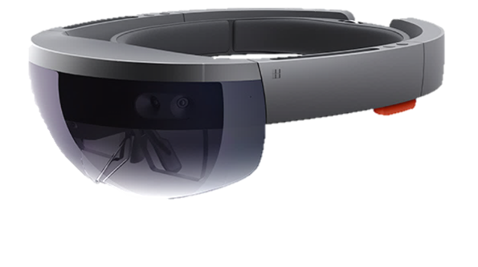
HoloLens: What is it? How it Works
Hololens is an augmented reality device developed and manufactured by Microsoft.
It is a headset computer running the Window Holographic platform under the Windows 10.
Containing holographic lenses and a depth camera as well as speakers above the ears and on-board processing.
Produce holographic and interact with the real world holograms by gesture and voice command.
Notes:
Talk abot limitations of hololens and large size files of fbx.

Slide 6
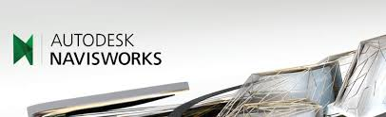

Models
LPCiminelli initially gave us Navisworks .nwd files. Unity cannot render these.
Navisworks, however, can naturally export .fbx files, which Unity does support.
FBX Analyzer
Uses FBX SDK (From Autodesk)
Parses through FBX and breaks the nodes down in a logical manner.
Notes:
This slide could probably be broken into multiple and and simplified. There’s too many words on it.

Slide 7
The Pipeline
The pipeline is what we call the conversions necessary to take a FBX autodesk file and have the model generate as an intractable hologram.
Unity settings such as physics and mesh colliders need to be added
Conversion to a Unity Asset Bundle for transfer and acceptance on Hololens
The reason a ‘server’ application is necessary.

Slide 8
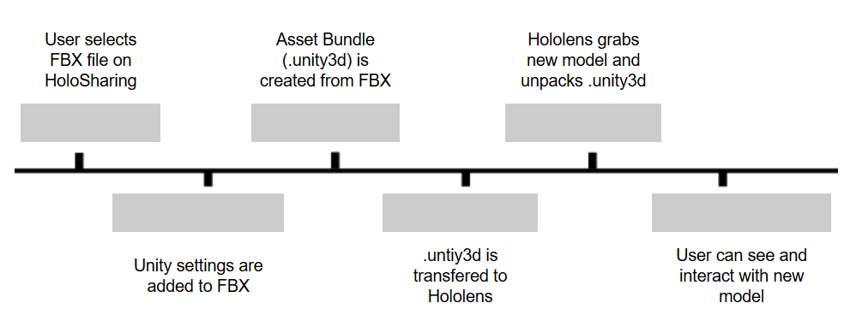
The Pipeline: Continued

Slide 9
HoloSharing
Our Server Application.
Is able to take over the Wireless Adapter of the desktop and create an exclusive WLAN between the Workstation running HoloSharing and the Hololens.
Handles all the settings and conversions necessary for hologram interaction
Will eventually handle FBX breakdown
Will eventually handle as a control panel for device as well

Slide 10
HoloDevelop: Capabilities
It allows the user to take a model of a building and output it as a 3-D model in Augmented reality
You can take the model and resize it, move it, and rotate it, take measurements of said model or real world objects.
Project also has an option to be voice controlled

Slide 11
HoloDevelop: Spatial Mapping
Hololens uses Microsoft Kinect Infrared Tech to scan its surroundings.
Data is stored in multiple 3D objects, which can be viewed as virtual meshes.
This information is used for many tasks:
Object Placement
Distance Calculation
Room Memory
Real World Object Interaction
We plan to use this information to align holograms with reality.

Slide 12
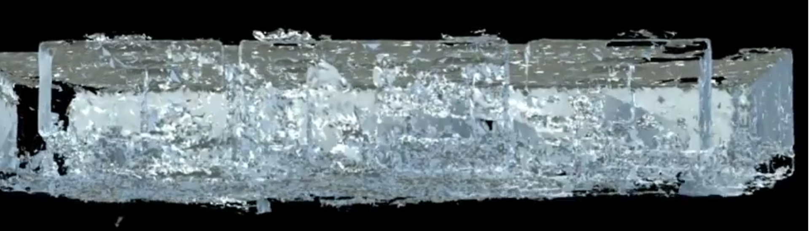
Spatial Mapping: Baldy 19

Slide 13
HoloDevelop: Hologram Interactivity
Gestures: pinch, bloom, tap
Measuring: Tap a starting point and end point,
this will return a distance of both points

Slide 14
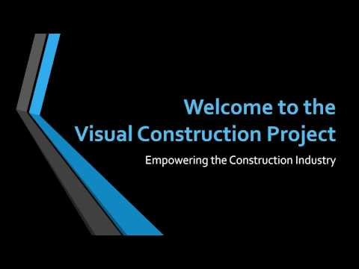
HoloDevelop Video/Demo

Slide 15
Competitor
Vocativ:
Released a similar product, currently has raised $15 million dollars for the in-progress project
Partnered with Mortenson-leader in world of construction, Autodesk, and DAQRI

Slide 16
Challenges
The pipeline has existing struggles
The Hololens is not designed to render files that are not part of a given application. We are currently still trying to work around this obstacle using Unity Scripting and HoloSharing as an anonymous FTP Server.
Spatial Mapping is inconsistent.
When we collect the spatial mapping data from the Hololens, this information is not in a form that can readily be used to align.
Other Challenges:

Slide 17
Future Plans
Website: http://www.acsu.buffalo.edu/~aparagga/
Monetization: GoFundMe, Possible Patent Pending (Per future conversations with UB)
Future Developments:
FBX Breakdown, Pipeline Improvement, Alignment of Hologram
Location tracking
Possible expansion to other industries (Interior Design, Automotive Design)

Slide 18
Technical Summary
We used the following Open Source Projects:
Virtual Router, HoloTool Kit
We used the following SDKs/APIs:
FBX SDK (Autodesk), HoloLens SDK, Unity Editor SDK, Unity Engine SDK
We used the following development Environments:
Unity, Visual Studio, Batch Scripting
We used the following languages:
Visual C#, Visual C++

Slide 19
Any Questions?
Specs for hololens:
https://www.microsoft.com/microsoft-hololens/en-us/development-edition?&SEMID=1&WT.srch=1&ocid=HL_Q2FY17_SEM_Google_OCID-4-Messaging_[OCID-5-Communication]_[Geo]_hololens&wt.mc_id=HL_Q2FY17_SEM_Google_OCID-4-Messaging_[OCID-5-Communication]_[Geo]_hololens

