Slide 1
NYISO Short-Term Load Forecast
Neural Network Model

Slide 2




Neural Network applications
Google ( picture recognition, google translator, spam detector)
Identifying suspicious credit card transactions (used by VISA)
Credit score evaluation
Predicting stock prices Neural Network software was used by LBS Capital Management to predict S&P 500 index with an accuracy of 95%
Weather Forecasting National Weather Service in Texas used neural networks to predict local rainfall to an accuracy of 85%
Predicting Natural Gas Prices Northern Natural Gas in Nebraska has developed a neural network that predicts next month's gas price change with an average accuracy of 97%
Energy Demand Forecasting Siemens Energy company uses forecasting software SENN, that generates very accurate demand forecasts with an error rate of only 3%.

Slide 3
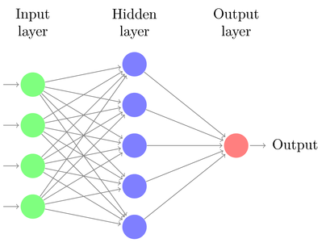
How does it work?
Neural network is a simplified simulation of a human brain. The neural network works as follows: it receives several input signals, processes them through the complex system of interconnected neurons, and creates an output signal.
Hour
Day of the week
Month
Weather Parameters
System Load
Forecasted Volume

Slide 4
Forecasting Process
Jan 2013
Oct 2014
Mar 2015
Training Data
Testing Data
Four Months Gap
Month we want to forecast

Slide 5
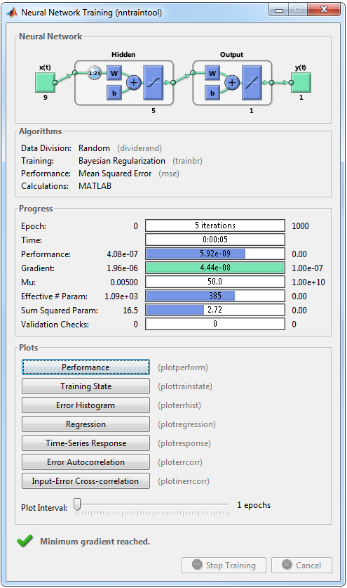
Matlab implementation
Input parameters:
Hour
Day of the week
Month
Wetbulb Temperature
Dewpoint Temperature
Wind Speed
Cloud Cover
Weighted Temperature Humidity Index
System Load
Model development:
Each model is a unique combination of legal entity, utility and zone.
Development requires selecting the right combination of input parameters, neurons, hidden layers, alpha (training rate) and beta (regularization).
Model is validated against first available Version 2 settlement with best run out of 10 tries selected to eliminate local minima error.

Slide 6
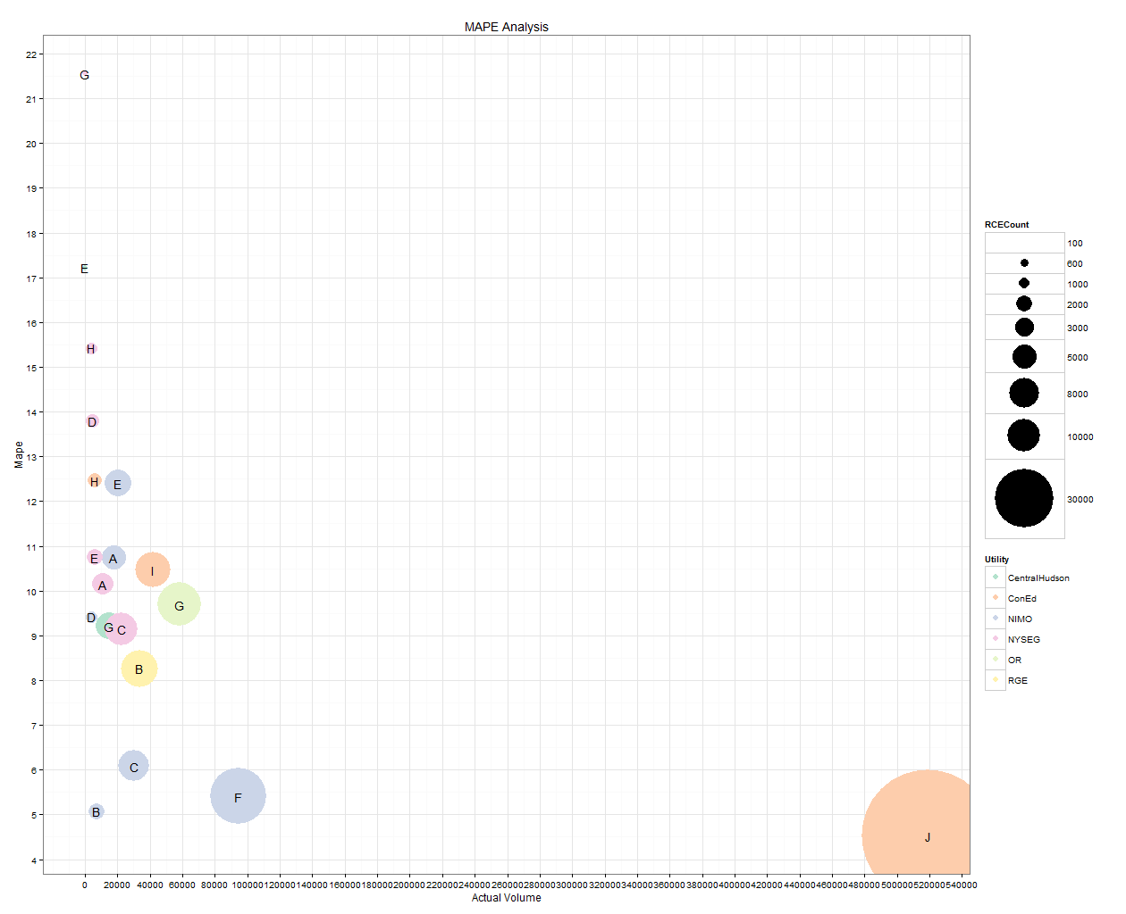
Hudson Results – Utility Zone Analysis
MAPE: 12.47% Weighted MAPE: 6.27%

Slide 7
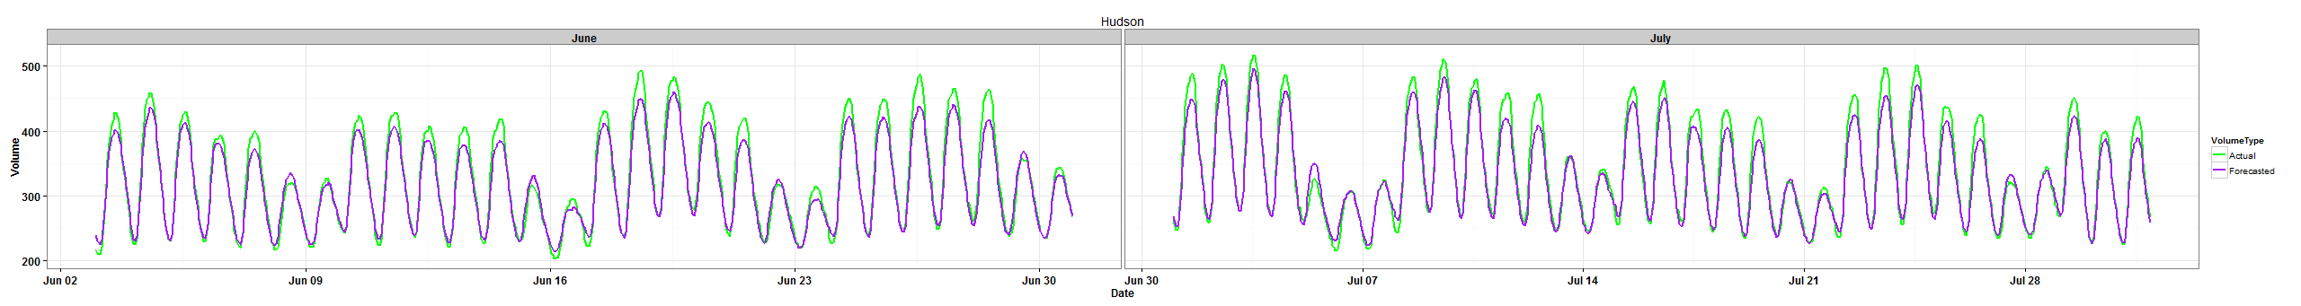
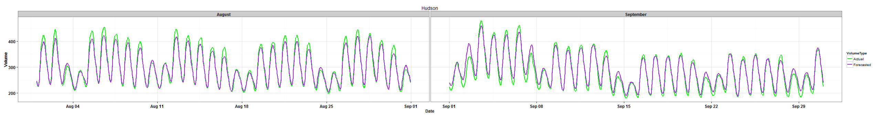
Hudson Results – Overall Summer 2014

Slide 8
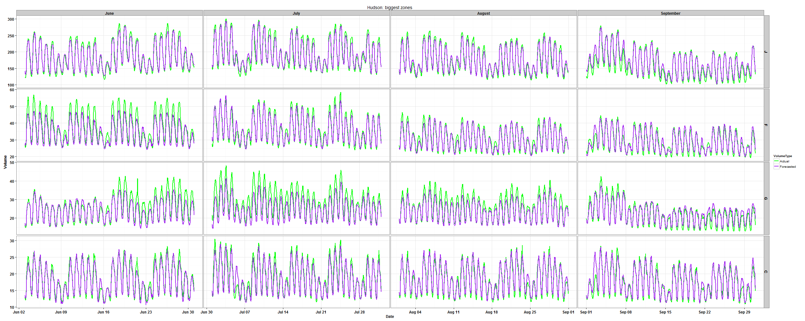
Hudson: Top 4 Largest Zones Summer 2014

Slide 9
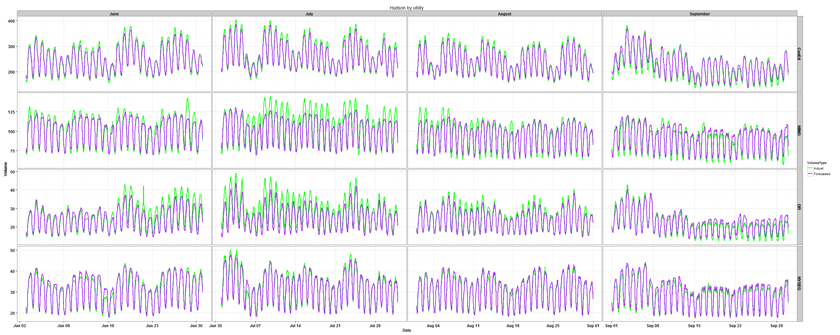
Hudson: Top 4 Largest Utilities Summer 2014

Slide 10
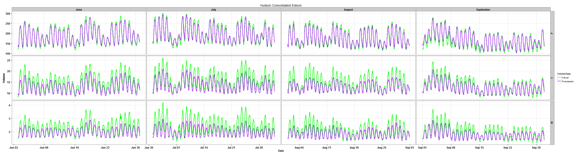
Hudson: Consolidated Edison Summer 2014

Slide 11
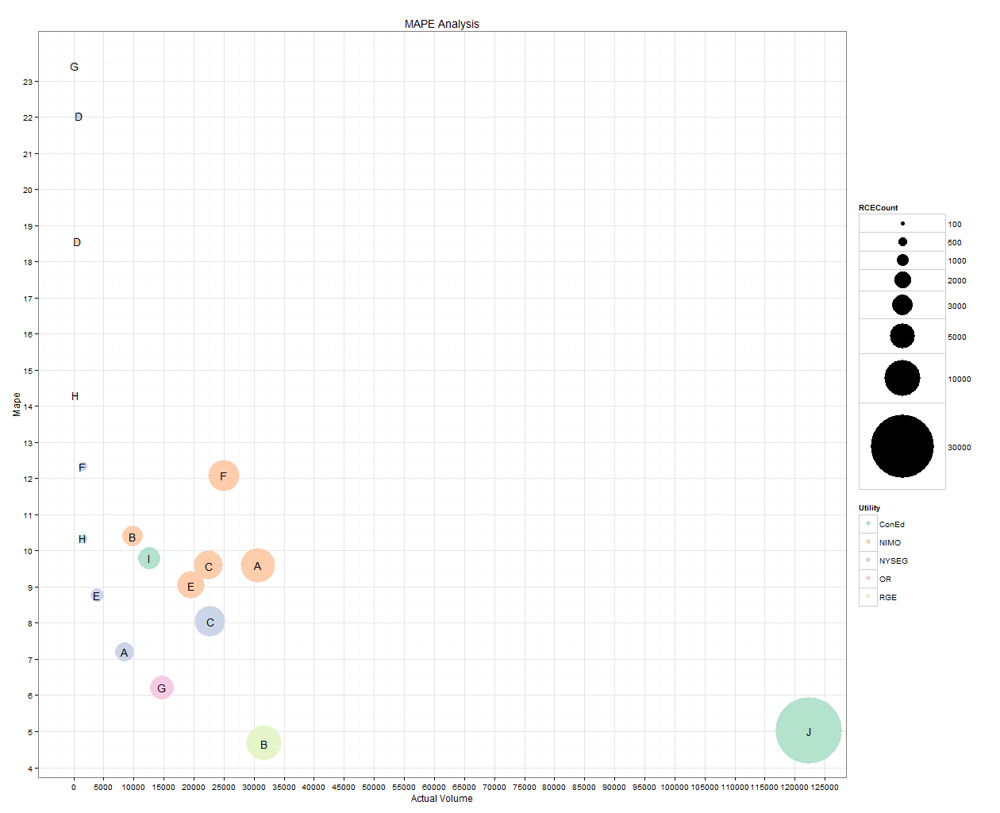
Just Energy Results – Utility Zone Analysis
Mape: 12.48% Weighted Mape: 7.7%

Slide 12
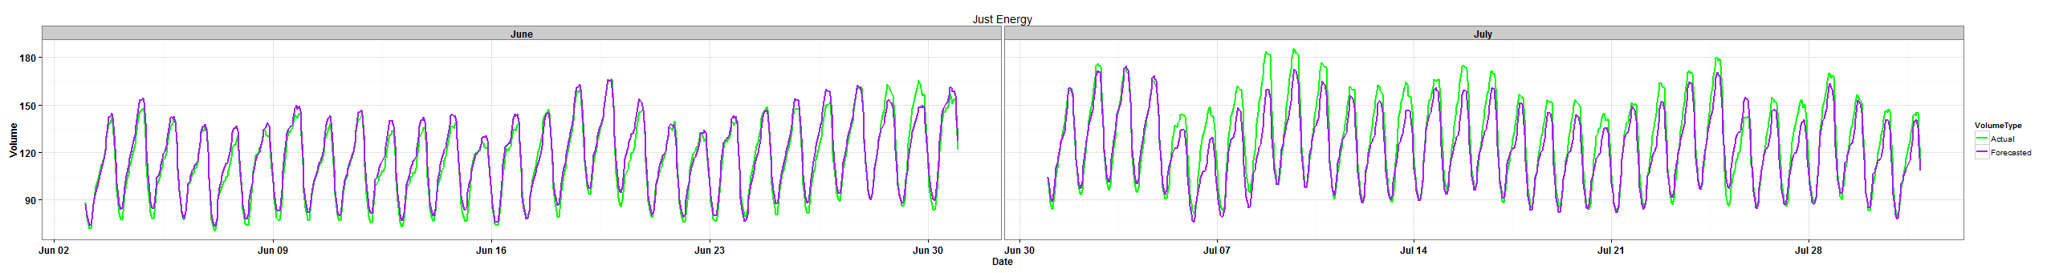
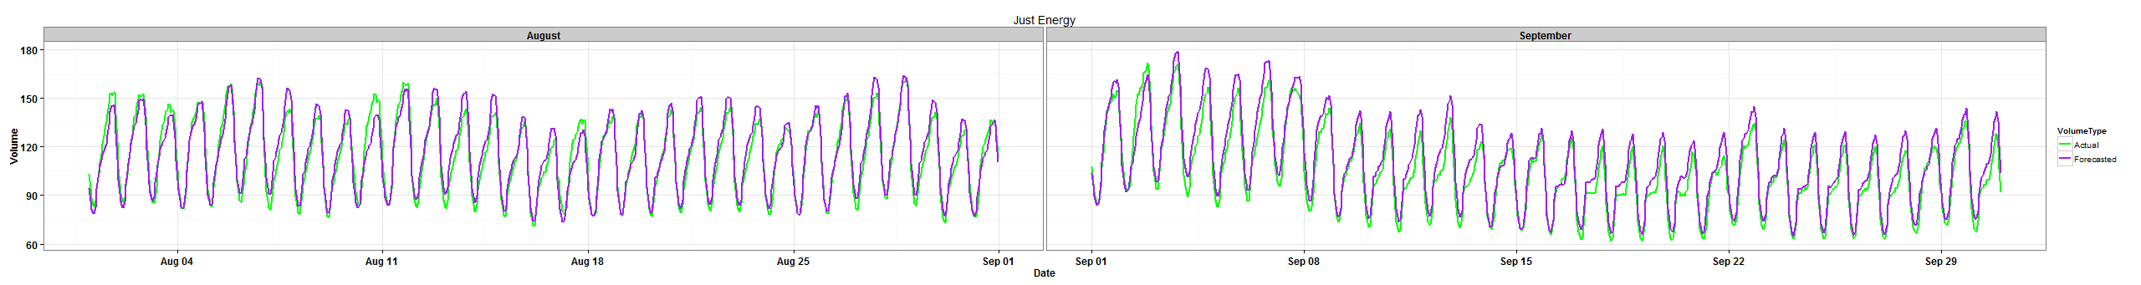
Just Energy Results – Overall Summer 2014

Slide 13
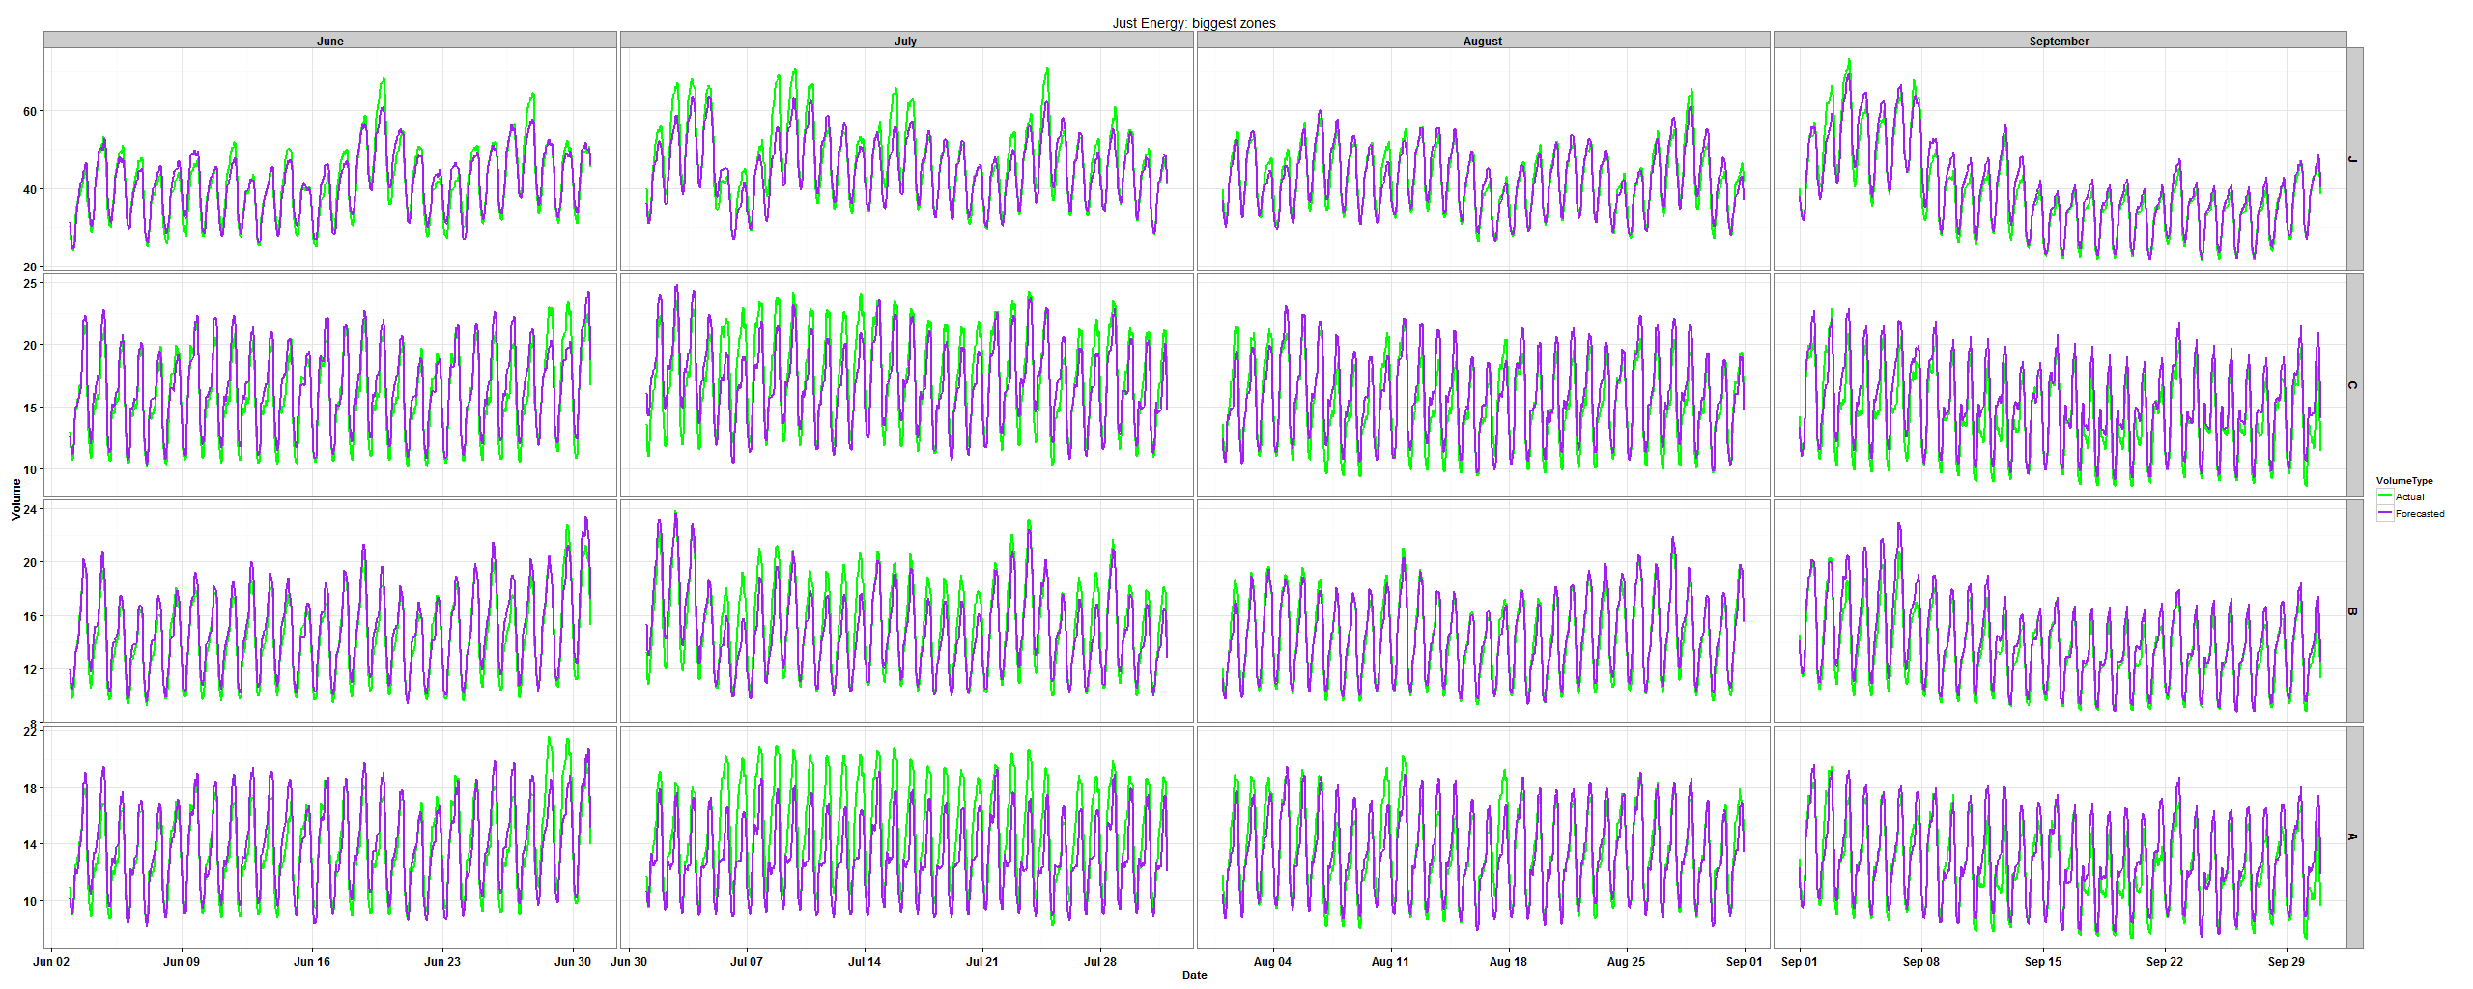
Just Energy: Top 4 Largest Zones Summer 2014

Slide 14
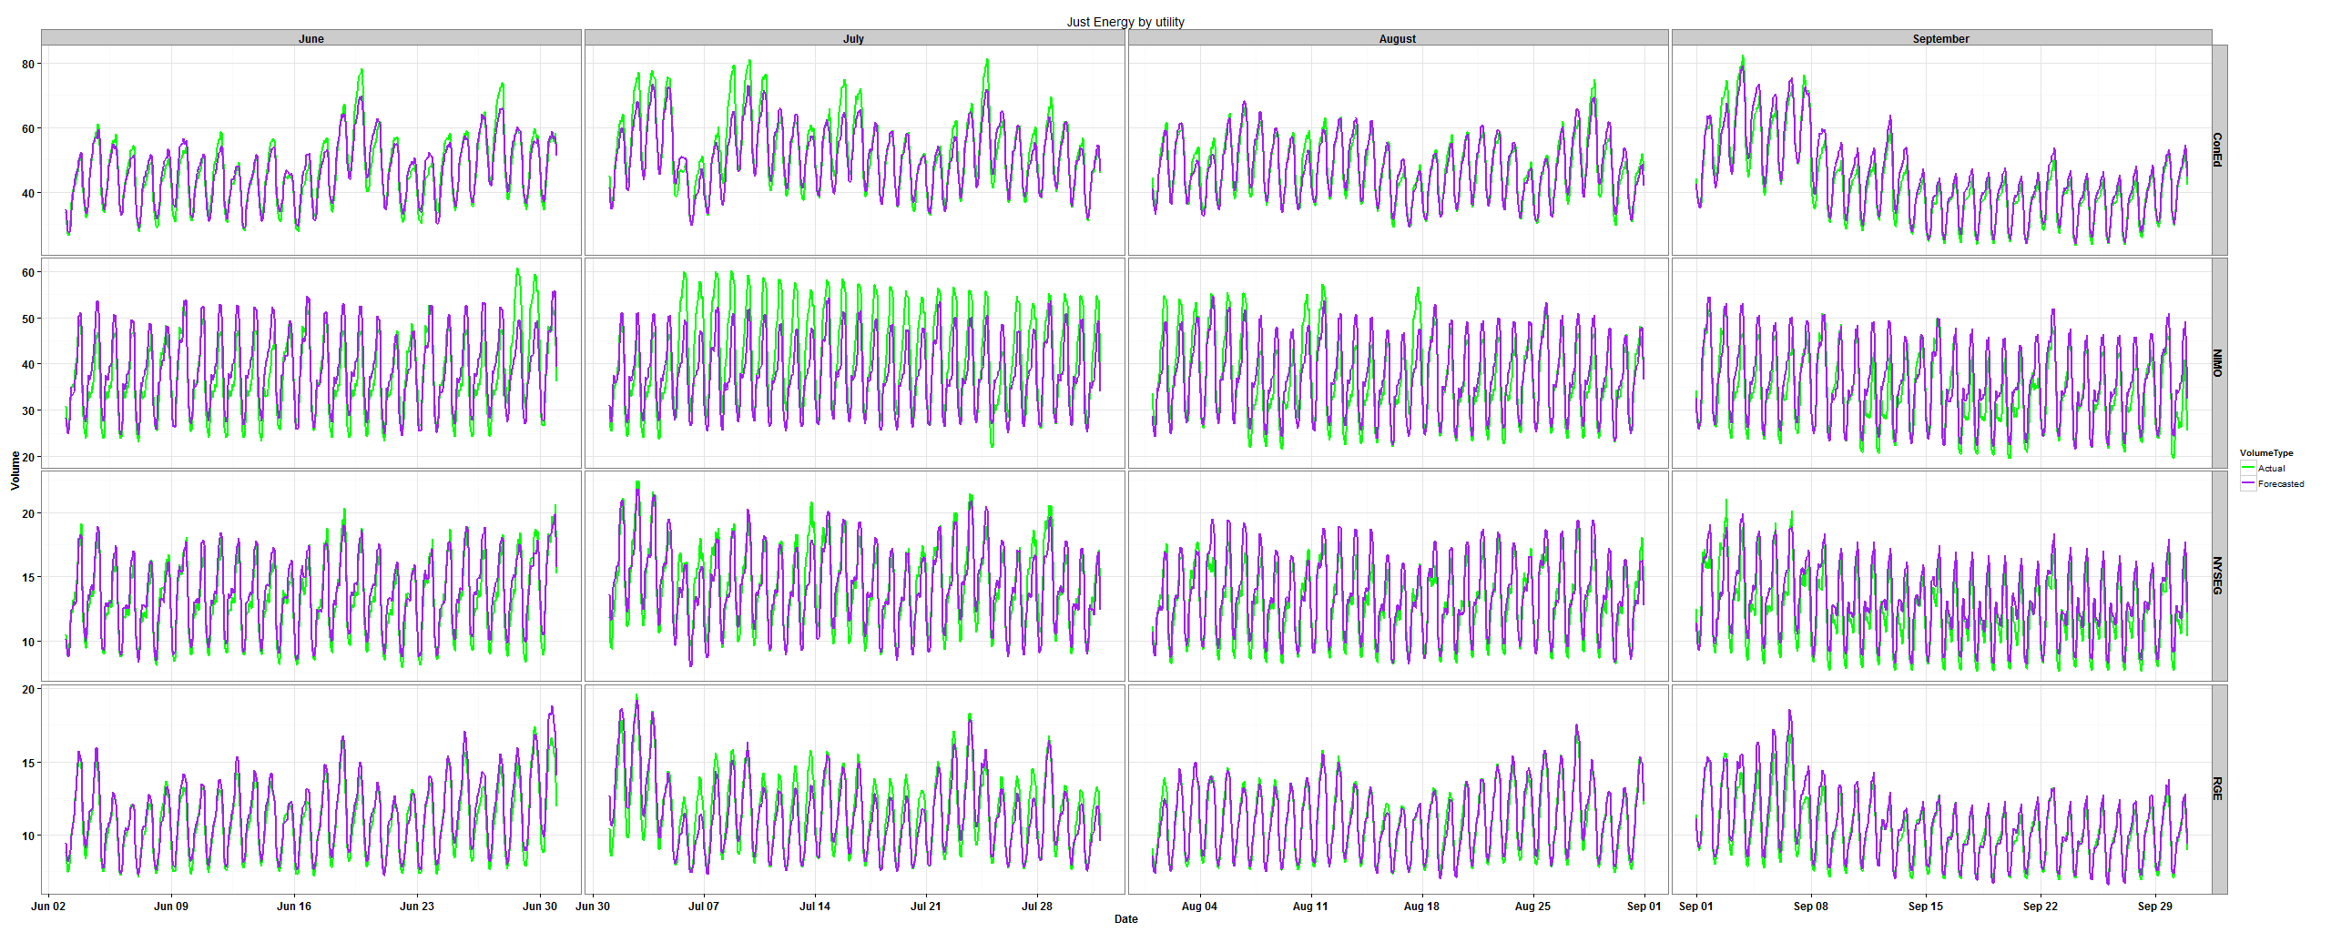
Just Energy: Top 4 Largest Utilities Summer 2014

Slide 15
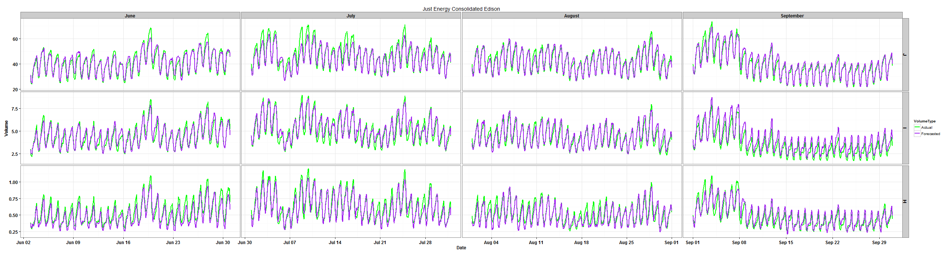
Just Energy: Consolidated Edison Summer 2014

Slide 16
R implementation
The model was replicated in R with similar method
R method gave results consistent with Matlab’s results
R Future Development:
R model was implemented with parameters that were chosen as best for Matlab method. As further development, we will choose parameters, that are optimal for R method

Slide 17
Reproducible Research: Matlab vs. R Hudson

Slide 18
Further Development
The following models require further development before release:
Hudson Energy: OR Zone G, RGE Zone B, ConEd Zone I, NYSEG Zone C, Central Hudson Zone G, Nimo Zone E and Nimo Zone A.
Just Energy: NIMO Zone J, NIMO Zone F, NYSEG Zone C and NIMO Zone E.
All models should be replicated in R:
Reproducible research.
Better access to additional packages and customization.
R models can be distributed without purchasing additional licensing.

Slide 19
Implementation and General Process
Monthly tasks:
Update historical inputs: Settlements, System Load, Contract info, and Weather data.
Retrain all models with one month additional data.
Compare variance in test month against previous model and investigate any negative variances.
Determine any model that is a candidate for redevelopment based on size and negative variance.
Daily tasks:
Update forecast inputs: System Load, Weather and Contract info.
Run trained model for next 14-day updated weather forecast.
Publish daily updated Short-Term forecast with variance from previous day’s report.

