Slide 1
EDU PREDICT TOOL
PREDICTING ENROLLMENT TRENDS IN HIGHER EDUCATION IN THE USA
MSDS Capstone –FA 24 DSCI 6051-02

Slide 2
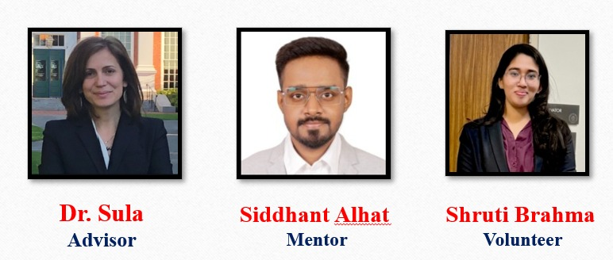
Advisor and Mentors

Slide 3
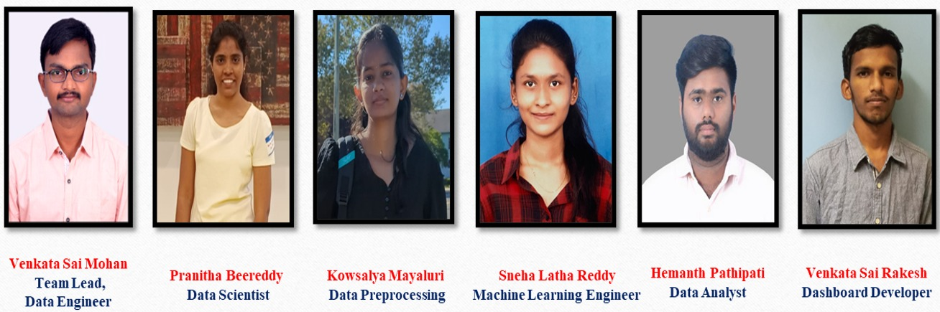
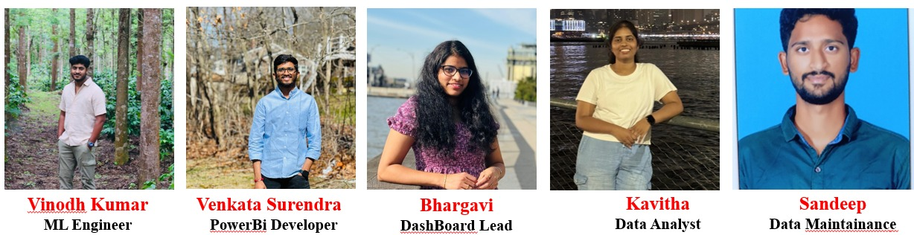
Team Members

Slide 4
Project Milestones Progress
# | Milestone | Deliverable | Due Date | Status | Completion Date
1 | Project Initial Planning and Proposal | Understand project plan, roles and responsibilities, and define project scope. Identify and list data sources for analysis. | Oct 12, 2024 | Completed | Oct 12, 2024
2 | Data Collection and Integration | Gather and integrate historical enrollment, demographic, and socio-economic data from various sources. Ensure data is cleaned and ready for analysis. | Oct 26, 2024 | Completed | Oct 26, 2024
3 | Exploratory Data Analysis (EDA) & Feature Engineering | Perform EDA to identify key trends, correlations, and anomalies. Engineer features that influence enrollment trends. Document findings and insights. | Nov 2, 2024 | Completed | Nov 2, 2024
4 | Model Development and Initial Forecasting | Develop machine learning models to project future enrollment trends. Run initial tests and validate the model outputs with historical data. | Nov 9, 2024 | Completed | Nov 9, 2024
5 | Scenario Analysis and Visualization Development | Implement scenario analysis by creating different projections (e.g., baseline, optimistic, pessimistic) and design initial visualizations to showcase findings. | Nov 16, 2024 | Completed | Nov 16, 2024
6 | MVP Development | Build the initial version of the interactive dashboard as the MVP. Include basic visualization of scenarios, key enrollment trends, and interactive filters. | Nov 23, 2024 | Completed | Nov 23, 2024
7 | User Testing and Feedback Incorporation | Conduct initial testing of the MVP dashboard; gather feedback from project stakeholders and implement necessary improvements. | Dec 2, 2024 | Completed | Dec 2, 2024
8 | Final Model and Dashboard Refinement | Refine models and dashboards based on feedback. Ensure all functionalities are working as expected and that visualizations clearly convey the insights. | Dec 7, 2024 | Completed | Dec 7, 2024
9 | Documentation and User Manual Development | Create detailed documentation, including project overview, methodology, technical specifications, and user manual for the MVP dashboard. | Dec 10, 2024 | Completed | Dec 10, 2024
10 | Final Presentation Preparation | Prepare presentation materials, finalize project deliverables, and rehearse for the final presentation. | Dec 12, 2024 | Completed | Dec 12, 2024
Final |  | Capstone Final Presentations | Dec 13, 2024
4

Slide 5
Introduction & Objectives
Objective
Key Problem
Scope
Forecast international student enrollment trends using ML
Institutions face volatile enrollment trends, needing accurate forecasts.
Develop an interactive Power BI dashboard featuring scenario-based forecasts.

Slide 6
CRISP-DM Phase I
Business
Objectives
Success
Criteria
Business Understanding
Accurate predictions and impactful dashboard usage for decision- making
To Provide scenario- based forecasts for strategic planning in higher education.
Utilize Python, Power BI, and scikit-learn for model development and dashboard creation.
Planning

Slide 7




CRISP-DM Phase II: Data Understanding
Data Source:
Open Doors data provided insights into international student enrollment trends.
Data Analysis:
Data analysis identified trends and correlations in enrollment, with feature engineering for improved predictions.
Data Quality Issues:
Addressed missing values, inconsistencies, and incomplete records through cleaning and standardization.

Slide 8

CRISP-DM PHASE 3: DATA PREPARATION
© 2023 University of New Haven
7
Preparation Steps
Challenges
Key Deliverables
The dataset includes academic, academic details, fields of study, student origin, funding sources, and student status.
One of the major challenges was addressing inconsistencies in data.
The data preparation phase involved cleaning, integrating, and formatting data.

Slide 9
CRISP-DM PHASE 3: MODELLING
Models Built: The project utilized ARIMA for time series analysis and Linear Regression for feature-based predictions to forecast enrollment trends.
Modelling
Training Process: The dataset was split 80 for training and 20 for testing, with features standardized to ensure model consistency.
Model assessment: The ARIMA model performed best due to its ability to capture time series patterns, its well-suited for forecasting enrollment trends.

Slide 10
CRISP-DM Phase V: Evaluation
Model Results | Key Learnings
Achieved 85% accuracy with the ARIMA model. Aligns with objectives to forecast enrollment trends across demographics over 10-15 years. | Critical Insight: Socio-economic factors significantly influence enrollment trends. Unexpected Finding: Nonlinear gender distribution patterns reveal shifting preferences.

Slide 11




What We Learned
Python
Data Analysis
Data Loading, pandas Preprocessing, Cleaning, finding Co-relations and anomaly
GitHub
Code Builder
Upto date building up the code which can be accessible to all team members
ML
ALgorithms
We learned about
Power BI
DashBoard
algorithms related to regression
Building interactive
up
an interface
problems ARIMA,
model,
like RF,
called dashboard for end users to analyse enrollment trends
Regression LTMS, ETC..

Slide 12


What We Learned
Team Growth
Our team enhanced collaboration by applying the CRISP methodology, fostering a structured approach to tasks and decision-making. We sharpened our problem-solving skills and deepened our technical expertise by addressing
challenges together and exchanging insights throughout the project.

Slide 13

Future Recommendations
Enhancements: Prioritize moving forward key perspectives such as information accuracy, dashboard usefulness, and highlight convenience to improve unraveling quality and client involvement. Investigate coordination progressed apparatuses or innovations to optimize forms and grow the solution's capabilities.
Long-Term Applications: Expand the project's scope by consolidating prescient analytics or machine learning calculations to expect patterns and back key decision-making. Tailor the arrangement to be pertinent over assorted businesses or bigger groups of onlookers for more prominent versatility and affect.
Next Steps: Keep up comprehensive documentation for future groups, center on progressing experiences into Higher Education Enrollment Patterns, and set up steady criticism circles to adjust advances with advancing goals and partner needs.

Slide 14

QR Code

Slide 15


