Slide 1
6. More on Pointers
14th September
IIT Kanpur

Slide 2
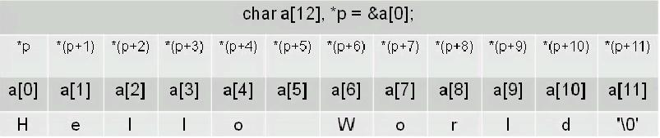
Pointers and arrays
Pointers and arrays are tightly coupled.
char a[] = “Hello World”;
char *p = &a[0];

Slide 3
Pointers and arrays contd..
Name of the array is synonymous with the address of the first element of the array.
int *p;
int sample[10];
p = sample; // same as p = &sample[0];
int *p;
int sample[10];
p = sample;
p[5] = 100; // Both these statements
*(p+5) = 100; // do the same thing

Slide 4
Pointers and function arguments
Functions only receive copies of the variables passed to them.
{program: swap_attempt_1.c}
A function needs to know the address of a variable if it is to affect the original variable
{program: swap_attempt_2.c}
Large items like strings or arrays cannot be passed to functions either.
What is passed is the address of “hello world\n” in the memory.
printf(“hello world\n”);

Slide 5
Passing single dimension arrays to functions
In C, you cannot pass the entire data of the array as an argument to a function.
How to pass array then?
Pass a pointer to the array.
int main() {
int sample[10];
func1(sample);
…
}
void func1(int *x) {
…
}
void func1(int x[10]) {
…
}
void func1(int x[]) {
…
}

Slide 6
2-Dimensional Arrays (Array of arrays)
Access the point 1, 2 of the array: d[1][2]
Initialize (without loops):
int d[3][2];
int d[3][2] = {{1, 2}, {4, 5}, {7, 8}};

Slide 7
More about 2-Dimensional arrays
A Multidimensional array is stored in a row major format.
A two dimensional case:
➔ next memory element to d[0][3] is d[1][0]
d[0][0] | d[0][1] | d[0][2] | d[0][3]
d[1][0] | d[1][1] | d[1][2] | d[1][3]
d[2][0] | d[2][1] | d[2][2] | d[2][3]
What about memory addresses sequence of a three dimensional array?
➔ next memory element to t[0][0][0] is t[0][0][1]

Slide 8
Multidimensional Arrays
Syntax
type array_name[size1][size2]…[sizeN];
e.g
size of array = 3 x 6 x 4 x 8 x 4 bytes
int a[3][6][4][8];

Slide 9
Arrays of Pointers
Declares an array of int pointers. Array has 10 pointers.
Assign address to a pointer in array
To find the value of var,
int *x[10];
x[2] = &var;
int i =*x[2];

Slide 10
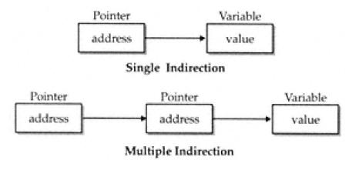
Pointer to Pointer
Declaration
Place an additional asterisk
newbalance is a pointer to a double pointer.
double **newbalance;

Slide 11
Pointer to Pointer contd..
{program: pointers.c}
#include <stdio.h>
int main() {
int x, *p, **q;
x = 10;
p = &x;
q = &p;
printf(“%d %d %d\n”, x, *p, **q);
return 0;
}

Slide 12
Dynamic Memory Allocation
To allocate memory at run time.
malloc(), calloc()
both return a void*
you’ll need to typecast each time.
char *p;
p = (char *)malloc(1000); /*get 1000 byte space */
int *i;
i = (int *)malloc(1000*sizeof(int));

Slide 13
Dynamic Memory Allocation contd..
To free memory
free()
free(ptr) frees the space allocated to the pointer ptr
int *i;
i = (int *)malloc(1000*sizeof(int));
.
.
.
free(i);

Slide 14
Pointers to functions
A function pointer stores the address of the function.
Function pointers allow:
call the function using a pointer
functions to be passed as arguments to other functions
return_type (*function_name)(type arg1, type arg2…)
{program: function_pointer.c}

