Slide 1
7. Pointers, Dynamic Memory
20th September
IIT Kanpur

Slide 2
Agenda
Pointer to Pointer
Dynamic Memory Allocation
Pointer to functions

Slide 3
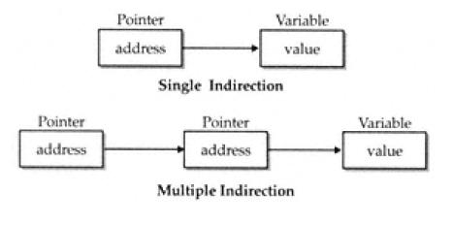
Pointer to Pointer
Declaration
Place an additional asterisk
newbalance is a pointer to a float pointer.
double **newbalance;

Slide 4
Pointer to Pointer contd..
{program: pointers.c}
#include <stdio.h>
int main() {
int x, *p, **q;
x = 10;
p = &x;
q = &p;
printf(“%d %d %d\n”, x, *p, **q);
return 0;
}

Slide 5
Dynamic Memory Allocation
To allocate memory at run time.
malloc(), calloc()
both return a void*
you’ll need to typecast each time.
char *p;
p = (char *)malloc(1000); /*get 1000 byte space */
int *i;
i = (int *)malloc(1000*sizeof(int));

Slide 6
Dynamic Memory Allocation contd..
To free memory
free()
free(ptr) frees the space allocated to the pointer ptr
int *i;
i = (int *)malloc(1000*sizeof(int));
.
.
.
free(i);

Slide 7
Pointers to functions
A function pointer stores the address of the function.
Function pointers allow:
call the function using a pointer
functions to be passed as arguments to other functions
return_type (*function_name)(type arg1, type arg2…)
{program: function_pointer.c}

