Slide 1

Cancer Surveillance Research in Asian Americans
Scarlett Lin Gomez, MPH, PhD
Cancer Prevention Institute of California
ARCH Meeting
May 2, 2013

Slide 2
Was planning to present…
Cancer incidence trends among Asian American populations in the United States, 1990-2008
Cancer incidence trends among Native Hawaiian and Pacific Islander populations in the United States, 1990-2008
Soon to published in the Journal of the National Cancer Institute (JNCI)
Collaborative effort between SEER and multiple SEER registries (GBACR, LA, CCR, Hawaii)

Slide 3
Outline
Overview of CPIC, cancer registries, and cancer surveillance research
Selected highlight of research in Asians:
  Breast cancer incidence & survival
  Prostate cancer risk profiles

Slide 4
Who is CPIC?
  Started in 1974 to support clinical trials
  Up until 2010, called the Northern California Cancer Center
Today, independent non-profit cancer research, education, outreach organization
    Research in population-based cancer research focusing on prevention (risk & adverse outcomes)
    Every Woman Counts Cancer Detection Program
    Community Education Program
www.cpic.org

Slide 5
CPIC’s Mission
The mission of the Cancer Prevention Institute of California (CPIC) is to prevent cancer and to reduce its burden where it cannot yet be prevented.
The Cancer Prevention Institute of California works across all communities to:
Explore the causes of cancer by studying the genetic, environmental, and viral origins of cancers, and, once these causes have been established,
Aid prevention by identifying where appropriate intervention can stop cancer before its starts
Ensure that cancer prevention and treatment strategies benefit all people everywhere by
  1. monitoring the incidence of cancer among the general public,
  2. investigating racial or ethnic based disparities in cancer prevention tactics or care options,
  3. educating the public about cancer prevention, treatment, and survivorship options, and
  4. reaching out to underserved populations to ensure that they have equal access to these advances.

Slide 6
CPIC’s Research
Population-based, epidemiological
Major programs:
  Breast Cancer Family Registry
  California Teachers Study
  Environmental research
    Childhood cancers
  Survivorship research
  Community-based participatory research
    Vietnamese nail salon workers
  Cancer surveillance
    Breast cancer, lymphomas, melanoma
    Hispanics, disparities
    → Asians

Slide 7
Cancer registry overview

Slide 8
What is a cancer registry?
Repository of information about cancers
  Tumor level, patient level
  Patient demographics, tumor characteristics, diagnostic and treatment specifics
Types of cancer registries
  Hospital
    Report its data to accrediting organizations, central registry
  Central (population-based)

Slide 9
What is a “population-based” cancer registry?
Repository of information that includes all newly diagnosed tumors
  Defined time period
  Defined geographic area
    e.g., county, counties, state, country
  Defined population
    Residents of area at diagnosis

Slide 10
Why is being “population-based” important?
Cancer burden is not equally distributed
  age, sex, race/ethnicity, social class, geography, etc.
Population-based cancer data are complete
  for given population groups/regions, etc.
Because everyone is included, findings from population-based cancer data are representative & generalizable

Slide 11
How is population-based cancer registration possible?
Mandated by state laws
  Cancer is a reportable disease
  All states in US
Careful establishment of data and data collection standards
  National standard-setting organizations
  Training

Slide 12
California Health and Safety Code
Section 103875-103885
(a) The director shall establish a statewide system for the collection of information determining the incidence of cancer, using population-based cancer registries
The department may designate any demographic parts of the state as regional cancer incidence reporting areas and may establish regional cancer registries, with the responsibility and authority to carry out the intent of this section in designated areas. Designated regional registries shall provide, on a timely basis, cancer incidence data as designated by the state department to the department.
(c) The director shall designate cancer as a disease required to be reported in the state or any demographic parts of the state in which cancer information is collected under this section.
(2) The department and any regional cancer registry designated by the department shall use the information to determine the sources of malignant neoplasms and evaluate measures designed to eliminate, alleviate, or ameliorate their effect.
3) Persons with a valid scientific interest who are engaged in demographic, epidemiological, or other similar studies related to health who meet qualifications as determined by the department, and who agree, in writing, to maintain confidentiality, may be authorized access to confidential information.

Slide 13
Specific Cancer Registry Systems
Federal programs
  Surveillance, Epidemiology, and End Results (SEER)
    National Cancer Institute
    National Program for Cancer Registries (NPCR)
      Centers for Disease Control and Prevention
  State programs
    e.g., California Cancer Registry (CCR)
  Regional programs
    Greater Bay Area Cancer Registry (GBACR)
      Cancer Prevention Institute of CA
      Supported by all of the above

Slide 14
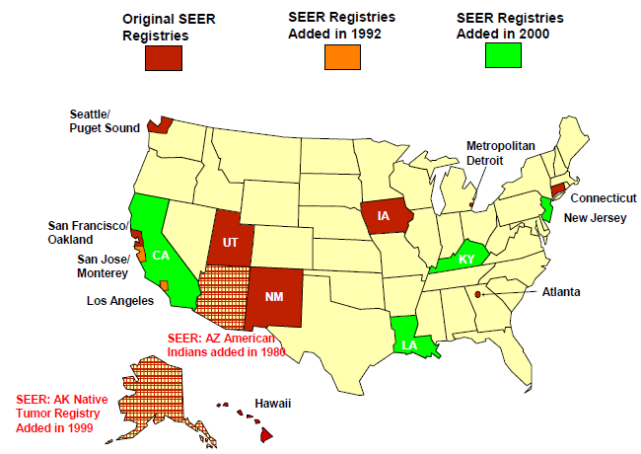
Surveillance, Epidemiology and End Results (SEER) program
9 regions with coverage from 1973-2007
All 18 regions with coverage 1992-2007
Now 26% of the total US population

Slide 15
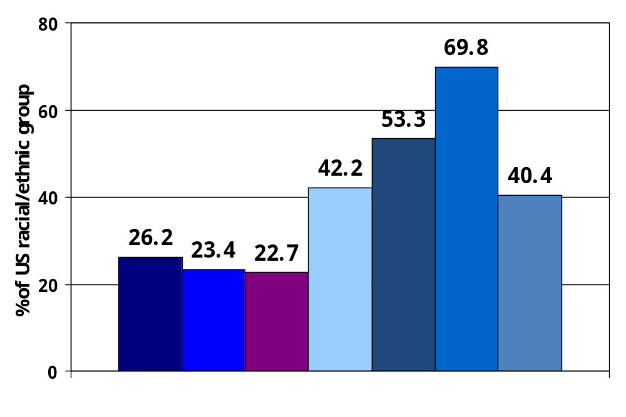
Coverage by race/ethnicity in SEER regions
TOTAL White Black Am Ind/ Asian Native Hispanic
Alaska Native Hawaiian/
other Pac Isl
http://www.seer.cancer.gov/registries/data.html

Slide 16
California Cancer Registry (CCR)
1985
  Cancer Reporting Law
    CCR established
      Cancer reportable
1988
  Reporting statewide
10 regional registries
1988-2007
  >3.4 M cancer cases
  >162,000 new cases annually
R
e
g
(
N
o
i
o
n
6
r
t
h
)
R
e
g
(
S
a
i
o
n
3
c
r
a
m
e
n
t
o
)
R
e
g
(
C
e
i
o
n
2
n
t
r
a
l
)
R
e
g
(
B
a
i
o
n
8
y
A
r
e
a
)
R
e
g
(
D
e
i
o
n
5
s
e
r
t
S
i
e
r
r
a
)
R
e
g
(
S
a
i
o
n
1
n
J
o
s
e
/
M
o
n
t
e
r
e
y
)
R
e
g
(
T
r
i
i
o
n
4
-
C
o
u
n
t
y
)
2001
  3 SEER programs
    Greater Bay Area, Los Angeles, all else (Greater CA)
R
e
g
(
L
o
i
o
n
9
s
A
n
g
e
l
e
s
)
R
e
g
R
e
g
i
o
n
7
i
o
n
1
0
(
S
a
n
D
i
e
g
o
/
I
m
p
e
r
i
a
(
O
r
a
n
ge
l
)
)

Slide 17
What data items are collected?
Patient demographic information
    Name, social security number, address at diagnosis, date of birth, race, ethnicity, gender, marital status, birthplace
  Tumor information
  Anatomic site, histology, detailed extent of disease (stage: tumor size, tumor extension, lymph nodes, metastasis at diagnosis, etc.), new site-specific factors
Treatment information (first course only)
  Surgery, chemotherapy, radiation therapy, hormone therapy, immunotherapy
Survival information
All patients followed for vital status for life
Recurrence, metastastic disease NOT reported

Slide 18
Research with registry data
Patient contact studies (interview, biospecimens, medical record abstraction, etc.)
  Case-control
  Cohort
    California Teachers Study
    Breast Cancer Family Registry
    CanCORS (Cancer Care Outcomes Research & Surveillance)
Secondary data analysis
  Using existing data
  Descriptive epidemiology
  Cancer surveillance research

Slide 19
Data resources
Registry data as is – cancer patients & survivors
Registry data + census/population data - rates
Linked to other databases, e.g.,
  SEER-Medicare
    Claims data for persons >=65 from before, during and after initial cancer diagnosis and treatment
  CCR-California OSHPD (Office of Statewide Health and Policy Development) claims data
  Hospital characteristics
  SEER linked to other registries
    HIV/AIDS, transplant database, cosmetologist
  California Neighborhoods Data System (numerous measures on the social and built environments in California)

Slide 20
Cancer Surveillance Disparities Research Program

Slide 21
Cancer surveillance research
Subdiscipline of cancer research “in which systematically collected data on cancer patients and population characteristics are analyzed and interpreted to examine and test hypotheses about cancer predictors, incidence, and outcomes in geographically defined populations over time” (Glaser et al. CCC 2005)
Primary resource = cancer registry data

Slide 22
CPIC Surveillance Disparities Research Program
Overall objective:
To optimize cancer surveillance data resources for identifying detailed population subgroups experiencing disparities in cancer incidence, diagnosis, treatment, and outcomes.

Slide 23
Surveillance Disparities Research Program
Optimize =
  To understand quality of registry data
    Race & ethnicity – extent of misclassification
    Birthplace – bias in completeness
    Individual SES – availability in medical records
    Language – availability & accuracy in medical records
  To enhance data
    Immigration
    Social & built environment
    Institutional environment, access to care

Slide 24
Surveillance Disparities Research Program
Detailed subgroups = groups defined by:
  Detailed race/ethnicity (e.g., Asian populations)
  Nativity, age/year of immigration
  Contextual environment:
    Social
    Built
    Immigration
    Institutional

Slide 25
Breast Cancer in Asian Women

Slide 26
“I was diagnosed with breast cancer 5 years ago. When the doctor told me that I had breast cancer I was in shock because I thought this is a white women/old people disease. Later, I was even more surprised to find out that many of the Asian women I knew had breast cancer, but nobody talked about it.”
(personal communication from a breast cancer survivor)

Slide 27
Breast cancer disparities in Asian women - incidence

Slide 28
Background
Prior study (Stanford et al., Epidemiology 1994):
  Compared incidence rates among US Asians by nativity
  Chinese, Japanese, Filipina; Seattle, Bay Area, LA; 1973-1986; Ages 20-79
  Unknown birthplace:
    Chinese = 22%
    Japanese = 13%
    Filipina = 20%
  Assumed same distribution of nativity among cases w/unknown birthplace

Slide 29
Breast cancer incidence rates*, California, 1988-2004
Race/Ethnicity | Rate (95% CI)
N-H White | 146.1 (145.5-146.7)
Asian ** | 82.7 (81.6-83.8)
* Rates, per 100,000, adjusted to the US 2000 standard
** Asian = Chinese + Japanese + Filipina + Korean + Vietnamese + South Asian

Slide 30
Breast cancer incidence rates*, California, 1988-2004
Race/Ethnicity | Rate (95% CI)
N-H White | 146.1 (145.5-146.7)
Asian ** | 82.7 (81.6-83.8)
Chinese | 73.5 (71.6-75.4)
Japanese | 102.5 (99.3-105.9)
Filipina | 100.4 (98.1-102.8)
Korean | 46.3 (43.8-49.0)
South Asian | 77.0 (72.1-82.1)
Vietnamese | 59.9 (56.7-63.1)
* Rates, per 100,000, adjusted to the US 2000 standard
** Asian = Chinese + Japanese + Filipina + Korean + Vietnamese + South Asian

Slide 31
Breast cancer incidence rates*, California, 1988-2004
Race/ ethnicity | Combined (US+foreign born) | US-born | Foreign-born | Rate ratio (95% CI) (US/foreign)
N-H White | 146.1 | - | - | -
Asian** | 82.7 | 120.6 | 76.3 | 1.6 (1.5-1.6)
Chinese | 73.5 | 122.1 | 66.3 | 1.8 (1.7-2.0)
Japanese | 102.5 | 106.1 | 103.1 | 1.0 (1.0-1.1)
Filipina | 100.4 | 129.5 | 98.2 | 1.3 (1.2-1.4)
* Rates, per 100,000, adjusted to the US 2000 standard
** Asian = Chinese + Japanese + Filipina + Korean + Vietnamese + South Asian

Slide 32
Breast cancer incidence rates* by age, California, 1988-2004
Race/ethnicity | <44 yrs | 45-54 yrs | >55 yrs
N-H White | 27.1 | 240.7 | 449.2
US-born
Chinese | 39.8 | 276.9 | 275.6
Japanese | 23.9 | 205.8 | 294.2
Filipina | 43.1 | 334.3 | 263.8
Foreign-born
Chinese | 18.9 | 161.2 | 167.9
Japanese | 24.8 | 196.0 | 283.6
Filipina | 25.9 | 215.1 | 245.0
* Rates, per 100,000, adjusted to the US 2000 standard

Slide 33
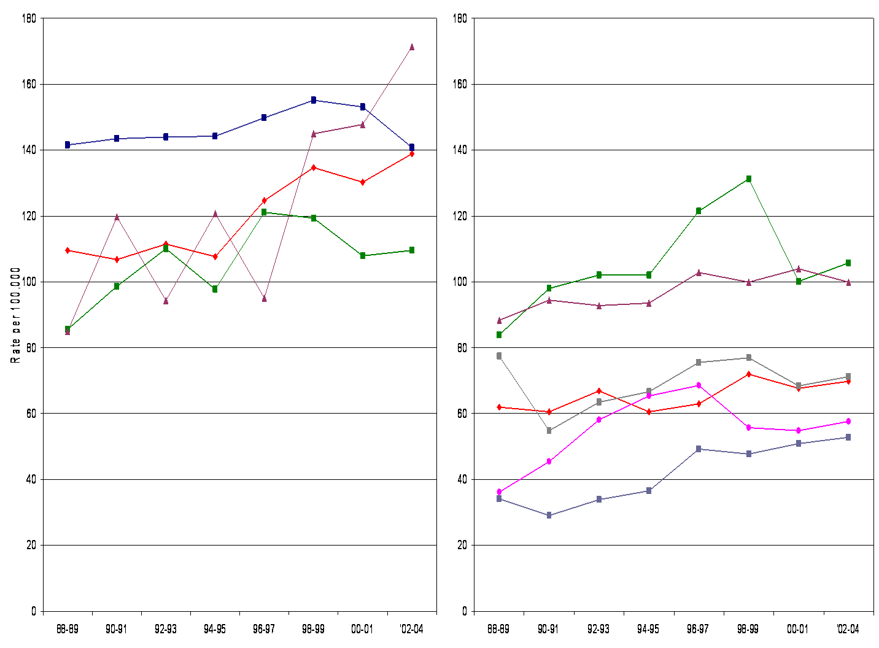
Breast cancer trends by immigrant status, California
Annual % change
Filipina=4.3*
Chinese=1.97*
Japanese=1.24
*Significant
Annual % change
Japanese=1.23
Filipina=0.8*
S. Asian=not calc
Chinese=0.97*
Vietnamese=2.35
Korean=4.24*
*Significant
US-born
Foreign-born
US-born
Foreign-born
N-H White
Year of diagnosis

Slide 34
Conclusions
Rates among US-born about 60% higher than foreign-born, with exception of Japanese
Pre-menopausal rates among US-born Chinese & Filipinas higher than Whites
Large increase in rates over time among US-born Filipinas and foreign-born Koreans
Rate among US-born in 2000-2004 exceeded (Filipinas) and equal to (Chinese) that of Whites
Burden of breast cancer is not low among Asians!

Slide 35
Conclusions
Implications:
  targeted cancer control, increased awareness and clinical education, to high-risk groups
  age-specific patterns provide clues to novel risk factors associated with immigration patterns

Slide 36
Breast cancer disparities in Asian women - survival

Slide 37
What we used to know about survival after breast cancer in AA & NHPI women
Survival after breast cancer most favorable among AAs & NHPIs of all racial/ethnic groups
  relative risk of death (relative to non-Hispanic White women):
    = 0.87 (SEER-wide, Clegg et al. Arch Int Med 2002)
    = 0.97 (GBACR, O’Malley et al. Cancer 2003)
Adjusted for stage and other patient sociodemographic and clinical factors

Slide 38
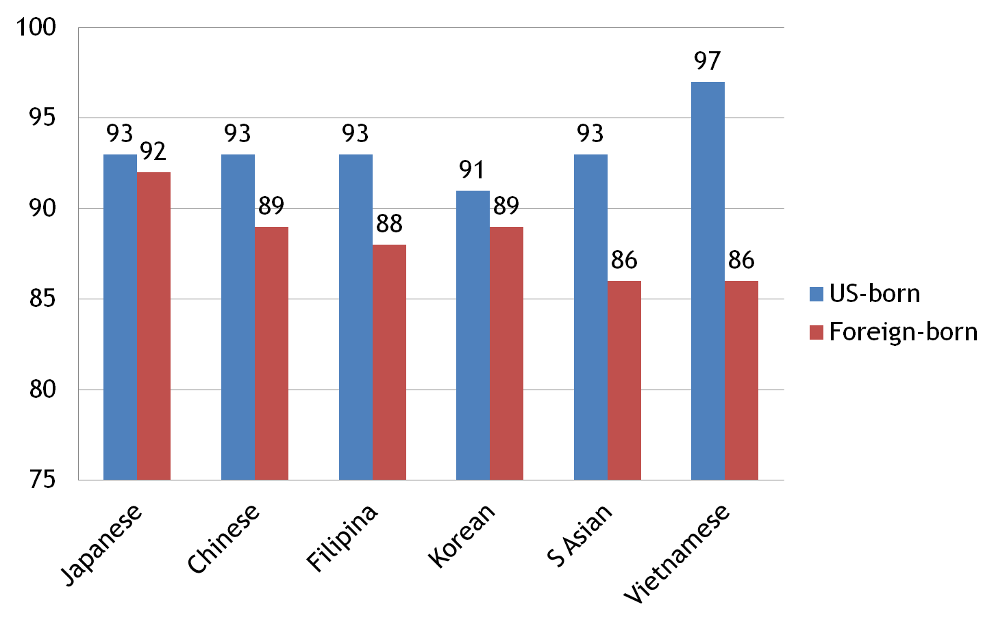
Unadjusted 5-year survival after breast cancer in AAs, California, 1998-2005
Gomez et al. Am J Public Health 2010

Slide 39
Relative death rates after breast cancer among AA ethnic groups, California, 1998-2005
Nativity | Japanese (N=3586) | Chinese (N=5654) | Filipina (N=7428) | Korean (N=1337) | South Asian (N=1158) | Vietnamese (N=1584)
US-born | 1.0 | 1.0 | 1.0 | 1.0 | 1.0 | 1.0
Foreign-born | 1.1 (0.9-1.4) | 1.6 (1.3-1.9) | 1.3 (1.0-1.7) | 1.1 (0.5-2.1) | 1.4 (0.7-2.5) | 3.9 (1.4-10.6)
Adjusted for stage, histology, ER status, grade, marital status, neighborhood socioeconomic status
Follow-up through 2007
Gomez et al. Am J Public Health 2010

Slide 40
Dissemination and impact
Reported in several news releases
Covered in Cantonese & Mandarin evening news (KTSF)
  calls to state Every Woman Counts screening program increased 10-fold
Presentation at National Press Club, Washington DC
Published in first issue of AJPH devoted to Asian American, Native Hawaiian, & Pacific Islander health
“2010 Author of the Year” (Am Journal of Public Health)

Slide 41
"The implications of this research for public health are profound. That survival after breast cancer is poorer among foreign- than US-born Asian women speaks volumes about who is screened and who receives appropriate care in this country. Because little of this variation was explained by differences in disease characteristics, attention must focus instead on increasing awareness among affected communities and their providers and targeting cancer control programs and policies to address these documented disparities.
Never again should we overlook the grave health disparities that exist in our heterogeneous Asian communities or potential strategies that might alleviate needless pain and suffering."
(Mary Northridge, Editor-in-Chief, American Journal of Public Health, Dec 2010)

Slide 42
Current Work
Identify underlying factors
  Survivorship studies
    “Equality in Breast Cancer Care”
      to evaluate impact of factors at multiple levels on cancer care & quality of life
    California Breast Cancer Survivorship Consortium
      to pool data from seven breast cancer studies to examine what factors explain racial/ethnic differences in stage-specific breast cancer survival
  Etiology studies
    Asian Community Health Initiative (Asian CHI)
      Pilot case-control study to identify novel risk factors
      Partnership with Asian Pacific Islander American Health Forum (APIAHF), Asian Health Services (AHS), and Asian Americans for Community Involvement (AACI)
      We are recruiting controls!
      www.asianchi.org

Slide 43
Prostate Cancer Risk Profiles

Slide 44

The Team…
…plus many more collaborators!

Slide 45
Look out for…
Cancer incidence trends among Asian American populations in the United States, 1990-2008
Cancer incidence trends among Native Hawaiian and Pacific Islander populations in the United States, 1990-2008
Soon to published in the Journal of the National Cancer Institute (JNCI)
Collaborative effort between SEER and multiple SEER registries (GBACR, LA, CCR, Hawaii)

Slide 46



www.cpic.org
Thank you!
scarlett@cpic.org

