Slide 1
Anomaly Detection & Forecasting
Xiaoxin Xu
Notes:
Make a point about the switched roles of presentation

Slide 2
Executive Summary
Business Problem
A telecommunication major wanted to understand whether there is a problem on its website
Current process was manual and the expected state was to derive anomalous behavior across major KPIs in an automated manner
Solution Approach
Identify key KPIs
Detect Anomalies
Forecast behavior
Provide Insights
Identify business drivers and their impact on conversion rate
Find good and bad
anomalies across major KPIs
Predict the following 7 days and detect anomalies in the forecast
Derive insights from Tableau visualizations and provide recommendations
Some Insights
Many visitors browse from phones but do not place orders through mobile that often compared to desktop.
More customer browse on desktop while more undetermined browse on mobile.
Avg conversion rate of customer >> prospect > undetermined. Traffic of undetermined > customer > prospect.
Avg conversion rate of desktop > tablet > mobile. Traffic of desktop > mobile >> tablet.
Change of traffic volumes and numbers placed stay consistent across device types but vary from customer types.
On 2/3, three metrics all went down
Visitors and orders from Prospect and Customer go down
Visitors and orders from Undetermined experienced a little bump up but not enough to affect the overall downward trend
On 2/22, visitors, digital orders and conversion rate all spike up
Large volumes from Undetermined visited the website and placed orders
Fewer visitors and orders from Prospect and Customer
Conversion of Prospect increases while that of Customer decreases
-

Slide 3
Statistics
59 Days
Feb 1 – Mar 31
38M
Total Visitors
369K
Total Orders
0.96% find out the stats of telecom
Avg Conversion Rate
Avg 2.43% in e-commerce
Visitors
Orders
Rate
 | Desktop | Mobile | Tablet
Undetermined | 9.3M | 11.8M | 1.3M
Prospect | 1M | 1M | 0.18M
Customer | 7.6M | 4.8M | 0.78K
Desktop | Mobile | Tablet
59K | 27K | 5K
5K | 5K | 473
198K | 49K | 18K
Desktop | Mobile | Tablet
0.63% | 0.23% | 0.39%
0.51% | 0.45% | 0.26%
2.59% | 1.02% | 2.39%
* Visitors and orders from Gaming Console and E-Reader are low so they are excluded from analysis
* Reference: https://www.growcode.com/blog/ecommerce-conversion-rate/

Slide 4
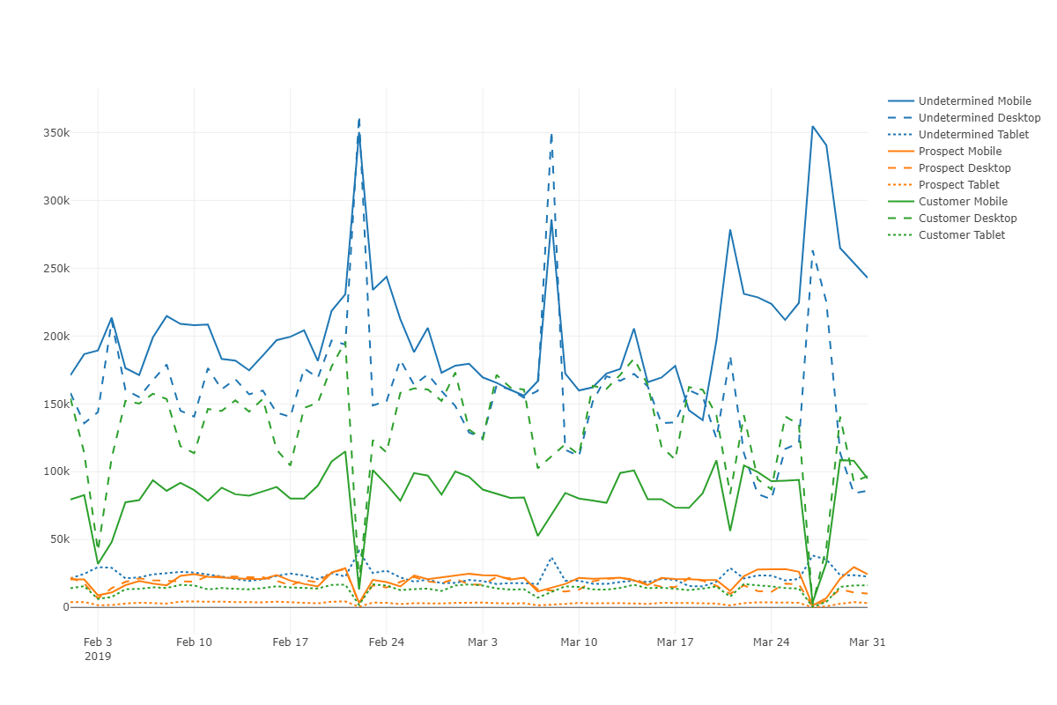
Visitors
customer tagging issue?
3/8 & 3/27
Undetermined ↑
Customer ↓
Prospect ↓
2/22
Undetermined ↑
Customer ↓
Prospect ↓
2/17 All ↓
2/28 All ↓
3/7 All ↓
2/3
Customer ↓
Prospect ↓

Slide 5
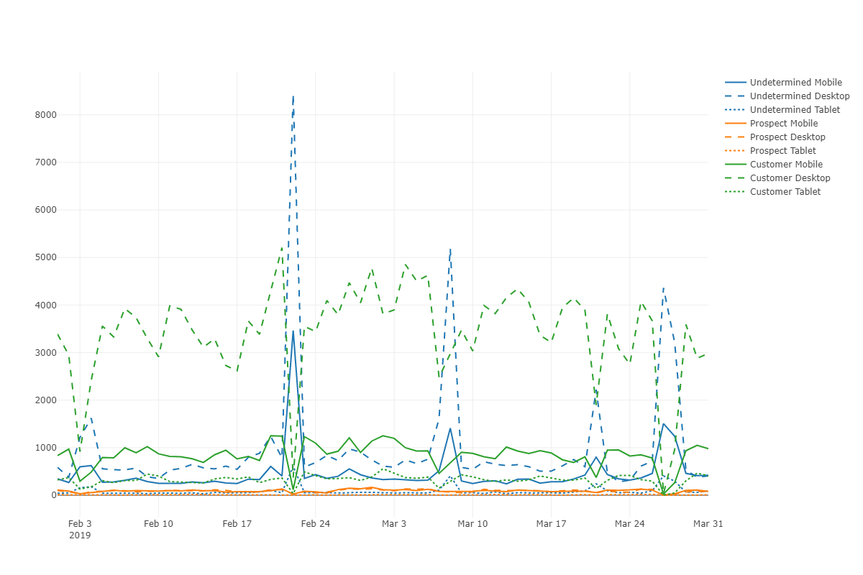
Orders
2/22
Undetermined ↑
Customer ↓
Prospect ↓
2/17 All ↓
2/28 All ↓
3/7 All ↓
2/3
Customer ↓
Prospect ↓

Slide 6
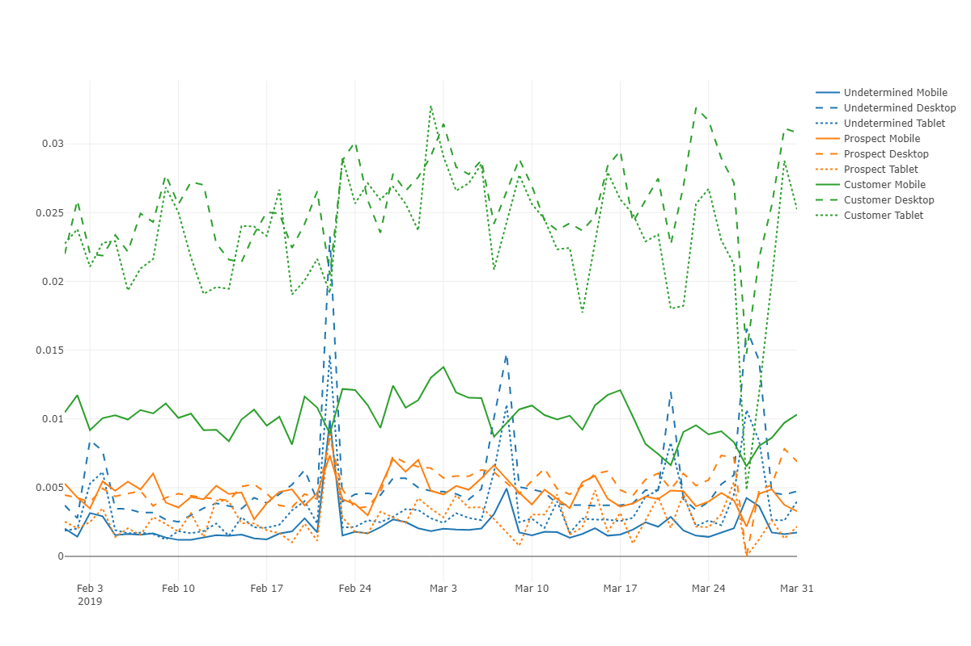
Conversion Rate
3/27
Undetermined ↑
Customer ↓
Prospect ↓
2/22
Undetermined ↑
Customer ↓
Prospect ↑
2/3
Undetermined ↑
Customer ↓
Prospect ↓

Slide 7
Anomaly Detection Process – Top Down
All visitors and devices
Model selection
Breakdown across customer & device types

Slide 8
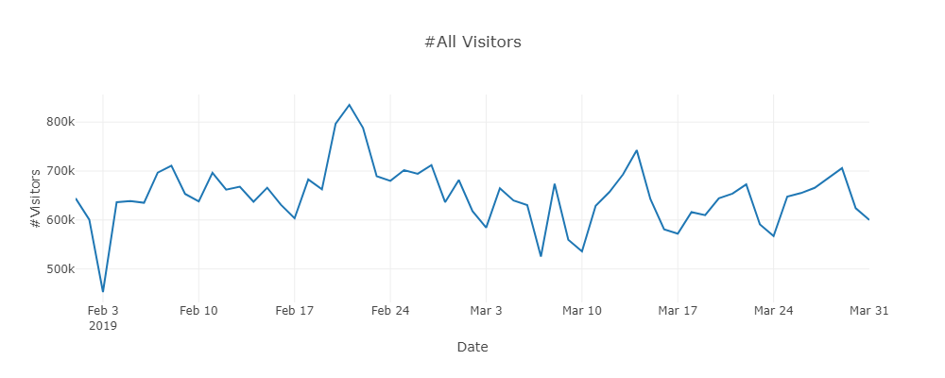
Model Selection
Total # visitors over time
ARIMA
Well-studied Parameters(p, d, q) -> more accurate | Model assumption – stationary Parameter tuning
Twitter+IQR
Catch seasonal component No loops – easily scaled | No long term trend IQR is easily skewed by outliers
STL+GESD
More sensitive to capture anomalies Less resistant to outliers | Iterative – more expensive

Slide 9
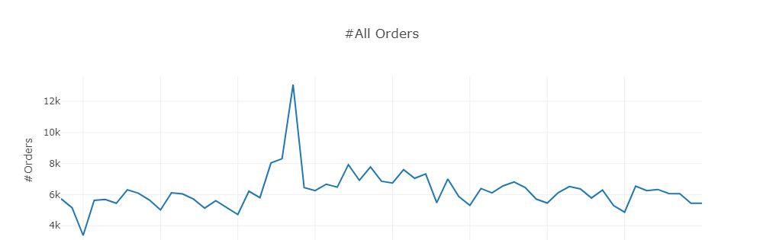
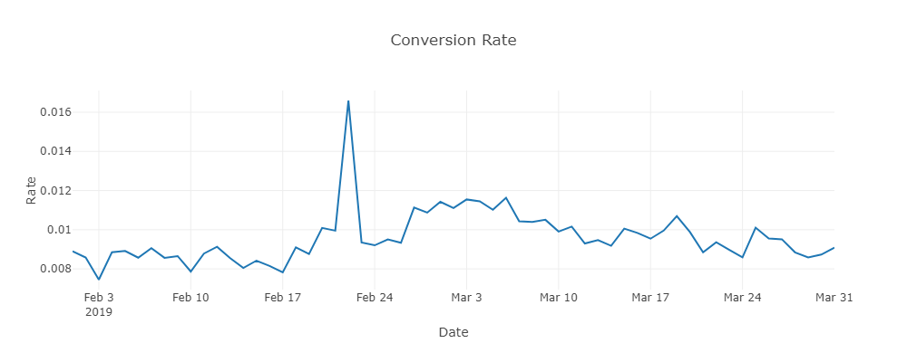
Using STL+GESD
Anomalous days of visitors and orders are consistent.
Good: 2/22
Bad: 2/3, 2/17, 2/28, 3/7
Conversion rate:
Bad: 2/3
Good: 2/22

Slide 10
Forecasting

Slide 11
Forecasting Process
Forecast the next week
Metric evaluation
Model selection
Find anomalies in forecast

Slide 12
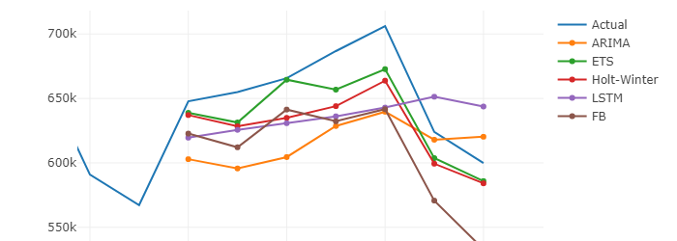
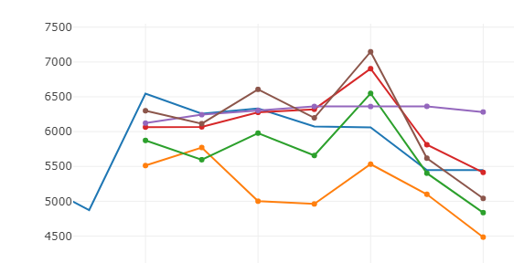
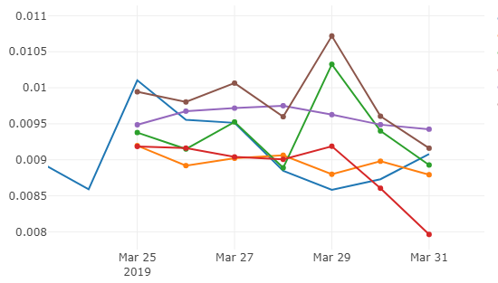
Models - Forecasting
Visitors
ARIMA
Parameters(p, d, q) -> more accurate | Model assumption – stationary Parameter tuning
ETS
No requirement for stationarity | Parameter selection
Holt-Winter
Triple exponential smoothing | Model complexity Overfitting
LSTM
Time dependency Perform well with large data | Hyperparameter Tuning Require large data
Facebook Prophet
Strong Seasonal effects Robust to missing data and outliers Easy to use | Overfitting Require large data
Orders
Rate

Slide 13
Evaluation Metrics
 | RMSE | MAE | MAPE | MASE
ARIMA | 132365.16 | 45206.40 | 7.35% | 0.51
ETS | 57044.35 | 18758.97 | 2.94% | 0.21
Holt-Winter | 78978.53 | 27637.01 | 4.36% | 0.31
LSTM | 109966.68 | 39619.52 | 6.22% | 0.45
Facebook | 132491.19 | 47319.07 | 7.91 | 0.54
Visitors
ARIMA | 2376.38 | 829.25 | 16.30% | 1.59
ETS | 1343.48 | 464.59 | 8.22% | 0.89
Holt-Winter | 1083.92 | 316.09 | 4.99% | 0.60
LSTM | 1373.22 | 400.71 | 6.36% | 0.77
Facebook | 1242.65 | 349.72 | 5.52% | 0.67
Orders
ARIMA | 1.31e3 | 0.43e3 | 4.76% | 0.48
ETS | 2.21e3 | 0.63e3 | 6.26% | 0.69
Holt-Winter | 1.69e3 | 0.54e3 | 6.19% | 0.69
LSTM | 1.74e3 | 0.57e3 | 5.94% | 0.63
Facebook | 2.50e3 | 0.68e3 | 7.66% | 0.76
Rate

Slide 14
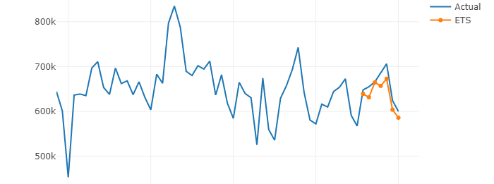
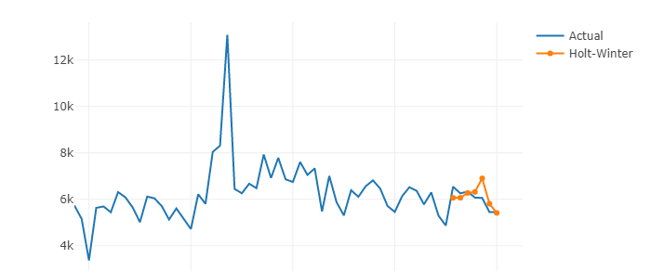
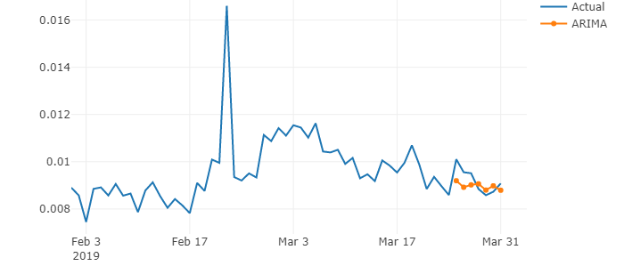
Anomalies in the forecast
Visitors
Orders
No blue line
Rate
*Anomalies: points out of 1 rolling standard deviation

Slide 15
Appendix

Slide 16
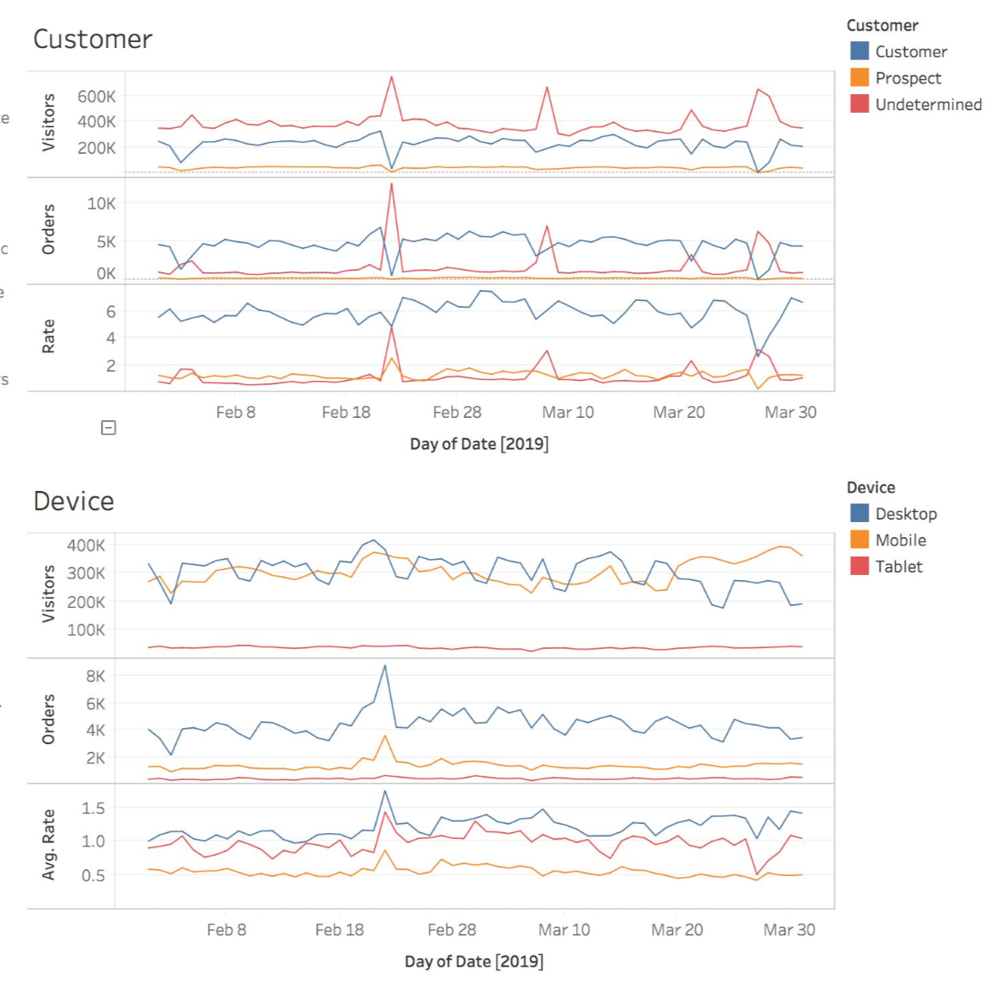
Breakdown – two callout days
Feb 3
Fewer Customer and Prospect visit the website
Decrease in visitors and orders is mainly caused by Desktop
Feb 22
Large volumes of traffic come from Undetermined
Three KPIs increase across all devices

Slide 17
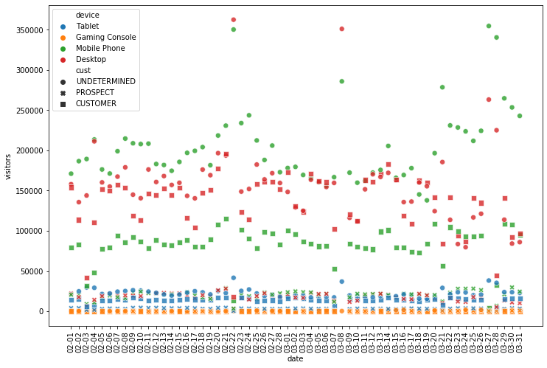
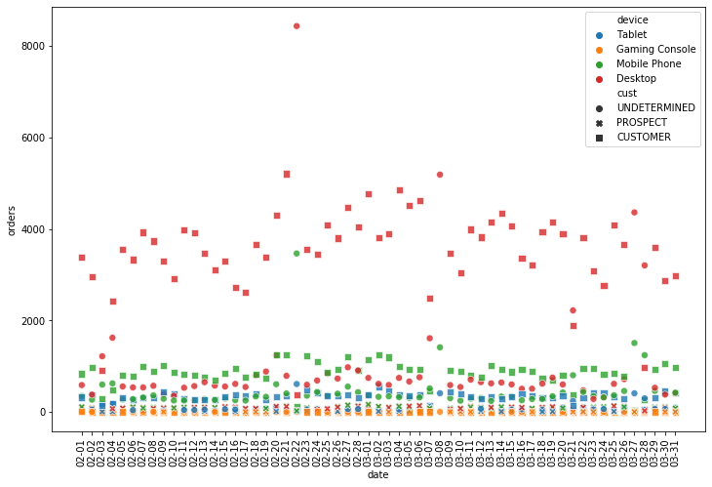
Exploratory Analysis
# Visitors
# Orders

Slide 18
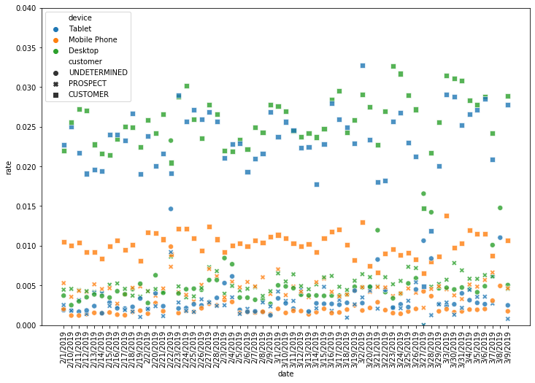
Exploratory Analysis
Rate = #Orders / #Visitors

Slide 19
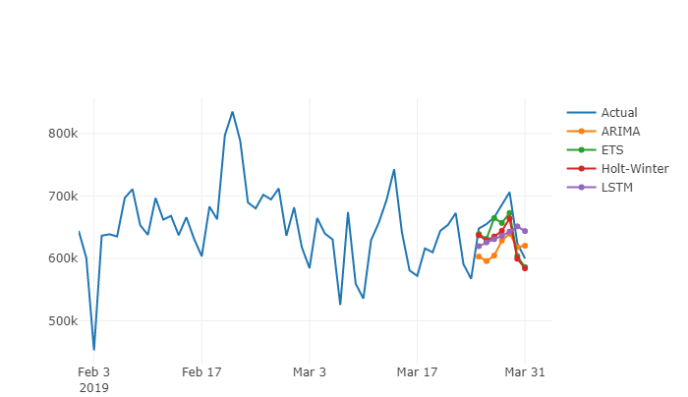
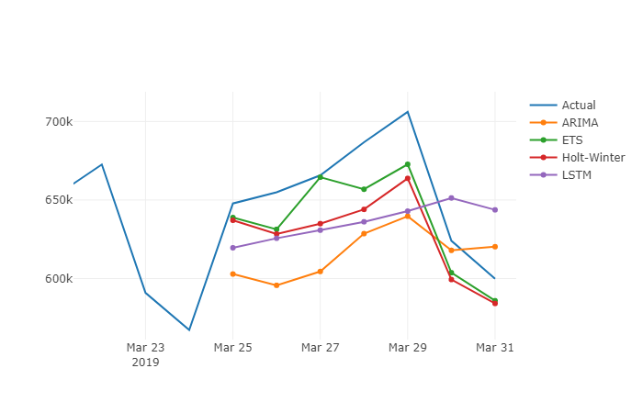
Model Selection - Forecasting
# Visitors
ARIMA
Parameters(p, d, q) -> more accurate | Model assumption – stationary Parameter tuning
ETS
No requirement for stationarity | Parameter selection
Holt-Winter
Triple exponential smoothing | Model complexity Overfitting
LSTM
Memory – time dependency Perform well with large data | Hyperparameter Tuning Require large data

Slide 20
My Ideal Approach
Anomaly Detection
Validate
Forecast
*Forecasting will be useful in capturing ongoing sales and traffic, and thus it’s good for validation.
It’s hard to “predict” anomaly in the future because forecasting assumes smoothing, trend and seasonality but
does not consider abnormal noise.

Slide 21
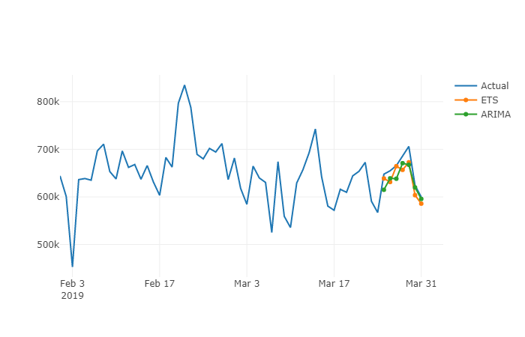
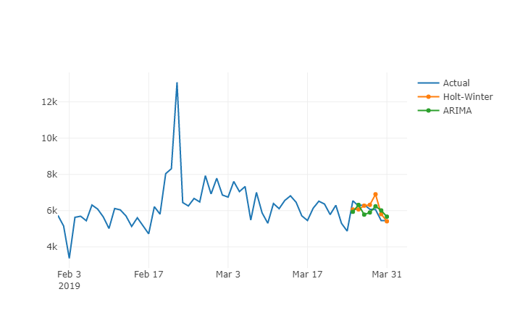
ARIMA outperforms
with proper tuning

Slide 22
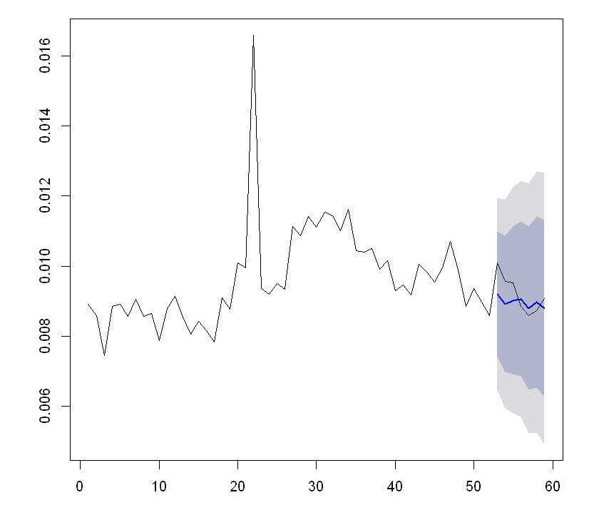

Anomaly Detection on Predictions
Approach 1
Approach 2
No anomalies
No anomalies
which is actually true in this case

Slide 23
Anomaly Detection on Predictions
Approach 1
Approach 2
How | Check if values within range | Run anomaly detection algorithm on the forecasting
Usage | Used for validation – potentially a method for anomaly detection if more data is provided | Used to detect anomalies in the future
Drawback | Doesn’t work when there’s no future data Range is wide due to large variances | No range - point estimate instead of statistical inference

Slide 24
Statistics
59 Days
Feb 1 – Mar 31
38M
Total Visitors
369K
Total Orders
0.96%
Avg Conversion Rate
Avg 2.43% in e-commerce
Device
Customer
 | Total Visitors | Total Orders | Avg Rate | Avg Rate (e-commerce)
Desktop | 18M | 262K | 1.45% | 3.45%
Mobile | 18M | 82K | 0.45% | 1.6%
Tablet | 2M | 24K | 1.05% | 3.3%
Gaming | 53K | 51 | 0.09% | -
E-Reader | 25 | 0 | 0% | -
 | Total Visitors | Total Orders | Avg Rate
Undetermined | 23M | 92K | 0.40%
Prospect | 2M | 11K | 0.55%
Customer | 13M | 266K | 2.04%
* Visitors and orders from Gaming Console and E-Reader are low so they are excluded from analysis
* Reference: https://www.growcode.com/blog/ecommerce-conversion-rate/

Slide 25

Average conversion rates from all device sources are below industry averages.
Visitors’ intent and the nature of the product have a direct impact on conversion rates.
Electronics such as phones and tablets fall into the category of higher browse online/lower buy online. That means customers come to your website to research products with less intension of buying online, and take information from your site.
Focus less on factors you control, such as website messaging and design but more on visitor-centric information.
* Reference: https://www.growcode.com/blog/ecommerce-conversion-rate/

