Slide 1
Anomaly Detection & Forecasting
Xiaoxin Xu
Aug 22, 2019

Slide 2

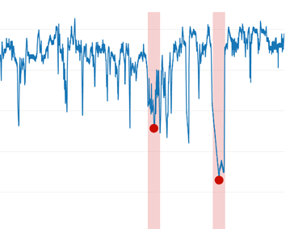
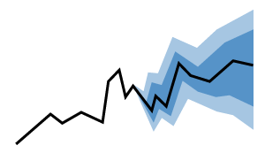
Executive Summary
Business Problem
A telecommunication major wanted to understand if there is a problem on its website
Current process is manual and the expected state was to derive anomalous behavior across major KPIs in an automated manner
Solution Approach
Identify KPIs
Anomaly Detection
Forecasting
Identify main KPIs
Conversion Rate = #Orders / #Visitors
Find good and bad anomalies across key KPIs
Predict the following 7days and find outliers in the forecast

Slide 3




Architecture
Algorithm
Python
R
Consumption
Power BI
Tableau
Input Data
Excel
Deck
PPT
Pipeline
Input
Automation
Output
When did the anomalies happen?
Which customer/device types lead to the anomalous behavior?
What are the projections of main KPIs?
Time Series Models
Anomaly Detection
Website data
Abode Site Cat
CSV format
Forecasting

Slide 4
Data & Statistics
59 Days
Feb 1 – Mar 31
38M
Total Visitors
369K
Total Orders
0.96%
Avg Conversion Rate
Avg 3.33% in Telecom*
Visitor
Order
Rate*
 | Desktop | Mobile | Tablet
Customer | 7.6M | 4.8M | 0.78K
Prospect | 1M | 1M | 0.18M
Undetermined | 9.3M | 11.8M | 1.3M
Desktop | Mobile | Tablet
198K | 49K | 18K
5K | 5K | 473
59K | 27K | 5K
Desktop | Mobile | Tablet
2.59% | 1.02% | 2.39%
0.51% | 0.45% | 0.26%
0.63% | 0.23% | 0.39%
* Conversion rate = #Orders / #Visitors
* Visitors and orders from Gaming Console and E-Reader are low so they are excluded from analysis
* Reference: https://www.wordstream.com/blog/ws/2018/08/13/google-ads-mobile-benchmarks

Slide 5
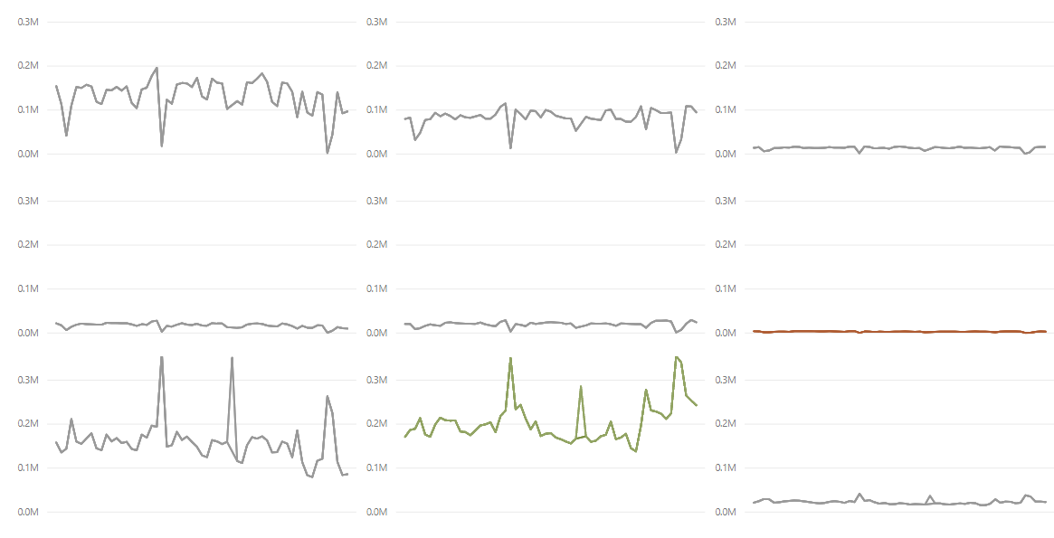
Exploratory Analysis - Visitor
Customer tagging problem
Neutral
Best
Worst
Desktop
Mobile
Tablet
Customer
Prospect
Undetermined

Slide 6
Exploratory Analysis - Visitor
Neutral
Best
Worst
Desktop
Mobile
Tablet
Customer
Prospect
Undetermined

Slide 7
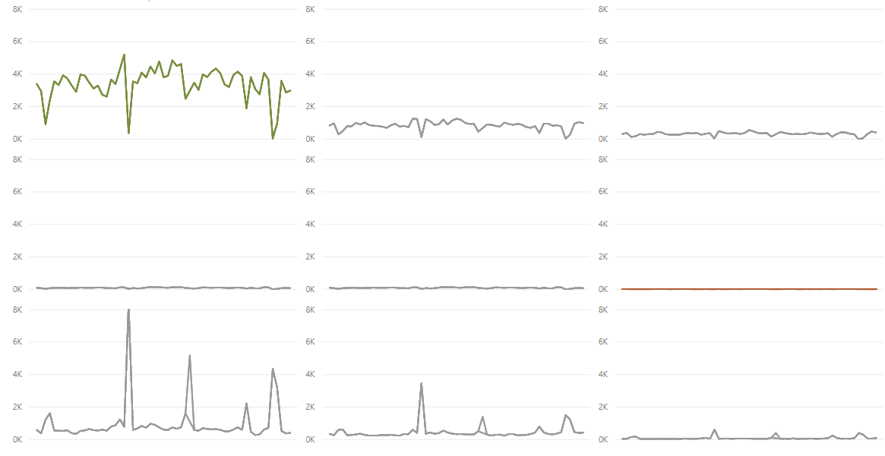
Exploratory Analysis - Order
Neutral
Best
Worst
Desktop
Mobile
Tablet
Customer
Prospect
Undetermined

Slide 8
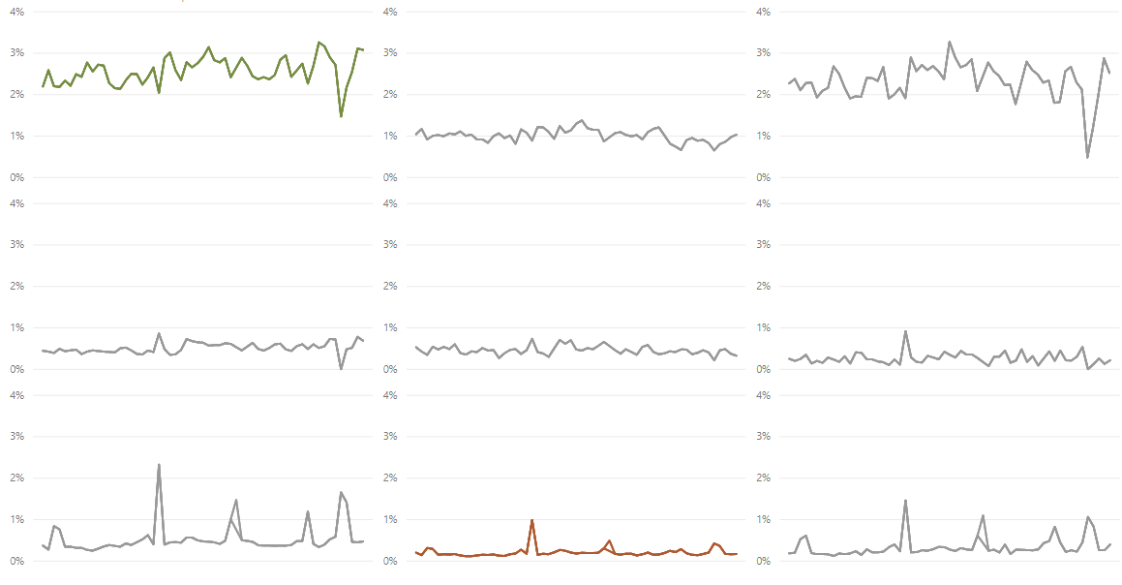
Exploratory Analysis - Rate
Neutral
Best
Worst
Desktop
Mobile
Tablet
Customer
Prospect
Undetermined

Slide 9
Anomaly Detection

Slide 10
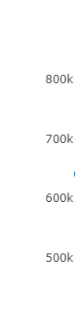
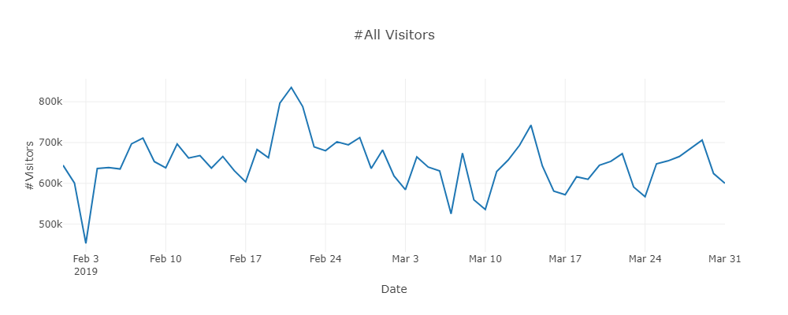
Model Selection
Total Visitors Over Time
Good
Bad
ARIMA
Twitter+IQR
STL+GESD
Strict
Stricter
Strictest
Pros | Well-studied Parameters(p, d, q) -> more accurate | Catch seasonal component No loops – easily scaled | More sensitive to capture anomalies Less resistant to outliers
Cons | Stationarity assumption Parameter tuning | No long term trend IQR is easily skewed by outliers | Iterative – more expensive

Slide 11
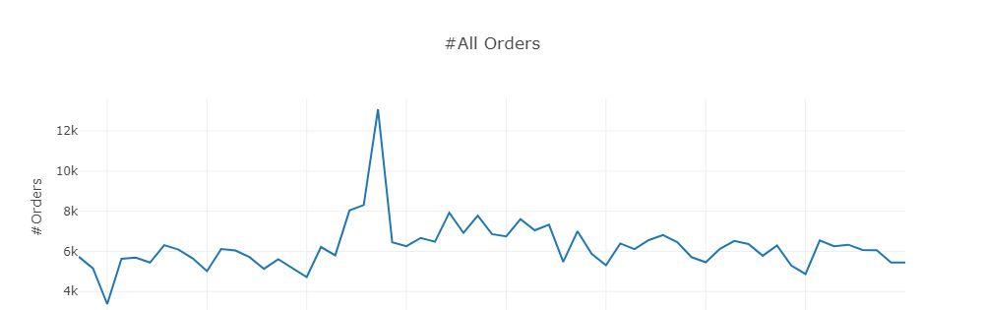
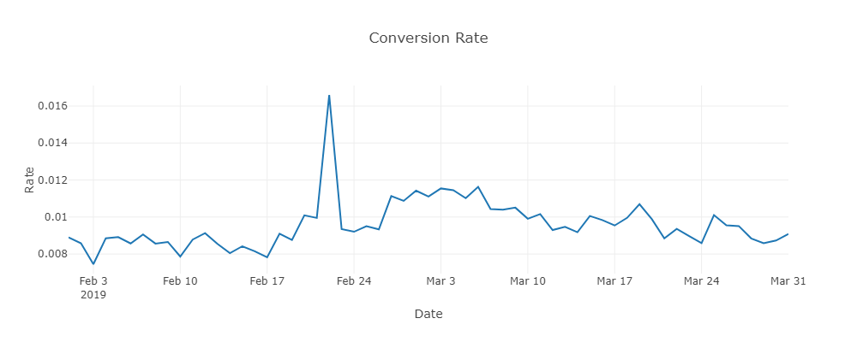
Two Callouts
Technical issues?
Launches?
Sales? Campaigns?
Events?
Feb 3rd – Bad anomalies
Feb 22nd – Good anomalies
Cause Analysis
Technical issues?
Launches?
Sales? Campaigns?
Events?

Slide 12
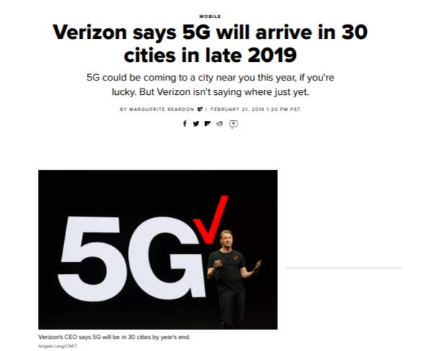
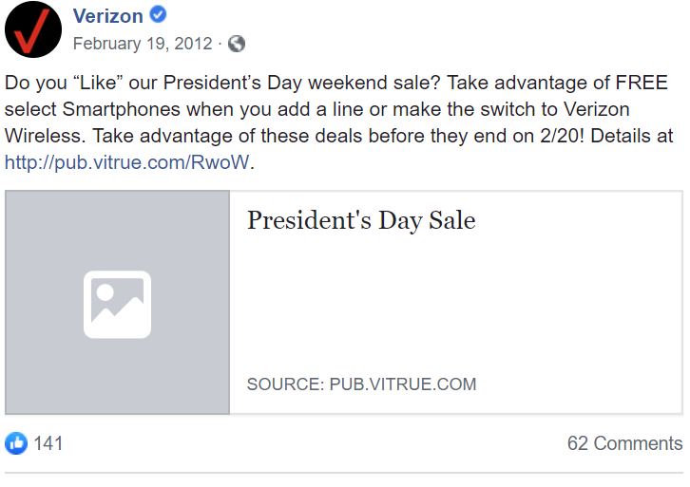
Cause Analysis
Technical issues?
Launches?
Sales? Campaigns?
Events?

Slide 13
Forecasting

Slide 14
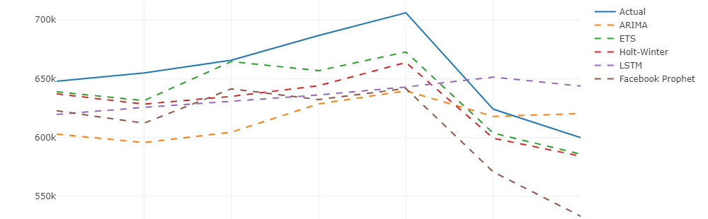
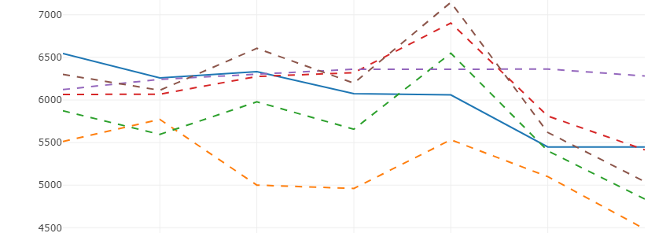
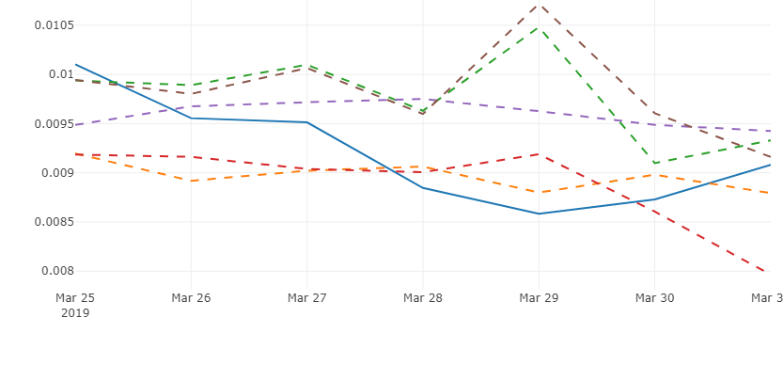
Model Selection - Forecasting
Visitors
Pros
Cons
ARIMA
Parameters(p, d, q) -> more accurate | Model assumption – stationary Parameter tuning
ETS
No requirement for stationarity | Parameter selection
Holt-Winter
Triple exponential smoothing | Model complexity Overfitting
LSTM
Time dependency Perform well with large data | Hyperparameter tuning Require large data
Facebook Prophet
Seasonal effects Robust to missing data and outliers | Overfitting Require large data
Orders
Rate

Slide 15
Metric Evaluation
Training: Feb1 – Mar 24
Testing: Mar 25 – Mar 31
Visitors
Orders
Rate
 | RMSE | MAPE | MASE
ARIMA | 132365.1 | 7.3% | 0.5
ETS | 66286.1 | 2.9% | 0.2
HW | 78978.5 | 4.4% | 0.3
LSTM | 109966.7 | 6.2% | 0.5
FB | 132491.2 | 7.9% | 0.5
RMSE | MAPE | MASE
2376.4 | 16.3% | 1.6
1343.5 | 8.2% | 0.9
1093.8 | 5.0% | 0.3
1373.2 | 6.4% | 0.8
1242.6 | 5.5% | 0.6
RMSE | MAPE | MASE
1.5e3 | 5.1% | 0.5
2.2e3 | 6.3% | 0.7
1.7e3 | 6.2% | 0.7
1.7e3 | 5.9% | 0.6
2.5e3 | 7.7% | 0.8
* See metrics across customer and device type in appendix

Slide 16
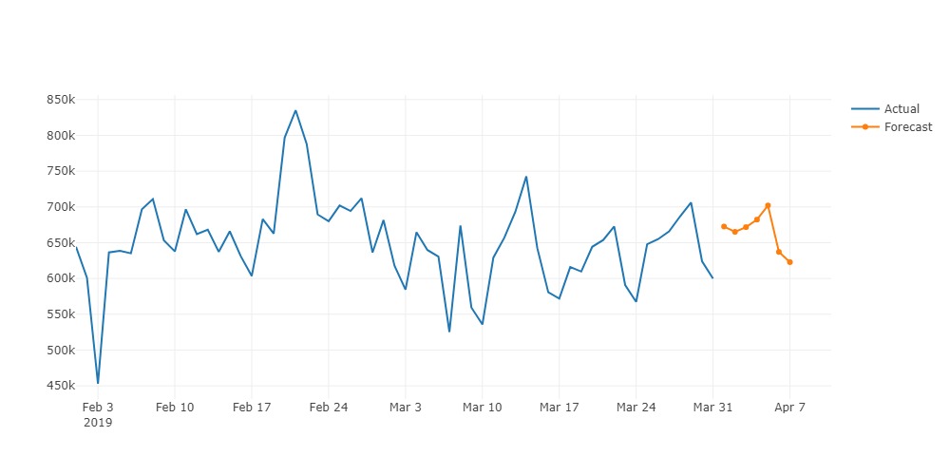
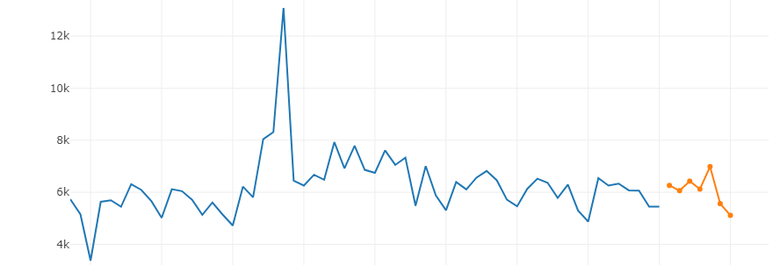
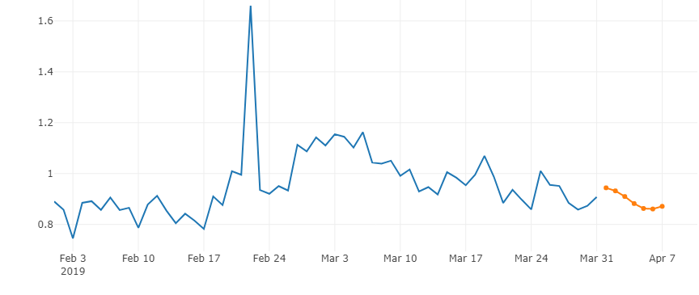
Forecast
Visitors
Orders
Rate

Slide 17
Outliers in the forecast?
Visitors
Orders
Rate
* Outliers: points lie out of ±1.5 standard deviation

Slide 18
KPI Dashboard Demo

Slide 19
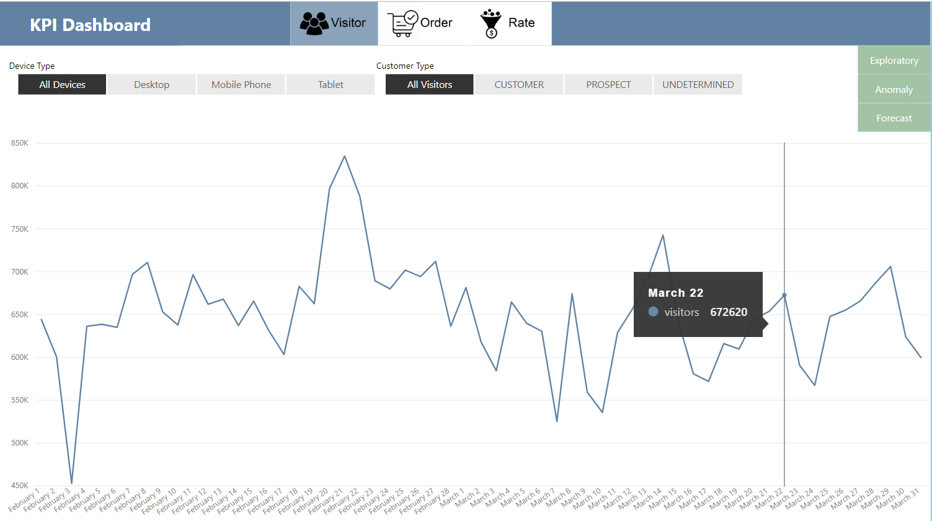

Slide 20
Appendix

Slide 21
Metric Evaluation
Visitor ETS
Order Holt-Winter
Rate ARIMA
 | RMSE | MAE | MASE
All | 66286.08 | 20686.66 | 0.235732
Customer x Desktop | 73263.96 | 23571.93 | 0.899388
Customer x Mobile | 86510.63 | 30973.98 | 0.727294
Customer x Tablet | 9435.26 | 3168.783 | 0.713414
Prospect x Desktop | 80504.49 | 24909.79 | 0.497514
Prospect x Mobile | 130128.7 | 39952.52 | 0.617765
Prospect x Tablet | 19274.86 | 6028.2 | 1.240991
Undetermined x Desktop | 13608.78 | 4135.544 | 0.465872
Undetermined x Mobile | 14486 | 5197.83 | 1.120878
Undetermined x Tablet | 3193.753 | 927.2324 | 0.726834
RMSE | MAE | MASE
1093.834 | 310.1625 | 0.269539
865.6737 | 253.26 | 0.922383
3745.477 | 1068.289 | 0.942647
353.9444 | 89.99719 | 0.548286
1274.202 | 336.9946 | 0.894224
3954.163 | 1001.093 | 0.876723
370.9294 | 95.74592 | 1.012419
112.8573 | 32.89702 | 0.903055
115.6508 | 36.62473 | 0.989858
13.16669 | 4.430497 | 0.939802
RMSE | MAE | MASE
0.001493 | 0.000511 | 0.832543
0.00494 | 0.001532 | 1.647831
0.014045 | 0.004057 | 0.680417
0.022752 | 0.006194 | 0.77245
0.002757 | 0.000761 | 0.783244
0.014254 | 0.003275 | 0.817562
0.008957 | 0.002382 | 0.954046
0.002962 | 0.00083 | 1.17678
0.006676 | 0.001979 | 1.013532
0.004344 | 0.00128 | 1.045439

Slide 22
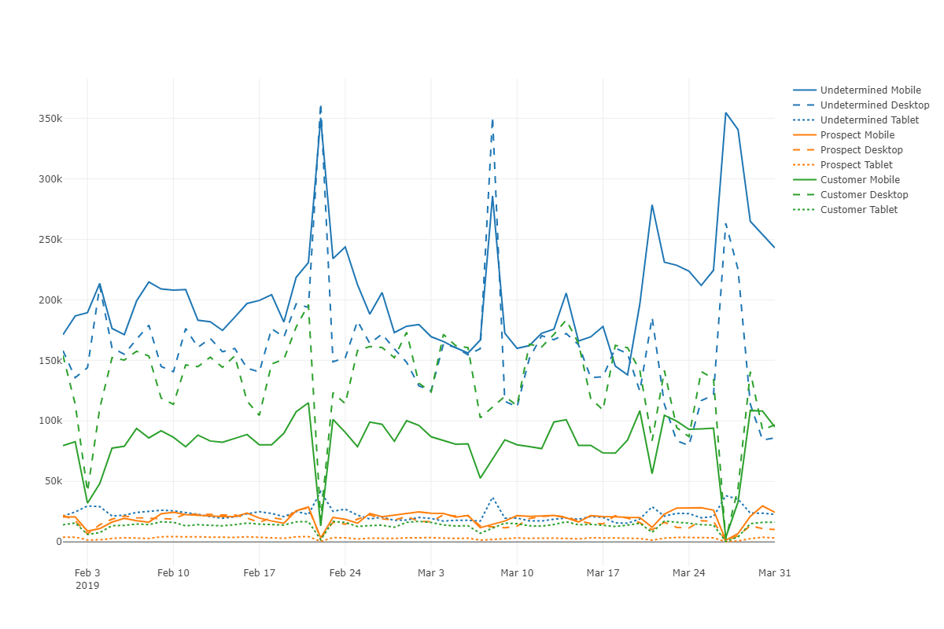
Visitors
customer tagging issue?
3/8 & 3/27
Undetermined ↑
Customer ↓
Prospect ↓
2/22
Undetermined ↑
Customer ↓
Prospect ↓
2/17 All ↓
2/28 All ↓
3/7 All ↓
2/3
Customer ↓
Prospect ↓

Slide 23
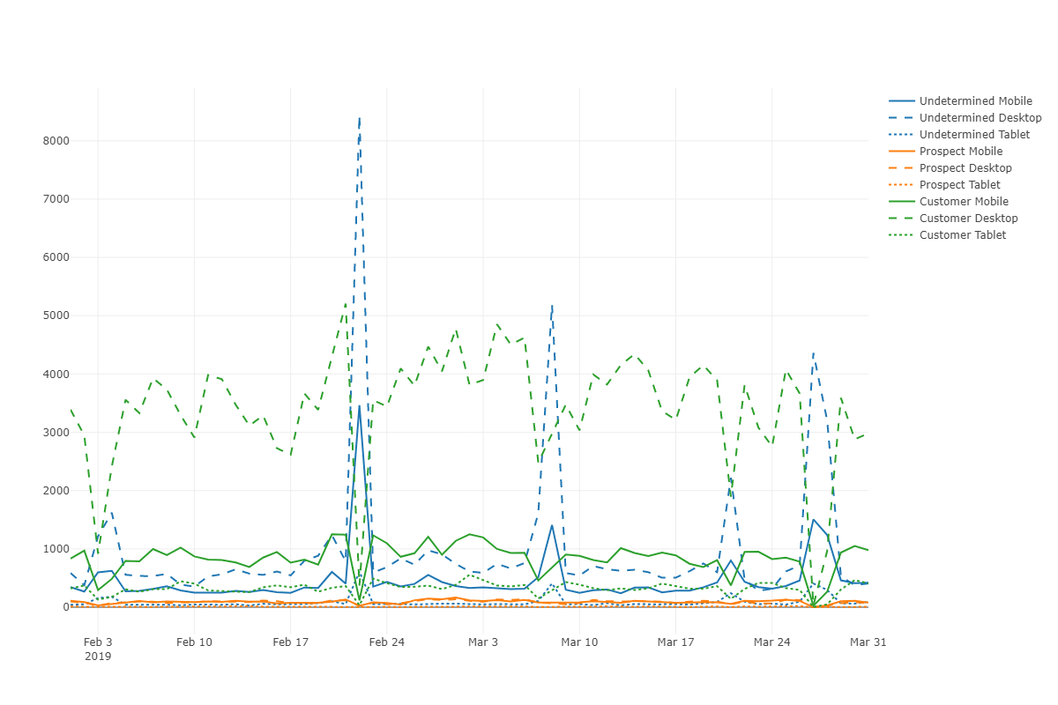
Orders
2/22
Undetermined ↑
Customer ↓
Prospect ↓
2/17 All ↓
2/28 All ↓
3/7 All ↓
2/3
Customer ↓
Prospect ↓

Slide 24
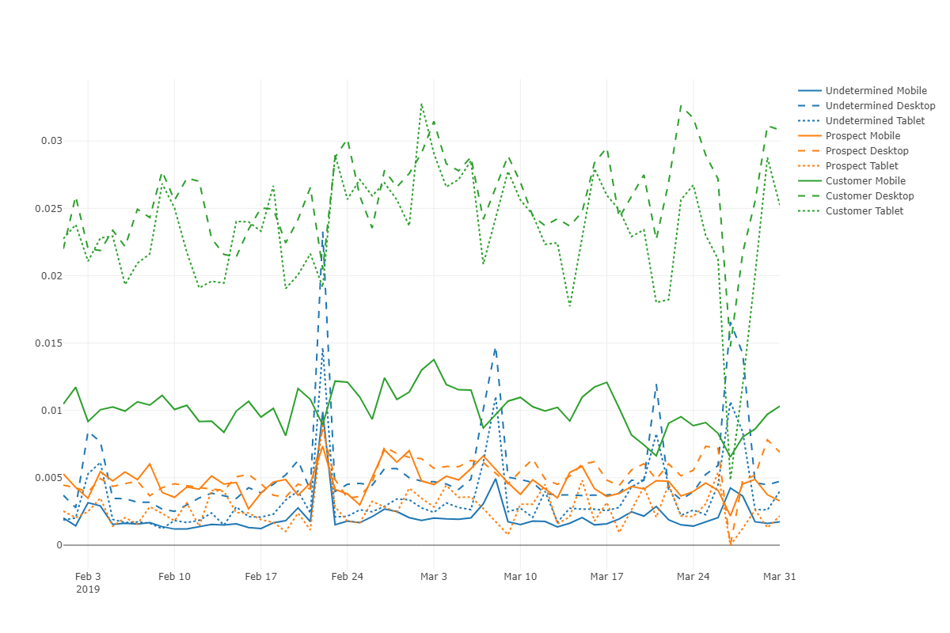
Conversion Rate
3/27
Undetermined ↑
Customer ↓
Prospect ↓
2/22
Undetermined ↑
Customer ↓
Prospect ↑
2/3
Undetermined ↑
Customer ↓
Prospect ↓

Slide 25
More Models for Anomaly Detection
ARIMAX
Deep Learning
Clustering Algorithms

Slide 26
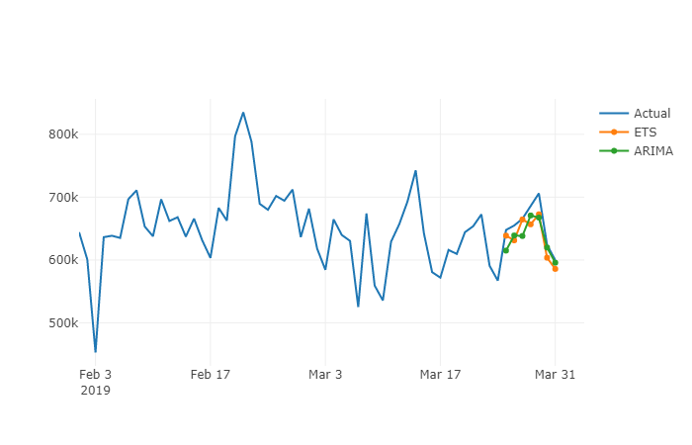
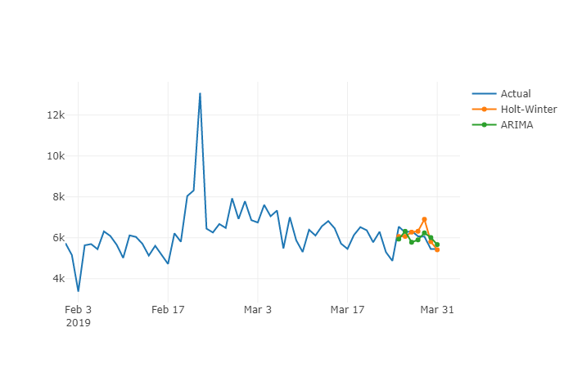
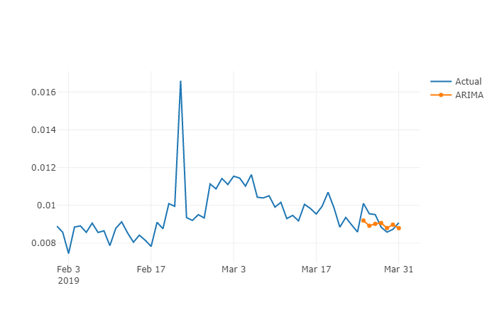
ARIMA outperforms
with proper tuning

Slide 27
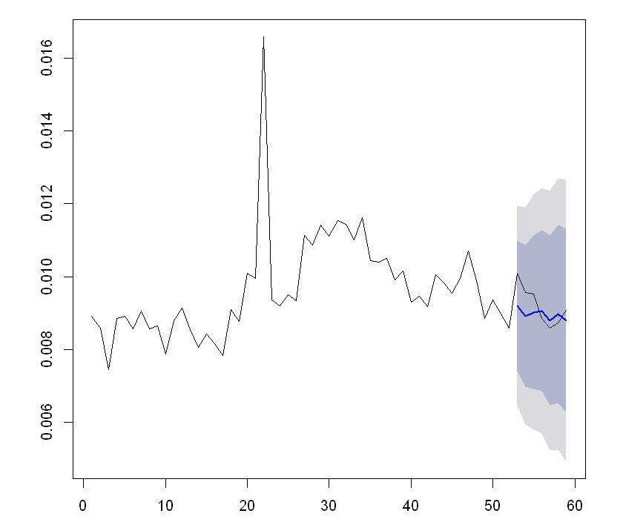

Anomaly Detection on Predictions

