Slide 1
Programming with MPI

Slide 2
Message-passing Model
Processor
Processor
Processor
Memory
Memory
Memory
Interconnection Network

Slide 3
Processes
Number is specified at start-up time.
  Typically, fixed throughout the execution.
All execute same program (SPMD).
  Each distinguished by a unique ID number.
Processes explicitly pass messages to communicate and to synchronize with each other.

Slide 4
Advantages of Message-passing Model
Gives programmer ability to manage the memory hierarchy.
  What’s local, what’s not?
Portability to many architectures: can run both on shared-memory and distributed-memory platforms.
Easier (though not definitely) to create a deterministic program.
  Non-deterministic programs are very difficult to debug.

Slide 5
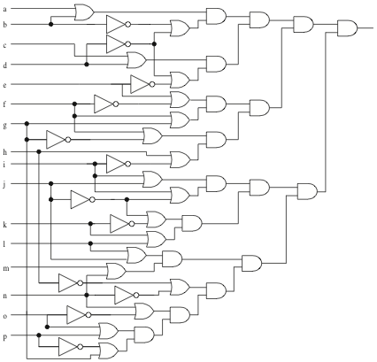
Circuit Satisfiability
1
1
0
1
1
1
Not satisfied
1
1
1
1
1
1
1
1
1
1
1

Slide 6
/* Return 1 if 'i'th bit of 'n' is 1; 0 otherwise */
#define EXTRACT_BIT(n,i) ((n&(1<<i))?1:0)
void check_circuit (int id, int z) {
int v[16]; /* Each element is a bit of z */
int i;
for (i = 0; i < 16; i++) v[i] = EXTRACT_BIT(z,i);
if ((v[0] || v[1]) && (!v[1] || !v[3]) && (v[2] || v[3])
&& (!v[3] || !v[4]) && (v[4] || !v[5])
&& (v[5] || !v[6]) && (v[5] || v[6])
&& (v[6] || !v[15]) && (v[7] || !v[8])
&& (!v[7] || !v[13]) && (v[8] || v[9])
&& (v[8] || !v[9]) && (!v[9] || !v[10])
&& (v[9] || v[11]) && (v[10] || v[11])
&& (v[12] || v[13]) && (v[13] || !v[14])
&& (v[14] || v[15])) {
printf ("%d) %d%d%d%d%d%d%d%d%d%d%d%d%d%d%d%d\n", id,
v[0],v[1],v[2],v[3],v[4],v[5],v[6],v[7],v[8],v[9],
v[10],v[11],v[12],v[13],v[14],v[15]);
fflush (stdout);
}
}

Slide 7
Solution Method
Circuit satisfiability is NP-complete.
No known algorithms to solve in polynomial time.
We seek all solutions.
We find through exhaustive search.
16 inputs ⇒ 65,536 combinations to test.

Slide 8
Summary of Program Design
Program will consider all 65,536 combinations of 16 boolean inputs.
Combinations allocated in cyclic fashion to processes.
Each process examines each of its combinations.
If it finds a satisfiable combination, it will print it.

Slide 9
Include Files
#include <mpi.h>
MPI header file.
#include <stdio.h>
Standard I/O header file.

Slide 10
Local Variables
int main (int argc, char *argv[]) {
int i;
int id; /* Process rank */
int p; /* Number of processes */
Include argc and argv: they are needed to initialize MPI
One copy of every variable for each process running this program

Slide 11
Initialize MPI
MPI_Init (&argc, &argv);
First MPI function called by each process.
Not necessarily first executable statement.
Allows system to do any necessary setup.

Slide 12
Shutting Down MPI
MPI_Finalize();
Call after all other MPI library calls
Allows system to free up MPI resources

Slide 13
Communicators
Communicator: opaque object that provides message-passing environment for processes.
MPI_COMM_WORLD
  Default communicator.
  Includes all processes that participate the run.
It’s possible to create new communicators by user.
  Always a subset of processes defined in the default communicator.

Slide 14
Communicator
Communicator Name
Communicator
MPI_COMM_WORLD
Processes
0
5
Ranks
2
1
4
3

Slide 15
Determine Number of Processes
MPI_Comm_size (MPI_COMM_WORLD, &p);
First argument is communicator,
Number of processes returned through second argument.

Slide 16
Determine Process Rank
MPI_Comm_rank (MPI_COMM_WORLD, &id);
First argument is communicator.
Process rank (in range 0, 1, …, p-1) returned through second argument.

Slide 17
Replication of Automatic Variables
id
1
id
0
p
6
p
6
id
5
id
2
p
6
id
4
6
p
id
3
p
6
p
6

Slide 18
What about External Variables?
int total;
int main (int argc, char *argv[]) {
int i;
int id;
int p;
…
Where is variable total stored?

Slide 19
Cyclic Allocation of Work
for (i = id; i < 65536; i += p)
check_circuit (id, i);
Parallelism is outside function check_circuit
It can be an ordinary, sequential function

Slide 20
#include <mpi.h>
#include <stdio.h>
int main (int argc, char *argv[]) {
int i;
int id;
int p;
MPI_Init (&argc, &argv);
MPI_Comm_rank (MPI_COMM_WORLD, &id);
MPI_Comm_size (MPI_COMM_WORLD, &p);
for (i = id; i < 65536; i += p)
check_circuit (id, i);
printf ("Process %d is done\n", id);
fflush (stdout);
MPI_Finalize();
return 0;
}
Put fflush() after every printf()

Slide 21
Compiling MPI Programs
% mpicc -O -o foo foo.c
mpicc: script to compile and link MPI programs.
Flags: same meaning as C compiler.
  -O ⎯ optimization level.
  -o <file> ⎯ where to put executable.

Slide 22
Running MPI Programs
% mpirun -np <p> <exec> <arg1> …
  -np <p> ⎯ number of processes.
  <exec> ⎯ executable.
  <arg1> … ⎯ command-line arguments.

Slide 23
Execution on 1 CPU
% mpirun -np 1 sat
0) 1010111110011001
0) 0110111110011001
0) 1110111110011001
0) 1010111111011001
0) 0110111111011001
0) 1110111111011001
0) 1010111110111001
0) 0110111110111001
0) 1110111110111001
Process 0 is done

Slide 24
Execution on 2 CPUs
% mpirun -np 2 sat
0) 0110111110011001
0) 0110111111011001
0) 0110111110111001
1) 1010111110011001
1) 1110111110011001
1) 1010111111011001
1) 1110111111011001
1) 1010111110111001
1) 1110111110111001
Process 0 is done
Process 1 is done

Slide 25
Execution on 3 CPUs
% mpirun -np 3 sat
0) 0110111110011001
0) 1110111111011001
2) 1010111110011001
1) 1110111110011001
1) 1010111111011001
1) 0110111110111001
0) 1010111110111001
2) 0110111111011001
2) 1110111110111001
Process 1 is done
Process 2 is done
Process 0 is done

Slide 26
Deciphering Output
Output order only partially reflects order of output events inside parallel computer.
If process A prints two messages, first message will appear before second.
If process A calls printf before process B, there is no guarantee process A’s message will appear before process B’s message.

Slide 27
Enhancing the Program
We want to find total number of solutions.
Incorporate sum-reduction into program.
Reduction is a collective communication operation.

Slide 28
Modifications
Modify function check_circuit
  Return 1 if circuit satisfiable with input combination.
  Return 0 otherwise.
Each process keeps local count of satisfiable circuits it has found.
Perform reduction after for loop.

Slide 29
New Declarations and Code
int count; /* Local sum */
int global_count; /* Global sum */
count = 0;
for (i = id; i < 65536; i += p)
count += check_circuit (id, i);

Slide 30
Prototype of MPI_Reduce()
int MPI_Reduce (
void *operand, /* addr of 1st reduction element */
void *result, /* addr of 1st reduction result */
int count, /* reductions to perform */
MPI_Datatype type, /* type of elements */
MPI_Op operator, /* reduction operator */
int root, /* process getting result(s) */
MPI_Comm comm /* communicator */
);

Slide 31
MPI_Datatype Options
MPI_CHAR
MPI_DOUBLE
MPI_FLOAT
MPI_INT
MPI_LONG
MPI_LONG_DOUBLE
MPI_SHORT
MPI_UNSIGNED_CHAR
MPI_UNSIGNED
MPI_UNSIGNED_LONG
MPI_UNSIGNED_SHORT

Slide 32
MPI_Op Options
MPI_BAND
MPI_BOR
MPI_BXOR
MPI_LAND
MPI_LOR
MPI_LXOR
MPI_MAX
MPI_MAXLOC
MPI_MIN
MPI_MINLOC
MPI_PROD
MPI_SUM

Slide 33
Our Call to MPI_Reduce()
MPI_Reduce (&count,
&global_count,
1,
MPI_INT,
MPI_SUM,
0,
MPI_COMM_WORLD);
Only process 0
will get the result
if (!id) printf ("There are %d different solutions\n",
global_count);

Slide 34
Execution of Second Program
% mpirun -np 3 seq2
0) 0110111110011001
0) 1110111111011001
1) 1110111110011001
1) 1010111111011001
2) 1010111110011001
2) 0110111111011001
2) 1110111110111001
1) 0110111110111001
0) 1010111110111001
Process 1 is done
Process 2 is done
Process 0 is done
There are 9 different solutions

Slide 35
Benchmarking the Program
MPI_Barrier ⎯ barrier synchronization.
MPI_Wtick ⎯ timer resolution.
MPI_Wtime ⎯ current time.

Slide 36
Benchmarking Code
double elapsed_time;
…
MPI_Init (&argc, &argv);
MPI_Barrier (MPI_COMM_WORLD);
elapsed_time = - MPI_Wtime();
…
MPI_Reduce (…);
elapsed_time += MPI_Wtime();

Slide 37
MPI Functions So Far
Basic Functions:
  MPI_Init
  MPI_Comm_rank
  MPI_Comm_size
  MPI_Finalize
More:
  MPI_Reduce
  MPI_Barrier
  MPI_Wtime
  MPI_Wtick

Slide 38
Two More Functions to Conquer the World
int MPI_Send(
void* buf, /* addr of 1st element to send */
int count, /* number of elements */
MPI_Datatype datatype, /* type of elements */
int dest, /* destination process id */
int tag, /* message tag */
MPI_Comm comm /* communicator */
);
int MPI_Recv(
void* buf, /* addr of 1st element to receive */
int count, /* number of elements */
MPI_Datatype datatype, /* type of elements */
int source, /* source process id */
int tag, /* message tag */
MPI_Comm comm, /* communicator */
MPI_Status* status /* info about message received */
);

Slide 39
More on MPI_Recv
MPI_Recv is a blocking function.
Use wildcards:
  MPI_ANY_SOURCE.
  MPI_ANY_TAG.
You can check the status of the received message:
  MPI_Status.MPI_SOURCE
  MPI_Status.MPI_TAG

Slide 40
MPI Walkthrough

Slide 41
A Walk Through the Maze
A bit of a history.
Basics.
Environment management routines.
Point-to-point communication routings.
Collective communication routings.
Derived data types.
Group and communicator management routings.
Virtual topology.

Slide 42
History of MPI
Late 1980s: vendors had unique libraries.
1989: Parallel Virtual Machine (PVM) developed at Oak Ridge National Lab.
1992: Work on MPI standard begun.
1994: Version 1.0 of MPI standard.
1997: Version 2.0 of MPI standard.
Today: MPI is dominant message passing library standard.
Notes:
• MPI resulted from the efforts of numerous individuals and groups over the course of a 2 year period between 1992 and 1994. Some history:• 1980s - early 1990s: Distributed memory, parallel computing develops, as do a number of incompatible software tools for writing such programs - usually with tradeoffs between portability, performance, functionality and price. Recognition of the need for a standard arose.• April, 1992: Workshop on Standards for Message Passing in a Distributed Memory Environment, sponsored by the Center for Research on Parallel Computing, Williamsburg, Virginia. The basic features essential to a standard message passing interface were discussed, and a working group established to continue the standardization process. Preliminary draft proposal developed subsequently.• November 1992: - Working group meets in Minneapolis. MPI draft proposal (MPI1) from ORNL presented. Group adopts procedures and organization to form the MPI Forum. MPIF eventually comprised of about 175 individuals from 40 organizations including parallel computer vendors, software writers, academia and application scientists.• November 1993: Supercomputing 93 conference - draft MPI standard presented.• Final version of draft released in May, 1994 - available on the WWW at: http://www.mcs.anl.gov/Projects/mpi/standard.html • MPI-2 picked up where the first MPI specification left off, and addresses topics which go beyond the first MPI specification. MPI-2 is briefly covered later.

Slide 43
Basics
Header file: #include <mpi.h>
Format of MPI calls:
  ret = MPI_Function(parameters…);
  Returns MPI_Success if successful.

Slide 44
General Programming Structure
#include <mpi.h>
int main(int argc, char** argv) {
MPI_Init(&argc, &argv);
/* Do work and call MPI routines */
MPI_Finalize();
return 0;
}

Slide 45
Environment Management Routines
MPI_Init(&argc, &argv);
MPI_Comm_size(comm, &size);
MPI_Comm_rank(comm, &rank);
MPI_Wtime();
MPI_Wtick();
MPI_Finalize();

Slide 46
Point-to-Point Communications
Message-passing between two and only two different MPI processes: one sending and one receiving.
Different flavors of send and receive:
  Synchronous vs. asynchronous.
  Blocking vs. non-blocking.
  Buffered vs. unbuffered.

Slide 47
Point-to-Point Communication Routine Arguments
Buffer: program address space that references the data to be sent or received.
Count: number of data elements.
Type: either predefined or user created data types.
Source: the rank of the originating process of the message (wildcard MPI_ANY_SOURCE).
Destination: the rank of the processes where the message should be delivered.

Slide 48
More Arguments
Tag: a non-negative integer to indicate the type of a message (wildcard: MPI_ANY_TAG).
Communicator: the set of processes for which the source and destination fields are valid.
Status: a pointer to the MPI_Status structure, used by a receive operation to indicate the source and the tag of the received message, as well as the actual bytes received.
Request: used as a handle to later query the state of a non-blocking operation.

Slide 49
MPI Predefined Data Types
MPI_CHAR
MPI_BYTE
MPI_DOUBLE
MPI_FLOAT
MPI_INT
MPI_LONG
MPI_LONG_DOUBLE
MPI_SHORT
MPI_UNSIGNED_CHAR
MPI_UNSIGNED
MPI_UNSIGNED_LONG
MPI_UNSIGNED_SHORT
MPI_PACKED

Slide 50
Point-to-Point Communications
MPI_Send(&buf, count, type, dest, tag, comm);
  Blocking send: buffer can be reused after function returns.
  Implemented either by copying the message into system buffer, or copying the message into the matching receive buffer.
MPI_Recv(&buf, count, type, src, tag, comm, &status);
  Blocking receive.
MPI_Ssend(&buf, count, type, dest, tag, comm);
  Synchronous send: returns only when a matching receive has been posted.
  Send buffer can be reused after function returns.

Slide 51
Point-to-Point Communications
MPI_Rsend(&buf, count, type, dest, tag, comm);
  Ready send: send may only be started if the matching receive is already posted. Error otherwise.
  Buffer can be reused after function returns.
MPI_Bsend(&buf, count, type, dest, tag, comm);
MPI_Buffer_attach(&buf, size);
MPI_Buffer_detach(&buf, &size);
  Buffered send: the outgoing message may be copied to the user-specified buffer space, so that the sending process can continue execution.
  User can attach or detach memory used to buffer messages sent in the buffered model.

Slide 52
Point-to-Point Communications
MPI_Sendrecv(&sendbuf, sendcnt, sendtype, dest, sendtag, &recvbuf, recvcnt, recvtype, src, recvtag, comm, &status);
  Combines the sending of a message and receiving of a message in a single function call.
  Can be more efficient.
  Guarantee deadlock will not occur.
MPI_Probe(src, tag, comm, &status);
  Checks for an incoming message without actually receiving it.
  Particularly useful if you want to allocate a receive buffer based on the size of an incoming message.

Slide 53
Point-to-Point Communications
MPI_Isend(&buf, count, type, dest, tag, comm, &request);
  Non-blocking (or immediate) send.
  It only posts a request for send and returns immediately.
  Do not access the send buffer until completing the receive call with MPI_Wait.
MPI_Irecv(&buf, count, type, src, tag, comm, &request);
  Non-blocking (or immediate) receive.
  It only posts a request for receive and returns immediately.
  Do not access the receive buffer until completing the receive call with MPI_Wait.

Slide 54
Point-to-Point Communications
MPI_Test(&request, &flag, &status);
  Determines if the operation associated with a communication request has been completed.
  If flag=true, you can access status to find out the message information (source, tag, and error code).
MPI_Wait(&request, &status);
  Waits until the non-blocking operation has completed.
  You can access status to find out the message information.

Slide 55
Point-to-Point Communications
MPI_Issend(&buf, count, type, dest, tag, comm, &request);
  Non-blocking synchronous send.
MPI_Ibsend(&buf, count, type, dest, tag, comm, &request);
  Non-blocking buffered send.
MPI_Irsend(&buf, count, type, dest, tag, comm, &request);
  Non-blocking ready send.
MPI_Iprobe(src, tag, comm, &flag, &status);
  Non-blocking function that checks for incoming message without actually receiving the message.

Slide 56
Collective Communications
All processes in a communicator must participate by calling the collective communication routine.
Purpose of collective operations:
  Synchronization: e.g., barrier.
  Data movement: e.g., broadcast, gather, scatter.
  Collective computations: e.g., reduction.
Things to remember:
  Collective operations are blocking.
  Can only be used with MPI predefined types (no derived data types).
  Cannot operate on a subset of processes; it’s all or nothing.

Slide 57
Collective Communications
MPI_Barrier(comm);
  Performs a barrier synchronization.
MPI_Bcast(&buf, count, type, root, comm);
  Allows one process to broadcast a message to all other processes.
MPI_Scatter(&sendbuf, sendcnt, sendtype, &recvbuf, recvcnt, recvtype, root, comm);
  A group of elements held by the root process is divided into equal-sized chunks, and one chunk is sent to every process.
MPI_Gather(&sendbuf, sendcnt, sendtype, &recvbuf, recvcnt, recvtype, root, comm);
  The root process gathers data from every process.

Slide 58
Collective Communications
MPI_Allgather(&sendbuf, sendcnt, sendtype, &recvbuf, recvcnt, recvtype, root, comm);
  All processes gather data from every processes.
MPI_Alltoall(&sendbuf, sendcnt, sendtype, &recvbuf, recvcnt, recvtype, comm);
  Performs an all-to-all communication among all processes.
MPI_Reduce(&sendbuf, &recvbuf, count, type, op, root, comm);
  Reduction operation.
MPI_Allreduce(&sendbuf, &recvbuf, count, type, op, comm);
MPI_Reduce_scatter(&sendbuf, &recvbuf, recvcnt, type, op, comm);
MPI_Scan(&sendbuf, &recvbuf, count, type, op, comm);

Slide 59
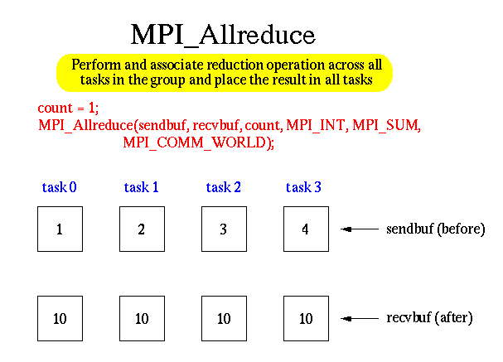

Slide 60
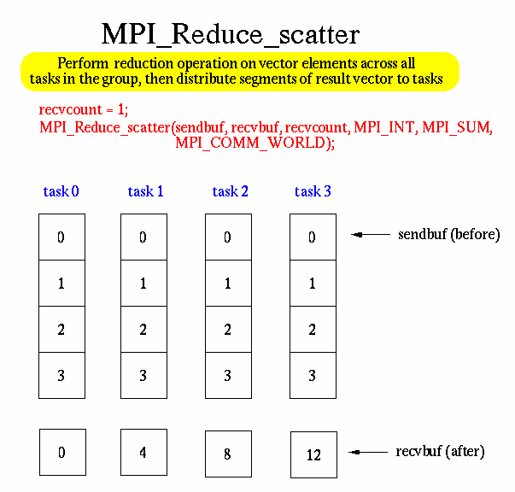

Slide 61
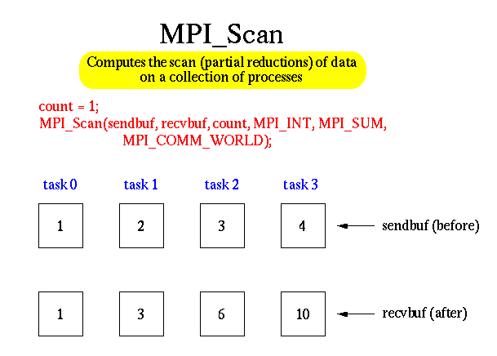

Slide 62
Derived Data Types
MPI allows you to define your own data structures.
Why do I need this?
You can construct several data types:
  Contiguous: an array of the same data types.
  Vector: similar to contiguous, but allows for regular gaps (stride) in the displacements.
  Indexed: an array of displacements of the input data types.
  Struct: a general data structure.

Slide 63
Derived Data Types
MPI_Type_contiguous(count, oldtype, &newtype);
  Create a new data type consisting of count copies of the old type.
MPI_Type_vector(count, blocklength, stride, oldtype, &newtype);
  Create a new data type that consists of count blocks of length blocklength. The distance between blocks is called stride.
MPI_Type_indexed(count, blocklengths[], displacements[], oldtype, &newtype);
  Create a new data type of blocks with arbitrary displacements.

Slide 64
Derived Data Types
MPI_Type_struct(count, blocklength[], displacements[], oldtypes[], &newtype);
  Create a generic data structure.
MPI_Type_extent(type, &extent);
  Returns the extent of a data type -- the number of bytes a single instance of data type would occupy in a message (depending on hardware data alignment requirement).
MPI_Type_commit(&newtype);
  New data types must be committed before use.
MPI_Type_free(&type);
  Deallocate a data type object.

Slide 65
Contiguous Type
x
Matrix A
MPI_Type_contiguous(x, MPI_FLOAT, &rowtype);
MPI_Type_commit(&rowtype);
y

Slide 66
Vector Type
x
Matrix A
y
MPI_Type_vector(y, 1, x, MPI_FLOAT, &columntype);
MPI_Type_commit(&columntype);

Slide 67
Groups and Communicators
A group is an ordered set of processes.
A group is always associated with a communicator.
All MPI messages must specify a communicator.
From the programmer’s perspective, a group and a communicator are one.
Group is used to specify which processes are used to construct a new communicator.

Slide 68
Groups and Communicators
Groups and communicators can be created and destroyed during the program execution.
Processes may be in more than one group/communicator. They will have a unique rank within each group/communicator.

Slide 69
Group/Communicator
MPI_Comm_group(comm, &group);
  Returns the process group associated with a communicator.
MPI_Group_incl(group, n, rank[], &newgroup);
  Produces a new group from an existing group,.
  Only includes those processes who ranks appear in rank.
MPI_Group_excl(group, n, rank[], &newgroup);
  Produces a new group from an existing group,.
  Only includes those processes who ranks do NOT appear in rank.
MPI_Group_rank(group, &rank);
  Returns the rank of the process in the process group.
MPI_Comm_create(comm, group, &newcomm);
  Create a new communicator from a process group.
MPI_Group_free(&group);
MPI_Comm_free(&comm);

Slide 70
Virtual Topologies
A mapping/ordering of MPI processes into a geometric “shape”.
Two main types: Cartesian and graph.
Reasons to use them?
  Convenience: match between the communication pattern of an algorithm with MPI processes topology.
  Efficiency: communication may be optimized against the a given parallel machine architecture.

Slide 71
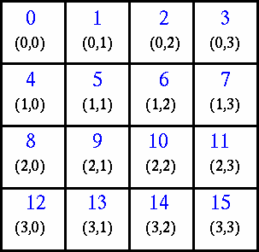
An Example of a 2-D Cartesian Virtual Topology

Slide 72
Cartesian Topology
MPI_Cart_create(comm, dims, size[], periodic[], reorder, &newcomm);
  Creates a new communicator that contains information about the Cartesian topology of the processes.
MPI_Cart_coords(comm, rank, dims, coords[]);
  Returns the coordinates of the process within the Cartesian grid.
MPI_Cart_rank(comm, coords[], &rank);
  Returns the rank of the process from its Cartesian coordinates.
MPI_Cart_shift(comm, shiftdim, direction, &src, &dest);
  Provides the calling process with the source and destination information it needs to perform a send-receive operation along a particular dimension of a Cartesian grid.

