Slide 1
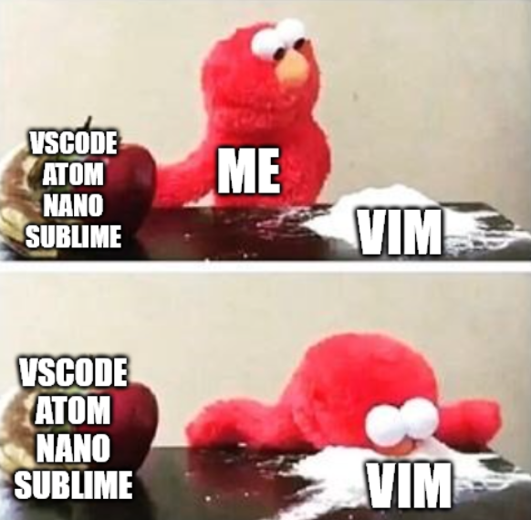

go brrr
Victor Kuo

Slide 2
The schedule tonight…
What is Vim?
Why use Vim?
Vim crash course
Tips to make Vim more useable!
Plugins
Computer settings
Tmux
Quality of life shell tweaks

Slide 3

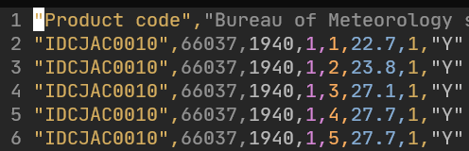
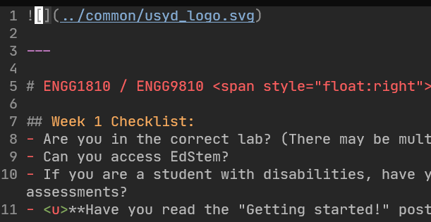
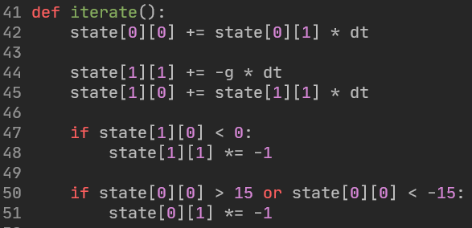
What is VIM?
A text editor!
Edits anything that is stored as raw text
E.g.
Text files
CSV files
Markdown files
Latex files
Source code (no matter the language!)

Slide 4

But what is a text file?
Raw text.
Letters, numbers, symbols, etc.
No images, fancy colouring, groupings, etc.
What about binary files?

Slide 5
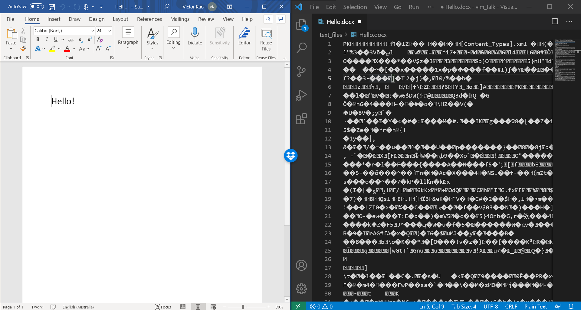

Slide 6
Why learn to edit text files when we have “better” software?
Text files:
Will never disappear.
Fully standardised across the world.
Viewable and editable by any format abiding editor.
Binary files:
Regularly change versions, format, styles, contents.
Hide away your actual contents in binary form.
You’re at the mercy of the software provider.
(This is not to say that binary files are bad, or that proprietary software is bad)

Slide 7








What is VIM?
A text editor!
Essentially, the same function as:

Slide 8
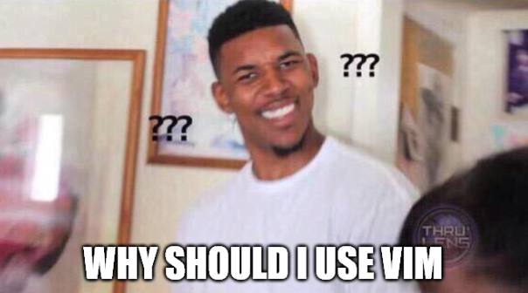
Notes:
Who wants to use regex!?
Middle click hold drag to multiline easier in VSCode.

Slide 9
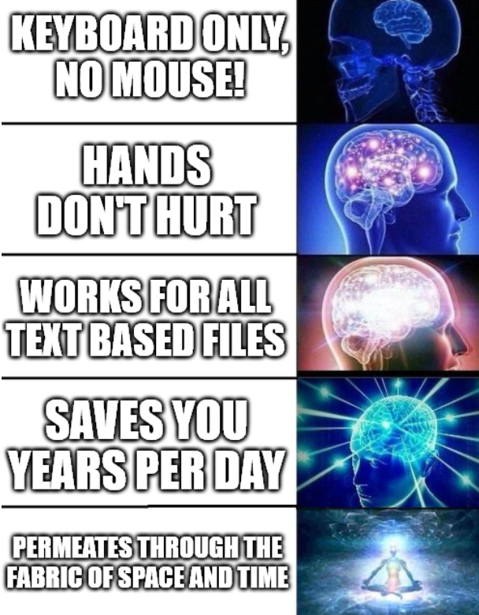
Notes:
Laptop coding is infinitely easier!
Much more intuitive! Commands make sense! Shortcuts make sense…

Slide 10
Let’s get started!

Slide 11
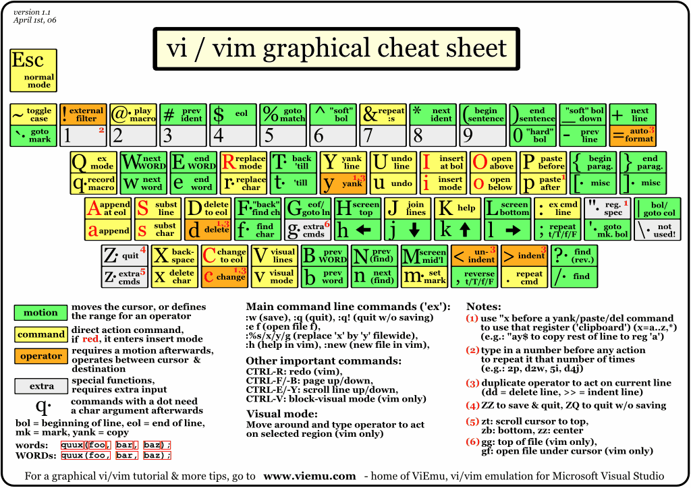
http://www.viemu.com/vi-vim-cheat-sheet.gif

Slide 12
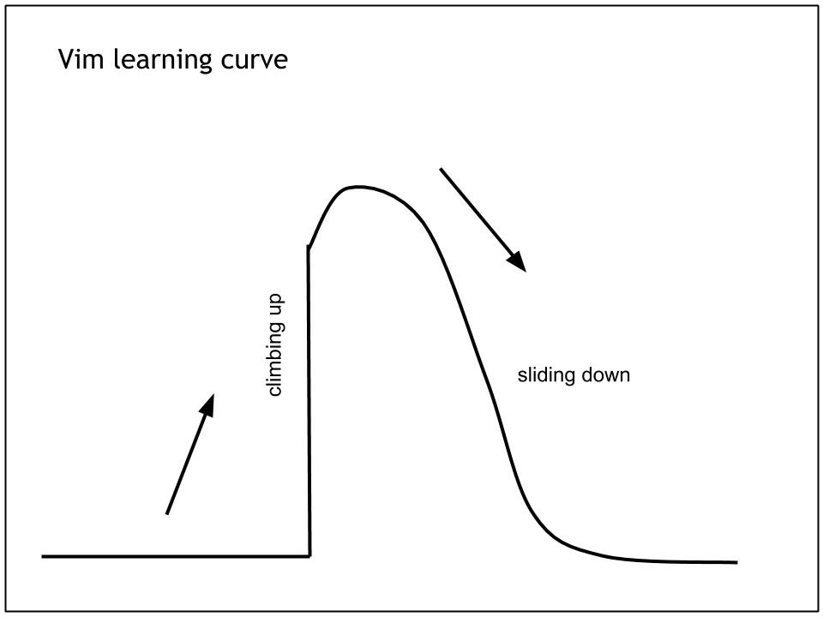
Exiting vim

Slide 13
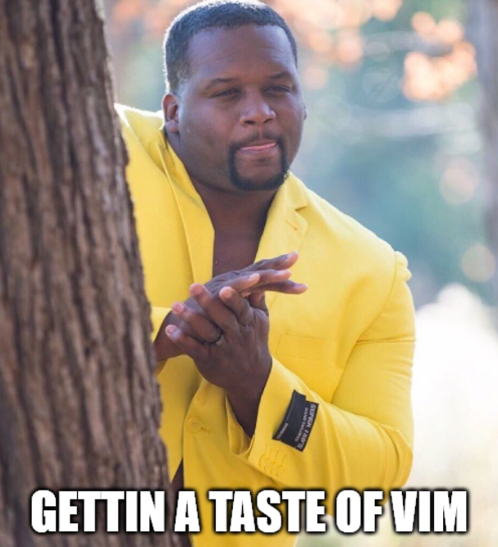
The goal tonight

Slide 14
How to get the most out of this talk…
Sit back, relax, and enjoy!
The goal is to give you guys exposure, to let you know what is out there.
Feel free to download these slides afterwards and try it out on your own ☺.
Taking notes or following along will drain you too quickly and you’ll miss what is really important! (imo at least)
Notes:
10:40m

Slide 15
Let’s actually get started…!
Notes:
18:40

Slide 16
5 minute break!
First 5 people can VIM-BE-GOOD!
Notes:
23:40

Slide 17
More complex Vim…
Macro
Notes:
33:40

Slide 18
Intermission programming example with application of learnt stuff
Notes:
38:40

Slide 19
Plugins
Recommended:
Plug 'junegunn/fzf', { 'do': { -> fzf#install() } } " fuzzy find
Plug 'junegunn/fzf.vim'
Plug 'morhetz/gruvbox'
Plug 'tpope/vim-commentary'
Plug 'preservim/nerdtree'
Plug 'tpope/vim-surround'
Plug 'jiangmiao/auto-pairs'
<your language syntax highlighter>
<Intellisense recommend COC>

Slide 20
Tips
Always look for easier ways to do things.
Remap caps lock to be ctrl
Remap leader to space
Increase the key repeat rate
Decrease the key repeat delay (to start)
Practise!!!
Notes:
46:40

Slide 21
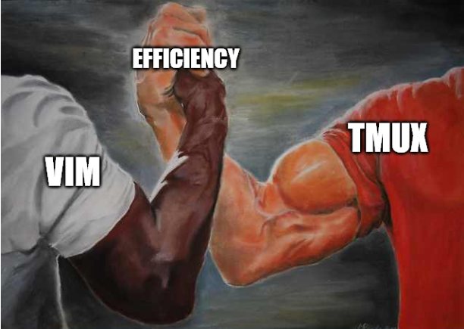
Vim & Tmux
Notes:
51:40

Slide 22
Zsh
Notes:
56:40

Slide 23
Caveats
Live debugging is hard…
Installing everything on a new machine takes a bit longer than installing a single VSCode installer.
Massive productivity drop at the start.
Learning all the basic shortcuts takes time…
Learning all the plugins takes time…
Configuring your new keymaps takes time…
Notes:
60

Slide 24
Closing
Vim is HARD to get started with.
But it’s a long term investment on your hands (and girlfriend 😉).
But once you see the light, once you come out of the other side of the tunnel, you will emerge a new, woke coder.
Notes:
65

Slide 25
Further study
`vimtutor`
This talk’s recording
The Primeagen https://www.youtube.com/channel/UC8ENHE5xdFSwx71u3fDH5Xw
https://vim-adventures.com/

