Slide 1
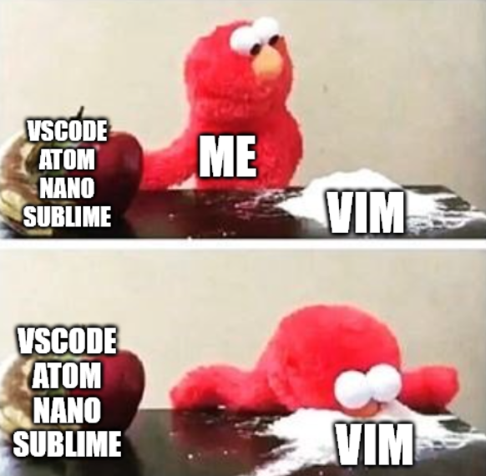

go brrr
Victor Kuo

Slide 2
The schedule tonight…
What is Vim?
Why use Vim?
Vim crash course
Tips to make Vim more useable!
Plugins
Computer settings
Tmux
Quality of life shell tweaks

Slide 3

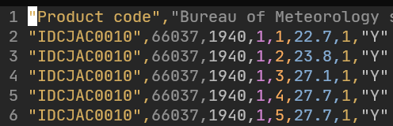
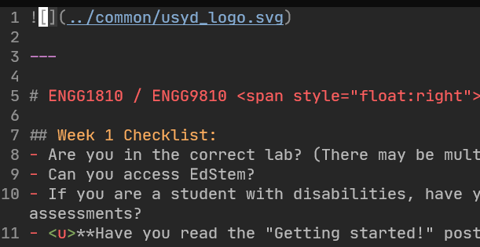
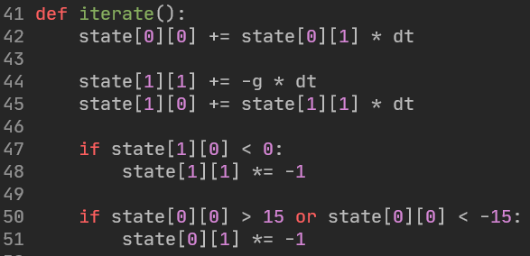
What is VIM?
A text editor!
Edits anything that is stored as raw text
E.g.
Text files
CSV files
Markdown files
Latex files
Source code (no matter the language!)

Slide 4

But what is a text file?
Raw text.
Letters, numbers, symbols, etc.
No images, fancy colouring, groupings, etc.
What about binary files?

Slide 5
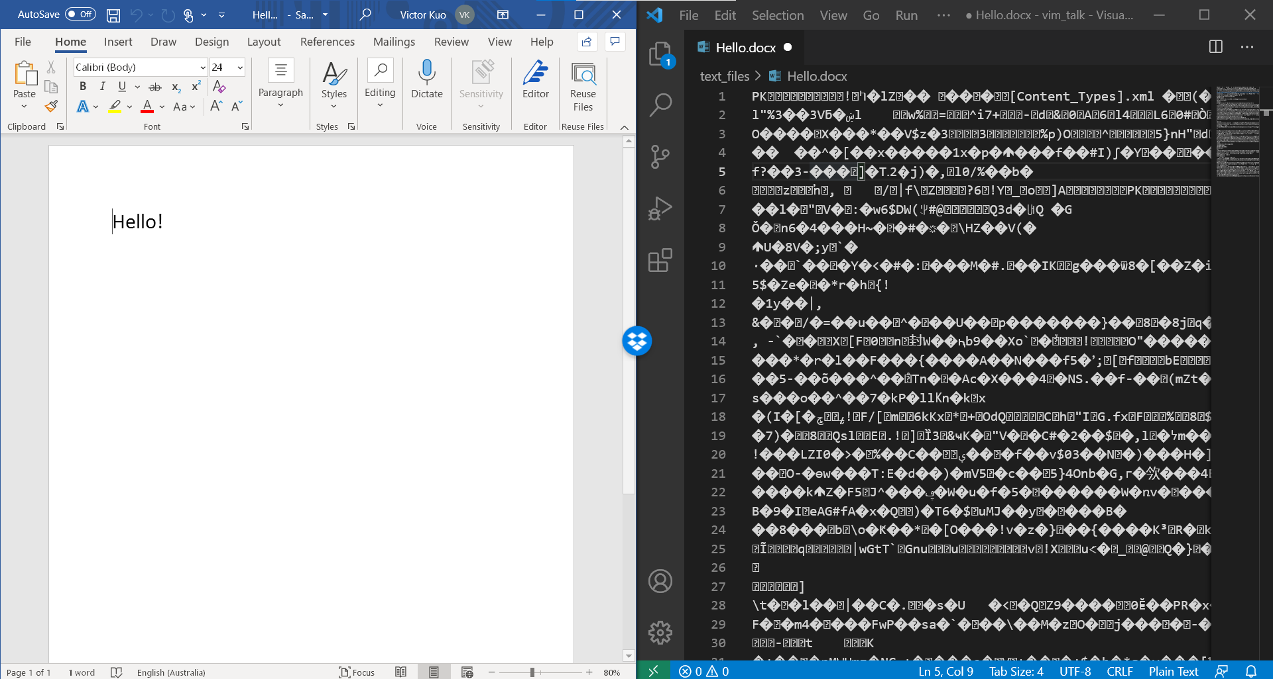

Slide 6
Why learn to edit text files when we have “better” software?
Text files:
Will never disappear.
Fully standardised across the world.
Viewable and editable by any format abiding editor.
Binary files:
Regularly change versions, format, styles, contents.
Hide away your actual contents in binary form.
You’re at the mercy of the software provider.
(This is not to say that binary files are bad, or that proprietary software is bad)

Slide 7
What is VIM?
A text editor!
Edits anything that is stored as raw text
E.g.
Text files
CSV files
Markdown files
Latex files
Source code (no matter the language!)

Slide 8








What is VIM?
A text editor!
Essentially, the same function as:

Slide 9
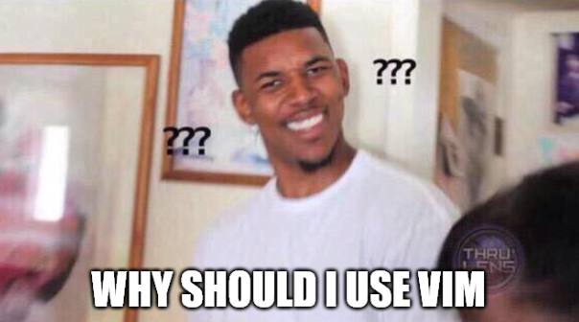

Slide 10
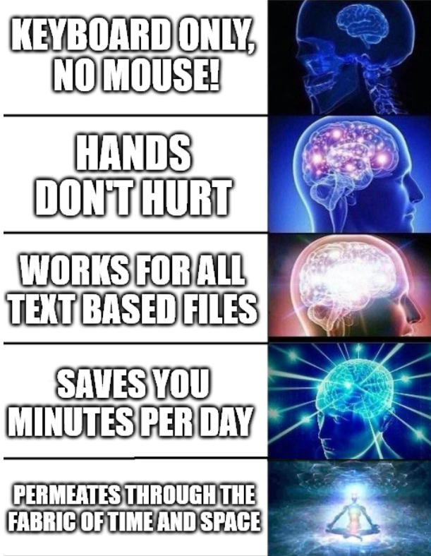

Slide 11
Let’s get started!

Slide 12
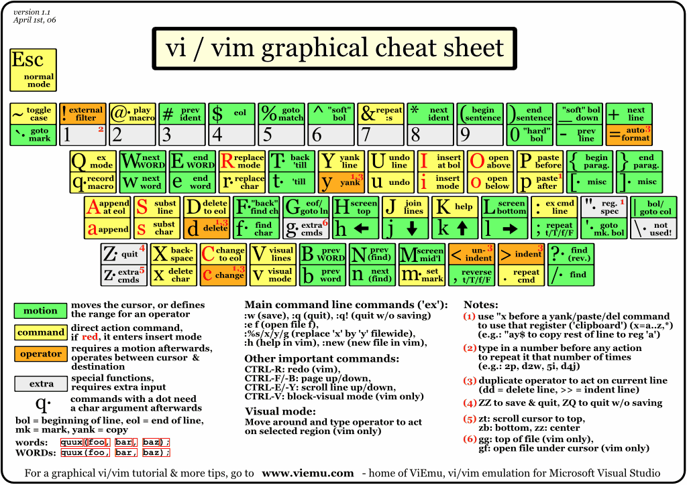
http://www.viemu.com/vi-vim-cheat-sheet.gif

Slide 13
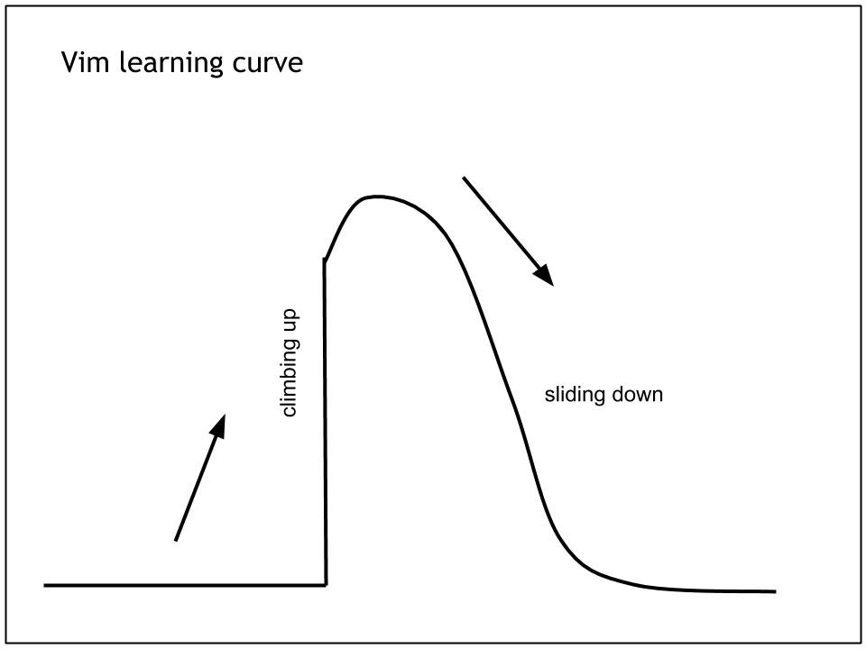

Slide 14
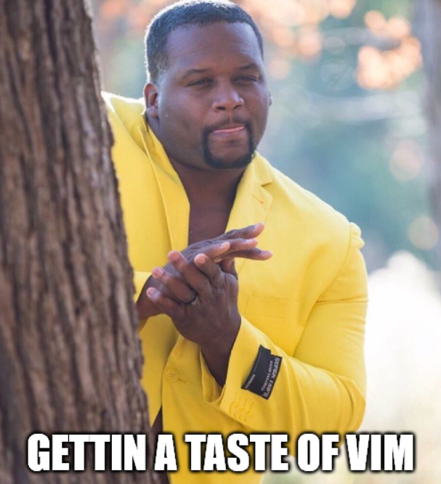
The goal tonight

Slide 15
How to get the most out of this talk…
Sit back, relax, and enjoy!
The goal is to give you guys exposure, to let you know what is out there.
Feel free to download these slides afterwards and try it out on your own ☺.
Taking notes or following along will drain you too quickly and you’ll miss what is really important! (imo at least)

Slide 16
How to open and close vim…
To start vim, type vim into a terminal.
To exit vim, type :q.

Slide 17
hjkl – the holy quartet

Slide 18
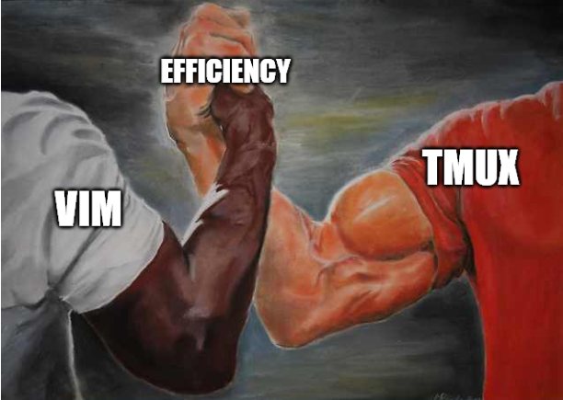

Slide 19
