Slide 1
Adversarial Search
Yun-Gyung Cheong
College of Software
SKKU
Notes:
Lecture notes are modified from the class of Dan Weld’s at U of Washington

Slide 2
Outline
Adversarial Search
Minimax algorithm
Alpha beta pruning

Slide 3
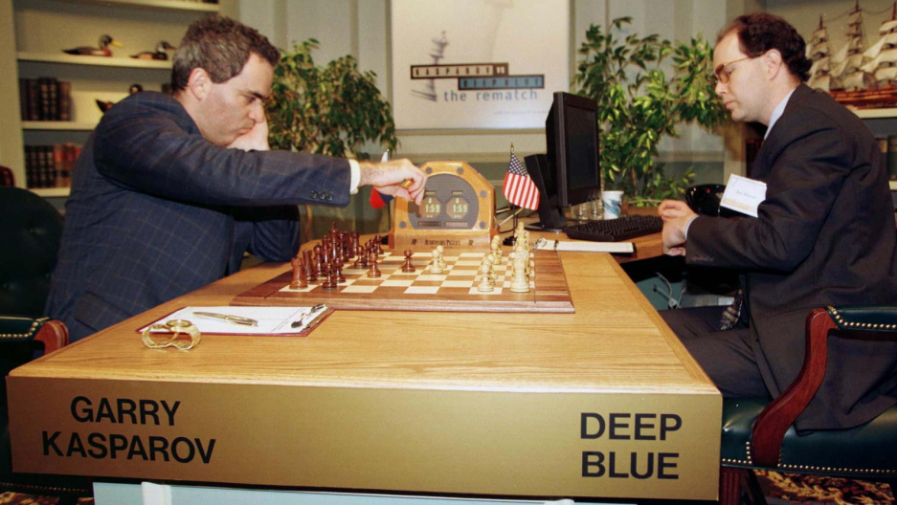
Games
The world chess champion Garry Kasparov and an IBM supercomputer called Deep Blue. The first match was played in Philadelphia in 1996 and won by Kasparov. The second was played in New York City in 1997 and won by Deep Blue.

Slide 4
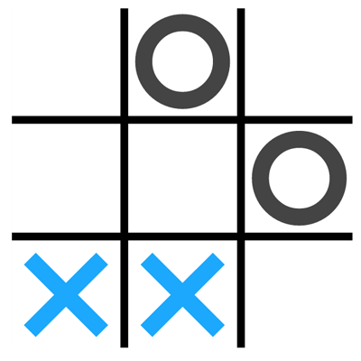
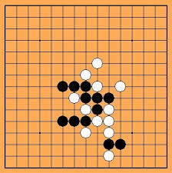
Games

Slide 5
Adversarial Search in zero-sum games
Chess, tic-tac-toe, connect-four, checkers, go, etc. etc. are zero-sum games, meaning in the end, the gains and losses among the players add up to zero
One player wins, another loses, so the sum of "utility" for each player at the end is zero
Poker is another zero-sum game, although there is one winner and many losers. However, the amount the winner wins is equal to the sum of the amounts the losers lose

Slide 6
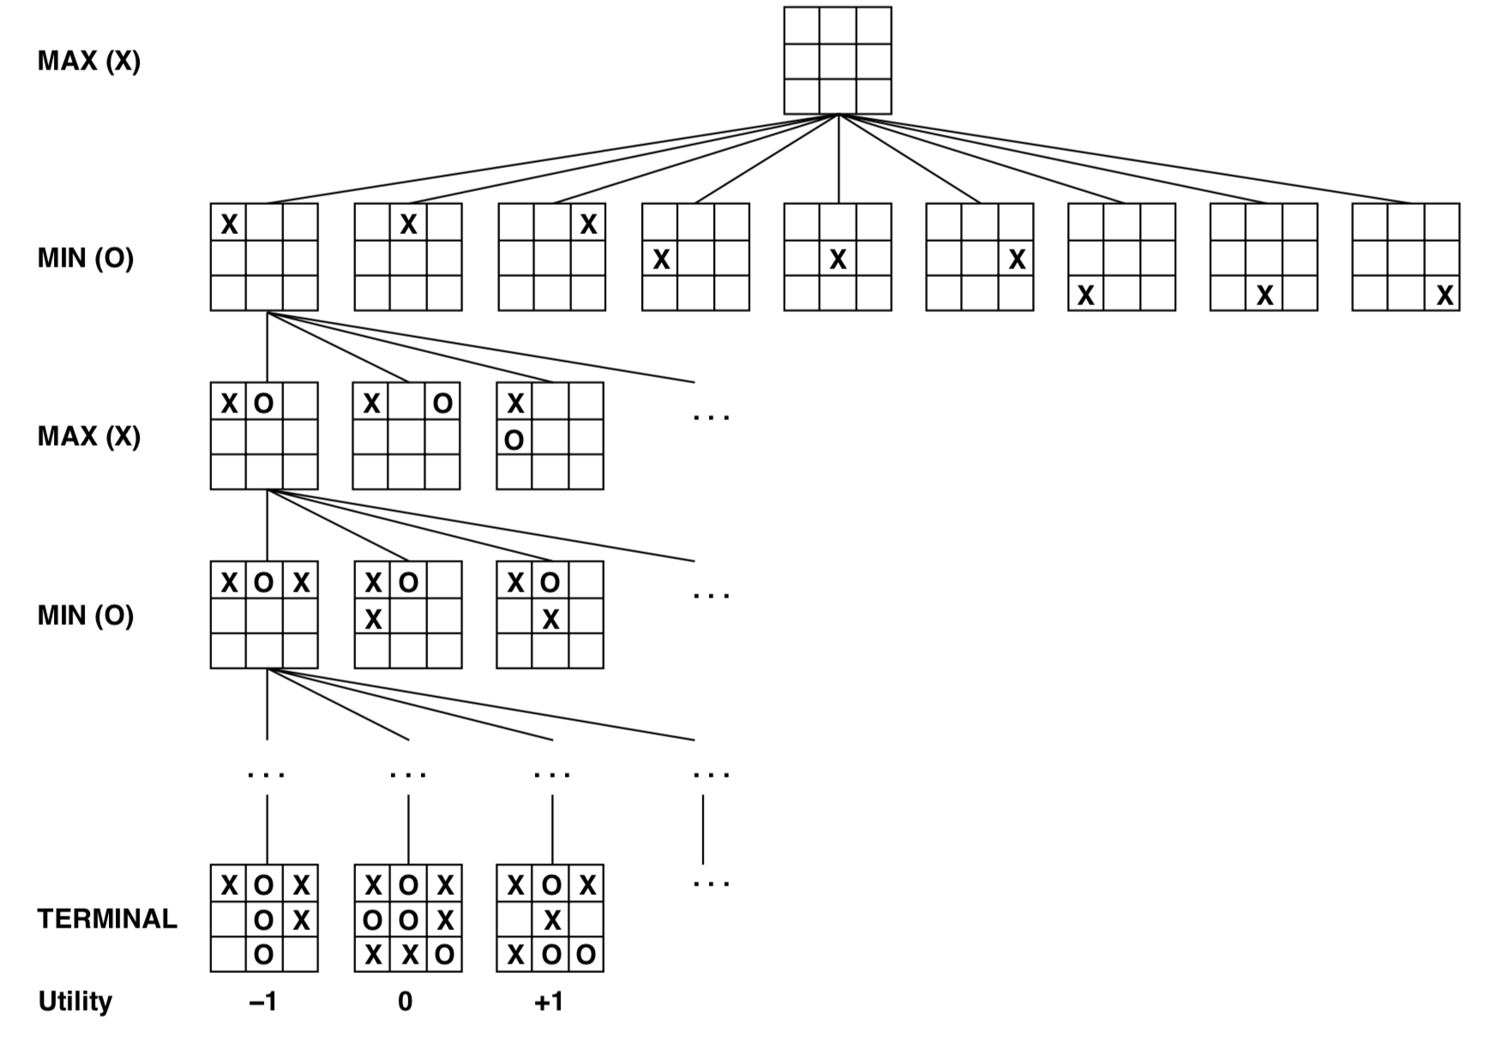
Game tree

Slide 7
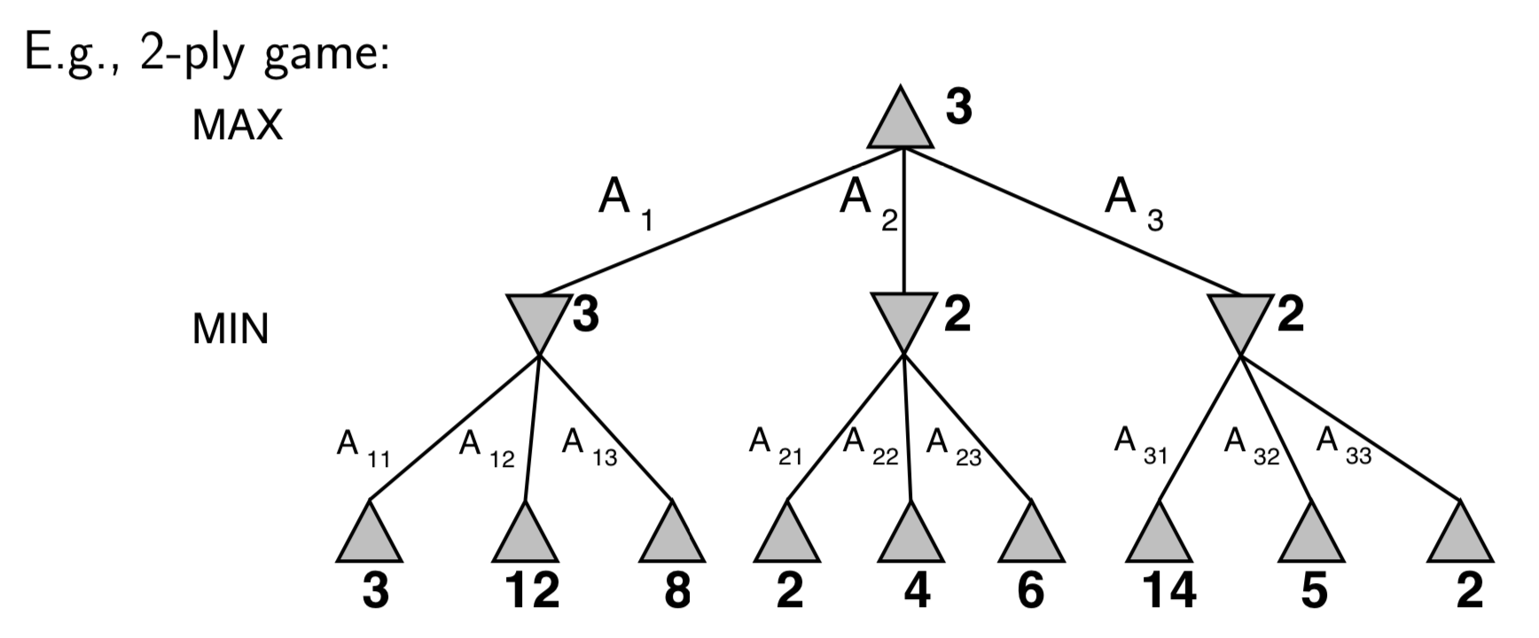
Minimax
Perfect play for deterministic, perfect-information games
Idea: choose move to position with highest minimax value = best achievable payoff against best play

Slide 8
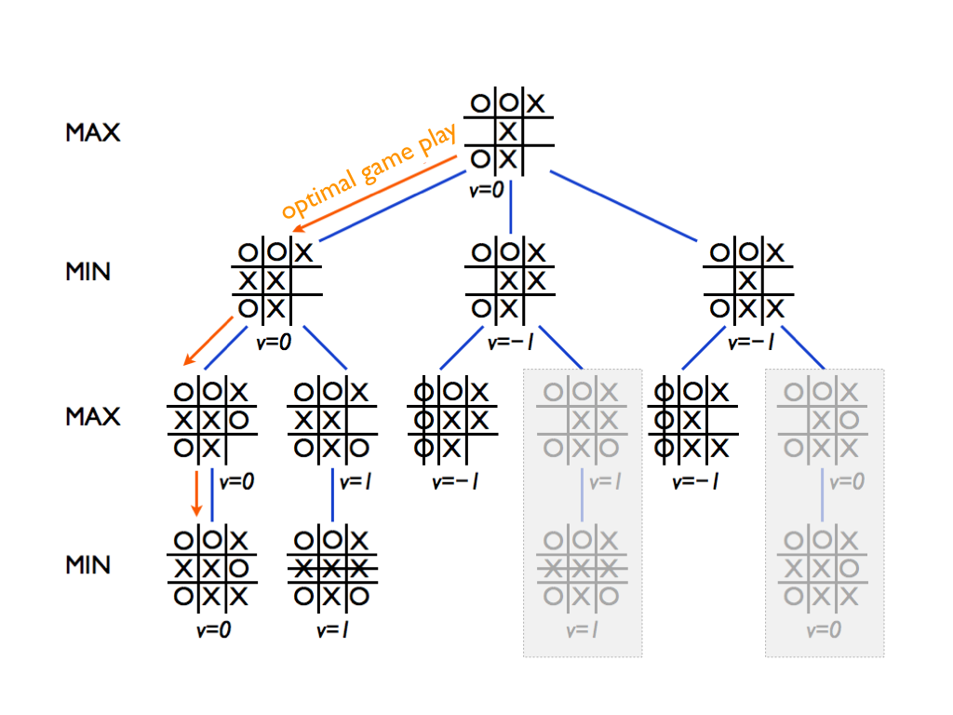

Slide 9
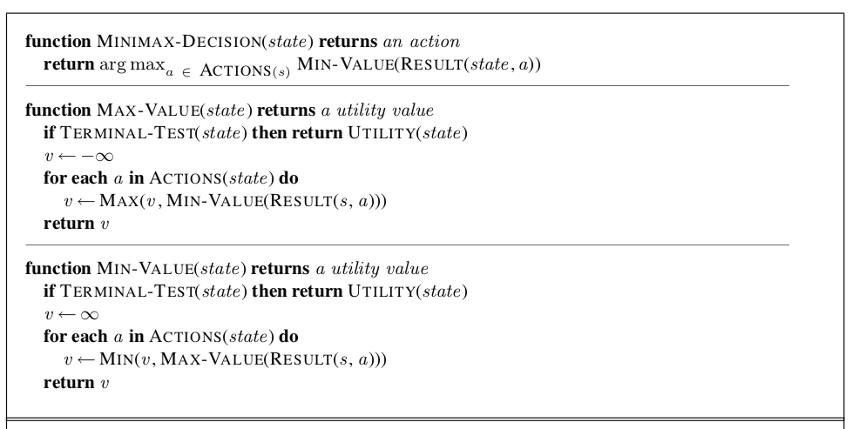

Slide 10
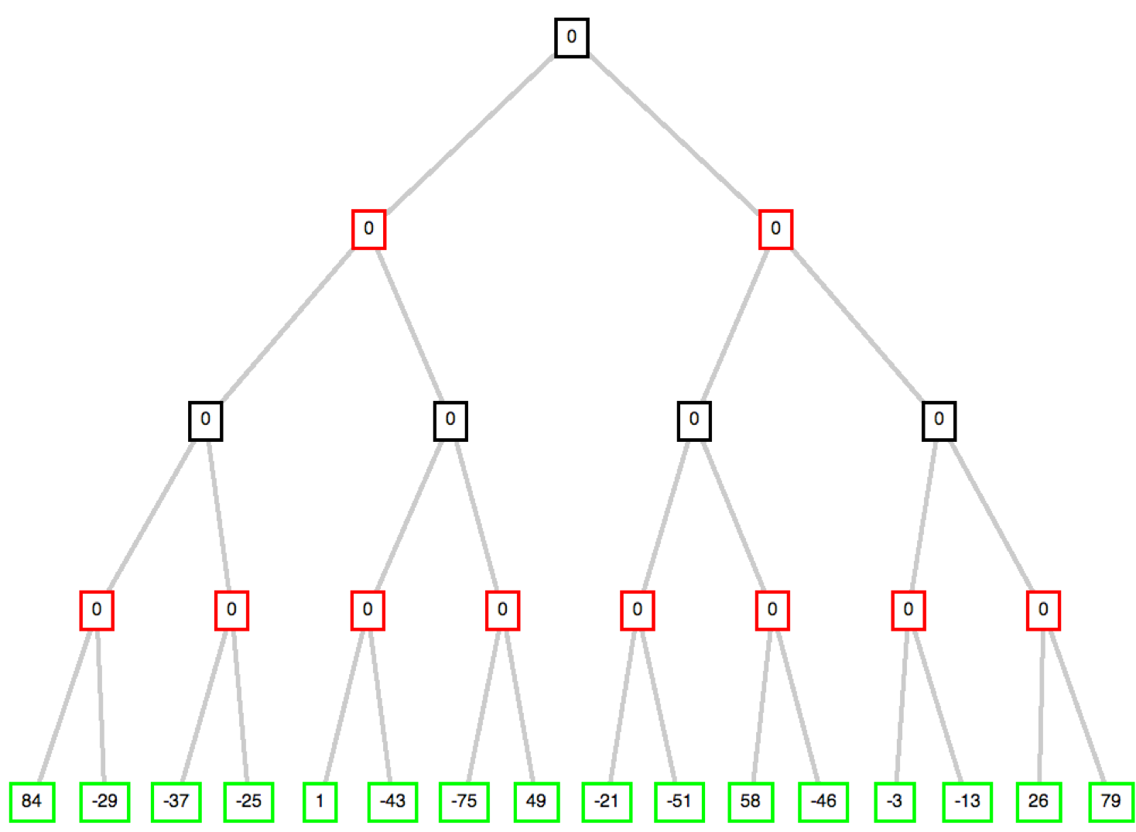
Optimal path on Minimax

Slide 11
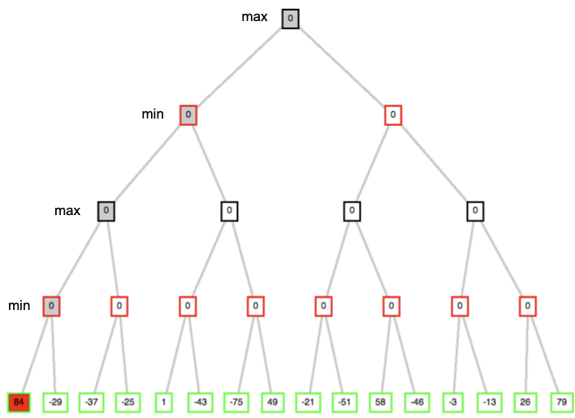

Slide 12
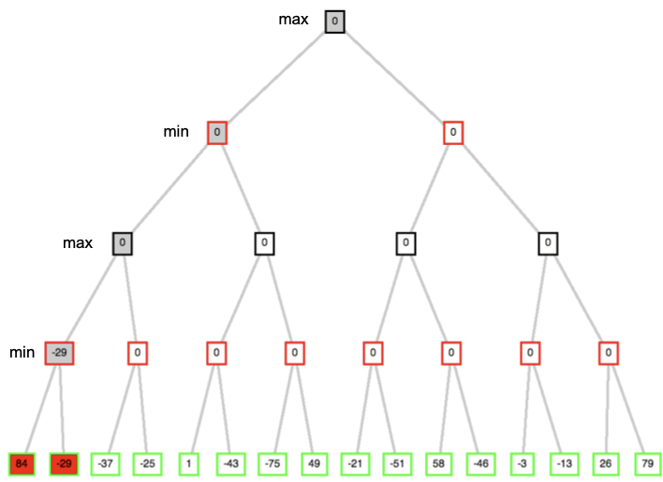

Slide 13
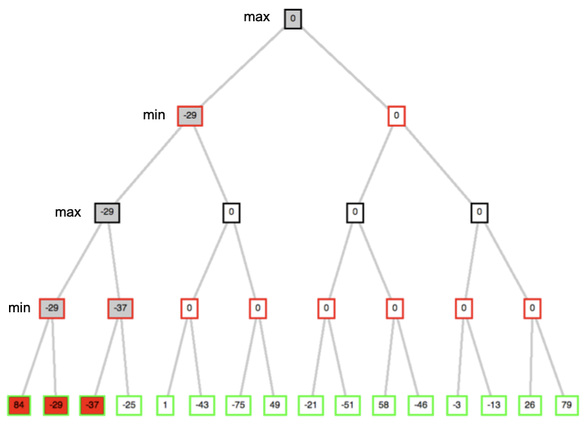

Slide 14
Practice

Slide 15
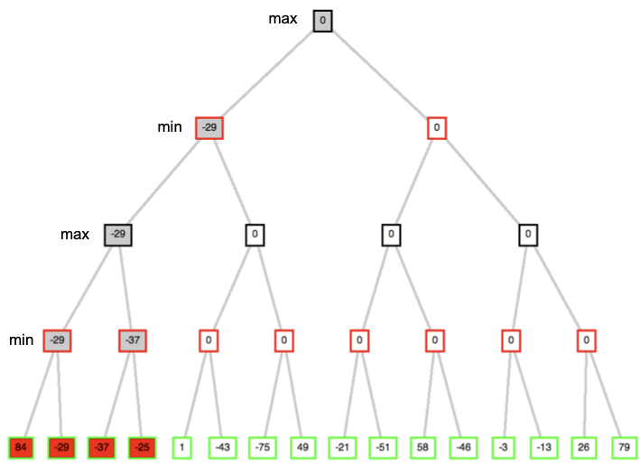
Practice

Slide 16
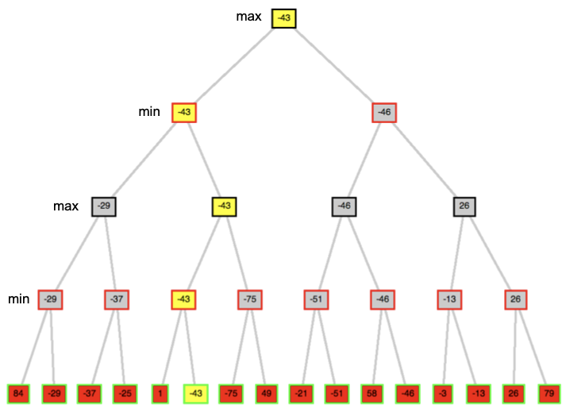

Slide 17
Properties Minimax
Complete? Yes, if tree is finite (chess has specific rules for this) Optimal?? Yes, against an optimal opponent. Otherwise??
Time complexity? O(b^{m})
Space complexity? O(bm) (depth-first exploration)
For chess, b ≈ 35, m ≈ 100 for “reasonable” games
⇒ exact solution completely infeasible

Slide 18
But do we need to explore every path?

Slide 19
α–β pruning
John McCarthy proposed the idea of Alpha-Beta after the representation of the Chess Program by Alex Bernstein at the Dartmouth Workshop in 1956
Alpha-beta pruning is a way of finding the optimal minimax solution while avoiding searching subtrees of moves which won't be selected
𝜷 (Minimizer) is the minimum upper bound of possible solutions
𝜶 (Maximizer) is the maximum lower bound of possible solutions
Thus, when any new node is being considered as a possible path to the solution, it can only work if: 𝜶 ≤ N ≤ 𝜷
where N is the current estimate of the value of the node

Slide 21
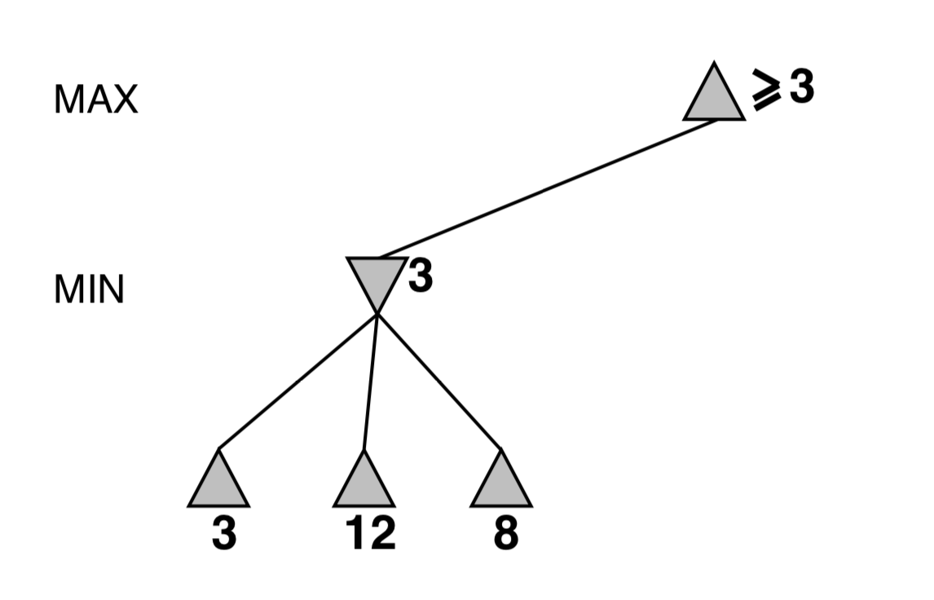
α–β pruning example

Slide 22
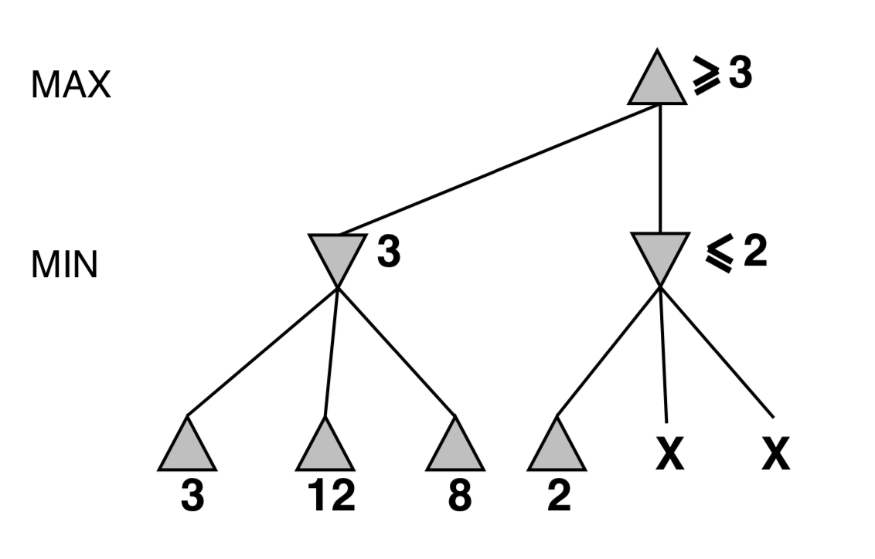

Slide 23
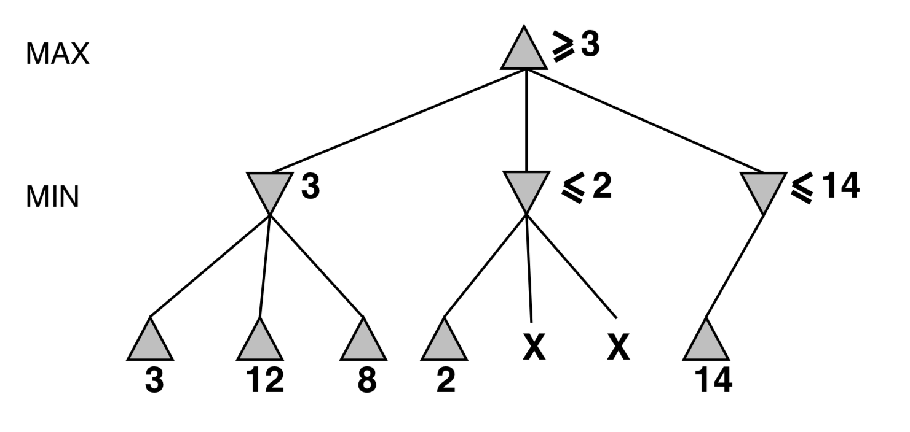

Slide 24
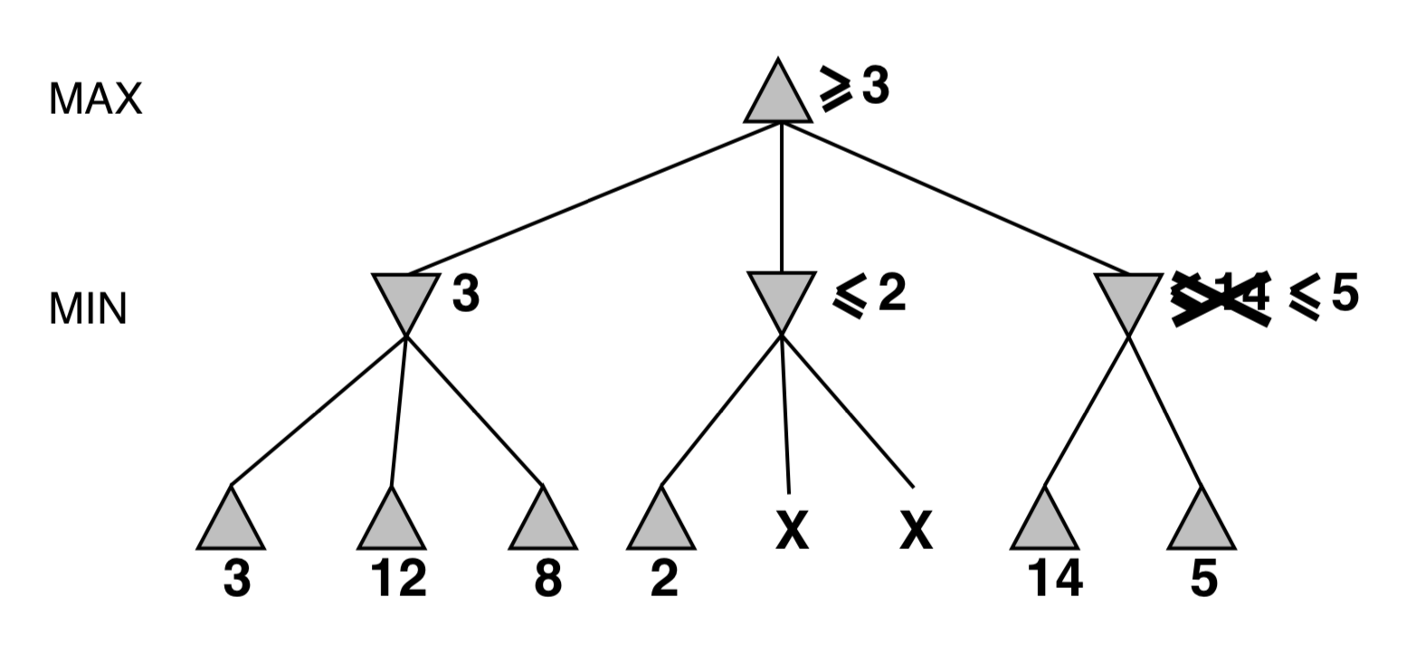

Slide 25
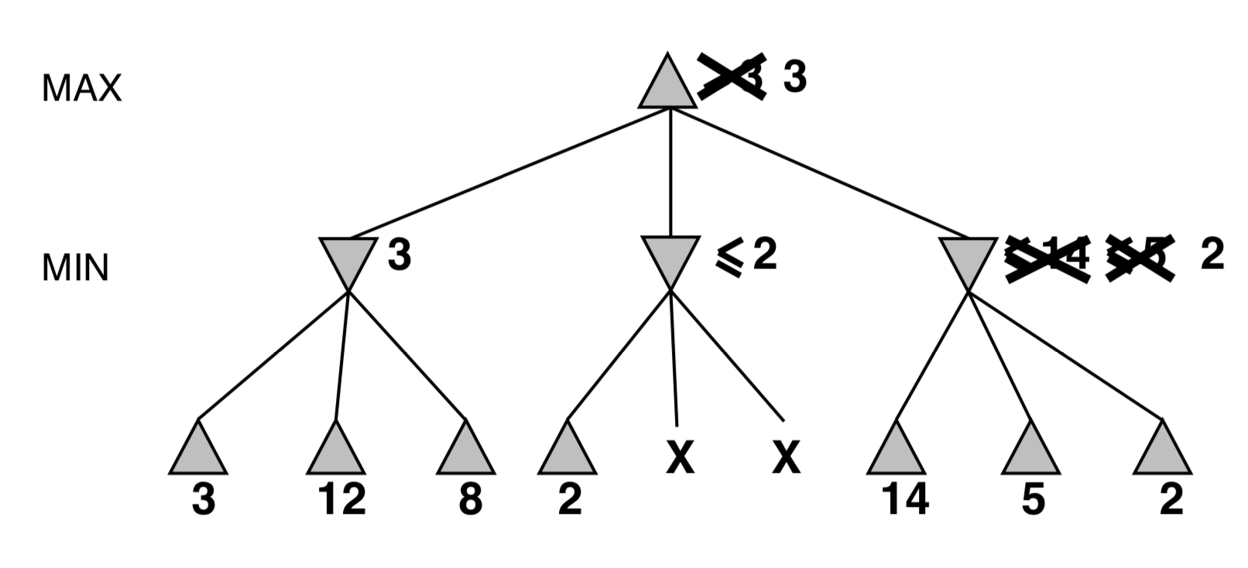

Slide 26
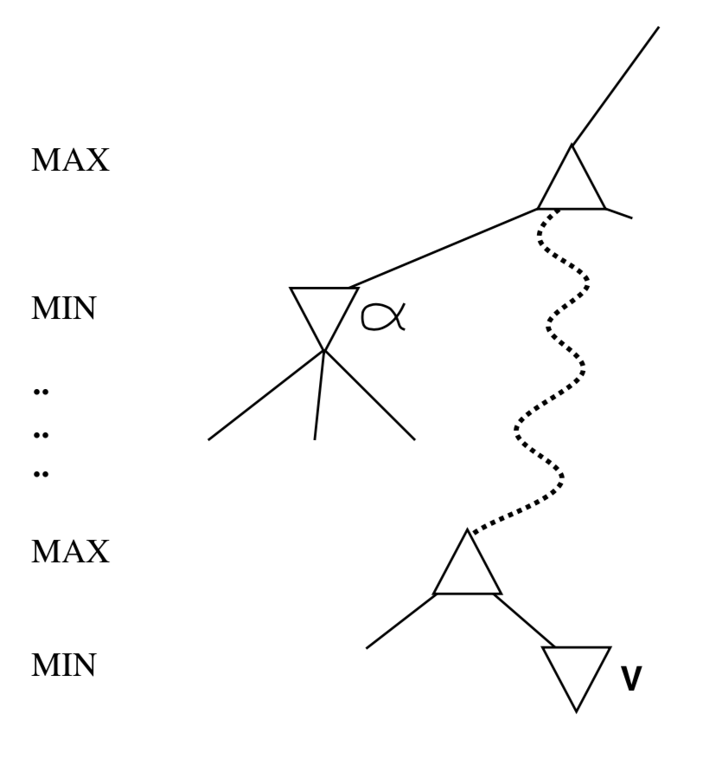
Why is it called α–β?
α is the best value (to max) found so far off the current path
If V is worse than α, max will avoid it ⇒ prune that branch
Define β similarly for min

Slide 27



α–β algorithm
𝞪 and 𝞫 are parameters representing the lower and upper bounds on possible solution values
As we move through the search tree, these bounds get closer and closer together
At some point in evaluating a node, we may find one of the bounds such that there is no longer any overlap between the ranges of alpha and beta. This node could never result in a solution path that we will consider
Stop generating its children and move back to its parent node and pass to the parent the value we changed which exceeded the other bound
Notes:
https://www.revolvy.com/page/Minimax-%252D-Alpha-Beta-Pruning-(Artificial-Intelligence)-by-Ice-Blended?stype=videos&cmd=list&sml=SROIGH1P2No&cr=1

Slide 28
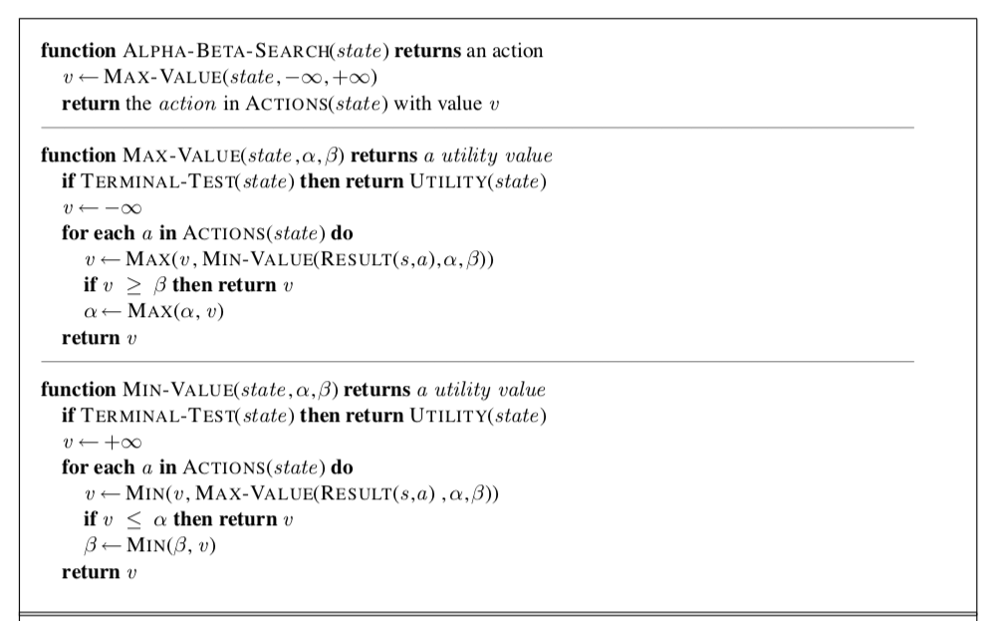
DFS based

Slide 29
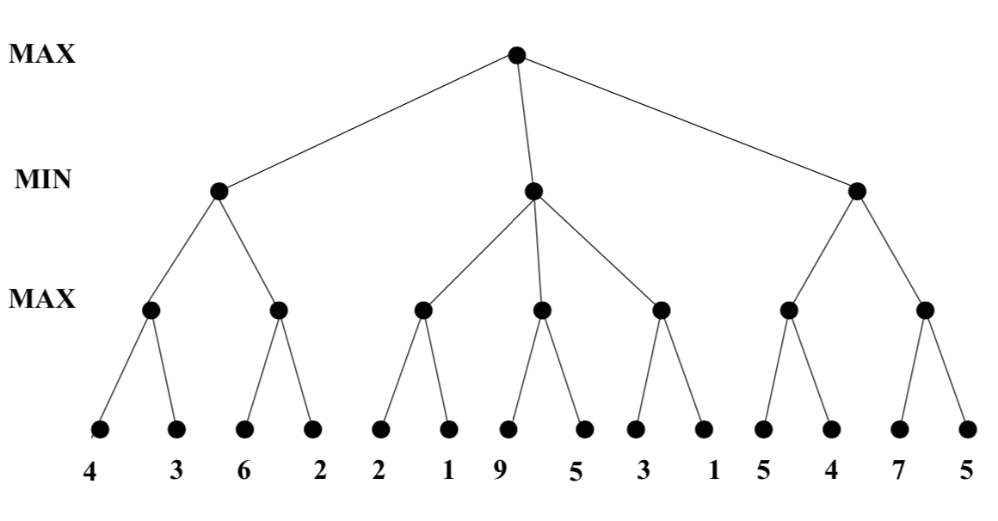
MAX: v >= β
MIN: v <= α
[-∞, +∞]

Slide 30
MAX: v >= β
MIN: v <= α
[-∞, +∞]
[-∞, +∞]

Slide 31
MAX: v >= β
MIN: v <= α
[-∞, +∞]
[-∞, +∞]
[-∞, +∞]

Slide 32
MAX: v >= β
MIN: v <= α
[-∞, +∞]
[-∞, +∞]
[-∞, +∞]

Slide 33
MAX: v >= β
MIN: v <= α
[-∞, +∞]
[-∞, +∞]
[4, +∞]

Slide 34
MAX: v >= β
MIN: v <= α
[-∞, +∞]
[-∞, 4]
4
[4, +∞]

Slide 35
MAX: v >= β
MIN: v <= α
[-∞, +∞]
[-∞, 4]
[4, +∞]
[-∞, 4]

Slide 36
MAX: v >= β
MIN: v <= α
[-∞, +∞]
[-∞, 4]
[4, +∞]
[-∞, 4]

Slide 37
MAX: v >= β
MIN: v <= α
[-∞, +∞]
[-∞, 4]
[4, +∞]
[6, 4]

Slide 38
MAX: v >= β
MIN: v <= α
[-∞, +∞]
[-∞, 4]
[4, +∞]
[6, 4]
//
X

Slide 39
MAX: v >= β
MIN: v <= α
[-∞, +∞]
[-∞, 4]
[4, +∞]
[6, 4]
//
X

Slide 40
MAX: v >= β
MIN: v <= α
[-∞, +∞]
[-∞, 4]
[4, +∞]
[6, 4]
//
X

Slide 41
[4, ∞]
MAX: v >= β
MIN: v <= α
4
[-∞, 4]
[4, +∞]
[6, 4]
//
X

Slide 42
[4, ∞]
MAX: v >= β
MIN: v <= α
[-∞, 4]
[4, ∞]
[6, 4]
[4, ∞]
[4, +∞]
//
X

Slide 43
[4, ∞]
MAX: v >= β
MIN: v <= α
[-∞, 4]
[4,2]
[6, 4]
[4, ∞]
[4, +∞]
//
X

Slide 44
[4, ∞]
MAX: v >= β
MIN: v <= α
[-∞, 4]
[4,2]
2
//
//
[6, 4]
[4, ∞]
[4, +∞]
//
X
X
X
X
X

Slide 45
[4, ∞]
MAX: v >= β
MIN: v <= α
2
[-∞, 4]
[4,2]
//
//
[6, 4]
[4, ∞]
[4, +∞]
//
X
X
X
X
X

Slide 46
[4, ∞]
MAX: v >= β
MIN: v <= α
[-∞, 4]
[4, ∞]
[4,2]
//
//
[6, 4]
[4, ∞]
[4, +∞]
//
X
X
X
X
X

Slide 47
[4, ∞]
MAX: v >= β
MIN: v <= α
[-∞, 4]
[4, ∞]
[4,2]
//
//
[6, 4]
[4, ∞]
[4, ∞]
[4, +∞]
//
X
X
X
X
X

Slide 48
[4, ∞]
MAX: v >= β
MIN: v <= α
[-∞, 4]
[4, ∞]
[4,2]
//
//
[6, 4]
[4, ∞]
[5, ∞]
[4, +∞]
//
X
X
X
X
X

Slide 49
[4, ∞]
MAX: v >= β
MIN: v <= α
[-∞, 4]
[4, 5]
[4,2]
//
//
[6, 4]
[4, ∞]
[5, ∞]
[4, 5]
[4, +∞]
//
X
X
X
X
X

Slide 50
[4, ∞]
MAX: v >= β
MIN: v <= α
[-∞, 4]
[4, 5]
[4,2]
//
//
[6, 4]
[4, ∞]
[5, ∞]
[7, 5]
[4, +∞]
//
X
X
X
X
X

Slide 51
[4, ∞]
MAX: v >= β
MIN: v <= α
[-∞, 4]
[4, 5]
[4,2]
//
//
[7, 5]
[6, 4]
[4, ∞]
[5, ∞]
[4, +∞]
//
//
X
X
X
X
X
X

Slide 52
[4, ∞]
MAX: v >= β
MIN: v <= α
[-∞, 4]
[4, 5]
[4,2]
7
//
//
[7, 5]
[6, 4]
[4, ∞]
[5, ∞]
[4, +∞]
//
//
X
X
X
X
X
X

Slide 53
[4, ∞]
MAX: v >= β
MIN: v <= α
5
[-∞, 4]
[4, 5]
[4,2]
//
//
[7, 5]
[6, 4]
[4, ∞]
[5, ∞]
[4, +∞]
//
//
X
X
X
X
X
X

Slide 54
[5, ∞]
MAX: v >= β
MIN: v <= α
[-∞, 4]
[4, 5]
[4,2]
//
//
[7, 5]
[6, 4]
[4, ∞]
[5, ∞]
[4, +∞]
//
//
X
X
X
X
X
X

Slide 55
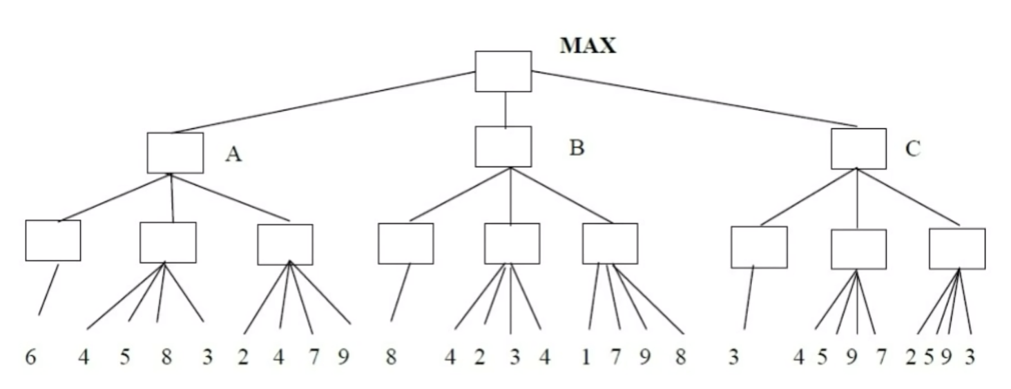
Practice
MAX: v >= β
MIN: v <= α

Slide 56
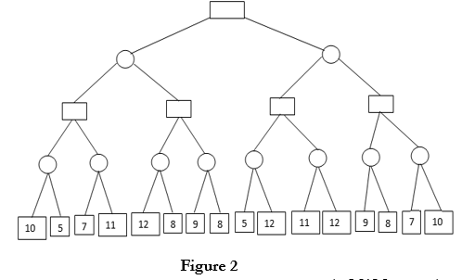
https://www.ques10.com/p/13506/apply-alpha-beta-pruning-on-example-given-in-fig-1/

Slide 57
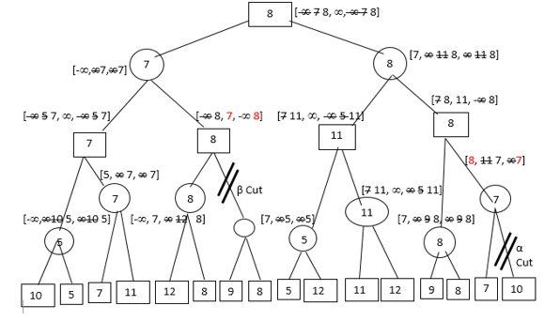

Slide 58
Properties of α–β
Pruning does not affect final result
Pruning depends on the order of search
Good move ordering improves effectiveness of pruning
With “perfect ordering,” time complexity = O(b^{m/2})
⇒ doubles solvable depth

Slide 59
Summary
Games are fun to work on!
They illustrate several important points about AI
perfection is unattainable ⇒ must approximate
Minimax algorithm is a type of DFS and approximates the best achievable payoff against best play
Alpha-beta pruning works on the top of Minimax to reduce the number of search nodes
Alpha-beta efficiency depends on the order

