Slide 1
Corona Trend (EDA + Prediction) MVP
Using deep-learning methods (LSTM)

Slide 2


Summary
Details

Slide 3



Executive Summary
To better understand disease progression, we’ve developed a robust (and extensible) MVP forecasting engine using Deep Learning Method (LSTM) …
… with the following insights.
 | Objective | Build forecasts for COVID19 disease progression using Deep Learning Method (LSTM)
 | Complication | 3253 trends in 58 states (one trend per town) 74 days of data (2020/01/22 – 2020/04/04) Uni-variate (temporal) data for forecasting
 | Approach
Accuracy using LSTM on trend for Middlesex county using 7 hold-out days = 86%
The lower accuracies are in the recent days, where the trend seems to be getting better
Current Deliverable
Next Phase
Accuracy = 1 – abs(RMSE / Actual Volume)
RMSE = Root Mean Square Error, a measure of how good the forecasts are in out-of-time hold-out days (1 week)
Understand
data
Build MVP
using 1 algorithm
Enhance
Forecasting Process
Create Modeling Dataset
Distributions
Temporal trends
Build Dash framework to visualize data
LSTM on 1 trend
Data enrichment (exogenous data)
Algorithm enrichment

Slide 4
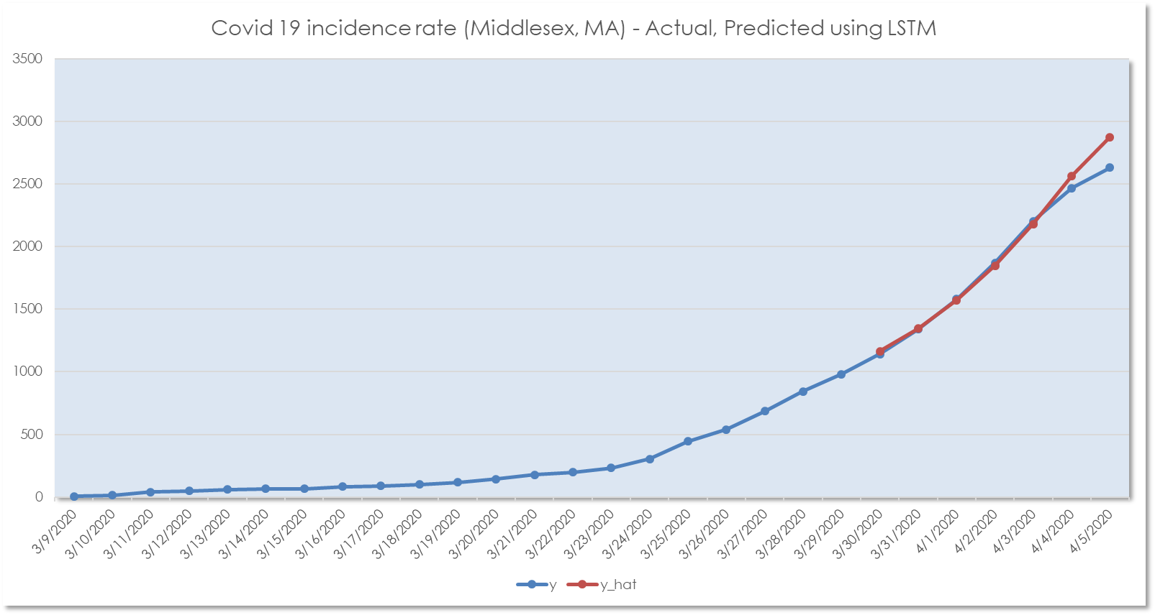
Actual trend vs. predicted using LSTM

Slide 5
Summary
Details

Slide 6

Understand Data

Slide 7
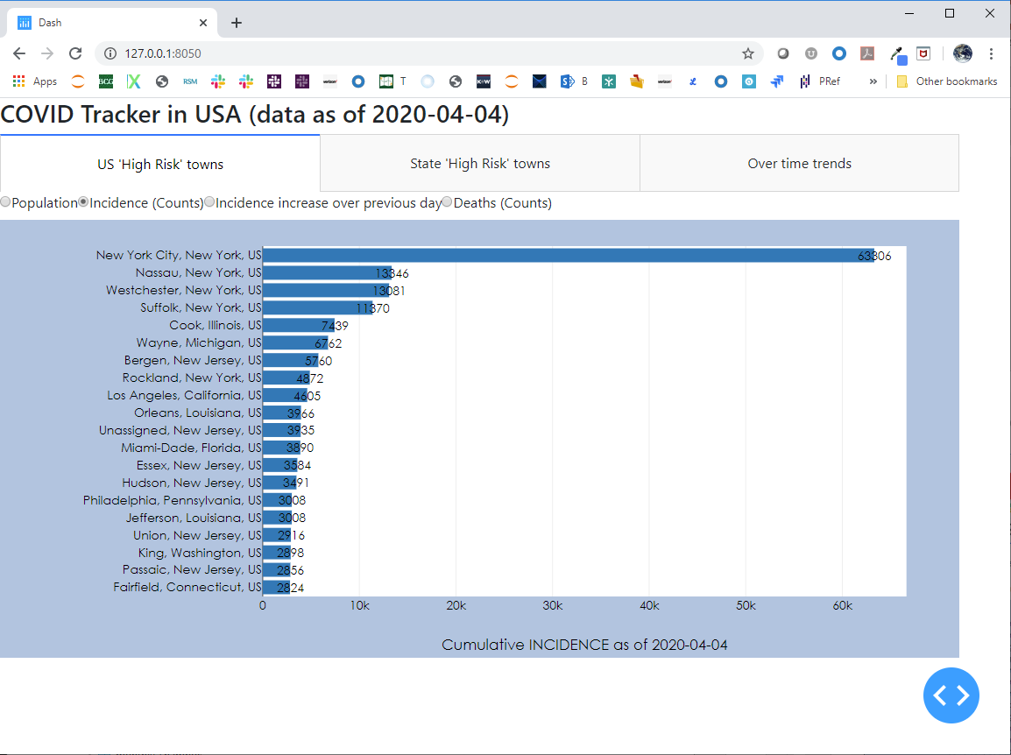
Dashboard layout – top 20 high risk towns
When this dashboard is launched from the command line, one can view the results in a web-browser
US-level view (only looking at the high risk towns) looking at the grain of a town
State-level view (only looking at the high risk towns) looking at the grain of a town
Town-level view to understand detailed trends
Various measures (population size, incidence, increase in incidence over the last day, deaths)
The towns ranked ordered by descending risk
A distribution of measure
1
2
3
4
5
7
6

Slide 8
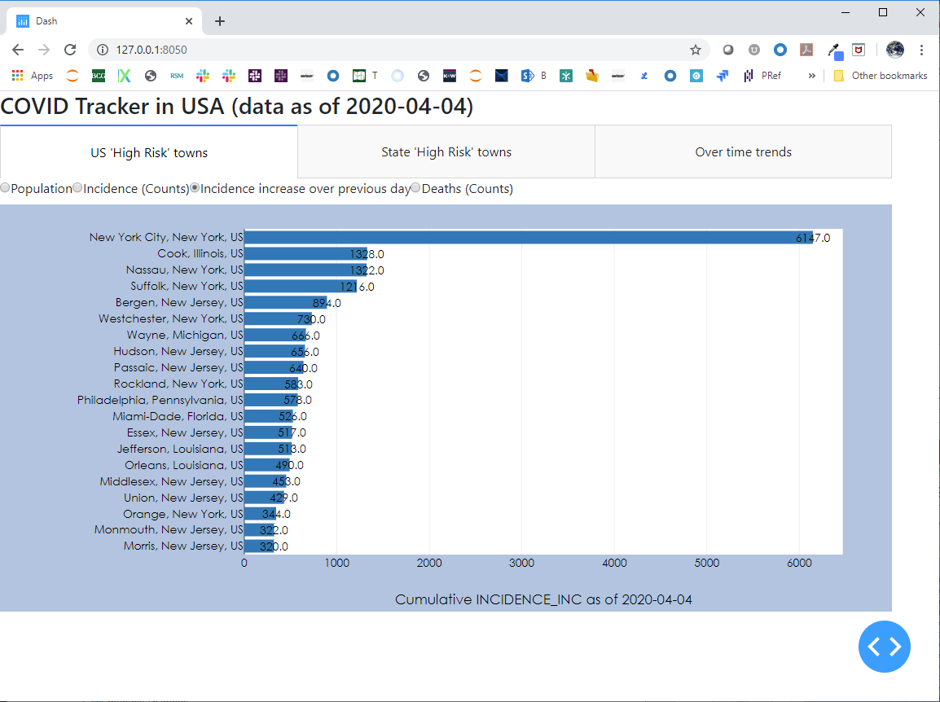
US View – increase in incidence from previous day
When this dashboard is launched from the command line, one can view the results in a web-browser
US-level view (only looking at the high risk towns) looking at the grain of a town
State-level view (only looking at the high risk towns) looking at the grain of a town
Town-level view to understand detailed trends
Various measures (population size, incidence, increase in incidence over the last day, deaths)
The towns ranked ordered by descending risk
A distribution of measure
1
2
3
4
5
7
6

Slide 9
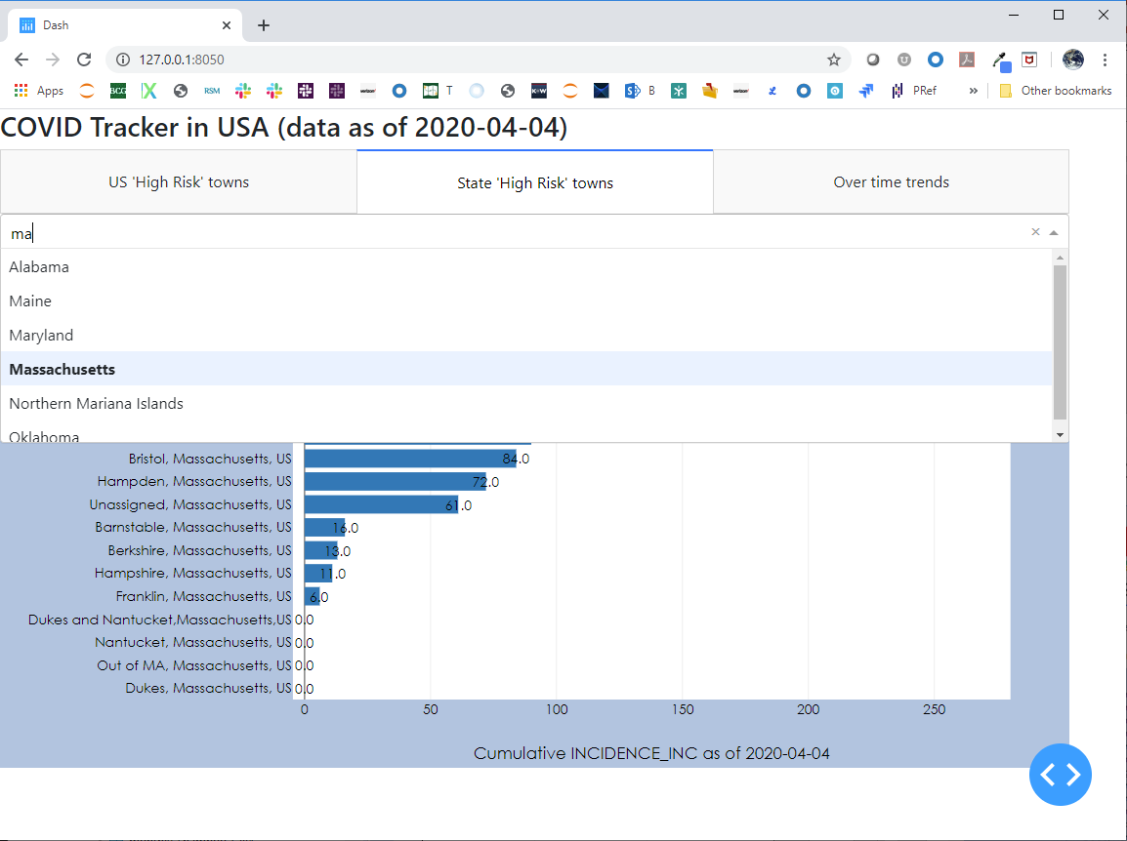
State View (grain = town) – increase in incidence from previous day
State high risk town tab
Contextual filtering
Towns rank ordered by metric
The metric value
1
2
3
4

Slide 10
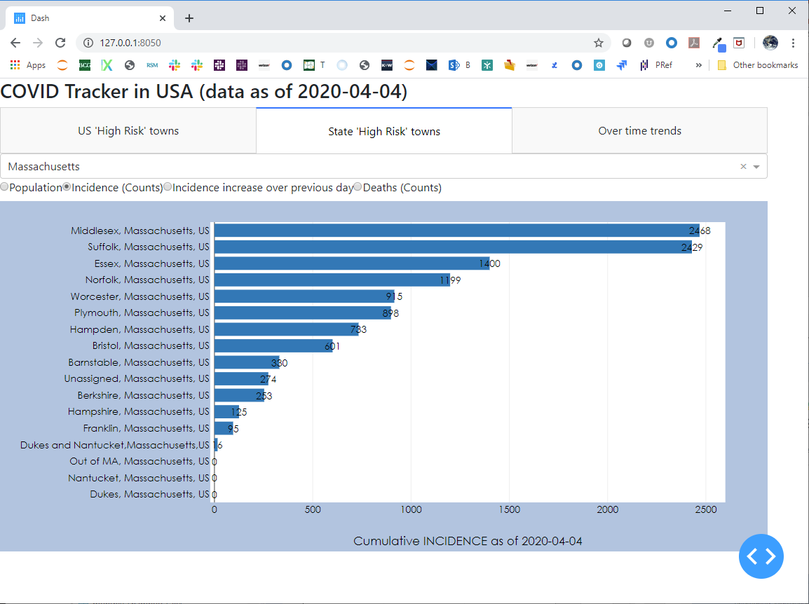
State View – cumulative incidence till 04/04/2020
Middlesex the largest county by population has the highest number of cases
Suffolk county is very densely populated and has a lot of cases despite its lower population counts
1

Slide 11
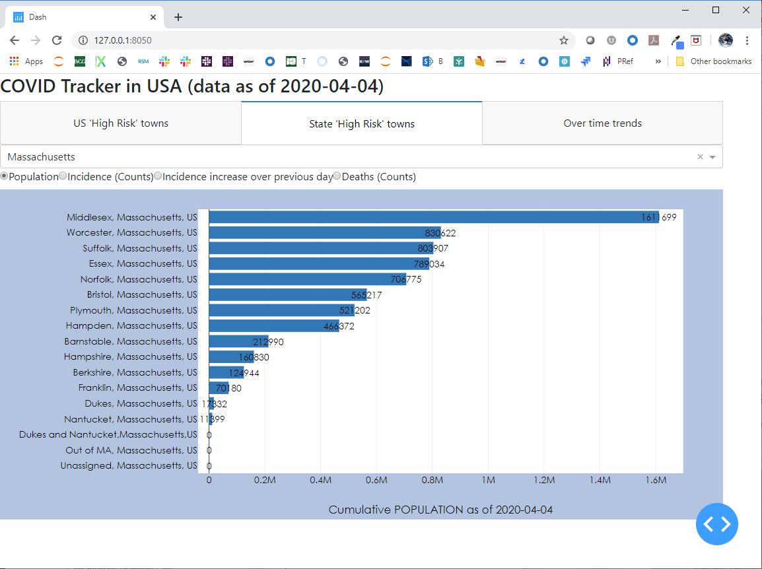
State View – population size in 04/04/2020
Middlesex the largest county by population
Worcester county has nearly ½ the size of population as in Worcester
1

Slide 12
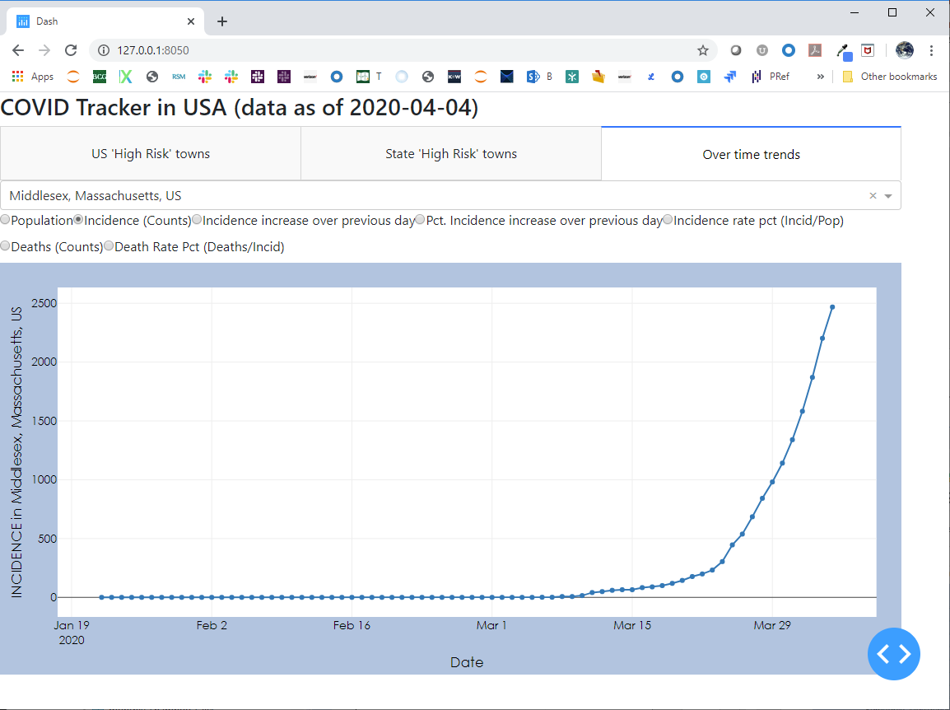
Town trend – incidence rate
Middlesex the largest county by population has the highest number of cases
As of 04/04/2020, Middlesex county still is in its growth phase. Growth does not seem to be abating
1

Slide 13
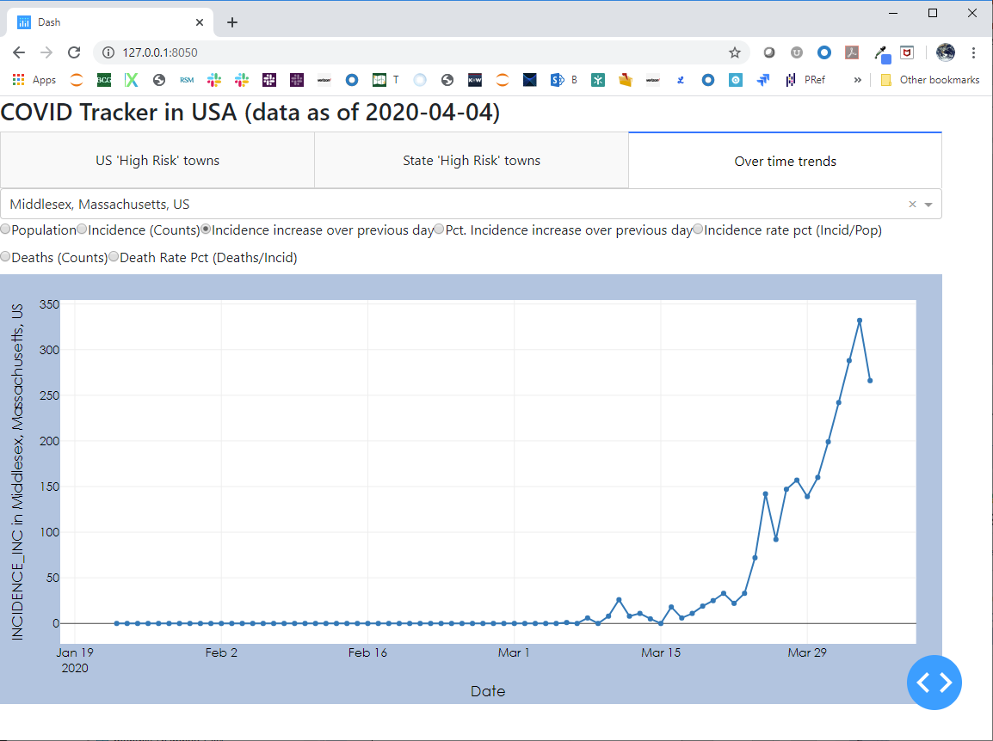
Town trend – incidence growth
Day over day growth is still high confirming the previous hypothesis that Middlesex county is still in its growth phase.
Social distancing measures need to continue
1

Slide 14
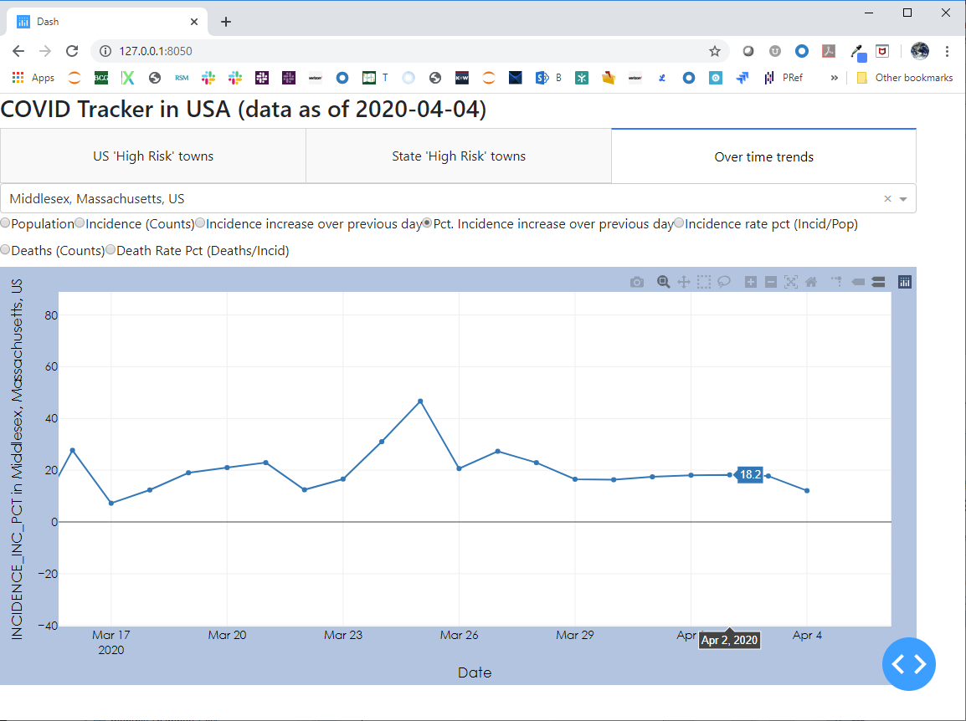
Town trend – incidence growth
New incidences are growing around 18% day over day
1

Slide 15
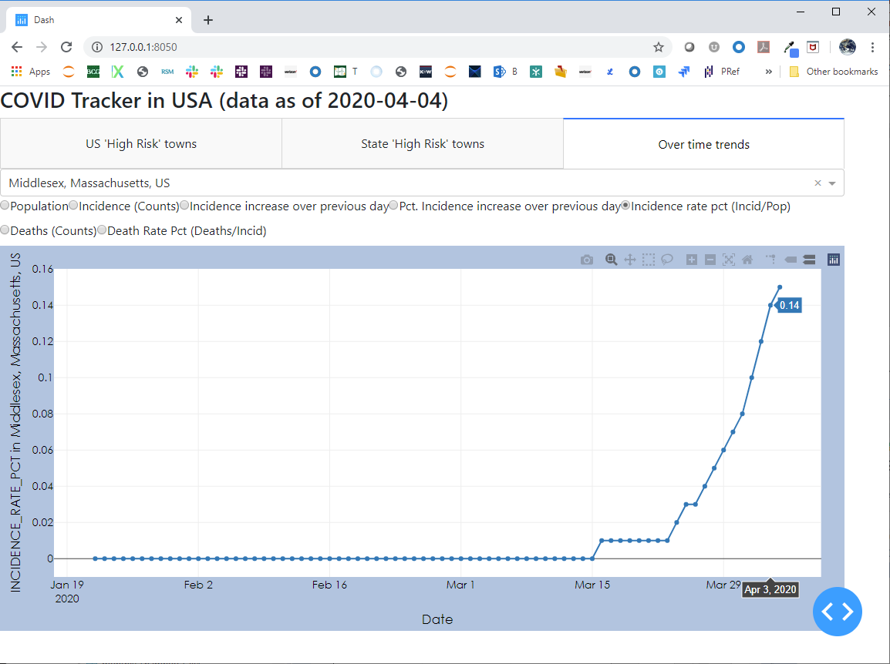
Town trend – incidence growth
Only about 0.14% of population has tested positive. The numbers are relatively small
Should lock-down measures be relaxed sooner rather than later, the new case incidence can significantly spike up
1

Slide 16
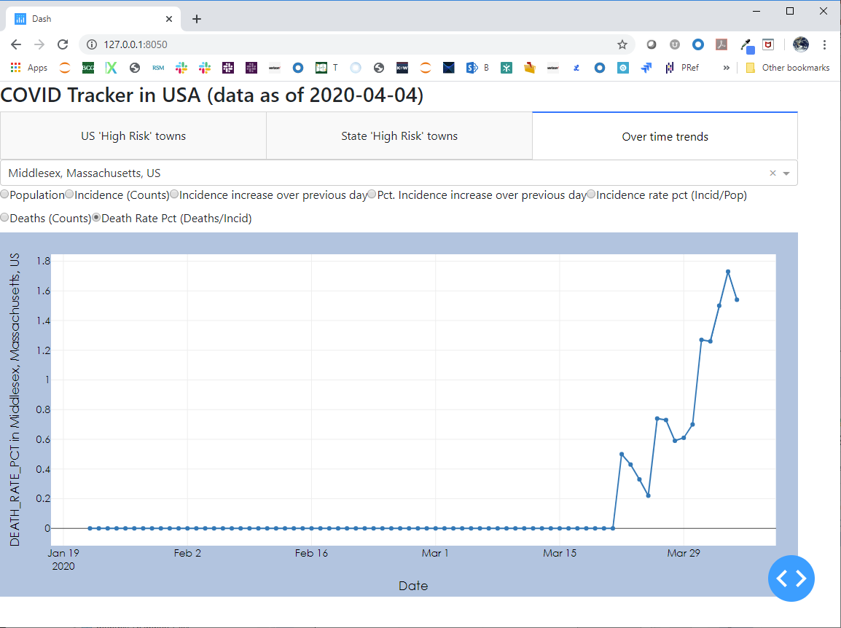
Town trend – incidence growth
Deaths rate is also climbing
1

Slide 17

Build MVP

Slide 18

Algorithm development steps
Generating forecasts @ scale involves getting through 18 steps including …
Prepare
data
Build MVP
using 1 algorithms
Save
Results
Start
Git Clone
Build
Configuration File
Build Prophet Forecast Module
Build Outlier handling Module
Build Saving of Results to DB
Load
Data into DB
Build Utility Libraries
(IO, Data)
Build Holt-Winter Forecast Module
Build Result Visualization Module
Build Saving of Results to Excel
Merge datasets & prepare Modeling Data Set
Parametrize forecast generation
Build LSTM
Build Result Ensemble Module
End
Build Visualizations & Explore Data in Dash
Build wrapper code
Build Canonical Model to Consume Results
Build Metrics Reporting Module
Sprint #1
Sprint 1+

Slide 19

Enhance Forecasting Process

Slide 20

Enriching components – data & algorithms
Data enrichment can occur through the inclusion of data sources such as …
… and algorithm enrichment can occur by evaluating output from algorithms including …
# | Data Type | Example
1 | Population | Size Age distributions Find similar towns around the globe
2 | Others | Lock-down period start Degree of lock-down Exposed individuals and Susceptible Individual movements
# | Algo. Type | Example
1 | Explainable | Naïve (Moving average) Multi-variate regression Decision tree Exponential Smoothing ARIMA ARIMAX
2 | Blackbox (with SHAP) | Multi-variate scenarios (with exogenous variables) Random Forest Adaboost

Slide 21
Appendix – Files in package

Slide 22
Files in the package
# | Component | File(s) | Purpose
1 | Git Clone & Daily Pull | Time_series_covid19_confirmed_us.csv Time_series_covid19_deaths_us.csv | Raw data (https://github.com/CSSEGISandData/COVID-19)
2 | Data Prep | 01_parse_covid_data.ipynb 02_create_modeling_data_set.ipynb 03_build_lstm_model.ipynb | Load data into SQL (for posterity) Prepare data Leverage output from data & model in Dash / Other viz. tools
3 | Data (& Result) Exploration | 04_app.py (Launches a dashboard on the Web) | Understand the various dimensions of data Use dimensions to infer patterns and improve forecasting algorithms
4 | Output | Covid19_2020_04_05.csv Covid_ms_data.xlsx | The modeling dataset for data prepared till 04/05/2020 The output of LSTM
5 | Discussion | 05_corona_trend_mvp_2020_04_05_v2 | This deck to summarize insights for broader discussion

