Slide 1
US COVID Tracker – 04/26/2020
me:dha:.ai

Slide 2
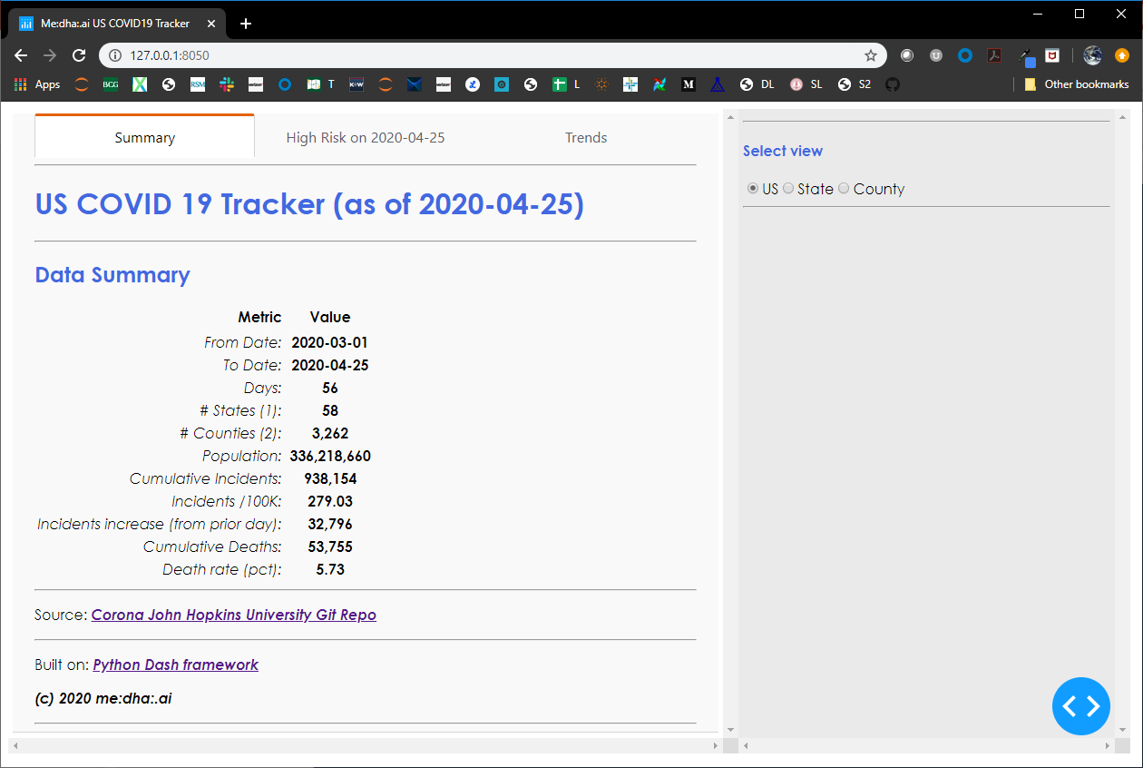
Summary
In ~2 months (56 days) into the pandemic, US has close to 1M COVID19 incidences and ~54 K deaths
1

Slide 3
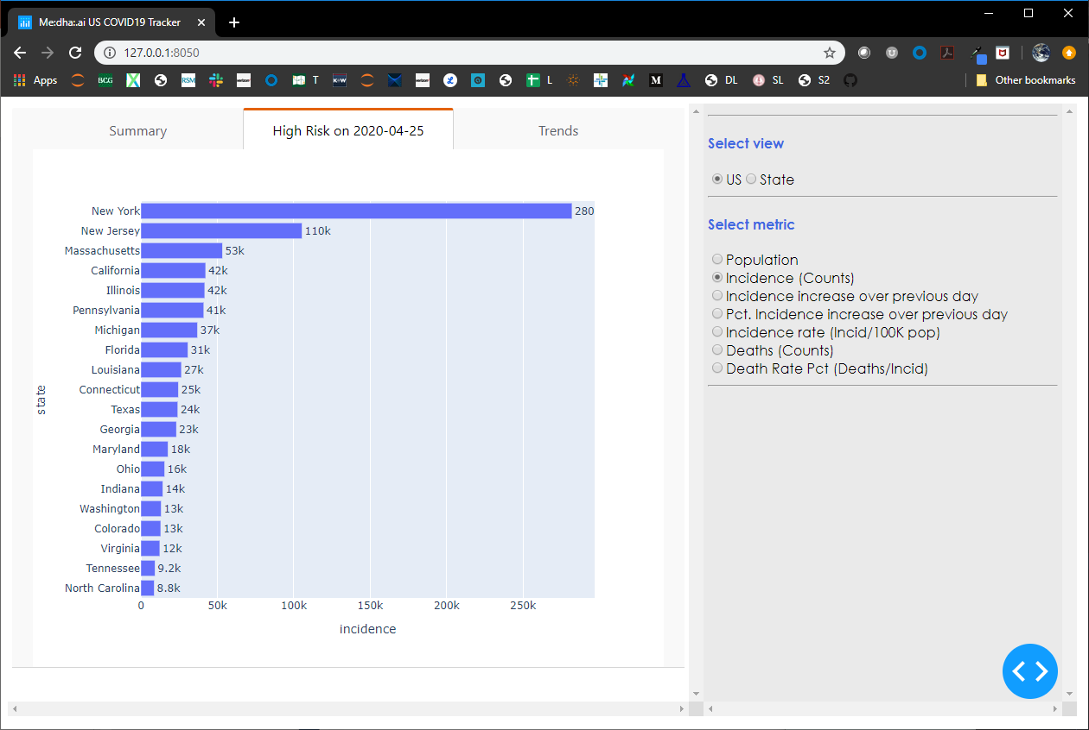
Cumulative high incidence states (04/25)
The state of mass is #3 from an incidence count
The sates of California, Illinois, Pennsylvania and Michigan are next highest in terms of incidence rates
1
2

Slide 4
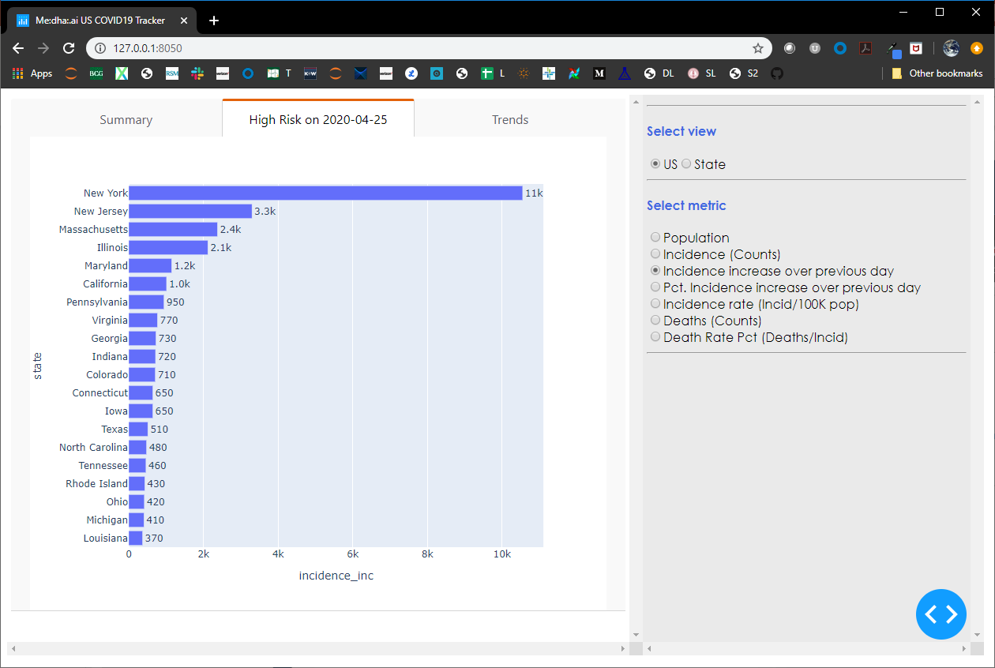
Incidence daily increase from 04/24
The incidence daily increase in state of Mass is still high
1

Slide 5
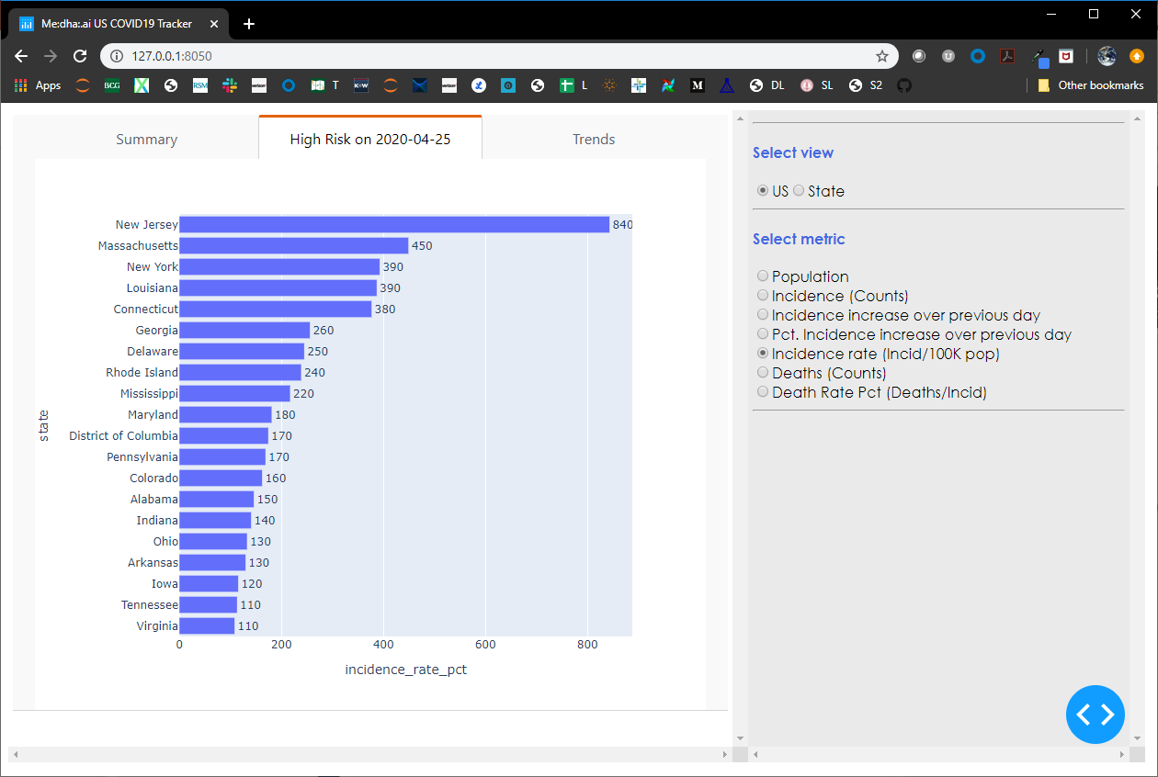
Incidence rate (incidences / 100 K population) from 04/24
Even from an incidence rate perspective, the state of Mass ranks very high
1

Slide 6

Cumulative deaths 04/25
Deaths in the state of Mass are high
1

Slide 7
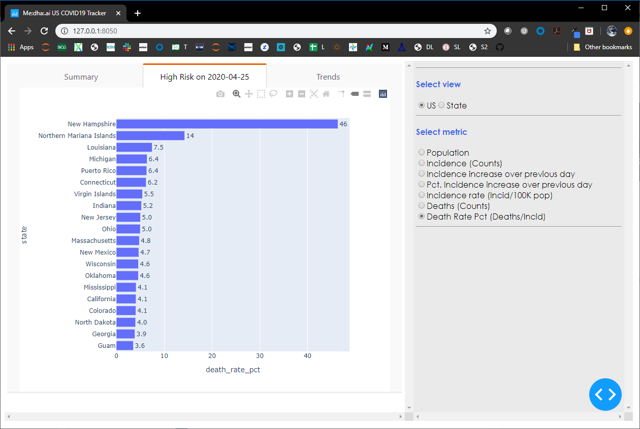
Death rate - 04/25
Death rate in Mass is relatively lower
1

Slide 8
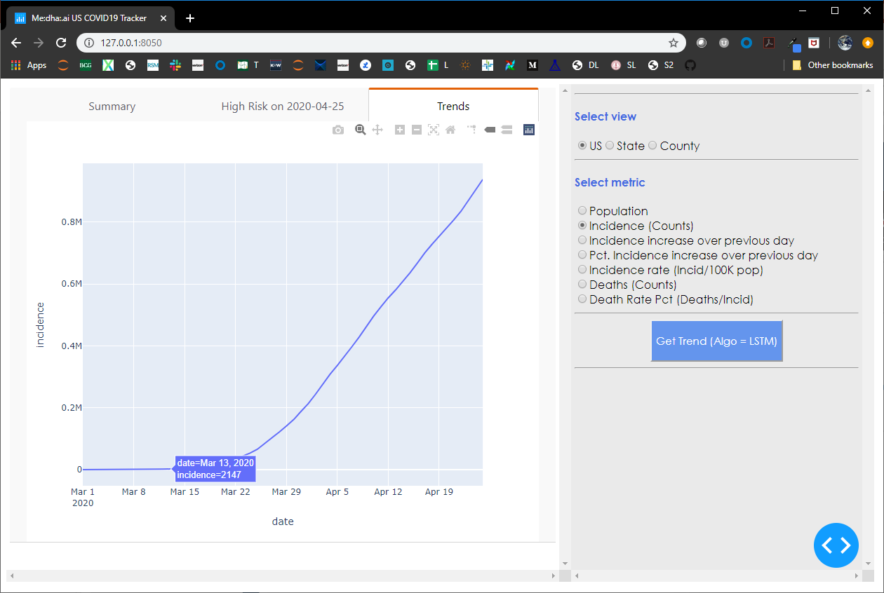
Incidence counts nation-wide
National emergency was declared on 03/13
Nation wide stats (03/13)
Incidence = 2 K
Deaths = 53
Death rate = 0.14%
Days = 0
CDGR = 0
Nation wide stats (04/25)
Incidence = 938 K
Deaths = 54 K
Death rate = 5.73%
Days = 43
CDGR = 15.3%
CDGR = Cumulative Daily Growth Rate = 16.6 % or doubling in incidence in roughly 4.7 days
3
2
https://www.whitehouse.gov/presidential-actions/proclamation-declaring-national-emergency-concerning-novel-coronavirus-disease-covid-19-outbreak/

Slide 9
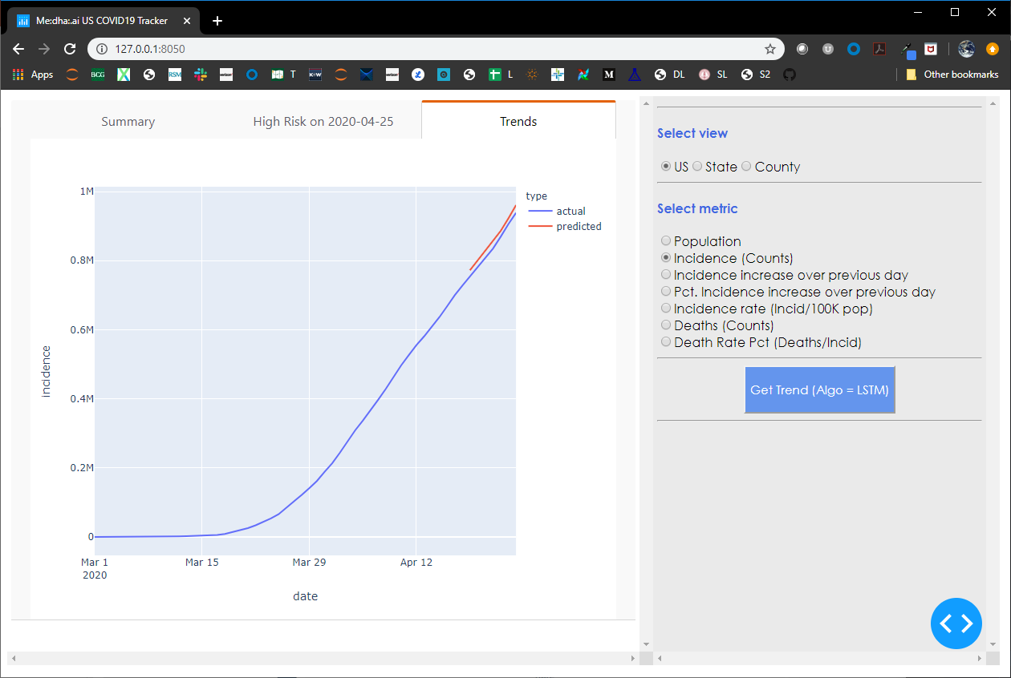
Incidence counts (actuals vs. predicted) nation-wide
From a nation-wide perspective, incidence spread hasn’t peaked yet
1

Slide 10
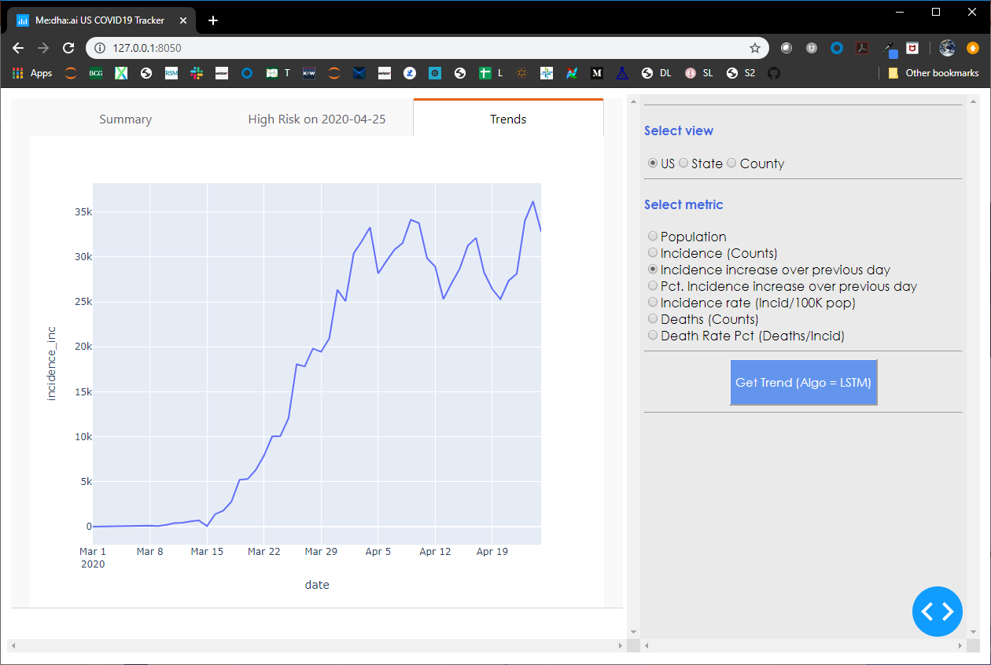
Incidence daily increase – nation-wide
From a nation-wide perspective, incidence count is still on the rise, albeit steadily
The peaks are showing weekly seasonality and correspond to weekends – either stats are updated each weekend or households are making milk runs over the weekend
2
1

Slide 11
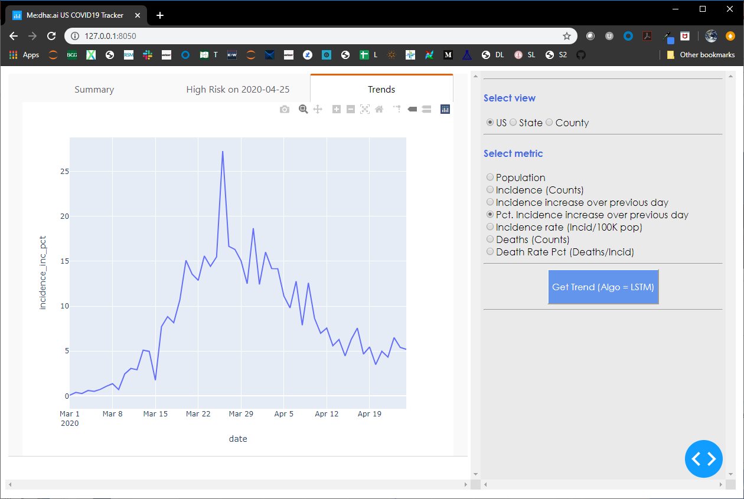
Incidence daily increase – nation-wide
While the rate of increase is decreasing, since the prior base is high, the incidence is still spreading at a faster clip
1

Slide 12
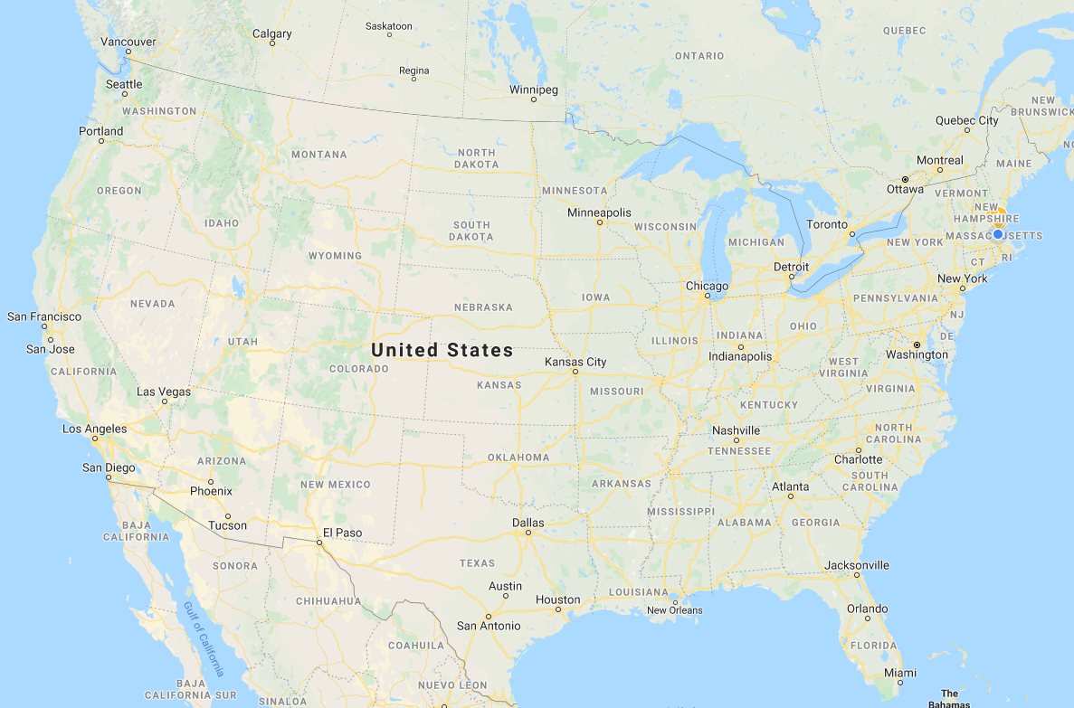
Breakdown by states

Slide 13
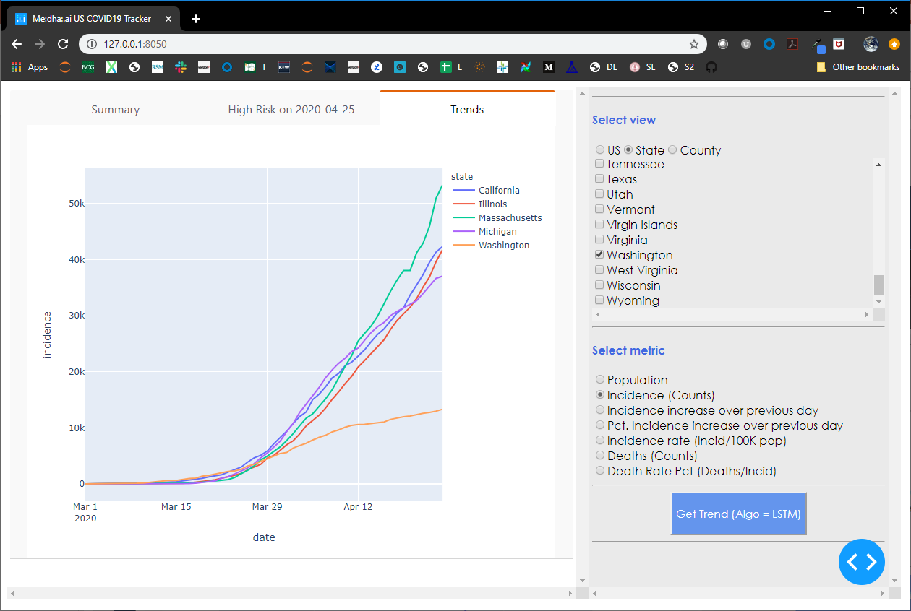
Incidence count break-down by high-risk states
Washington state shows most promise – cumulative case count is almost steady
The incidence spread in mass is still on the rise, showing limited signs of abatement
Illinois is showing similar trends as that of Mass’
Michigan seems to be showing signs of peak
California seems to be showing some resurgence
2
5
4
3
1

Slide 14
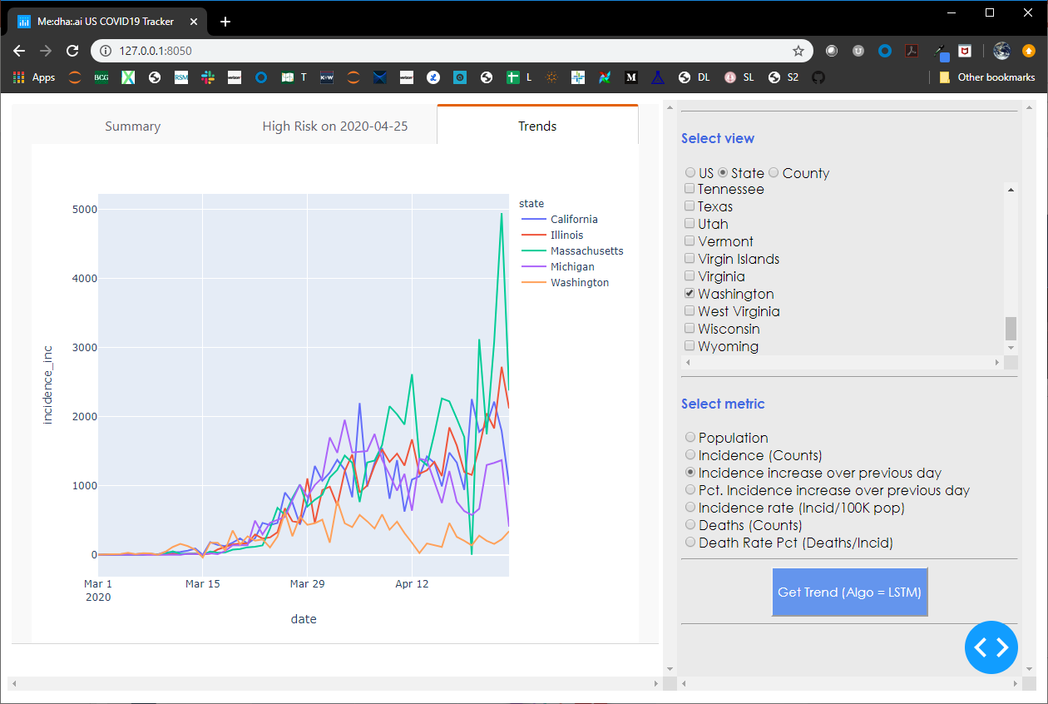
Incidence daily increase break-down by high-risk states
Washington state shows most promise – increase is more-or-less in check
In Mass, the incidence increase is still on a faster clip
Illinois is showing similar trends as that of Mass’
Michigan seems to be showing signs of peak
California seems to be showing some resurgence
2
3
5
4
1

Slide 15
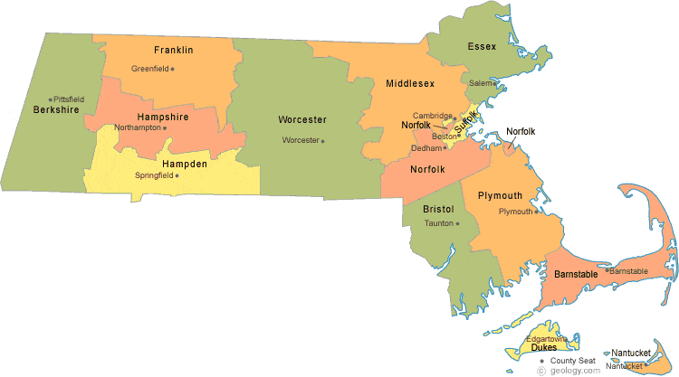
Counties in Massachusetts
https://geology.com/county-map/massachusetts.shtml

Slide 16
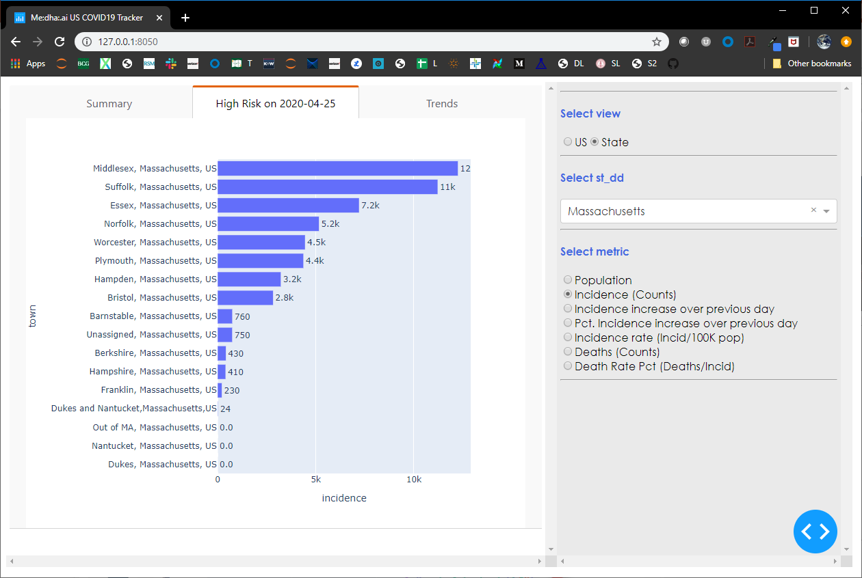
Incidence by counties in Massachusetts
Counties at most risk - Middlesex, Suffolk, Essex, Norfolk and Worcester

Slide 17
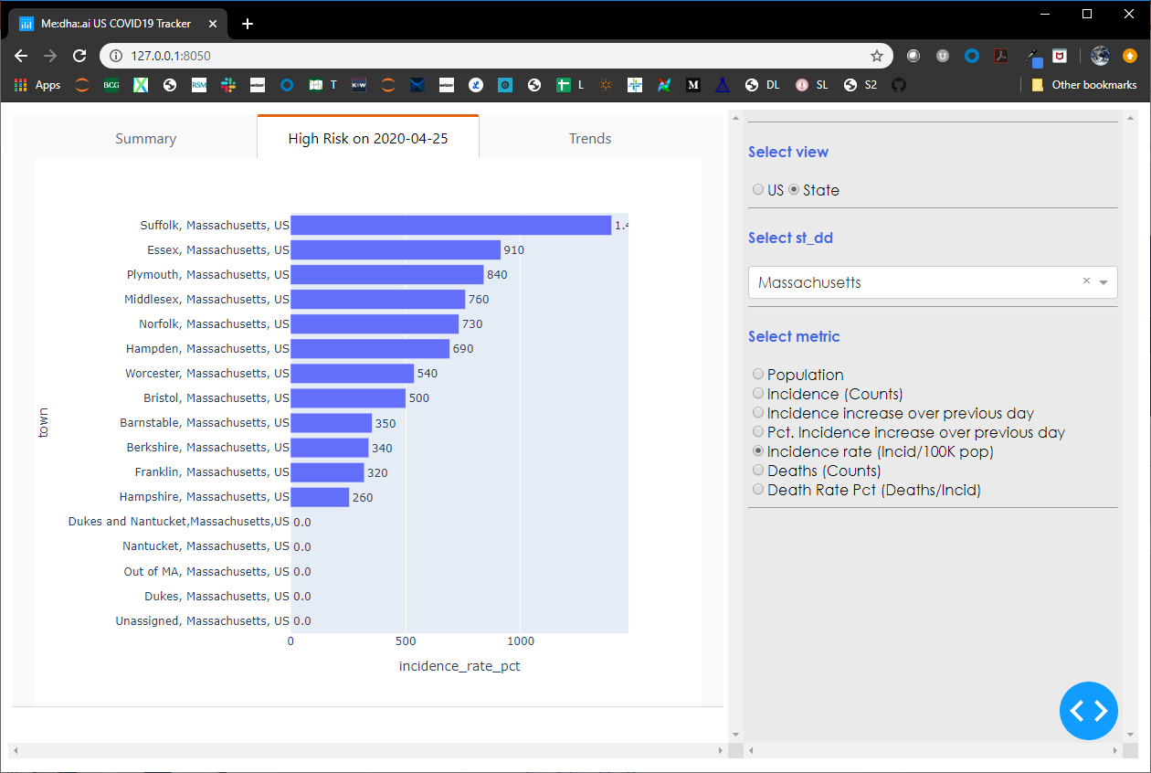
Incidence rates by counties in Massachusetts
Densely populated counties (Suffolk & Essex) have the highest incidence rates

Slide 18
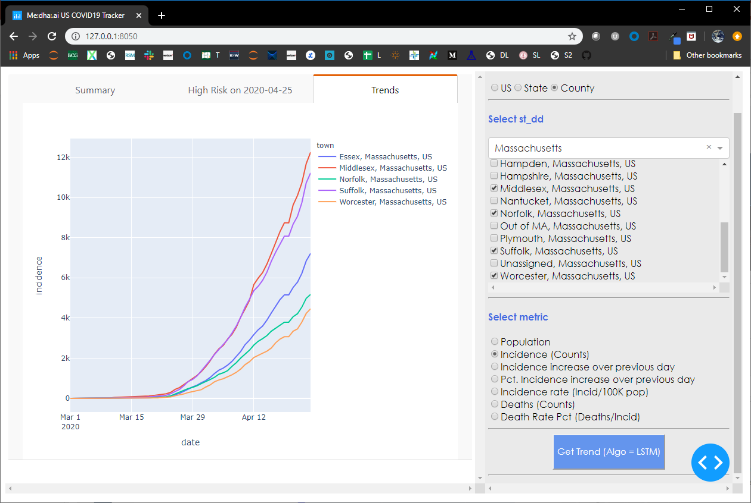
Incidence daily increase by counties in Massachusetts
Counties at most risk - Middlesex, Suffolk, Essex, Norfolk and Worcester

Slide 19
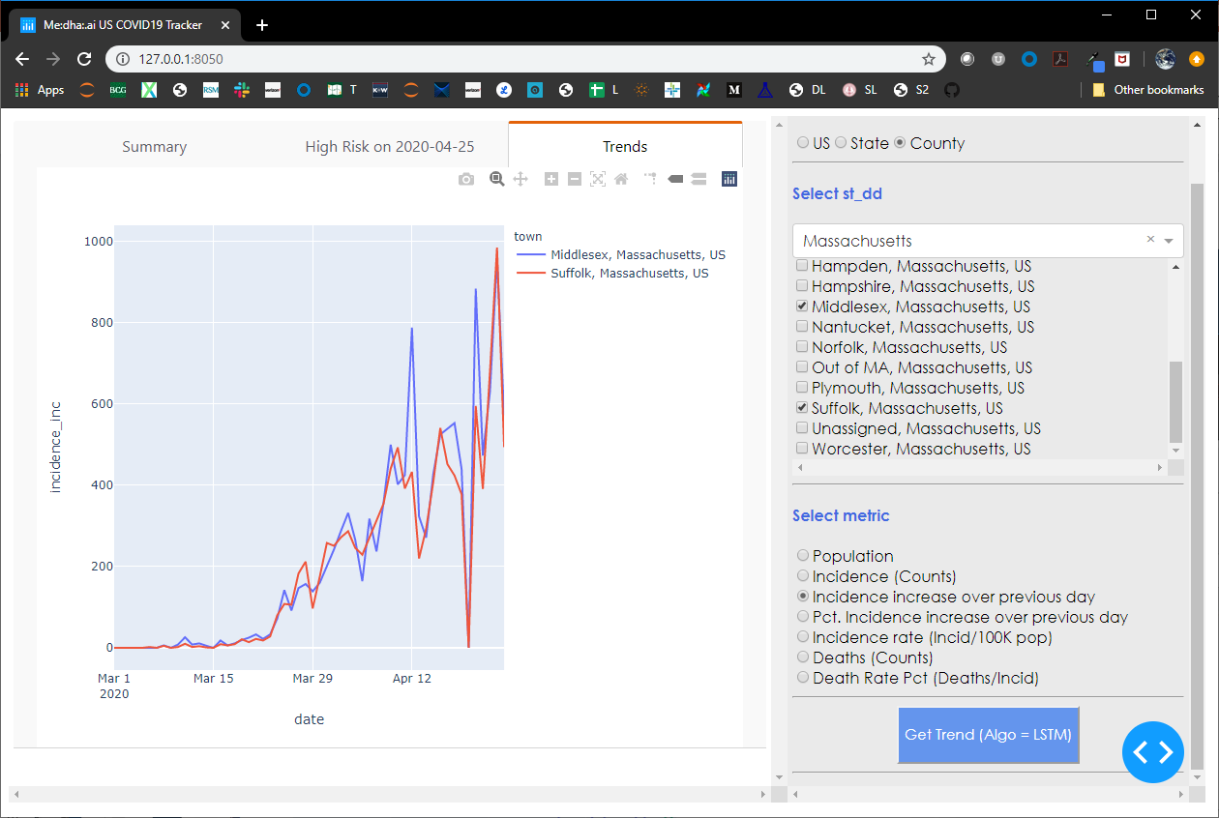
Incidence daily increase by select counties in Massachusetts
Incidence increases are similar in Middlesex & in Suffolk counties

Slide 20
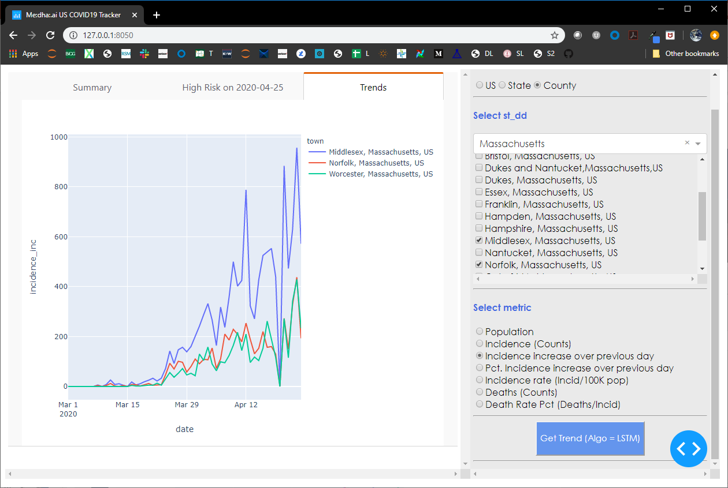
Incidence daily increase by select counties in Massachusetts
Incidence increases in Norfolk and Worcester counties are very similar, albeit at a much slower clip than that in Middlesex and Suffolk counties

