Slide 1
BOWFIN
TECH
01.14.2024
Bowfin LLC

Slide 2
About
Bowfin
Digital problem solving for forward-thinking businesses
What we will be doing:
Web development with google analytics, tag manager, DNS, and profitability tracking
Advantage Marketing
Marketing company that sets up google ads and buys google ads for the client (google ad campaign)
Bowfin Tech
Sets up the system where people click on ads that go to the clients website
We track the customer and follow their activity through the site
If they do something that adds value (spend money or sign up for something) we send this to google ads to see how much money/value was earned
Essentially seeing if Advantage Marketing’s google ad campaign is adding value to their client’s company
Client invests money in digital presence, we prove that is was worth it.
Bowfin Tech

Slide 3
Phase 1
Website Build
Phase 1 involves turning client designs into a responsive website using Elementor. A staging site will be built, approved, and optimized for all devices. Interactive elements and third-party tools, like Gingr and Google Calendar, will be integrated.
Transform client-provided design PDFs into fully functional, responsive web pages using Elementor.
Build a staging site on a temporary domain and ensure designer approval of the initial build.
Optimize the site for tablet and mobile responsiveness.
Integrate interactive elements, third-party booking software (e.g., Gingr), and the client's Google Calendar using the Google Calendar API.
Bowfin Tech

Slide 4
Phase 2: Domain & Email Migration
Phase 2 focuses on migrating the site live. This includes transferring domain ownership, configuring DNS/MX records to maintain email functionality, enabling SSL encryption, and testing to ensure seamless functionality.
Migrate the client's website to a live environment.
Backup and update DNS/MX records to maintain email functionality.
Transfer domain ownership, configure settings on WordPress.com, and enable SSL encryption.
Conduct thorough testing to ensure seamless global DNS updates and website functionality.
Bowfin Tech

Slide 5
Phase 3
Profitability Tracking
Phase 3 implements tracking for website profitability using Google Tag Manager and Meta Pixels. Triggers and events will be set up to track user actions and integrate with Google Analytics, Ads, and Meta, with thorough testing to ensure accurate data flow.
Implement Google Tag Manager (GTM) and Meta Pixels to track user actions and website profitability.
Set up triggers and events in GTM for Google Analytics, Google Ads, and Meta.
Integrate custom JavaScript triggers for tracking events on third-party booking platforms.
Test and validate data flow across all tools and enable enhanced conversions for comprehensive insights.
Bowfin Tech

Slide 6
Google Tag Manager
Google Tag Manager (GTM) is a tool that simplifies the process of adding and managing tags (snippets of code) on a website. Tags are essential for tracking user interactions, running analytics, and triggering marketing tools like Google Analytics, Ads, and Meta Pixels.
Container Code: GTM uses a container snippet added to your website's source code. This snippet loads GTM, which in turn loads all configured tags dynamically.
Workspaces: GTM uses workspaces, as shown in the image, to manage and edit tag configurations without directly altering the live environment. This prevents accidental disruptions to live tracking.
Triggers: Triggers define the conditions under which a tag fires. For instance, a trigger might activate when a user clicks a button or submits a form.
Variables: Variables store dynamic data, such as button IDs or user actions, used to define triggers and tag behavior.
Publishing: Once changes are tested and approved, the workspace is published, and the new tag configurations become live.
Bowfin Tech

Slide 7
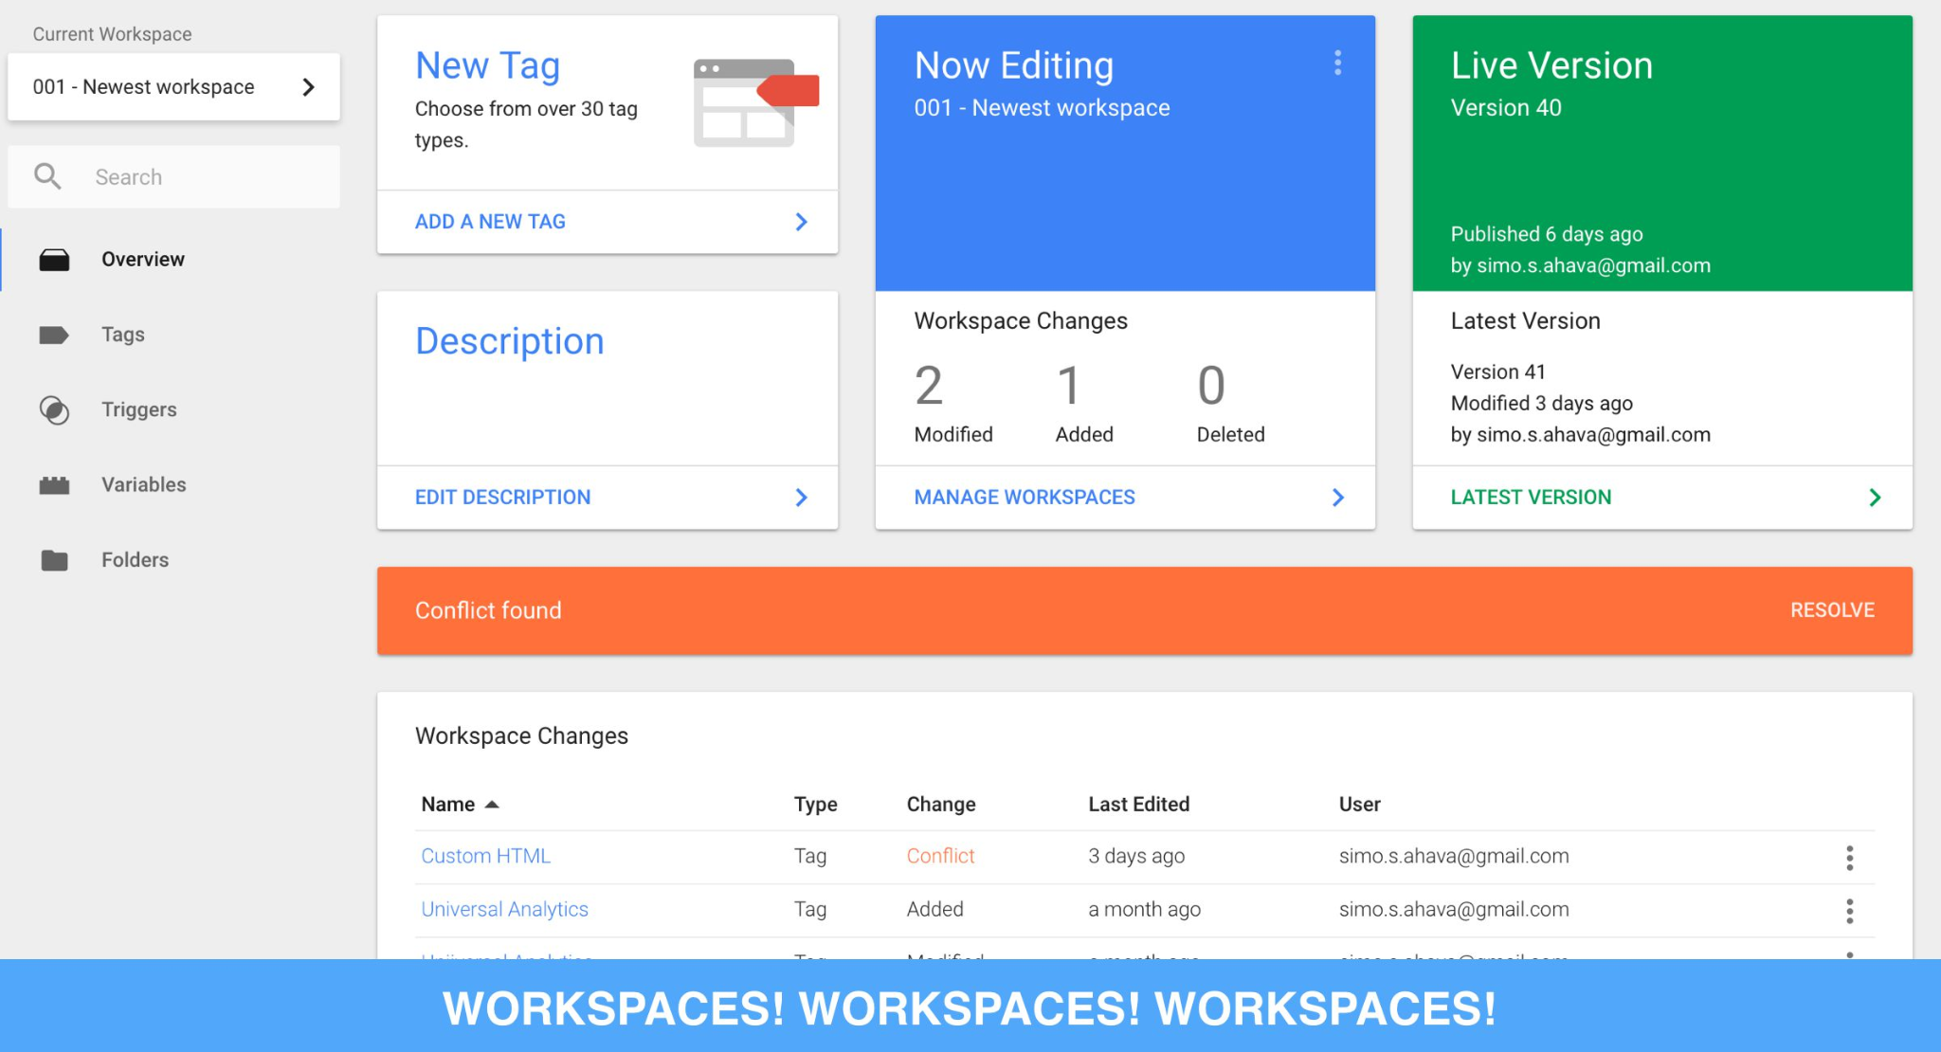
Google Tag Manager
Google Tag Manager (GTM) is a tool that simplifies the process of adding and managing tags (snippets of code) on a website. Tags are essential for tracking user interactions, running analytics, and triggering marketing tools like Google Analytics, Ads, and Meta Pixels.
Custom Code: For advanced tracking, GTM often requires custom JavaScript code. Writing and testing this code can be complex and prone to errors.
Writing JS to detect when changes in the website occur
Third-Party Integration: When integrating with external platforms (e.g., booking systems), developers must write platform-specific JavaScript triggers and ensure data flows correctly to GTM.
Data Validation: Ensuring that tags fire correctly and send accurate data requires thorough testing using tools like Google Tag Assistant.
Bowfin Tech

Slide 8
Google Analytics
Google Analytics (GA) is a powerful web analytics tool that helps businesses track and analyze their website traffic and user behavior. It provides insights into how users interact with your site, where they come from, and what actions they take, enabling data-driven decisions to improve website performance, marketing strategies, and overall user experience.
Tracking Code: GA uses a JavaScript tracking code embedded in your website. This code collects data about user interactions, such as pageviews, clicks, and transactions, and sends it to Google's servers.
Data Collection: The tracking code collects information like:
Device and browser details.
User location (via IP address).
Traffic sources (e.g., search engines, social media, direct).
User actions (e.g., button clicks, form submissions).
Processing Data: Once collected, the data is processed and organized into meaningful metrics and dimensions (e.g., sessions, bounce rate, traffic channels).
Reporting: The processed data is displayed in the GA dashboard, where users can view pre-built reports or create custom ones to analyze specific behaviors or goals.
Bowfin Tech

Slide 9
Enhanced Conversion Tracking
Advanced conversion tracking refers to techniques and tools that go beyond basic tracking methods to capture detailed user interactions and attribute them to specific marketing campaigns. It helps businesses understand the full customer journey and optimize their marketing strategies for better results. Common methods include using cookies, server-side tracking, and enhanced conversions.
Advanced Conversion Tracking Techniques
Enhanced Conversions (Google Ads):
Enhanced conversions capture user data (e.g., email, phone number) from forms or purchases, hash the data, and send it to platforms like Google Ads for better attribution.
This method improves tracking accuracy, especially when third-party cookies are blocked.
How Cookies Work in Conversion Tracking
Cookies are small text files stored in a user's browser that track their activity on a website. They are essential for attributing actions (e.g., purchases, form submissions) to specific marketing efforts.
Cookies enable tracking:
Conversions: By identifying users who completed specific actions after interacting with an ad.
Attribution: By connecting user actions to the ad, campaign, or platform that led them to the site.
User Journeys: By tracking how users move through a website (e.g., pages visited, time spent).
Bowfin Tech

Slide 10
Meta Business Suite
Meta Events Manager, a tool within Meta Business Suite, focuses on tracking user interactions on your website, apps, and even offline. It helps businesses collect data through the Meta Pixel, the Conversions API, or offline event uploads to measure and optimize their marketing efforts.
Events Manager:
Tracking Events: Tracks key user actions (e.g., purchases, form submissions) on your website via:
Meta Pixel: A JavaScript code snippet added to your site to track user behavior and conversions.
Conversions API (CAPI): Sends server-to-server user data directly to Meta, bypassing browser restrictions.
Event Customization: Allows you to create standard or custom events to track specific user actions critical to your business goals.
Data Diagnostics: Identifies errors in event tracking and suggests fixes to improve data accuracy.
Audiences and Optimization: Uses tracked events to build custom audiences and optimize ad campaigns for higher conversions.
Bowfin Tech

Slide 11
More than Web Design
In summary, this project isn’t just about creating a visually appealing website—it’s about building a comprehensive digital infrastructure that integrates design, technical processes, and business analytics to deliver a fully functional and impactful solution.
Design Implementation: Elementor – match the exact design specifications, which is more intricate than using pre-made templates.
Technical Depth: Each phase requires specialized knowledge in areas like domain management, analytics, and third-party API integrations, which go well beyond the scope of basic web design.
Business Impact: This project is not just about aesthetics—it’s about creating a tool that integrates with the client’s operations (e.g., bookings and email) and measures business success through data tracking.
Attention to Detail: The need for accuracy in coding, testing, and ensuring seamless functionality across platforms adds layers of responsibility and complexity.
Client Interaction: Students will be given a Bowfin Tech email and will assume the role of an employee. They will be expected to communicate with the client and generate worthwhile contributions to the team.
Bowfin Tech

