Slide 1

Exercise 1: Login module

Slide 2
Purpose
Control State in React function component
How to using fetch call API with redux thunk or redux saga
Control input data

Slide 3
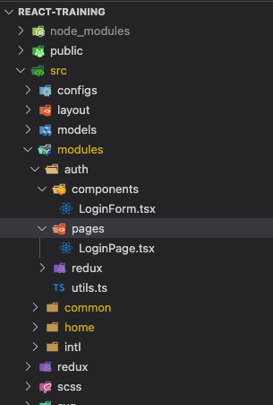
Setup skeleton module
Create 2 files similar to the image
Handle logic in pages
Components will receive data from page and display to view

Slide 4
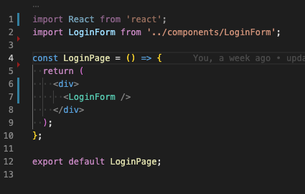
Setup skeleton module
File LoginPage.tsx
Import LoginForm into LoginPage

Slide 5
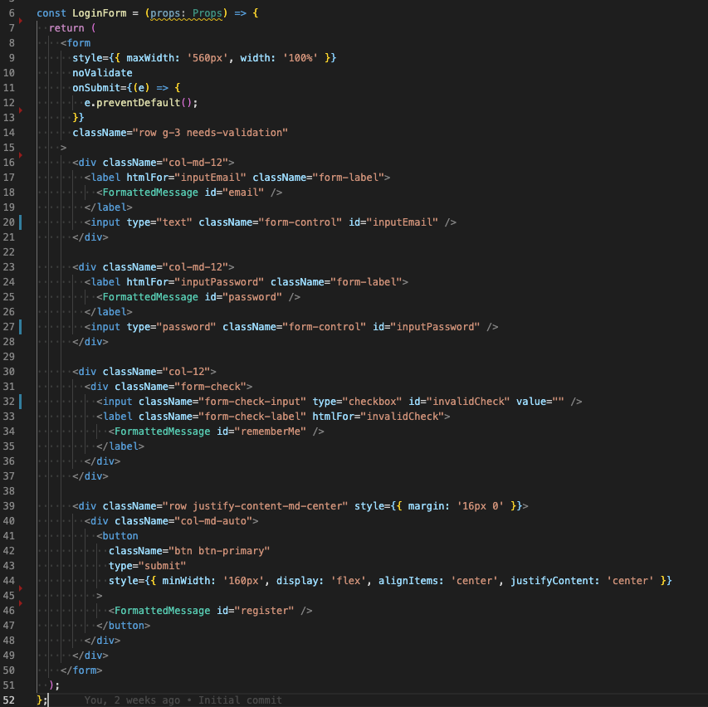
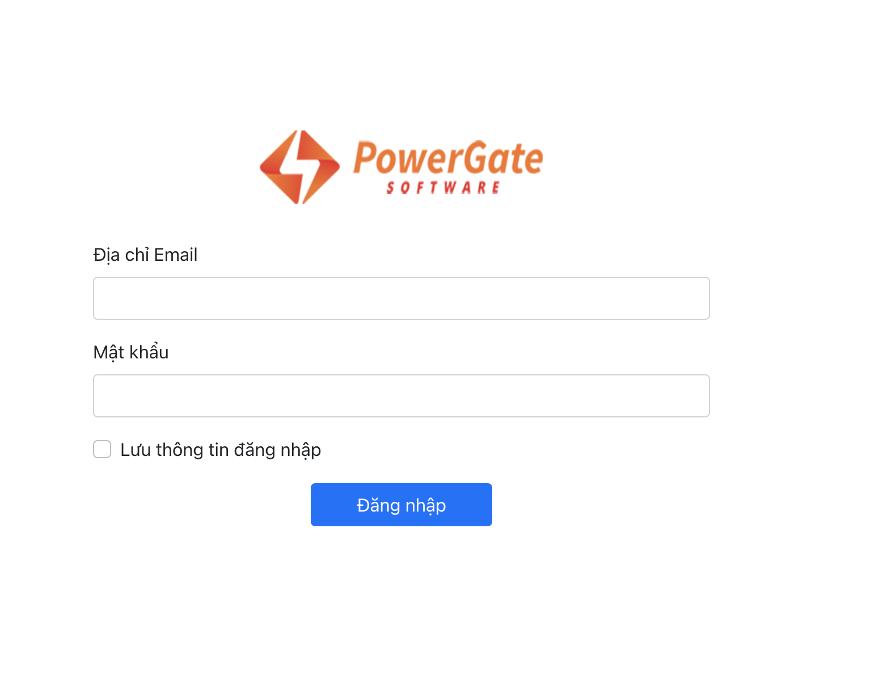
Code UI Login form
File LoginForm.tsx
Using bootstrap css styling login form input

Slide 6
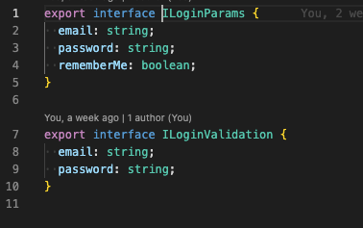
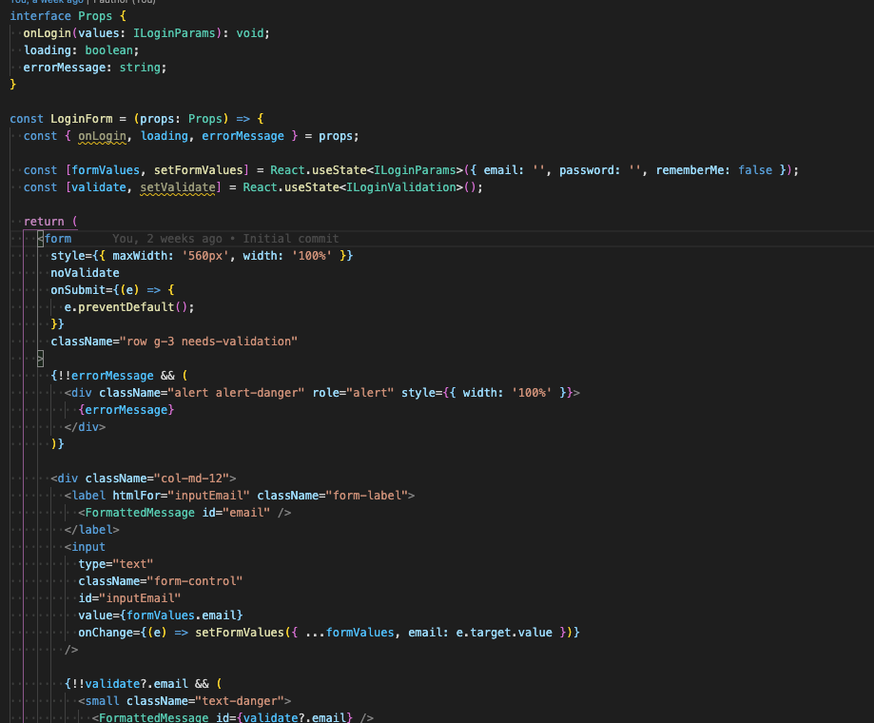
Init state & interface
Create interface
Create 2 state and init values:
formValues
validate
Set value input and update change value when input change (onChange)

Slide 7
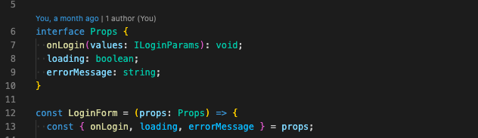
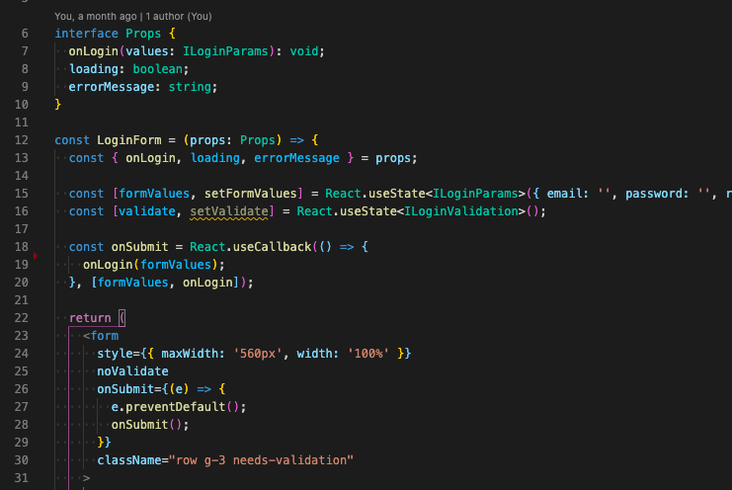
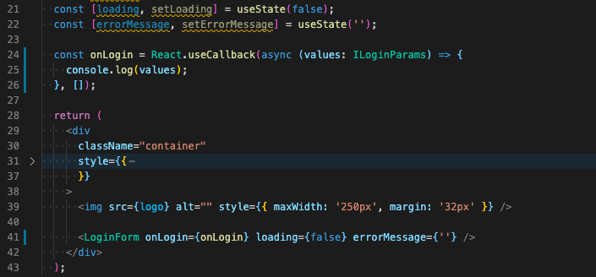
Send and get data via props
Define variables, functions in interface Props children component
Send and get data from parent component

Slide 8
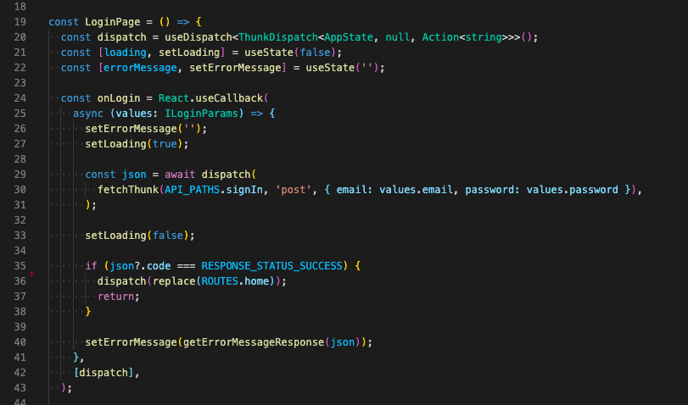
Update login function
File LoginPage.tsx
On function onLogin receive data from form input and call API login

Slide 9
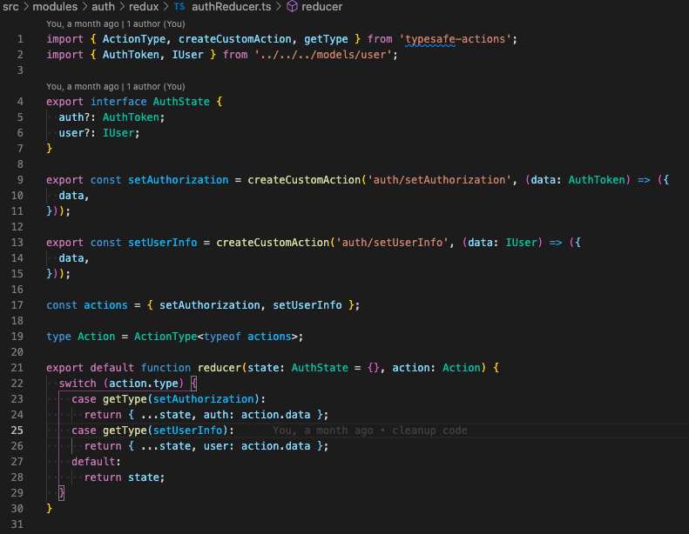
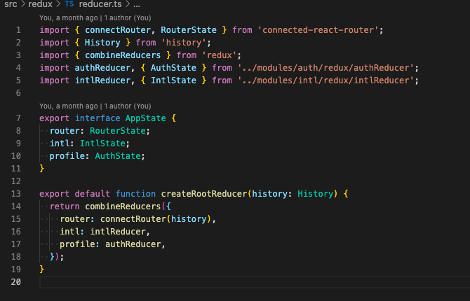
Setup redux
create file authReducer.ts in folder redux
Import authReducer to rootReducer

Slide 10
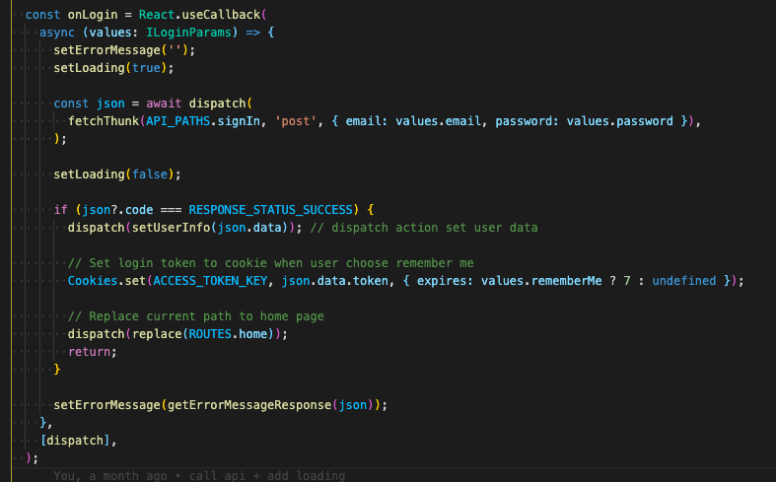
SET data to redux store
Update user data info, login token to redux store when login success

Slide 11
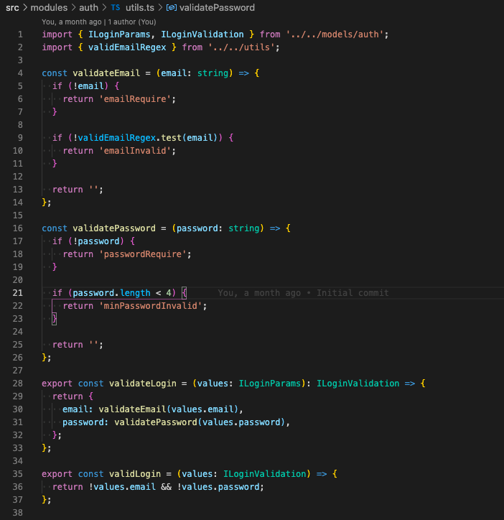
VALIDATE DATA BEFORE LOGIN
Create file utils.ts in module auth folder
Write function validate

Slide 12
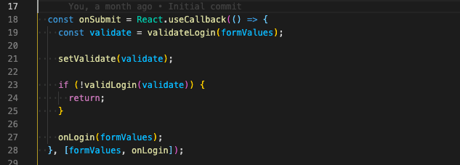
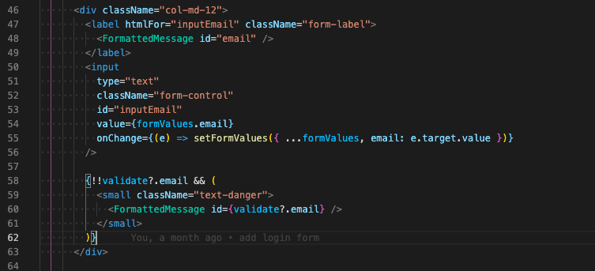
VALIDATE DATA BEFORE LOGIN
Call function validate
display error if form values invalid

Slide 13
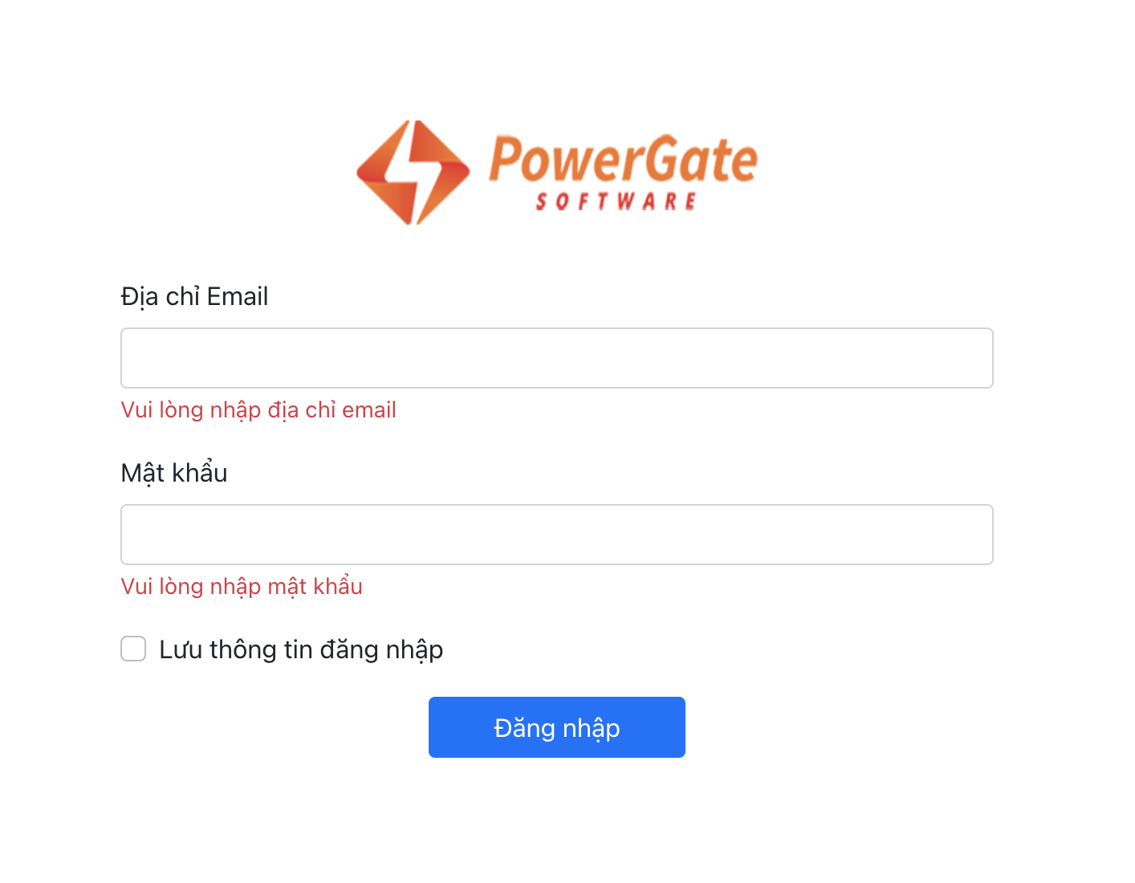
VALIDATE DATA BEFORE LOGIN
Call function validate
display error if form values invalid

Slide 14
HOMEWORK
Complete login module
Required:
Validate (email, password) (No use library)
Show error message when input invalid
Show error when login fail

Slide 15


Slide 16
THANK YOU FOR LISTENING
ANY QUESTIONS?

