Slide 1
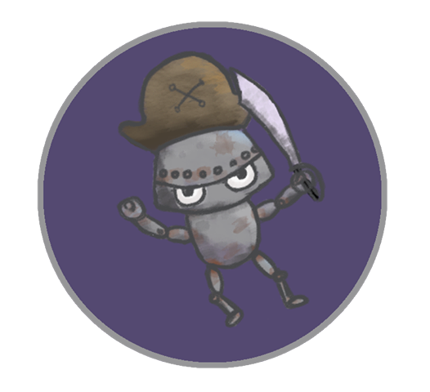
Android Galaxy Buccaneers
Leo Bunyea and Vincent Miller

Slide 2
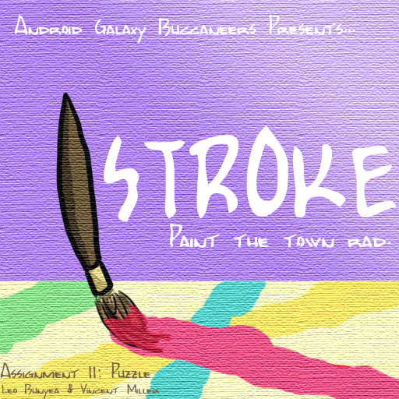
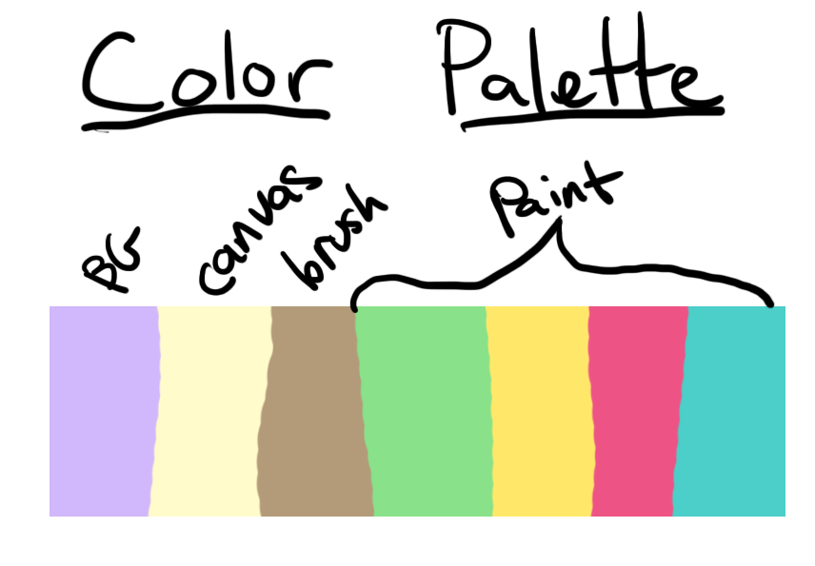
Stroke
Paint the town rad.

Slide 3
Summary
Stroke is a color-based, painting puzzle game in which the player recreates patterns. The player manipulates a paint brush that leaves behind a color trail in order to accomplish this. The trail can be overwritten by the brush once it has been “dipped” in a new color. In addition to this, the brush will only stay coated in paint for so long. The goal is to produce the desired pattern before the move limit is reached.

Slide 4
Essential Features
Thirteen levels with gradually increasing difficulty
Act as a paintbrush, leaving trails of color behind
Paint lasts four moves, shown by border thickness and a glyph
Recreate patterns shown on the level
Solve pattern before you run out of moves

Slide 5
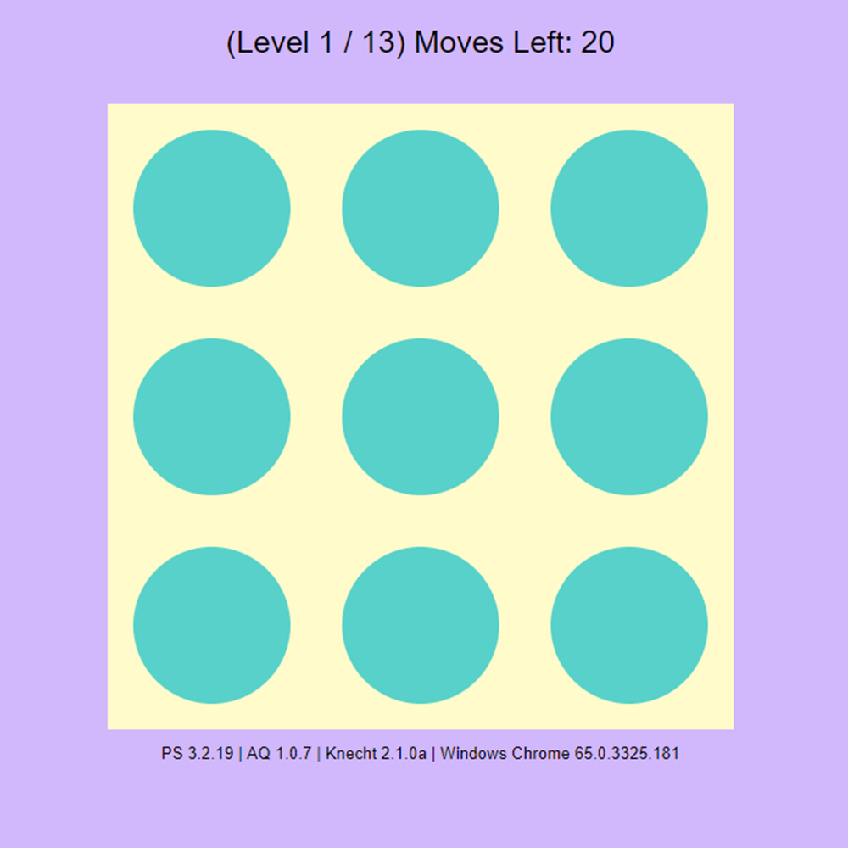
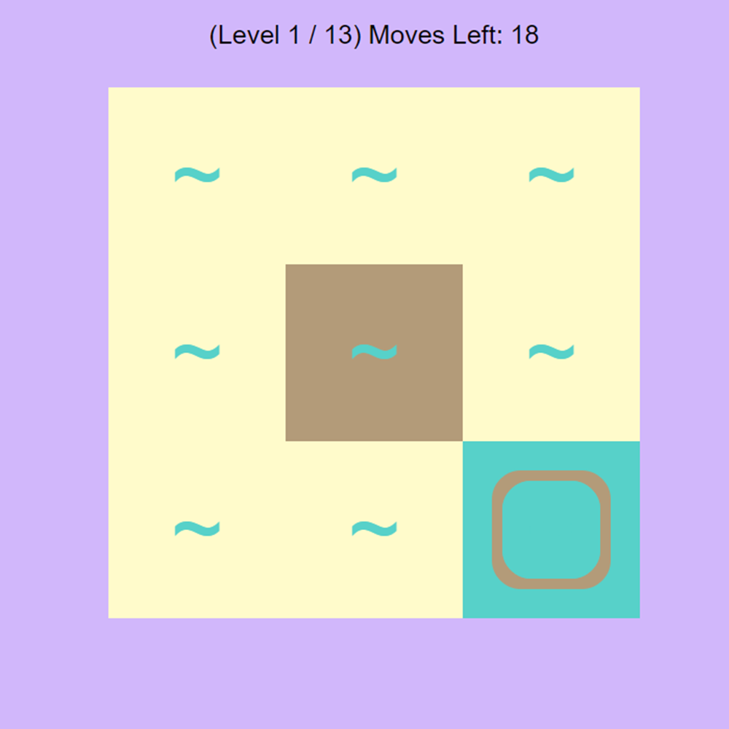
Play Description
See pattern that must be painted to pass level

Slide 6
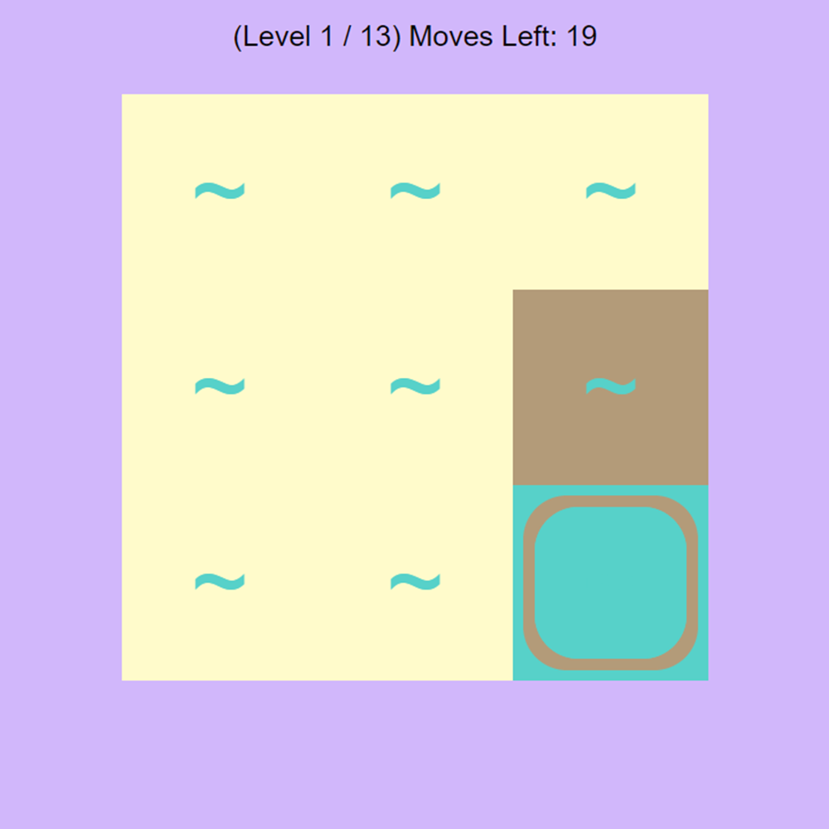
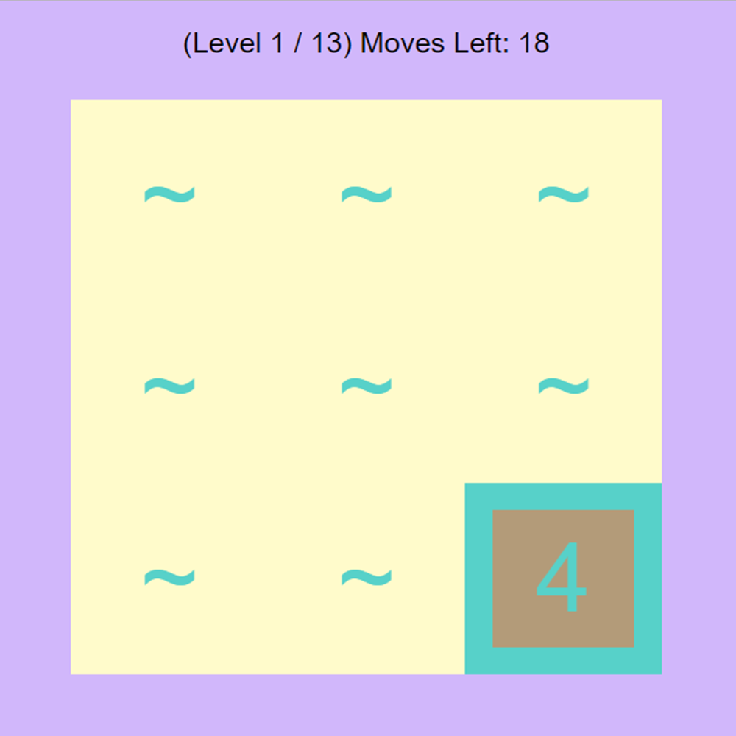
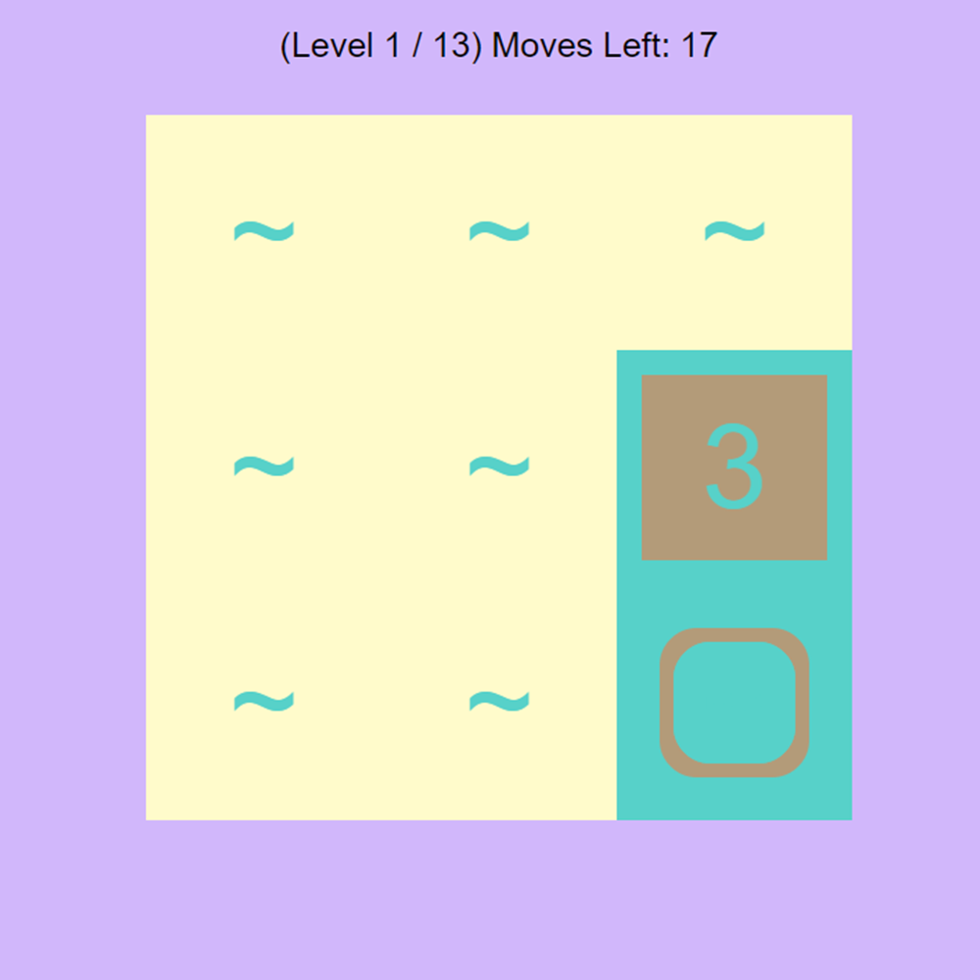
Play Description
Move brush with arrow keys over a paint source to pick up color

Slide 7
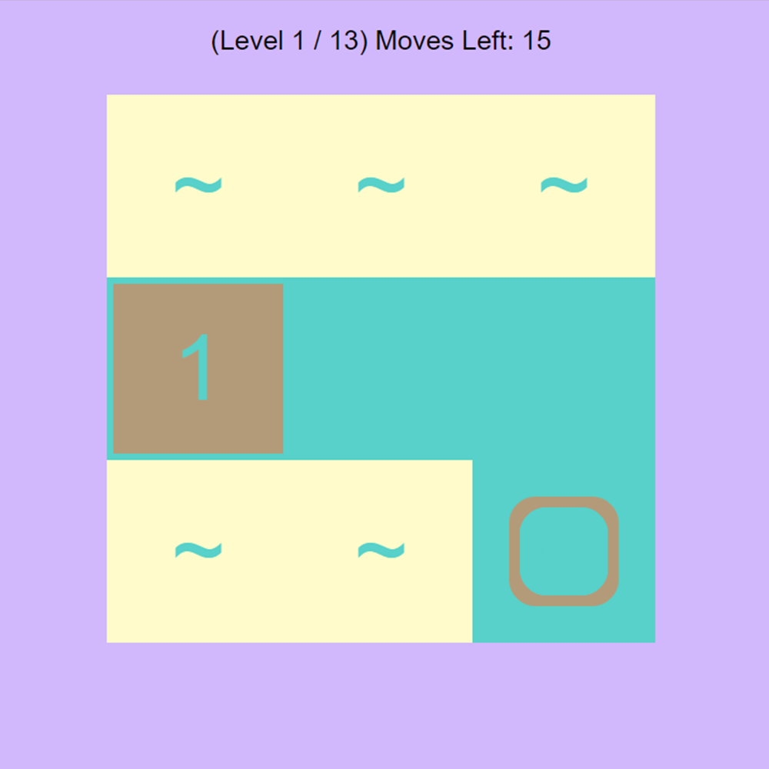
Play Description
Move loaded brush over a grid square to paint it

Slide 8
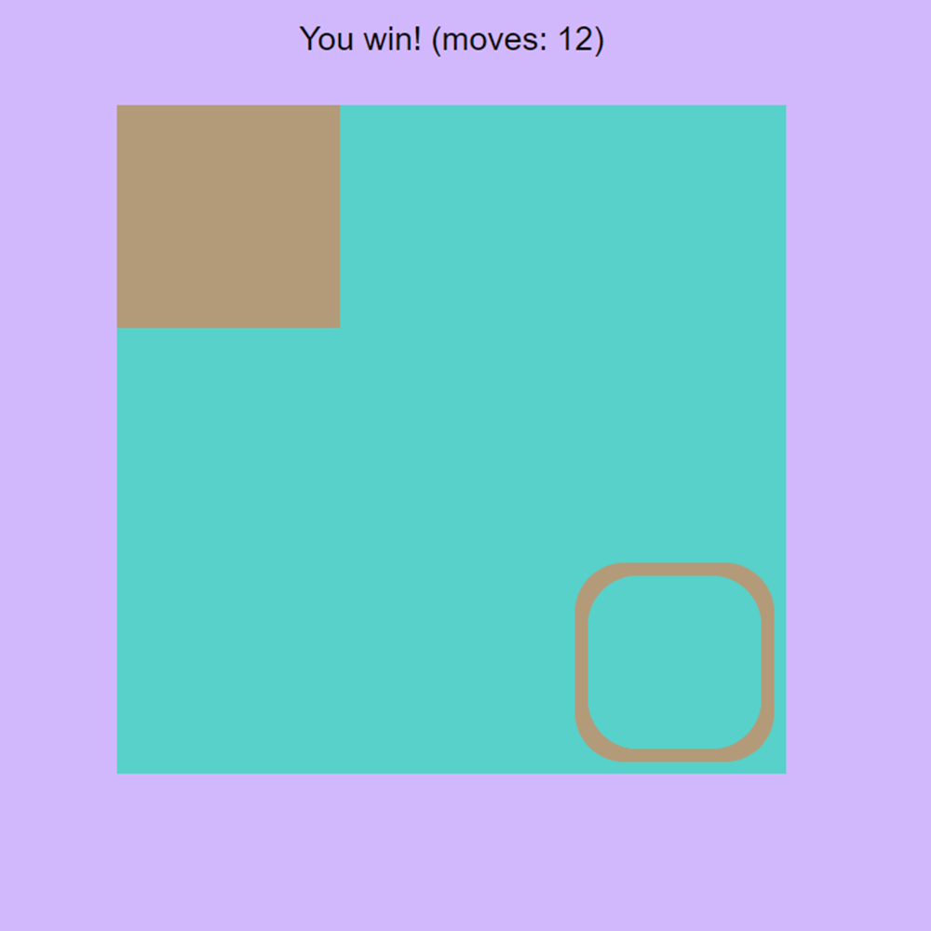
Play Description
Level is completed when the given pattern is constructed

Slide 9
Playtesting Observations
Game was too easy
Playtesters didn’t like having to restart after painting an empty square
Players tried to move but were moving into a wall, so nothing happened

Slide 10
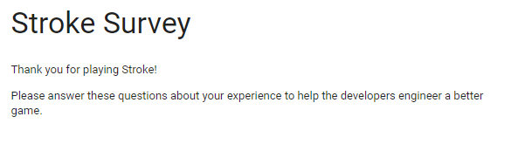
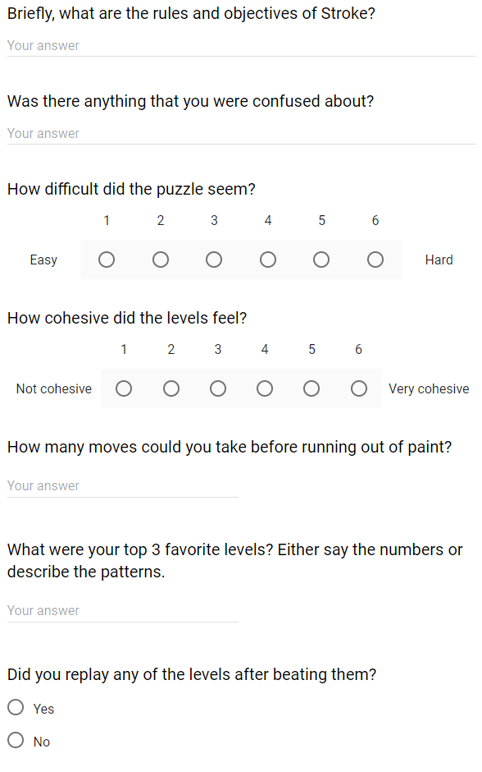
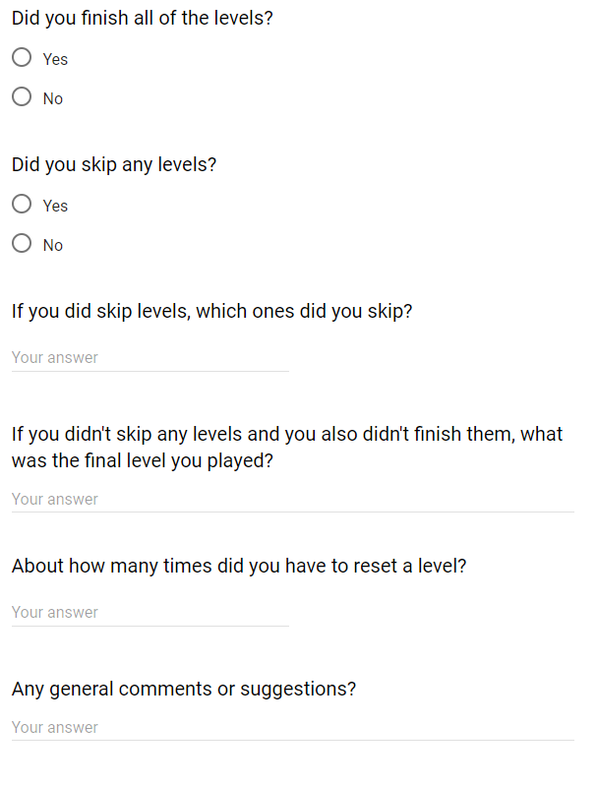

Slide 11
Survey Feedback
Cumbersome to press tab key to see pattern
Hard to know exactly how much paint remains
No indication of level progression

Slide 12
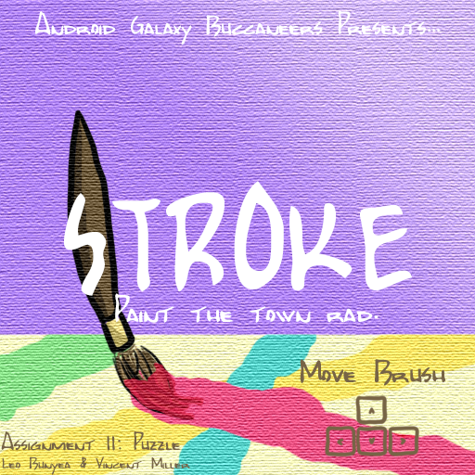
Critique Feedback
See desired color under brush
Hard to know what to do immediately
Text on cover clashed with background image

Slide 13
The End

