Slide 1
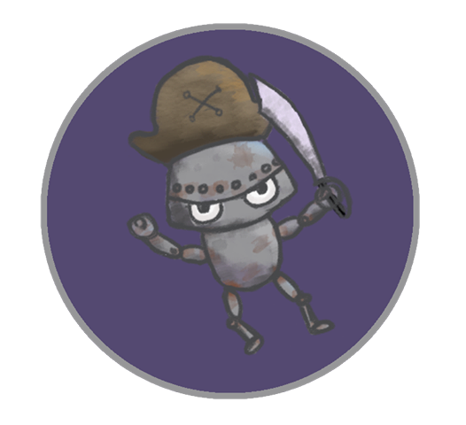
Android Galaxy Buccaneers
Leo Bunyea and Vincent Miller

Slide 2
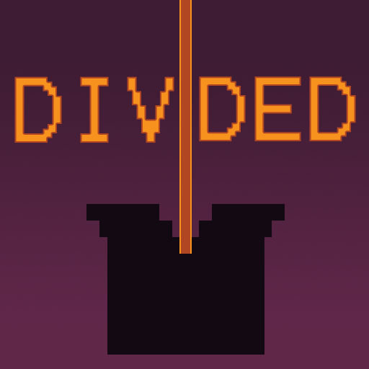

Divided
Torn between two places.

Slide 3
Summary
Divided is a movement-based puzzle game where the player must navigate all beads to the goal. The player starts by controlling one large bead, which can be split by “division” beads and rejoined by “join” beads throughout each level. Beads that are separated from the main bead have mirrored movement. These divisions persist as the player moves from level to level. It is up to the player to manage excess beads by moving them onto destruction beads or joining them with each other.

Slide 4
Features
Navigate all beads to goal through a set of levels
Split into two beads with mirrored movement
Divisions persist between levels
Custom audio

Slide 5



Emotional Goals
Despair and Regret.

Slide 6
Design Restrictions
16 x 16 grid maximum
Only controlled by arrow keys or WASD
No intelligible words, numbers, etc

Slide 7
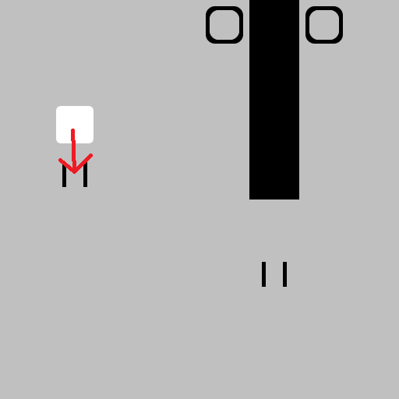
Move onto a division bead to create mirrored copy and shrink.
Play Description

Slide 8
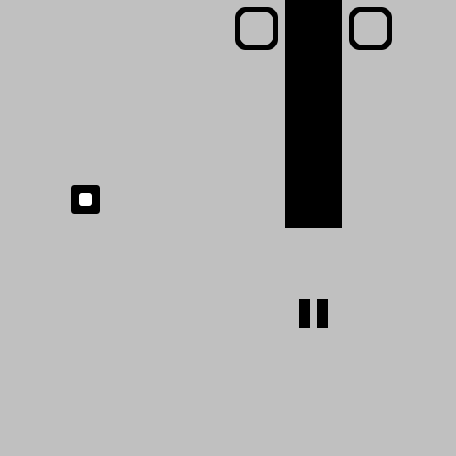
Move onto a division bead to create mirrored copy and shrink.
Play Description

Slide 9
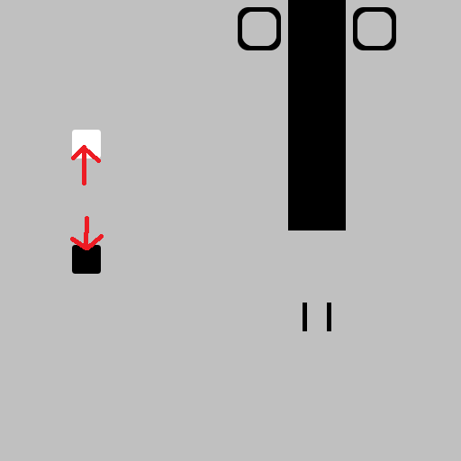
Move onto a division bead to create mirrored copy and shrink.
Play Description

Slide 10
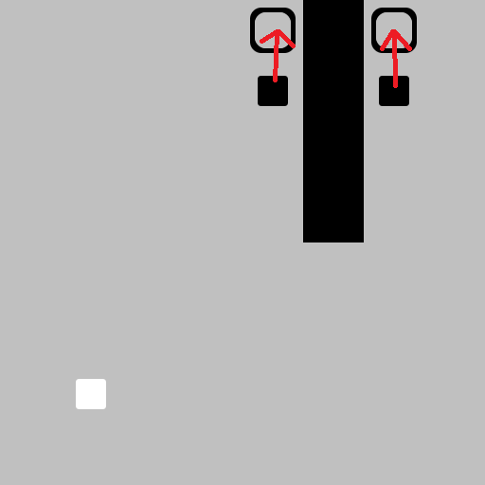
Move player beads to goals to finish level.
Play Description

Slide 11
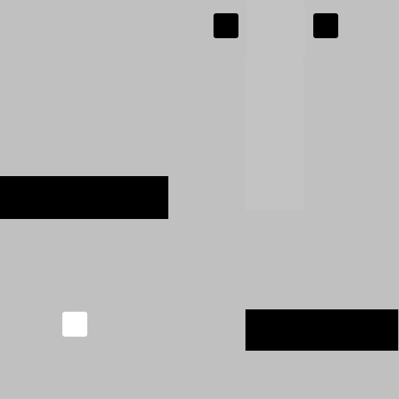
All player controlled beads persist to next level.
Play Description

Slide 12
THE END

