Slide 1

Android Galaxy Buccaneers
Leo Bunyea and Vincent Miller

Slide 2
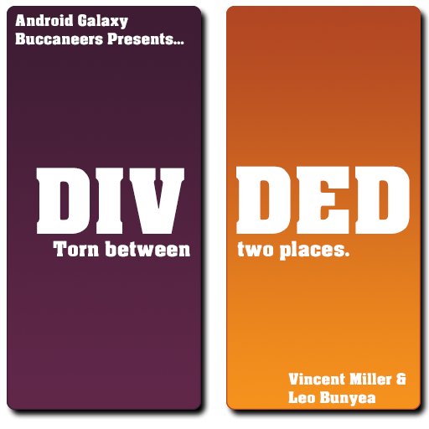

Divided
Torn between two places.

Slide 3
Summary
Divided is a movement-based puzzle game where the player must navigate beads to all goals. The player starts by controlling one large bead, which can be split by “division” beads and rejoined by “join” beads throughout each level. Beads that are separated from the main bead have mirrored movement. These divisions persist as the player moves from level to level. The player must avoid splitting whenever possible, as only beads which end on a goal will persist to the next level, and a bead can only divide three times.

Slide 4
Features
Navigate beads to goals through a set of levels
Split into two beads with mirrored movement
Bead states and positions persist between levels
Custom audio including music
Checkpoints to reset to if a mistake is made

Slide 5



Emotional Goals
Despair and then relief

Slide 6
Design Restrictions
16 x 16 grid maximum
(never exceeds 7x7)
Only controlled by arrow keys and spacebar
No glyphs in beads

Slide 7
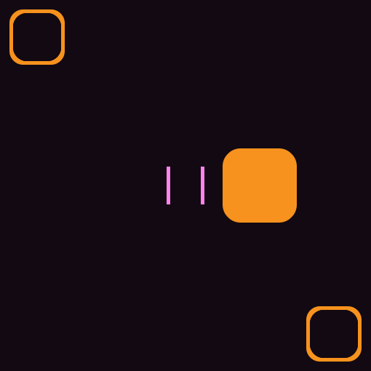
Move onto a division bead to create mirrored copy and shrink.
Play Description

Slide 8
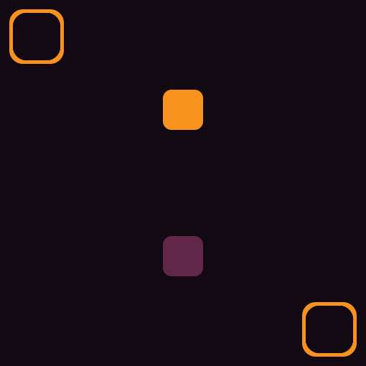
Move onto a division bead to create mirrored copy and shrink.
Play Description

Slide 9
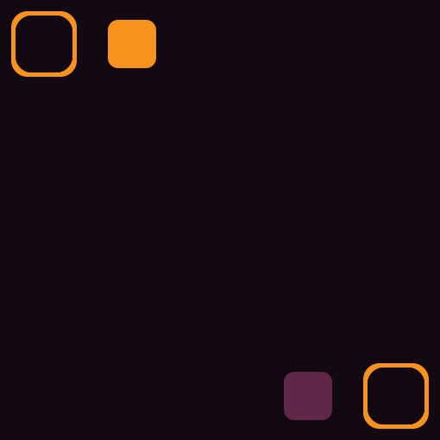
Move player beads to goals to finish level.
Play Description

Slide 10
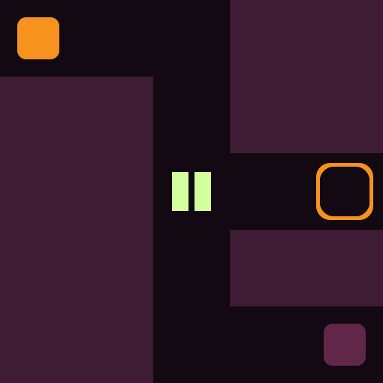
All player controlled beads persist to next level.
Play Description

Slide 11
Playtesting
Initial Playtesting
Levels were not solved with optimal solutions
Splitting and joining seemed like arbitrary additions
Second Class Playtesting
Levels could become unsolvable
Too difficult
Mechanics were taught better
Still not perfect
Splitters and joiners were not distinct enough
Outside Playtesting
Some teaching levels implied that bead size mattered
Mechanic teaching further improved

Slide 12
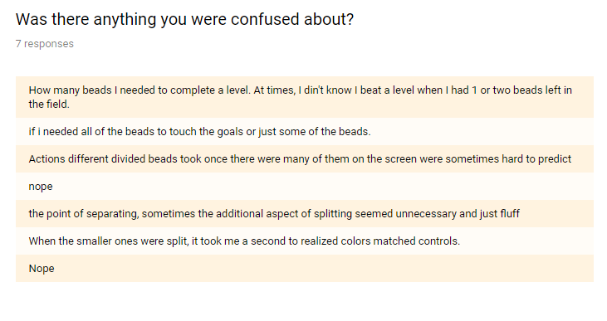
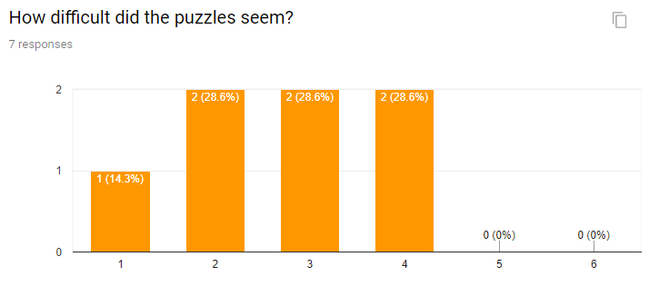
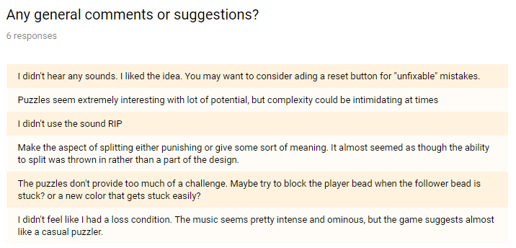
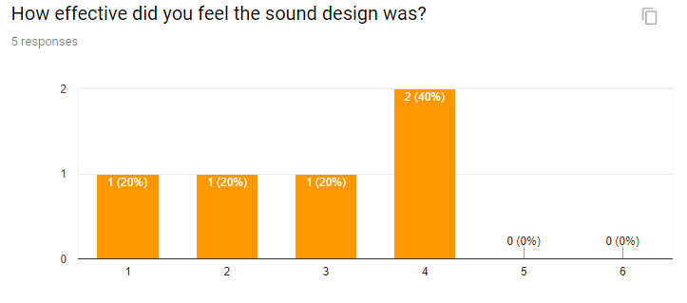

Slide 13
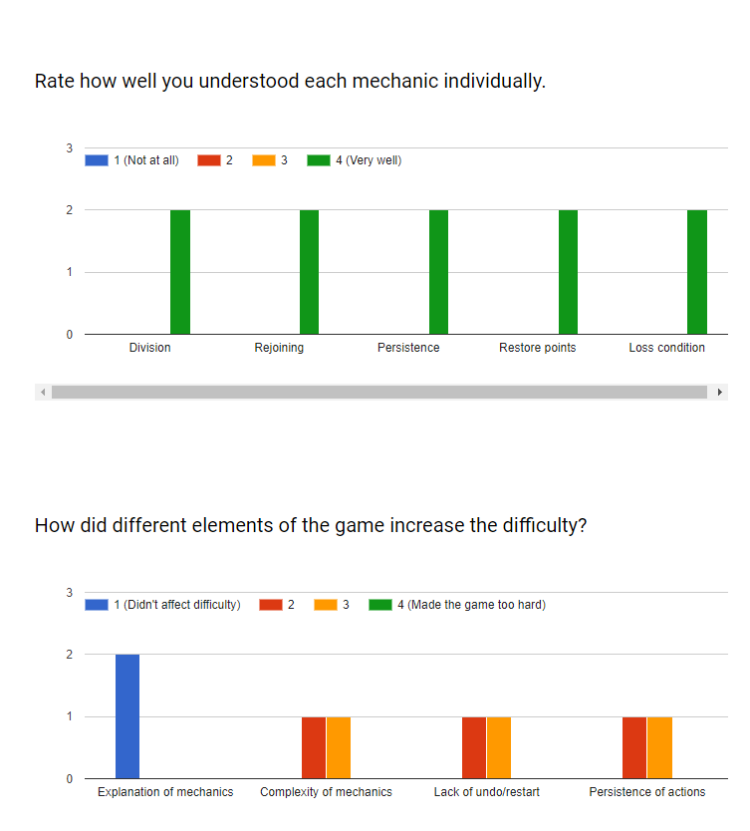
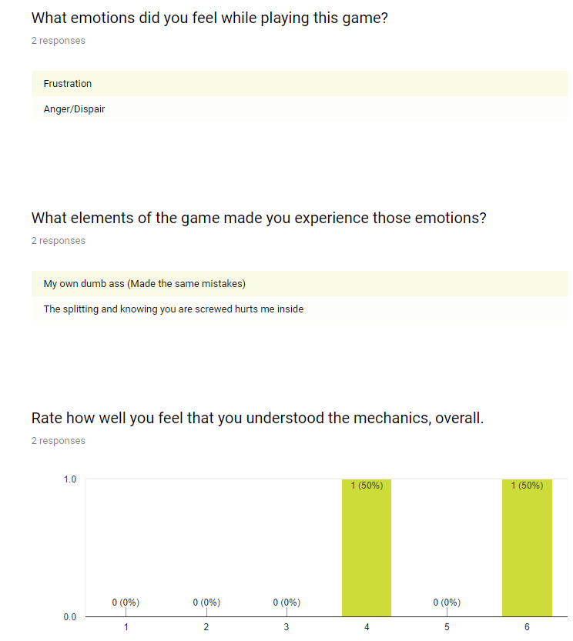

Slide 14
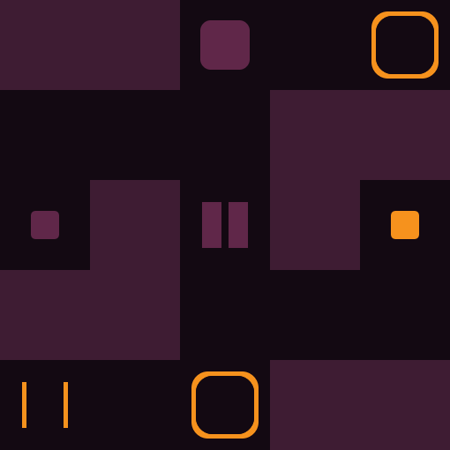
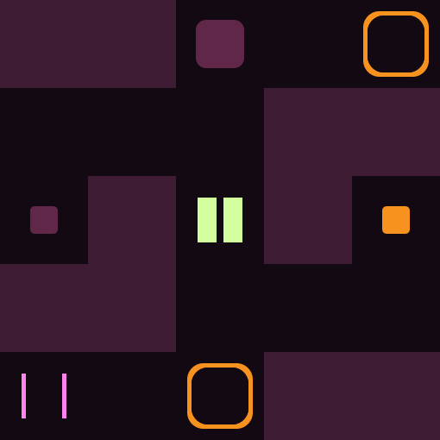
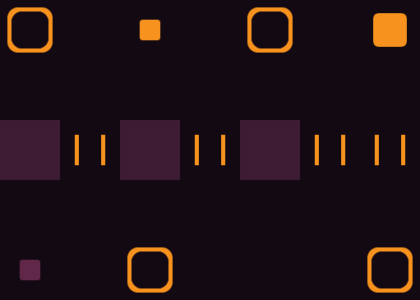
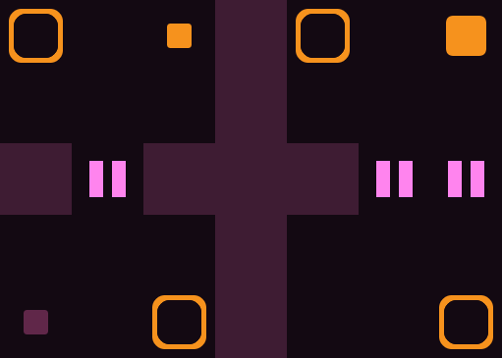
Survey Changes
Clarified some mechanics
More introductory levels
Different colors for splitters and joiners
Added more checkpoints early on in the game
Simplified some levels so they won’t become unwinnable

Slide 15
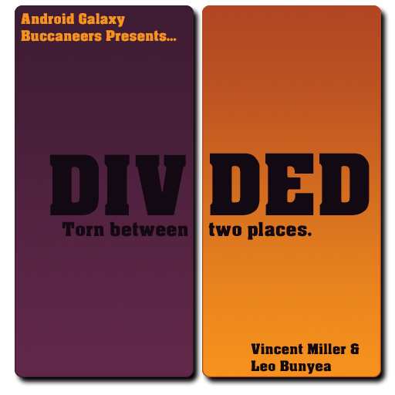


Critique
Text on the cover image was too dark and hard to read
The visuals were beautiful, but the mechanics weren’t being properly communicated
Specifically the persistence

Slide 16
THE END
Notes:
game.savedLevel = 24

