Slide 1
Design challenge: whither
By Leo Bunyea

Slide 2
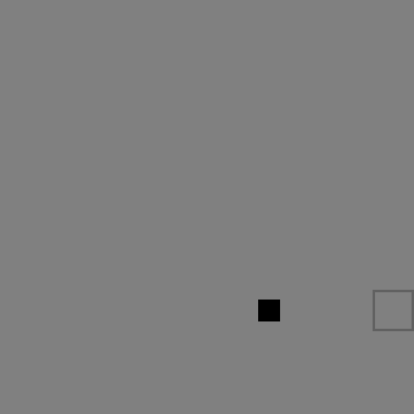
Problems With Original Ending
It can never be completed, and therefore is not satisfying
Even when it is failed, the visual effect is the same as failing a regular level
Doesn’t feel important
Anticlimactic

Slide 3
Ending demo

Slide 4
My Ending
Emotions
Happiness, Contentment, Relief
How does it achieve this?
Uplifting piano track
Second “human/entity” bead with growing mechanic
Narrative: You survived nineteen other levels, clinging to life, in order to meet and help a friend.
Fade to white instead of black

