Slide 1
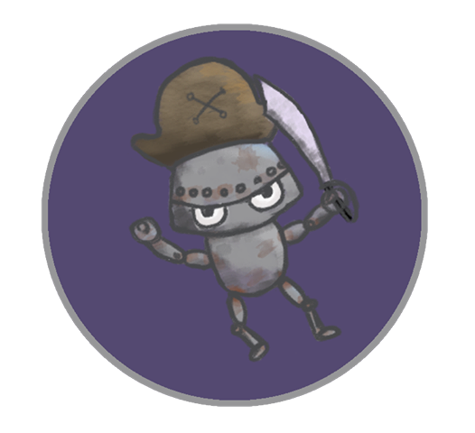
Android Galaxy Buccaneers
Leo Bunyea and Vincent Miller

Slide 2
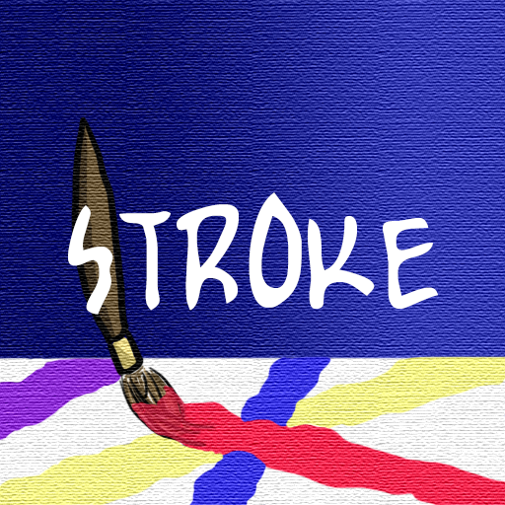
Stroke
Paint the town rad.

Slide 3
Summary
Stroke is a color-based, painting puzzle game in which the player recreates patterns. The player manipulates a paint brush that leaves behind a color trail in order to accomplish this. The trail can be overwritten by the brush once it has been “dipped” in a new color. In addition to this, the brush will only stay coated in paint for so long. The goal is to produce the desired pattern in the fewest number of moves.

Slide 4
Essential Features
Four introductory levels and four intermediate puzzles
Act as a paintbrush, leaving trails of color behind
Color lasts a set number of moves, shown by border thickness
Recreate patterns exposed at the start of the level
Solve pattern in the fewest number of moves

Slide 5
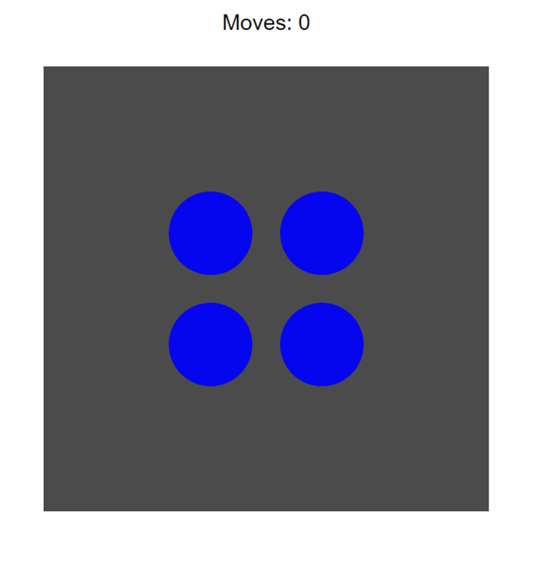
Play Description
See pattern that must be painted to pass level

Slide 6
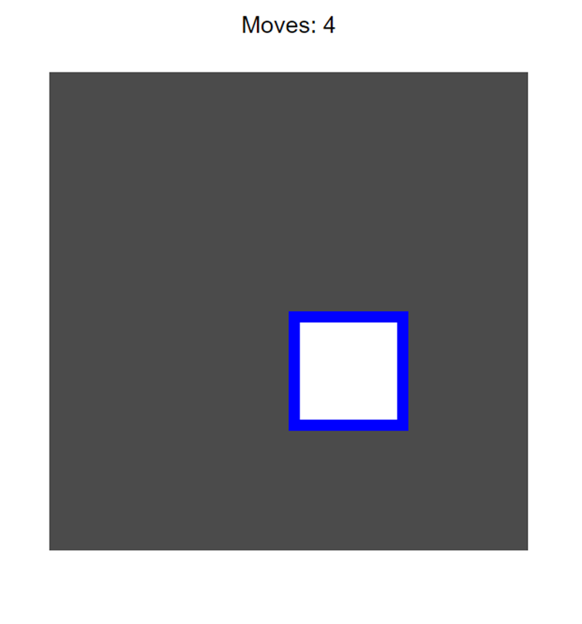
Play Description
Move brush with arrow keys over a paint source to pick up color

Slide 7
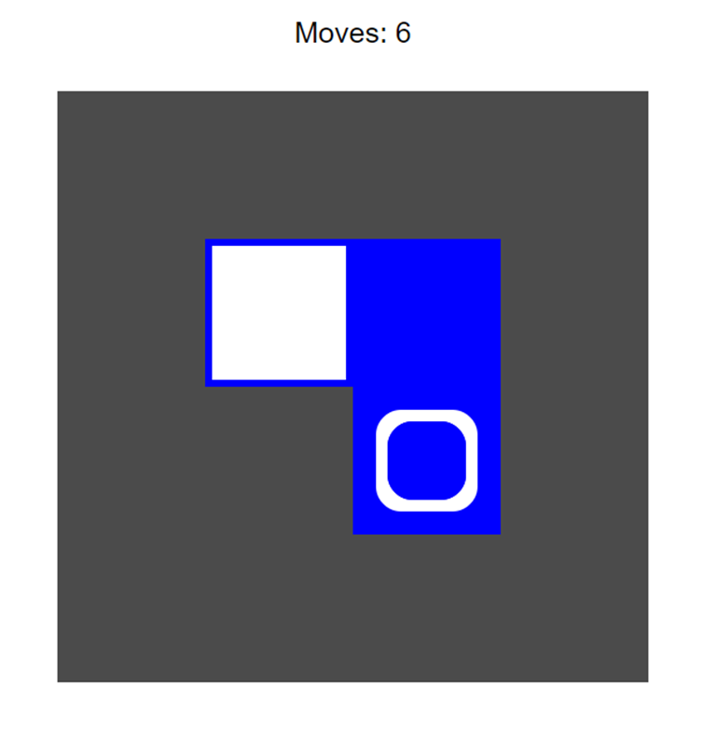
Play Description
Move loaded brush over a grid square to paint it

Slide 8
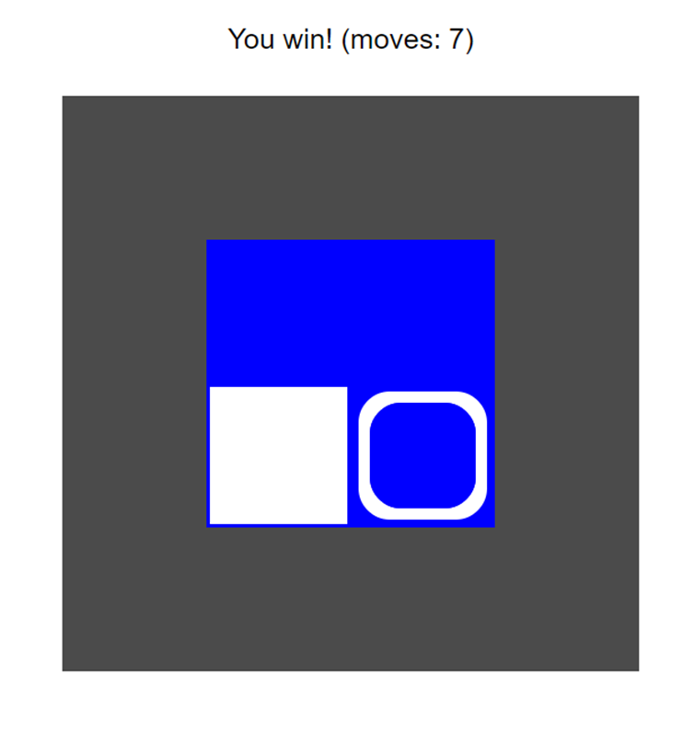
Play Description
Level is completed when the given pattern is constructed

Slide 9
The End

