Slide 1
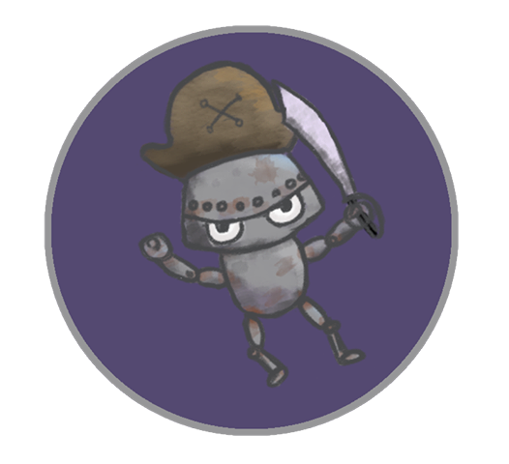
Android Galaxy Buccaneers
Leo Bunyea, Vincent Miller

Slide 2
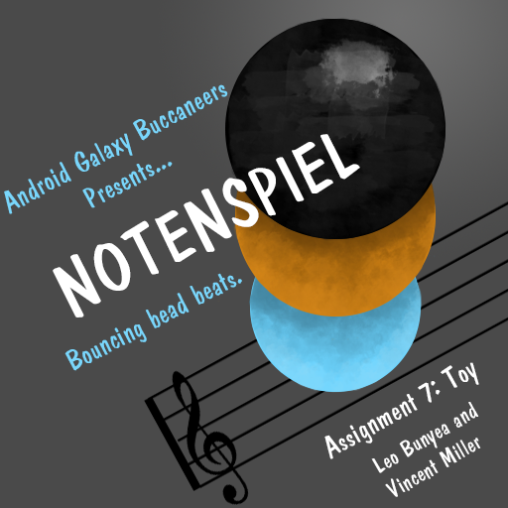
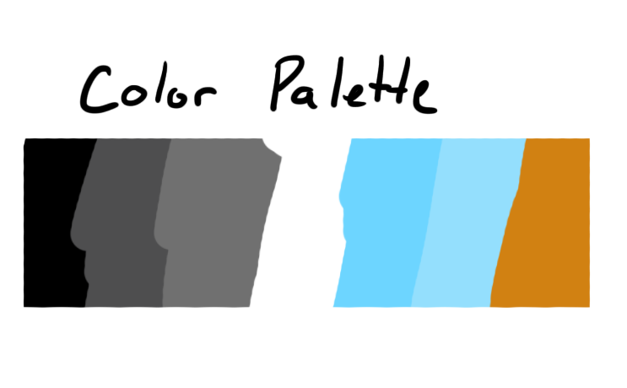
Notenspiel
Bouncing bead beats.

Slide 3
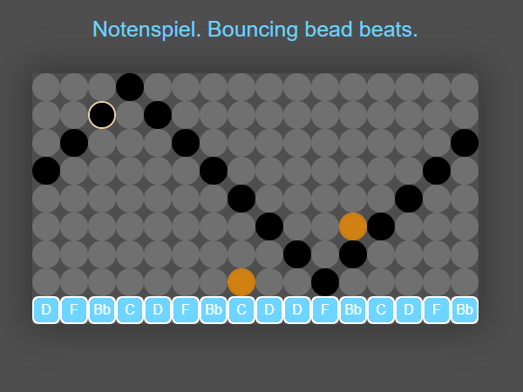
Essential Features
Assign bead columns different notes
Create note patterns
Make looping musical sequences in the key of D Minor
Utilizes the opening notes of “Let Me Call You Sweetheart” by Bing Crosby

Slide 4
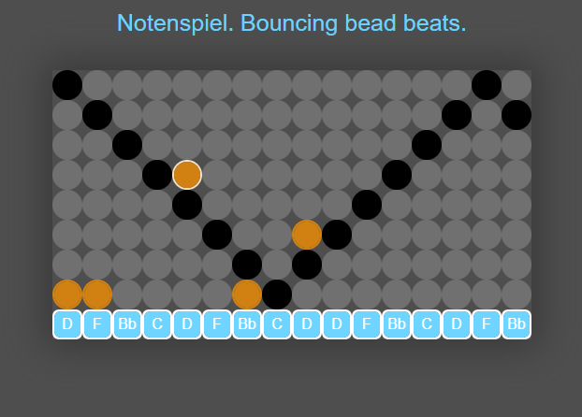
Activity Description
Start with a basic note pattern

Slide 5
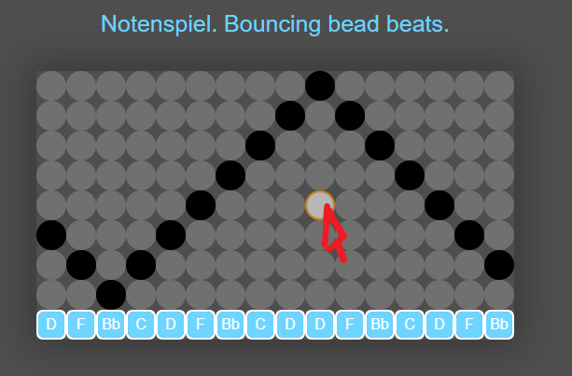
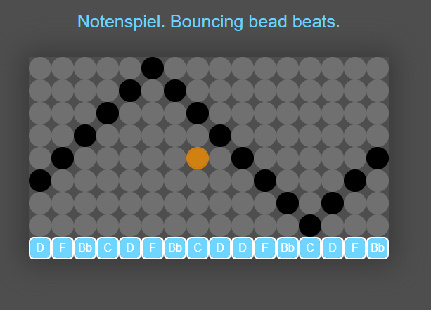
Activity Description
Click on beads in the grid to activate/deactivate note playing

Slide 6
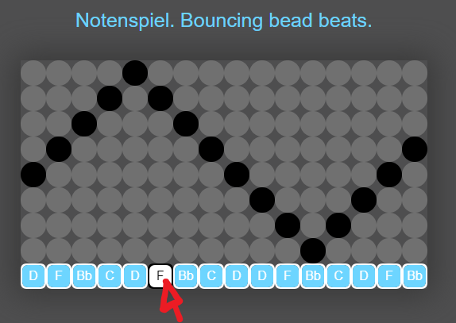
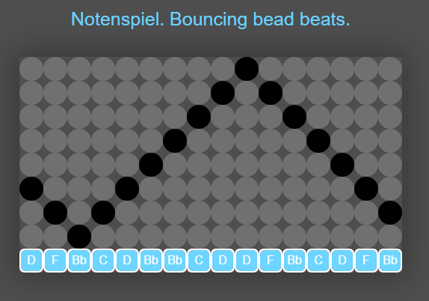
Activity Description
Click on beads at the bottom to cycle notes for that column

Slide 7
The End

