Slide 1
1. What are the different data types in JavaScript?

Slide 2
Primitive: String, Number, Boolean, undefined, null, BigInt, Symbol
Non-Primitive: Object, Array, Function

Slide 3
What is the difference between == and === in JavaScript?

Slide 4
== compares values (type coercion is applied).
=== compares values and types (strict equality)
'5' == 5 // true'5' === 5 // false

Slide 5
What is undefined vs null?

Slide 6
undefined: Variable declared but not assigned a value.
null: An assignment value representing "no value".

Slide 7
What is a closure in JavaScript?

Slide 8
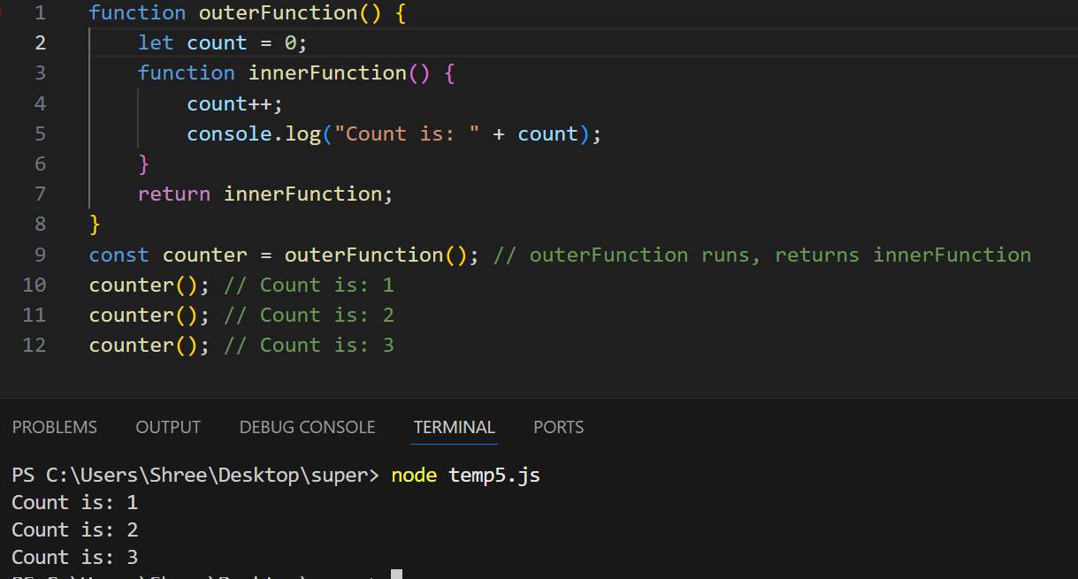
outerFunction runs, returns innerFunction

Slide 9
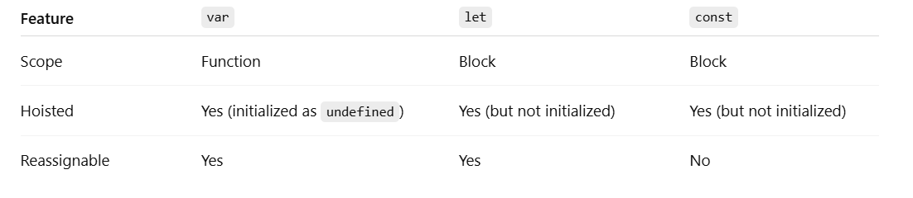
Explain let, const, and var differences.

Slide 10
What is the difference between synchronous and asynchronous code?

Slide 11
Synchronous: Executes line-by-line.
Asynchronous: Executes code without blocking, using callbacks, promises, or async/await.

Slide 12
What are Promises?

Slide 13
A Promise is a JavaScript object that represents the eventual result (or failure) of an asynchronous operation.
States of a Promise:
• Pending: The operation is ongoing.
• Fulfilled: The operation completed successfully.
• Rejected: The operation failed.

Slide 14
What is the difference between map(), filter(), and reduce()?

Slide 15
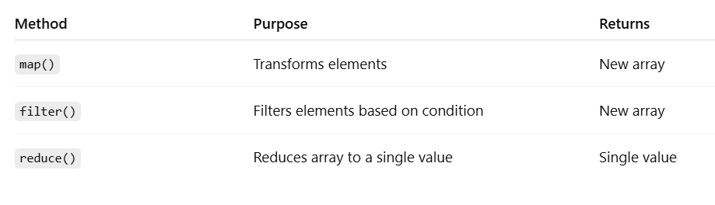

Slide 16
What is Hoisting in JavaScript?

Slide 17
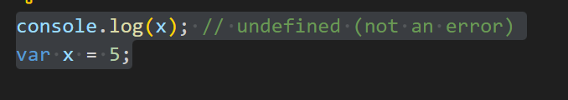
Hoisting is JavaScript's behavior of moving declarations (not initializations) to the top of their scope before code execution.

Slide 18
What is the this keyword?

Slide 19
Refers to the object that is executing the current function.
In global context: this is window (in browsers).
In object method: this is the object.
In arrow functions: this is lexically bound (inherits from parent scope).

Slide 20
What are arrow functions and how are they different?

Slide 21
Arrow functions are a shorter syntax for writing functions and do not bind their own this.
const add = (a, b) => a + b;

Slide 22
Explain the difference between for...in and for...of.

Slide 23
for...in: Iterates over keys (property names) of an object.
for...of: Iterates over values in an iterable (like arrays, strings, etc.)
let arr = [10, 20, 30];
for (let i in arr) console.log(i); // 0, 1, 2
for (let val of arr) console.log(val); // 10, 20, 30

Slide 24
What is the difference between Array.prototype.slice() and splice()?

Slide 25
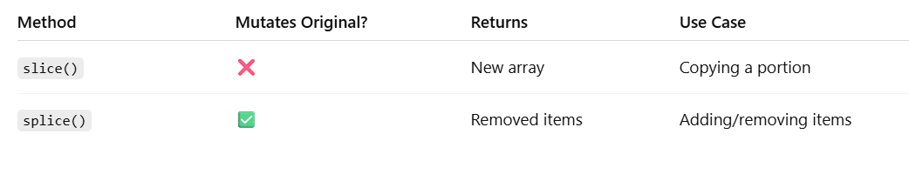

Slide 26
How is memory managed in JavaScript?

Slide 27
JavaScript uses automatic garbage collection:
Allocation: Memory is allocated when variables/objects are created.
Garbage Collection: JS detects when memory is no longer used and frees it.

Slide 28
What is the difference between microtasks and macrotasks?

Slide 29
Microtasks: Promises, MutationObserver
Macrotasks: setTimeout, setInterval, UI rendering

Slide 30
What is the difference between function declaration and expression?

Slide 31
Function Declaration:
function greet() { }
Function Expression:
const greet = function() { }

Slide 32
What is the difference between typeof and instanceof?

Slide 33
typeof: Returns a string indicating the type of a primitive or function.
typeof 'hello'; // 'string'
instanceof: Checks whether an object is an instance of a constructor.
[] instanceof Array; // true

Slide 34
What are symbols in JavaScript?

Slide 35
Symbol is a primitive data type used to create unique property keys that won’t collide.

Slide 36
Explain destructuring in JavaScript.

Slide 37
Allows unpacking values from arrays or objects into variables.
const [a, b] = [1, 2];
const {name, age} = {name: 'John', age: 30};

Slide 38
How does async/await work under the hood?

Slide 39
async functions always return a Promise.
await pauses execution until the Promise resolves.

Slide 40
What is the difference between mutable and immutable types in JavaScript?

Slide 41
Mutable (can be changed): Object, Array, Function
Immutable (cannot be changed): Number, String, Boolean, null, undefined, Symbol, BigInt

