Slide 1
IOweU
Project By
Chathuri Wimalasena
Nishith Mehta
Mayur Tare
Varun Patil

Slide 2
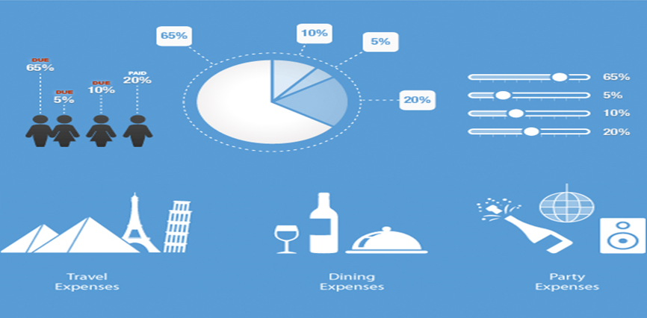
Number of expenses and many debts to settle…

Slide 3
Prominent Features
Groups
Private Users
Categorization of bills
Debt Transfer
Bill Approval

Slide 4

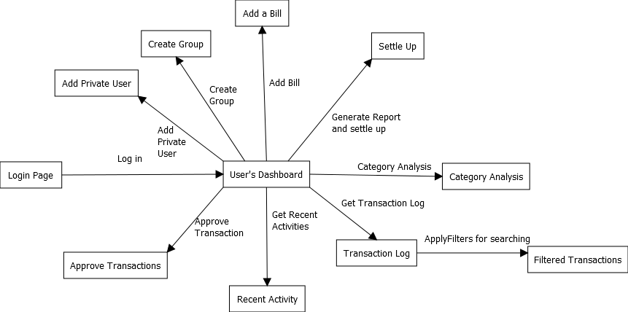
Transition Diagram

Slide 5
Demo

Slide 6
Future Scope
Email Notifications
Mobile Application
Provide a payment gateway to settle debts.

Slide 7
Any Questions

